Slide 1

遊戲物理約束
Physics Constraints in Games
軟性約束
Soft Constraints
Part 3
Ming-Lun “Allen” Chou
周明倫

Slide 2




周明倫
Min-Lun “Allen” Chou
AllenChou.net
@TheAllenChou
TheAllenChou
MingLunChou

Slide 3
位置誤差修正
Positional Error Correction

Slide 4
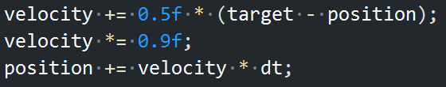
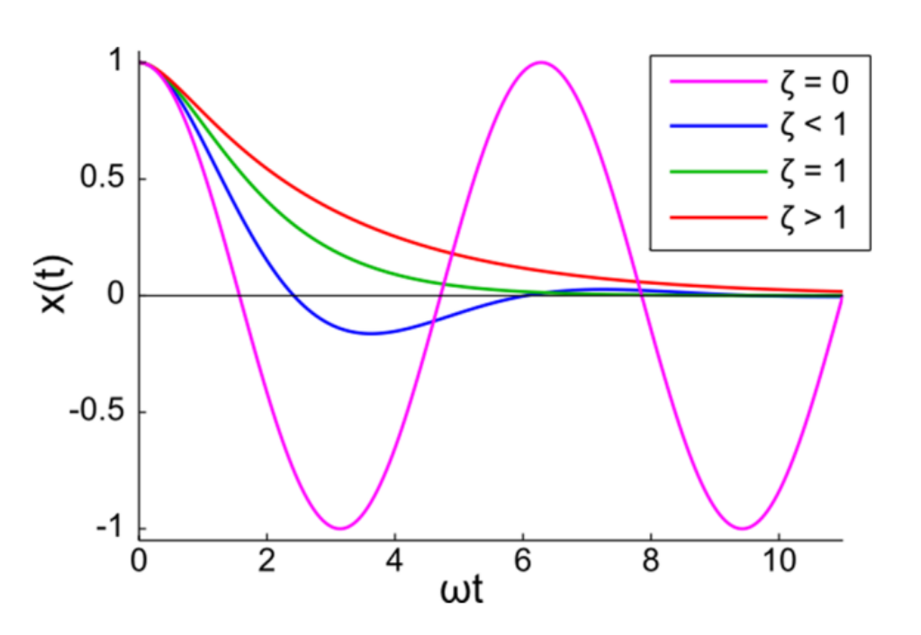
???
原點彈簧約束
Spring Constraint at Origin
阻尼係數
Damping Coefficient
彈力常數
Spring Constant
阻尼比例
Damping Ratio
角頻率
Angular Frequency
“Soft Constraints – Reinventing the Spring”
Erin Catto, 2011

Slide 5
原點彈簧約束
Spring Constraint at Origin

Slide 6
原點彈簧約束
Spring Constraint at Origin

Slide 7
軟性約束參數
Soft Constraint Parameters
阻尼係數
Damping Coefficient
阻尼比例
Damping Ratio
誤差回饋係數
Error Feedback Factor
彈力常數
Spring Constant
角頻率
Angular Frequency
力回饋係數(軟度)
Force Feedback Factor
(Softness)

Slide 8
軟性約束參數
Soft Constraint Parameters
阻尼比例
Damping Ratio
誤差回饋係數
Error Feedback Factor
角頻率
Angular Frequency
力回饋係數(軟度)
Force Feedback Factor
(Softness)

Slide 9
軟性約束參數
Soft Constraint Parameters

Slide 10
Thank You!
http://github.com/TheAllenChou/unity-physics-constraints

