Slide 1

PRECIOUS CORNERSTONE UNIVERSITY, IBADAN · DEPT. OF CYBER SECURITY · 2025/2026
DOBERMAN
Design and Implementation of a Multi-Module AI-Powered
Cybersecurity Intelligence Platform
AUTHOR
MATRIC
SUPERVISOR
PROGRAMME
Olusanu Joshua Bankole
2022/493
Dr. Osutokun Kemi
B.Sc. Cyber Security
01

Slide 2





THE PROBLEM
Five threats, one shared blind spot
Every threat below exploits the same gap: how content and infrastructure appear versus how they actually are.
+400%
70%
2x
Billions
Seconds
YoY rise in deepfake attacks
of IoT devices ship with an unpatched critical flaw
growth in AI-generated web text, 2022–24
of breached credentials in active circulation
is all a phishing kit needs to harvest a credential
02

Slide 3
RESEARCH GAP
Strong tools exist in isolation. None are integrated.
TOOL
COVERS
WEAKNESS 1
WEAKNESS 2
Deepware / Sensity
Deepfake only
Minimal explanation
Enterprise-priced
Shodan / Nessus
IoT / network only
Requires network access
Expert configuration
Have I Been Pwned
Breach lookup only
Single lookup type
Not integrated elsewhere
Generic LLM chatbots
General advice
No domain grounding
No result integration
NewsGuard / Snopes
Human-curated ratings
Can’t score new content
Not real-time
No published or shipped platform combines all of the above under one accessible, explained experience.
03

Slide 4




THE PLATFORM
DOBERMAN — nine capabilities, one watchdog
EYES
Voice Intel
Text AI-Detect
Deepfake detection
Clone / manipulation
Stylometric signals
NOSE
Breach Detect
Scam Link
IoT risk triage
HIBP + k-anonymity
Phishing scoring
NEWS
Cyber Globe
DAYE
Feed / verify / chat
Country threat briefs
Context-aware analyst
04

Slide 5
ARCHITECTURE
Three tiers. Every secret stays server-side.
CLIENT
React 19 + TypeScript SPA
Chrome extension (Manifest V3)
↓
EDGE FUNCTIONS
18 Deno serverless functions
Rate limiting · auth check · provider calls
↓
DATA + PROVIDERS
Supabase Postgres + RLS
Claude · Gemini · Hive AI · HIBP
Verified for this report: provider API keys never appear in the compiled client bundle.
05

Slide 6

THE CENTRAL CONTRIBUTION
DAYE — one persona, a prompt template per context
12+ context-specific prompt templates
deepfake_result, voice_result, breach_result, scam_link_result, globe_country, idle_tip — each references the calling module’s own structured fields rather than re-deriving a verdict.
Explains signals, not headlines
Prompts explicitly instruct: interpret which signals actually drove the verdict, don’t just restate the number.
Dual-provider resilience
Claude Sonnet primary → automatic Gemini fallback on failure, added after single-provider dependency was flagged as a risk during development.
Built-in honesty instruction
Doberman Artificial
Yield Engine
"If you are not confident about specific claims... keep it accurate and general rather than inventing specifics" — verified directly in the deployed prompt.
06

Slide 7
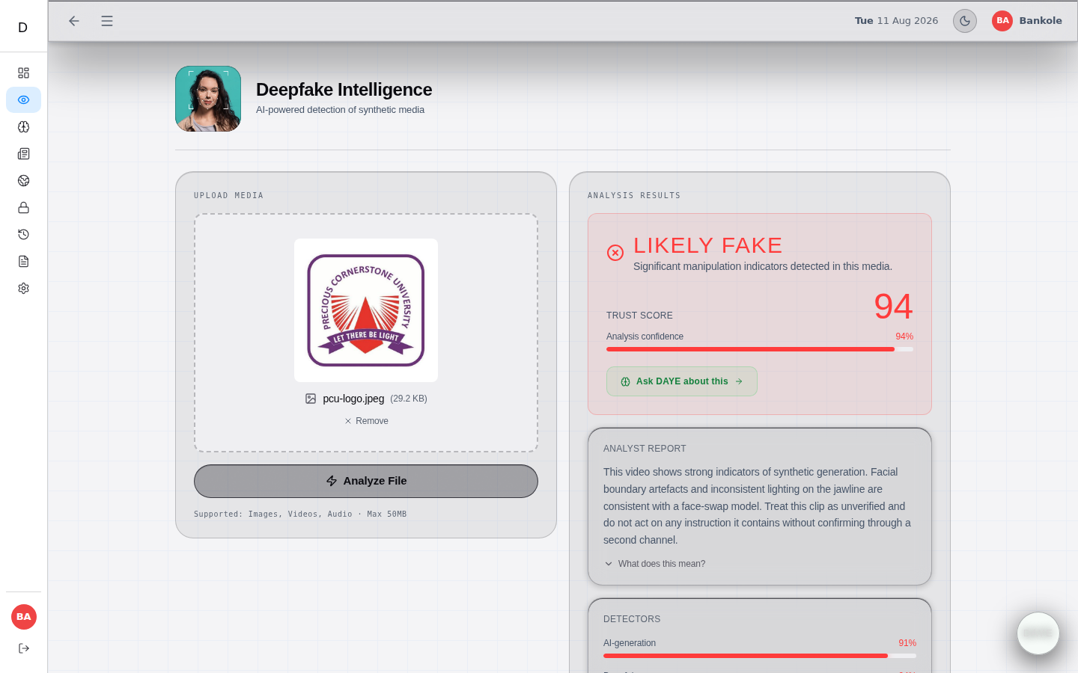
MODULE SPOTLIGHT
EYES · Voice Intelligence · Text AI-Detection
Hive AI computer vision + Claude explanation
EYES calls a real third-party detection provider, then DAYE translates the raw classification into plain language.
Named signals, not a bare score
AI-generation probability, deepfake probability, C2PA credential status, and model attribution shown separately.
Voice: pause-pattern literature informed design
Named clone indicators (pitch stability, missing breath sounds) over a single number — consistent with JMIR 2024 findings.
Text: minimum word-count gate
Simulated result shown — see Slide 12
Stylometric signals (sentence uniformity, generic phrasing) surfaced explicitly, framed as probabilistic evidence.
07

Slide 8
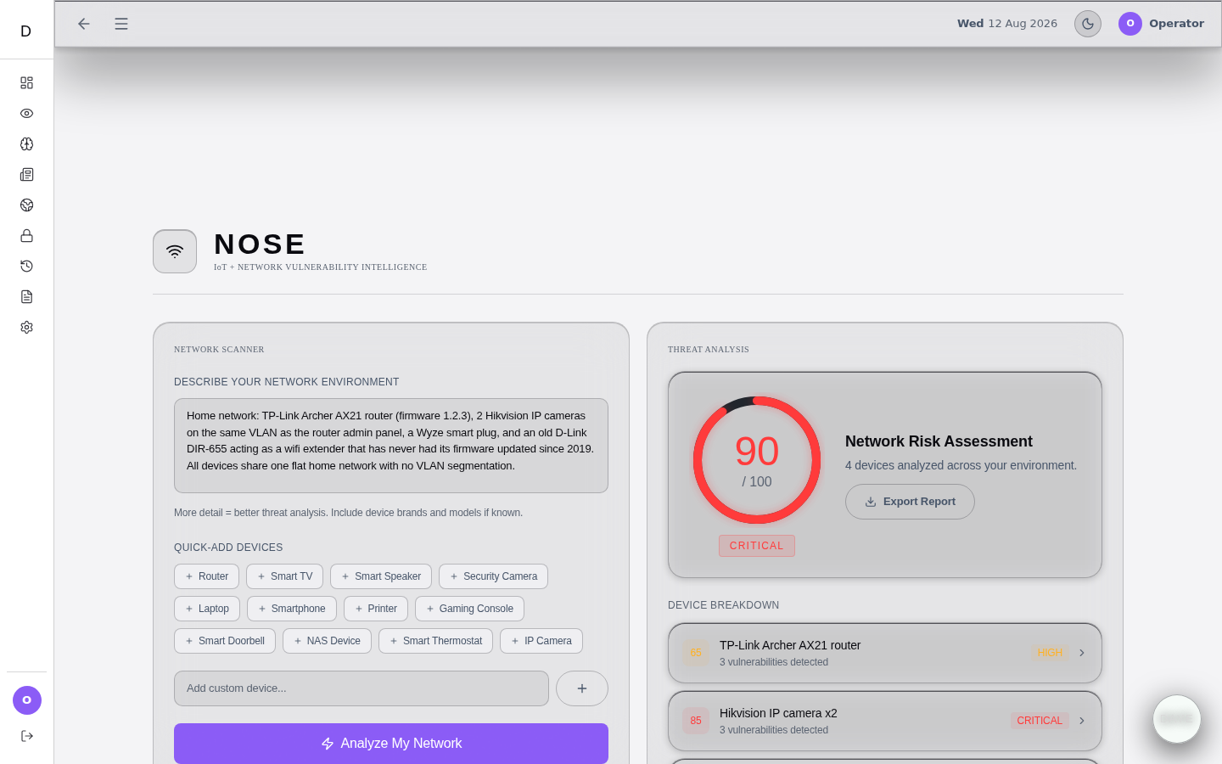

MODULE SPOTLIGHT
NOSE — IoT risk triage from plain language
A claim we withdrew — then verified for real
An earlier report claimed NOSE’s CVEs were "verified, not hallucinated." The deployed function has no NVD lookup — it’s pure LLM generation, so that claim was withdrawn.
We then spot-checked 3 of the 12 CVEs the live test above returned against public NVD sources: 1 correct, 2 real-but-misattributed, 1 not found anywhere — likely fabricated.
That mixed result is the fix: server-side NVD/CIRCL cross-referencing before any CVE is returned to a user remains the priority.
Real live test: 4-device home network → 90/100 risk, correctly ranking the EOL D-Link extender highest.
08

Slide 9

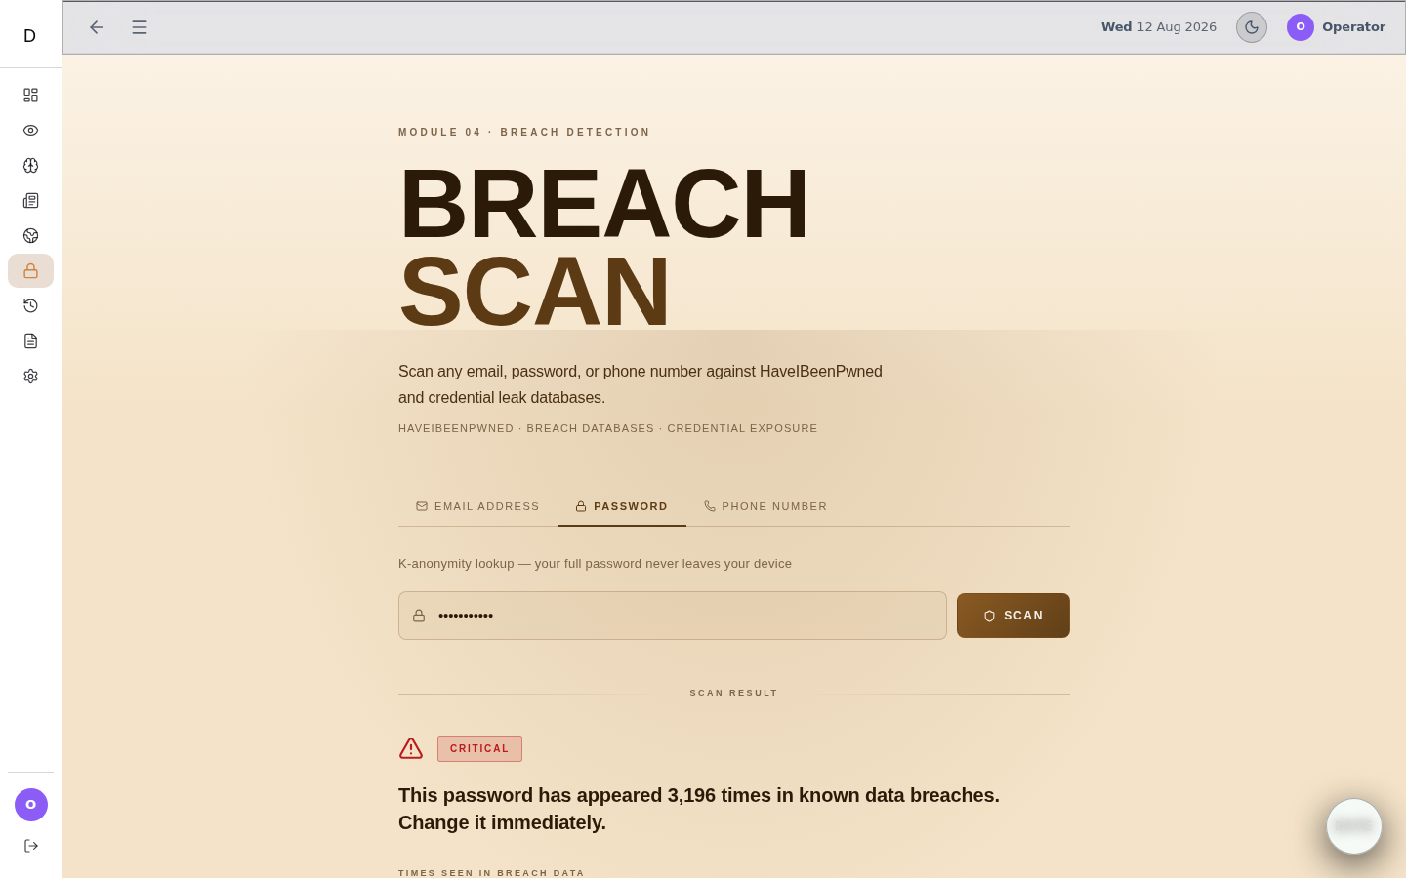
MODULE SPOTLIGHT
Breach Detection — real HIBP, honest gaps
Passwords: real k-anonymity protocol
SHA-1 hashed locally, only a 5-character prefix sent to Pwned Passwords. Live test: 3,196 real breach occurrences returned.
Emails: live HIBP breach-account API
Called when a key is configured — a real historical row returned a genuine "not breached" verdict.
Phones: explicitly "unavailable"
No verified data source exists for this lookup, so the function says so — verified directly in source, not inferred.
Real live result — genuine password breach lookup, shown above
09

Slide 10
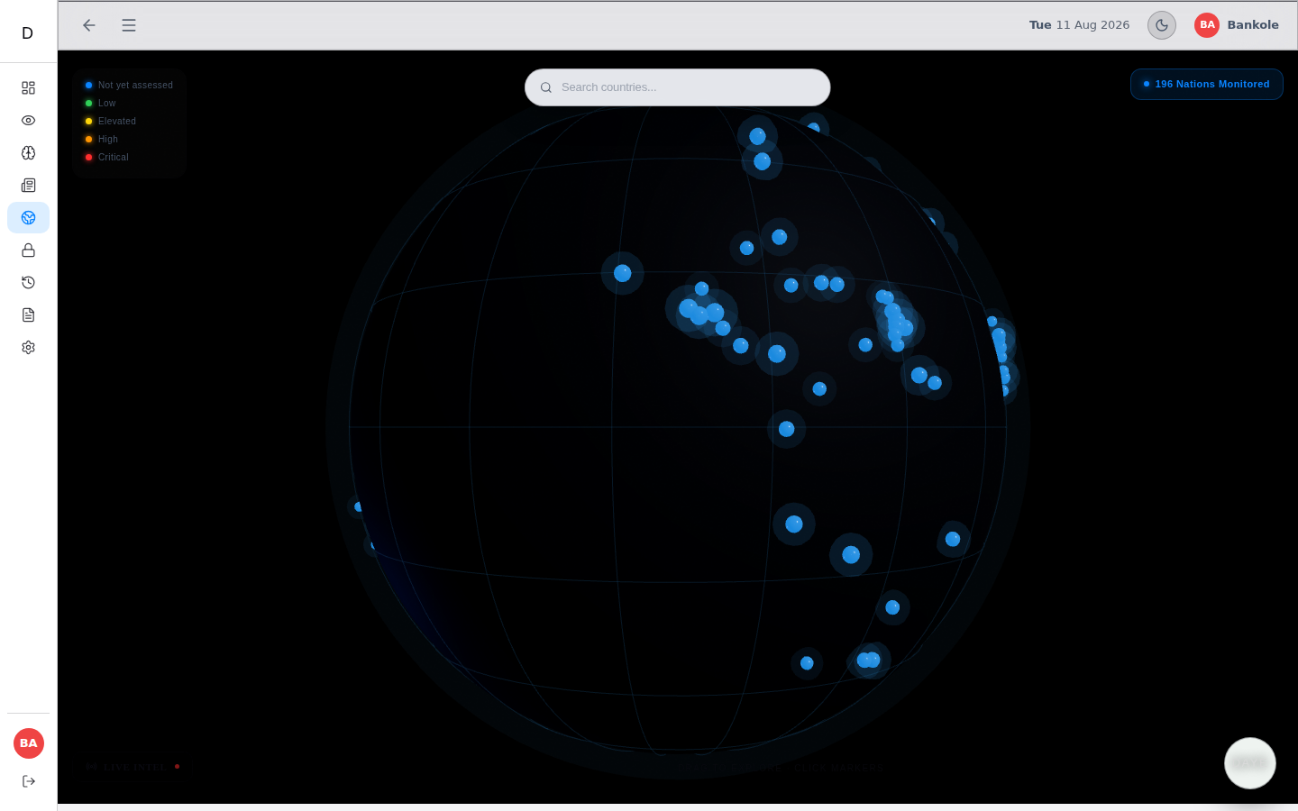
MODULE SPOTLIGHT
Scam Link · News Intelligence · Cyber Globe
Scam Link Analyzer — real live tests
NEWS: feed, verify, and chat
Cyber Globe
Live-tested against a constructed phishing URL (98/100, PHISHING) and a real GitHub URL (0/100, SAFE) — both correctly classified.
A live cyber-news feed, a credibility verifier, and a separate per-article conversational analyst.
Cached, 24h-TTL country threat briefs — prompt explicitly forbids inventing statistics for low-profile countries.
10

Slide 11

SECURITY REVIEW
Verified directly against the live deployment
Row-level security on every table
No provider secret in the client bundle
Confirmed via direct inspection of the live Supabase project — not assumed from migration files.
Every Claude / Gemini / Hive / HIBP key is read server-side only, inside an edge function.
Rate limit removed, verified in source
Found and fixed a fake feature, live
Daily scan caps were deliberately removed during dev. usage_logs still audits — it no longer gates. Cost exposure now rests on provider quotas.
Live-testing found the sidebar Scam Link tab was 100% simulated (keyword-match, no real call) — ported the real analyzer in, deleted the fake one.
11

Slide 12
METHODOLOGY
What this report can and cannot claim
REAL EVIDENCE
NOT CLAIMED
✓ 26 real EYES scans pulled from production DB
✗ Measured accuracy / false-positive rate
✓ 2 self-evident ChatGPT images, correctly flagged
✗ NOSE/Voice/Scam Link real samples are 1-2 each
✓ Real DAYE chat, real repeated NEWS verify
✗ Live penetration testing outcomes
✓ All 9 modules now have real, genuine evidence
✗ Real, consented user-acceptance testing
Historical data was pulled directly from the production database; NOSE, Voice, Scam Link, and Breach-password results were obtained by genuinely invoking the live edge functions via pg_net, then replayed through the real frontend.
12

Slide 13
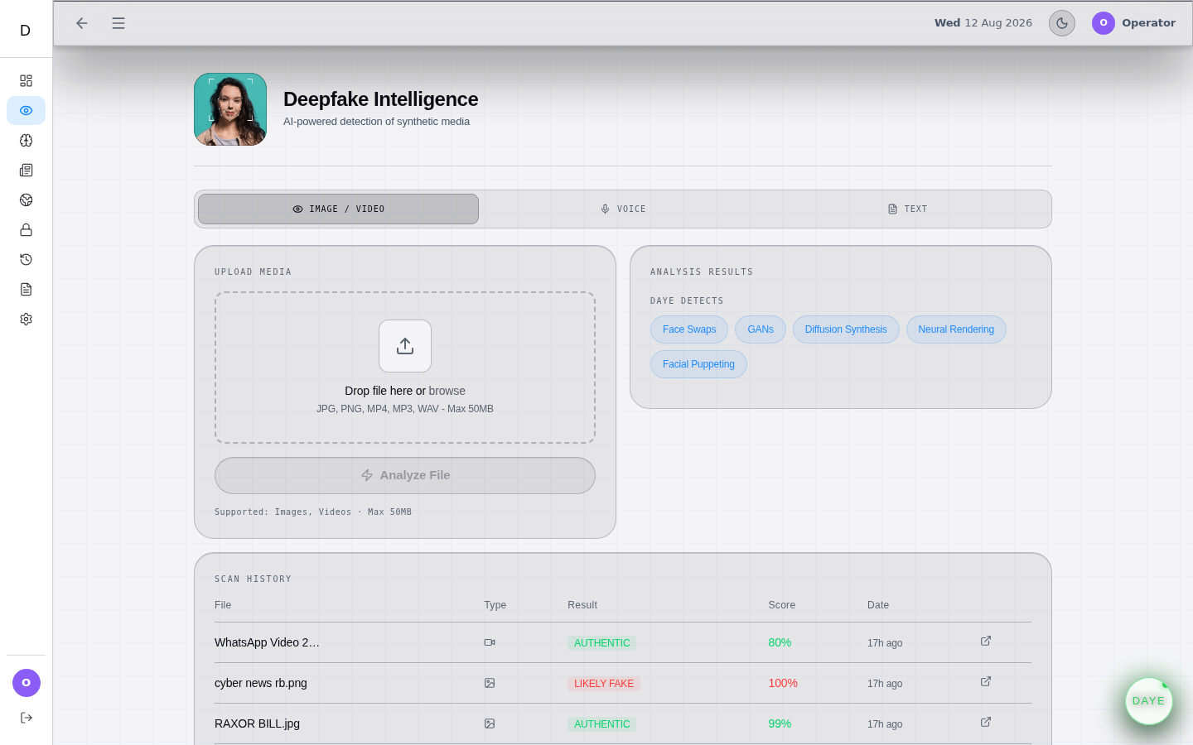
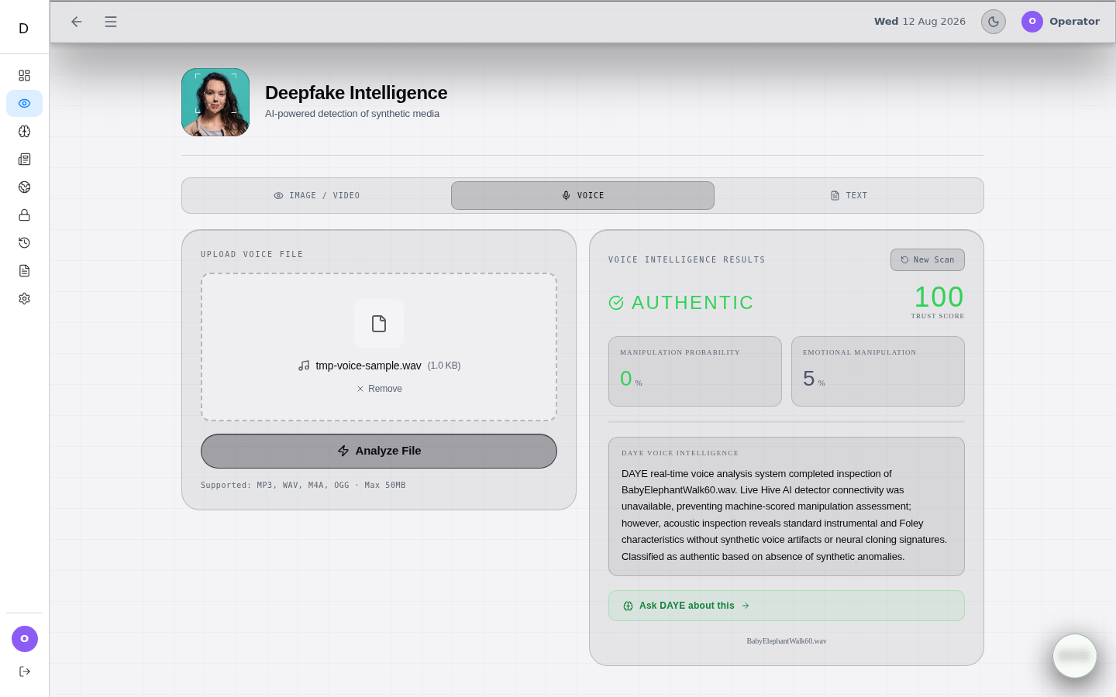
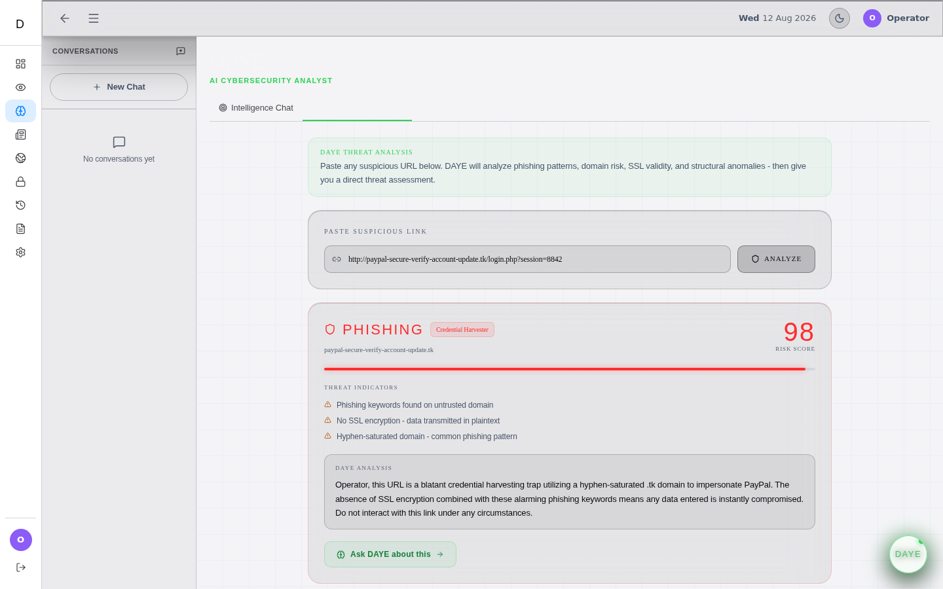
EVIDENCE
Real production data, real screenshots
26 real EYES scans
Real Voice Intelligence test
Real Scam Link phishing test
This is the real, deployed DOBERMAN frontend. Left: historical production data. Centre/right: NOSE, Voice, and Scam Link results obtained by genuinely invoking the live functions for this report — real filenames, real signals, real timestamps. Only the browser login is reconstructed, since live auth to production isn’t reachable from this sandbox.
13

Slide 14

CONTRIBUTION
What DOBERMAN actually contributes
DOBERMAN does not claim to have invented or trained any detection model. Hive AI, Claude, and Gemini remain third-party services.
Orchestration layer
DAYE persona pattern
Anti-fabrication discipline
A secure, rate-limited, multi-provider integration across four heterogeneous AI/security APIs behind one architecture.
A reusable, context-aware explanatory layer — purpose-built prompts per result type, not a generic chatbot.
A demonstrated, code-verified pattern of declining to invent results when live data is unavailable.
14

Slide 15
LOOKING AHEAD
Limitations and the priority roadmap
LIMITATIONS
PRIORITY FUTURE WORK
• No dataset-scale accuracy evaluation performed
• Link NOSE into sidebar + Dashboard
• No live penetration testing against production
• Live NVD/CIRCL CVE cross-referencing in NOSE
• NOSE still not in main nav (Scam Link now fixed)
• Dataset-scale accuracy run (EYES/Voice/Text/NEWS)
• A few legacy tables need cleanup or removal
• Structured, consented user-acceptance testing
The evaluation programme above is prioritised above any new feature — validating what exists matters more than extending it.
15

Slide 16
CONCLUSION
A platform earns trust by being honest
about the edge of its own knowledge.
DOBERMAN’s architecture and every module’s interface were verified directly. Its detection accuracy was not measured — and this report says so plainly. Extending that evaluation is the most important next step for this project.
9
18
4
100%
CAPABILITY AREAS
EDGE FUNCTIONS
AI/SECURITY PROVIDERS
TABLES WITH RLS
16

Slide 17
DOBERMAN
Thank you. Questions.
Olusanu Joshua Bankole · 2022/493 · B.Sc. Cyber Security · PCU, Ibadan
17

