Slide 1

OFFICIAL COLLABORATION PARTNER ONBOARDING
Welcome to Zebraish,
Christian.
Everything you need to know about the brand, your role, and how the collaboration works day to day, before you sign anything.
PREPARED FOR
Christian Prieto
PREPARED BY
Joshua Bankole, Founder
DOCUMENT
Onboarding presentation, companion to the Official Collaboration Agreement

Slide 2
WELCOME
01
You're officially part of Zebraish
A quick welcome before we get into the details.
ZEBRAISH
Welcome · 02 / 20

Slide 3
WELCOME
What is Zebraish?
• Zebraish is a brand and project built around two connected doors into the same world: Zebraish Studio and The Board on the technology side, and Zebraish Fashion on the creative side.
• Studio and The Board are where the tech and product work happens: building, prototyping, and shipping ideas. This is what's live right now, and it's what Zebraish is launching with.
• Fashion is the creative expression of the same brand: apparel and style built around a distinct, animal-inspired aesthetic. It's coming soon, but the product line isn't public yet.
• Both doors share one identity. Growing one grows the other.
ZEBRAISH
Welcome · 03 / 20

Slide 4
WELCOME
Where you start: Zebraish Studio
• You're joining as Zebraish's Official Collaboration Partner, and right now, your job is Studio: representing it, building awareness for it, and actively bringing in customers for it, because that's what Zebraish is starting with.
• You don't need to be a tech person to do this well. Your audience trusts you. That's the asset. Point people toward Zebraish Studio, explain what it does in plain terms, and make the introduction.
• Fashion joins your role once the clothing line actually launches, which is coming soon. When it does, it'll likely be an even more natural fit for you, but the work starts with Studio.
ZEBRAISH
Welcome · 04 / 20

Slide 5
YOUR ROLE
02
What you're signing up for
Position, responsibilities, and what "good" looks like.
ZEBRAISH
Your Role · 05 / 20

Slide 6
YOUR ROLE
Your position
• Position: Zebraish Official Collaboration Partner.
• Current focus: promoting Zebraish Studio and bringing in customers for it. That's the priority for the length of this Term.
• Non-exclusive: you're free to work with, promote, or represent other brands during the Term, as long as it doesn't conflict with your Zebraish obligations.
• Initial Term: 3 months from the date you both sign, renewable by mutual written agreement.
• You represent Zebraish, build brand awareness, create content, and introduce potential clients, all detailed in the Agreement itself.
ZEBRAISH
Your Role · 06 / 20

Slide 7
YOUR ROLE
Outreach responsibilities
• Proactively identify and approach potential Zebraish Studio clients within your own network and audience (anyone who could use what Studio builds) through DMs, in-person introductions, social engagement, whatever fits.
• Represent Zebraish's offering accurately when you do.
• Direct anyone interested to Joshua directly, or to the Zebraish Project & Payment Portal once it's live, so a project gets opened properly.
• This is the core of how commission gets generated: outreach is part of the job, not an optional extra.
ZEBRAISH
Your Role · 07 / 20

Slide 8
YOUR ROLE
Social media minimums
Content focus is Zebraish Studio for now. Fashion content joins once the line launches.
Deliverable
Requirement
Instagram posts / Reels
2 per week
Instagram Stories
3 per week
TikTok videos
1 per week
Campaign participation
As reasonably requested
Content approval
Required in advance only for specific flagged campaigns
ZEBRAISH
Your Role · 08 / 20

Slide 9
COMMISSION & PAYMENTS
03
How money moves
Client introductions, commission, and the weekly payout, in plain terms.
ZEBRAISH
Commission & Payments · 09 / 20

Slide 10
COMMISSION & PAYMENTS
Client introductions: no referral code needed
• When you introduce a client, the project gets opened through the Zebraish Project & Payment Portal (or you just tell Joshua directly and he opens it), and it gets a unique Project ID, like ZB-00017.
• There's no personal referral code or link to manage or share.
• Commission isn't calculated by matching individual clients to you: it's based on all qualifying Zebraish payments received during your Term.
ZEBRAISH
Commission & Payments · 10 / 20

Slide 11
COMMISSION & PAYMENTS
Commission, at a glance
10%
Weekly
Sunday
of all qualifying Zebraish client payments received during your Term
commission is calculated and paid every single week
payout day, reviewed and sent by bank transfer
No arbitrary cap on what you can earn, and no fixed salary: compensation is commission-based for the Initial Term.
ZEBRAISH
Commission & Payments · 11 / 20

Slide 12
COMMISSION & PAYMENTS
Weekly payout: how it works
Step
What happens
Sunday review
Joshua totals every qualifying payment Zebraish received Mon–Sun.
Calculation
10% of that weekly total is your commission for the week.
Payment
Sent by bank transfer the same day, or the next business day if a Sunday transfer isn't possible.
Exclusions
Refunds, chargebacks, cancelled or fraudulent orders don't count.
Example
₦485,000 in qualifying payments that week → ₦48,500 commission paid to you that Sunday.
ZEBRAISH
Commission & Payments · 12 / 20

Slide 13
COMMISSION & PAYMENTS
Your Collaborator Dashboard
• A private view of your weekly commission: Project IDs, amounts, and PAID / PENDING status.
• You'll see enough to verify every payment is calculated correctly, without Zebraish's client contact details being exposed to you.
• This is being built alongside the Project Portal. Joshua will confirm once it's live; a written weekly summary works as a bridge until then.
ZEBRAISH
Commission & Payments · 13 / 20

Slide 14
GUIDELINES & TERMS
04
The fine print, made readable
Brand guidelines, content rights, and how the Term works.
ZEBRAISH
Guidelines & Terms · 14 / 20

Slide 15
GUIDELINES & TERMS
Brand guidelines
• Represent Zebraish positively and professionally, always.
• No false or misleading claims about Zebraish, its products, or services.
• Don't imply you're an owner, director, or officer of Zebraish.
• No unauthorized promises or commitments on Zebraish's behalf.
• Paid advertising or sponsorships need Joshua's written approval before you commit to any spend.
ZEBRAISH
Guidelines & Terms · 15 / 20

Slide 16
GUIDELINES & TERMS
Content & your rights
• You keep full ownership of your identity, image, and likeness, always.
• Zebraish gets a non-exclusive license to use approved content (photos, videos, your name) for promotional purposes on Instagram, TikTok, the website, and ads.
• That license runs during the Term, plus 6 months after it ends, for archival and portfolio use only, not new campaigns.
• Confidential Zebraish information (products, pricing, strategy) stays confidential, during and after the Term.
ZEBRAISH
Guidelines & Terms · 16 / 20

Slide 17
GUIDELINES & TERMS
Term & how it ends
Item
Detail
Initial Term
3 months from the date of last signature
Renewal
Only by mutual written agreement; otherwise it ends automatically
Termination for convenience
14 days' written notice, either side
Immediate termination
For serious misconduct, fraud, or an unremedied breach
After termination
Commission already earned on qualifying payments stays payable
ZEBRAISH
Guidelines & Terms · 17 / 20

Slide 18
GUIDELINES & TERMS
Paid advertising & monthly check-ins
• If paid ads or boosted posts make sense, Joshua funds and confirms the budget in writing before anything's spent. You never commit Zebraish's money without sign-off.
• Once a month, a quick review: content delivered, client introductions, commission, and anything worth adjusting.
• Informal, low-friction: a call or a message is enough. It keeps both sides aligned without needing to touch the Agreement itself.
ZEBRAISH
Guidelines & Terms · 18 / 20

Slide 19
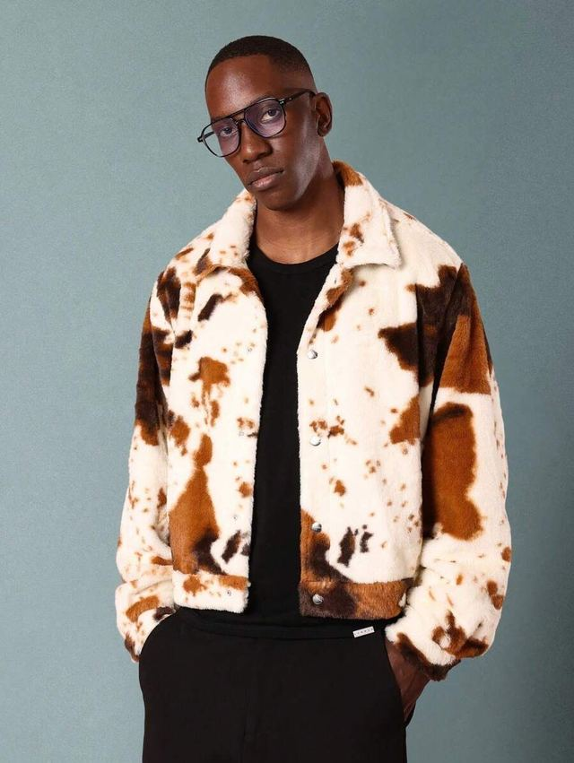
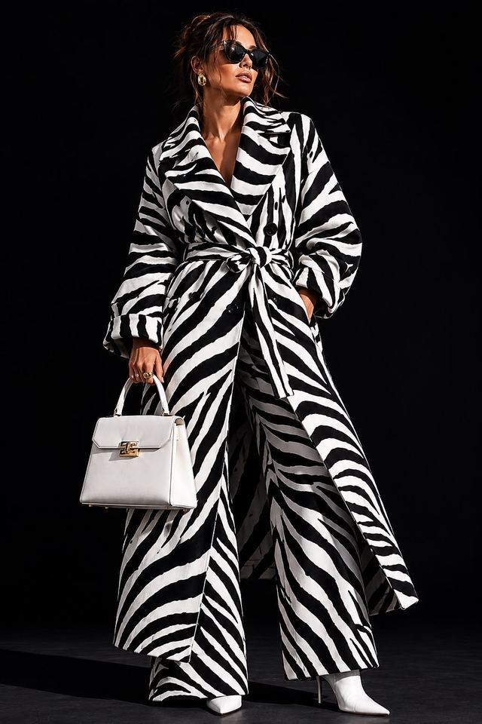

GUIDELINES & TERMS
What's coming: Fashion
A preview, not the current job: reference styling for the Fashion line, launching soon. Animal-inspired patterns and textures reinterpreted for a premium range. Your role expands to include this once it's live; for now, the focus is Zebraish Studio.
ZEBRAISH
Guidelines & Terms · 19 / 20

Slide 20
NEXT STEP
Let's make it official
This presentation is context. The Official Collaboration Agreement is the document that makes it binding. Read it, ask anything, and sign when you're ready.
Founder / Brand Representative
Joshua Bankole · j0shbankole19@gmail.com · +234 816 532 0780
Official Collaboration Partner
Christian Prieto · +34 631 53 71 36 · Barcelona, Spain
Document to sign
Zebraish Official Collaboration Agreement (EN / ES)
ZEBRAISH
Guidelines & Terms · 20 / 20

