Slide 1
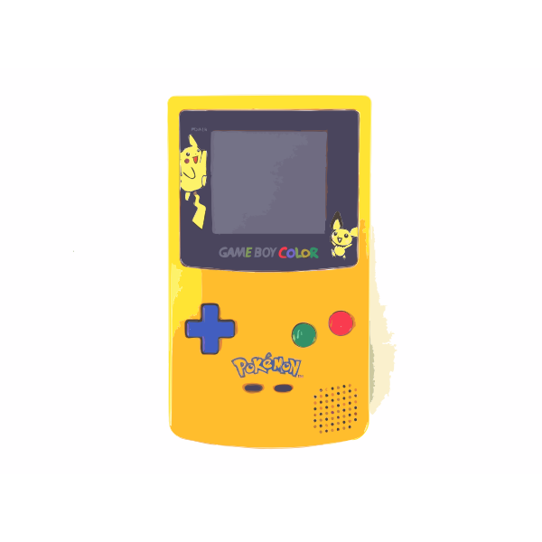

Pokemon VGT Stats
By: Alex Perera

Slide 2
Introduction
Pokemon Dataset
Contains 721 Unique Pokemon
Includes Alternative Forms (Mega Evolutions)
Names/Pokedex ID
Typings (Fire, Water, Electric, Dragon..)
Generation/Series Release
Legendary Status
Stats
Attack
Defense
Speed
HP (Health Points)
Sp. Attack & Sp. Defense
Pokemon Video Game Tournament Series
Going Strong since 2004
Different Divisions
Junior
Senior
Master
Matches played in Doubles format
For the tournament, all Pokemon are level-scaled to 50 (if above)
Player Influences
Choosing Team
Move Layout
Stat - Trained (favoring one Stat over another)
Notes:
https://www.smogon.com/forums/threads/vgc-2015-rules.3524352/

Slide 3
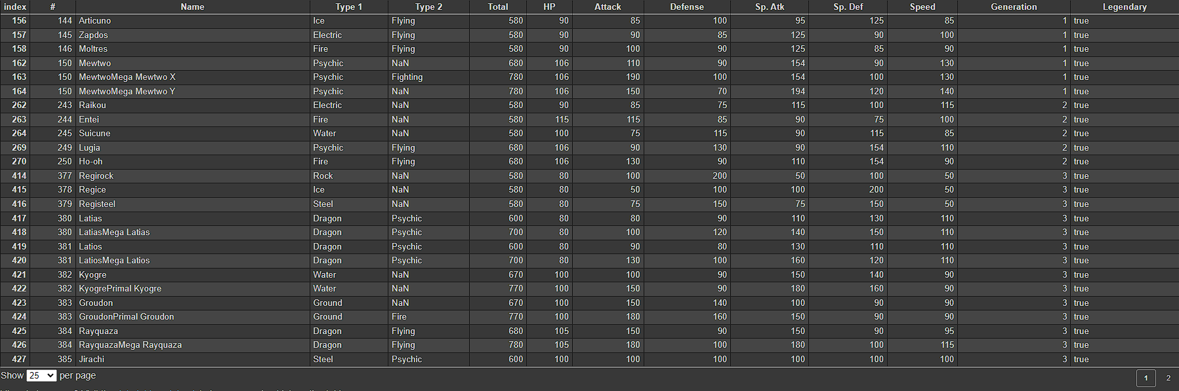
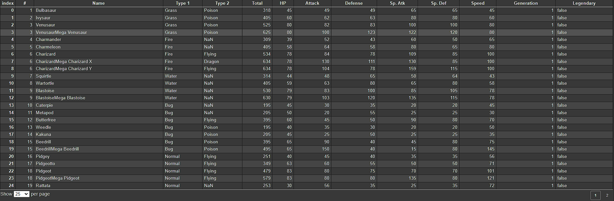
The Dataset Split into Legendary Pokemon vs Normal Pokemon
Notes:
Gives a good insight into the stats, and allows me to break down that stats and how they work in coordination of the attacks/moves pokemon do

Slide 4
Questions Explored
Pokemon has a recurring theme of introducing a ‘cute electric rodent’ pokemon (often similar to Pikachu), is there a statistical advantage over using the others? → Which is best?
When I was younger, my favorite starter pokemon has always been the fire types, I wondered amongst all the starter pokemon is the best to start with? In this case, what if I started the 6th generation with a different starter?
What difference is there between a non-competitive (casual) player’s team VS a competitive player’s team?
Exploring the competitive E-Sport side required me to research and watch gameplay from 7 years ago to understand how it works. The question I’ve observed is with the finals match of two players, and how their teams were different (built to different strengths) yet why did the 2015 Champion Ashton win the tournament with the four pokemon he chose as opposed to his runner up? What is different compared to the 2014 Champion: Se Jun Park?

Slide 5



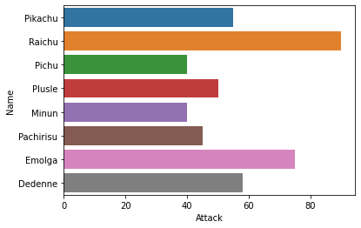
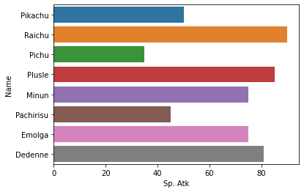
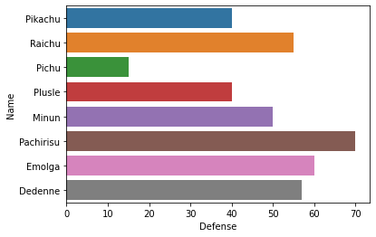
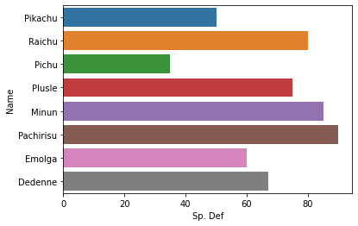
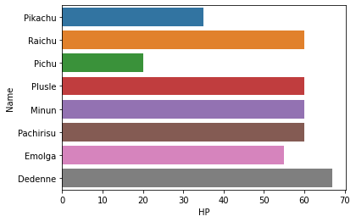
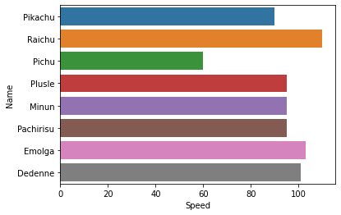
Question 1: Cute Electric Mouses
Uniquely, there is only one ‘Evolution Line’ of pokemon which are:
Pichu
Pikachu
Raichu
Evolution in game grants a stat-boost
These Fast-Electric Typings are somewhat of a Glass Cannon
Overall Raichu takes the spot of best Electric Mouse
This is interesting because Pachirisu is credited with winning the 2014 Pokemon VGT Masters Championship

Slide 6



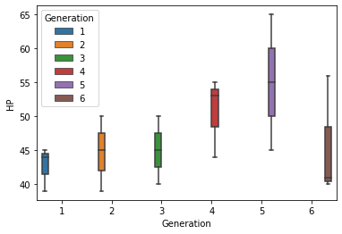
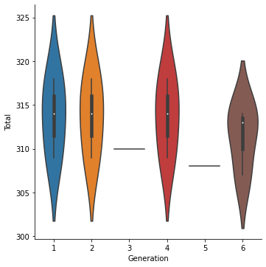
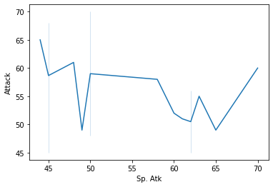
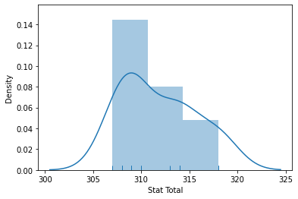
Q2: Starter Advantage
Generation/Region 1 → 6
Subset of regional Pokedex entries
Starting Pokemon provides the initial advantage in-game through ‘Typing Advantage’
I explored their HP stat against their total stats to see how they affect the collective stat total
Generational pokemon have either been ‘Power Crept’ while some others don’t receive favored treatment

Slide 7
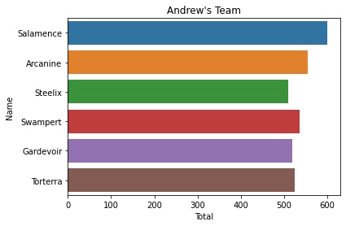
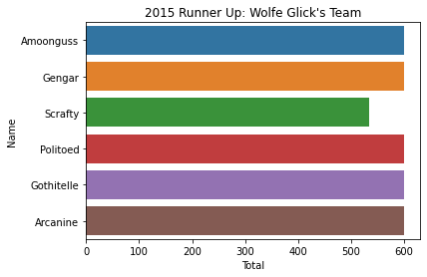
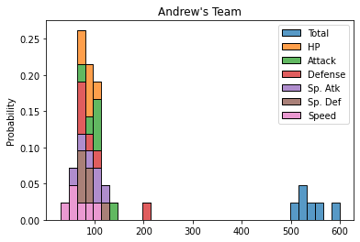
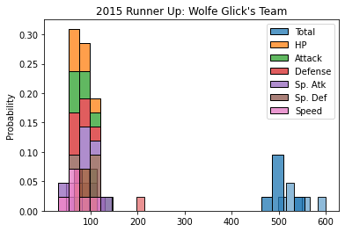
Q3: Casual VS Competitive
I had asked some friends to design Pokemon Teams as if they were to compete
There are two championships I was interested in exploring, which were the 2014 and 2015 (Champ + Runner Up Teams)
Initially the casual teams seem fine, but compared to the runner up teams, they’re unbalanced in their stats

Slide 8
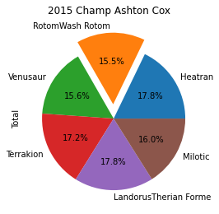
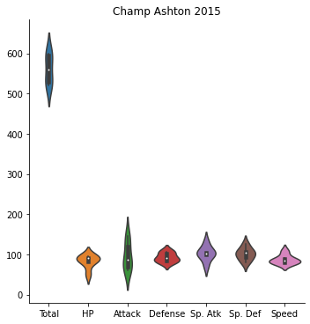
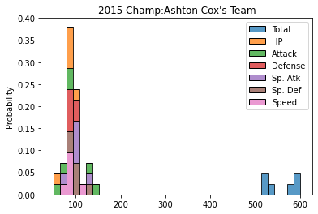
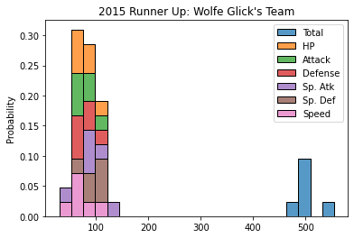
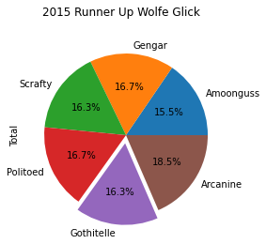
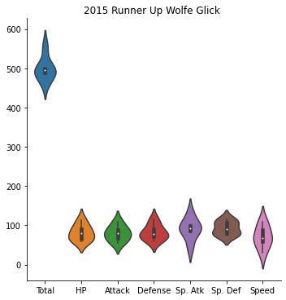
Q4: Champion Analysis
2015
Ashton Cox
Strategy: Perish Trap, an auto-defeat move that activates after 3 turns
Wolfe Glick
Generalized Team for anything

Slide 9
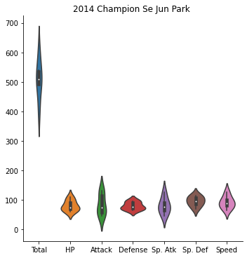
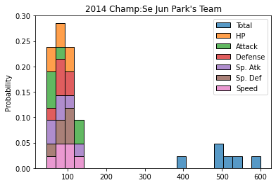
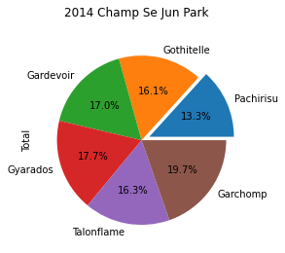
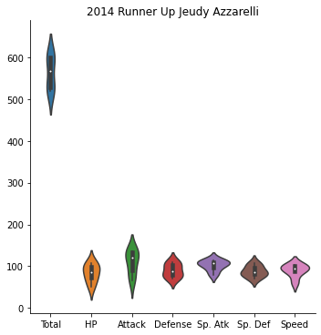
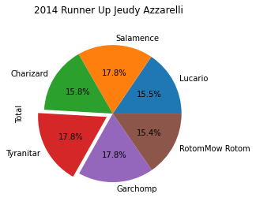
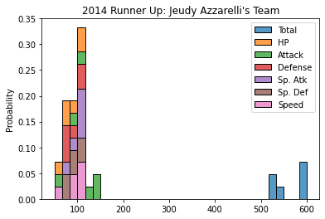
Champ Analysis Part II
2014
Se Jun Park
Out Paced Jeudy through Speed and high Attack stat
Jeudy Azzarelli
Dragon Type Heavy, led to the team being skewed towards a Type Disadvantage

