Slide 1
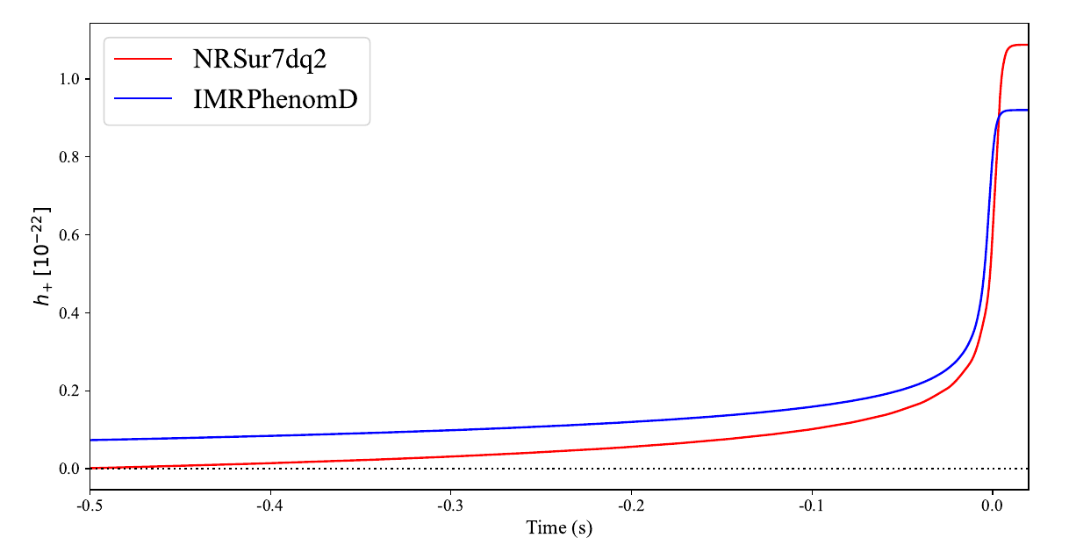
Memory

Slide 2
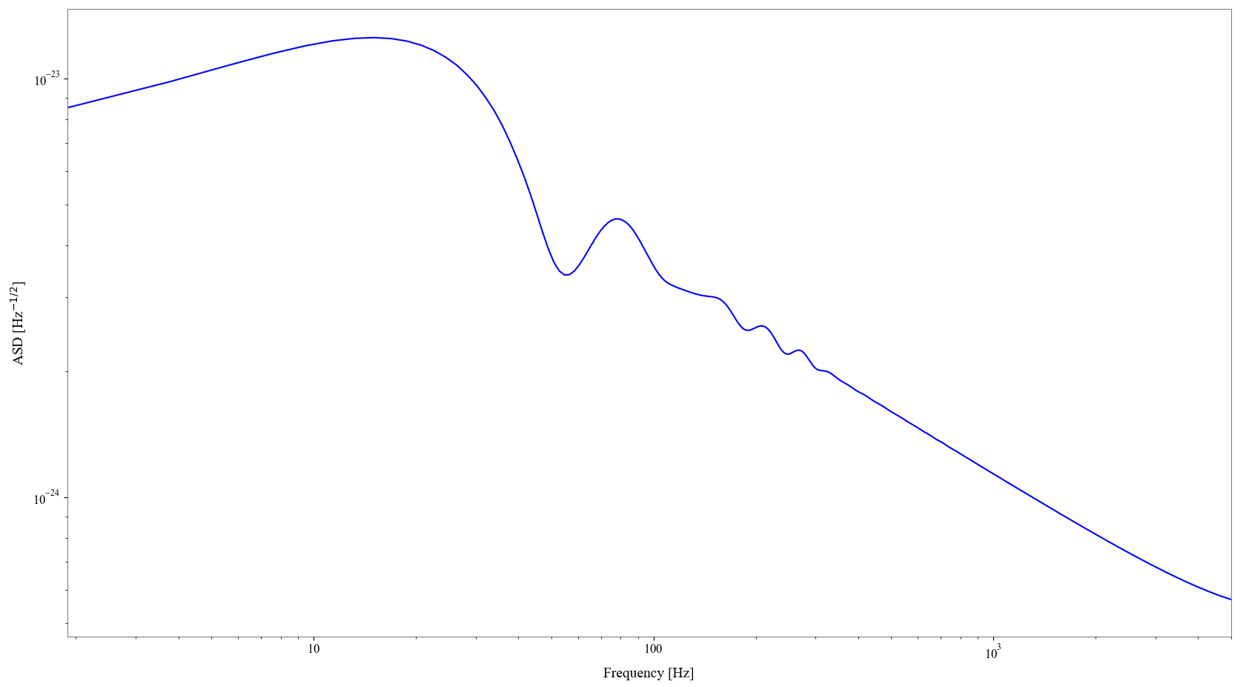
Frequency Domain Memory

Slide 3
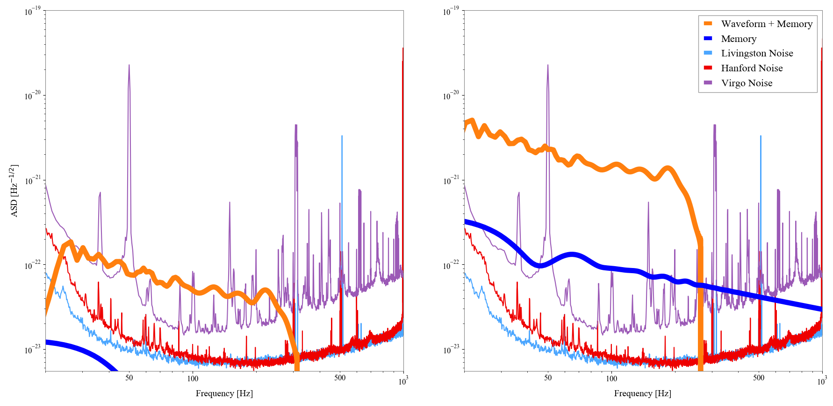
Memory Detectability

Slide 4
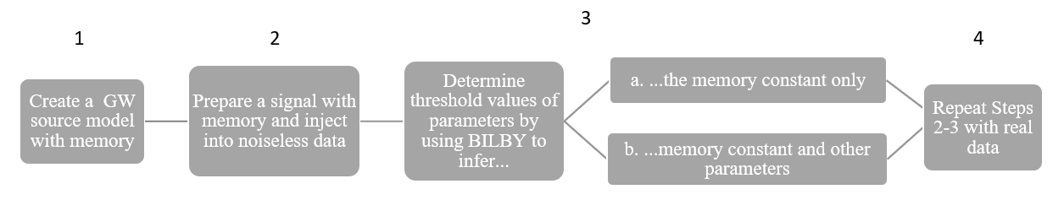

Work Flow
$$h_{tot}=h+{λ h}_{mem}$$

