Slide 1
Review
1-D Inferencing

Slide 2

Review
1-D Inferencing
$$h_{tot}=h+{λ h}_{mem}$$

Slide 3
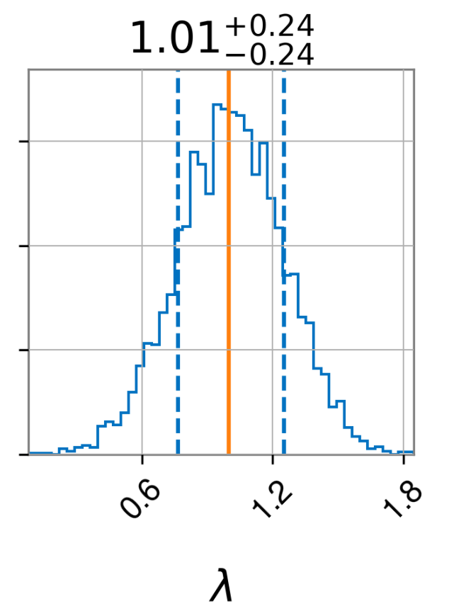
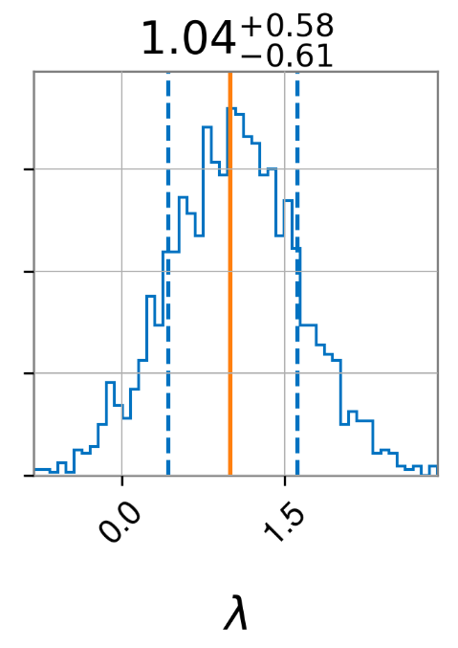
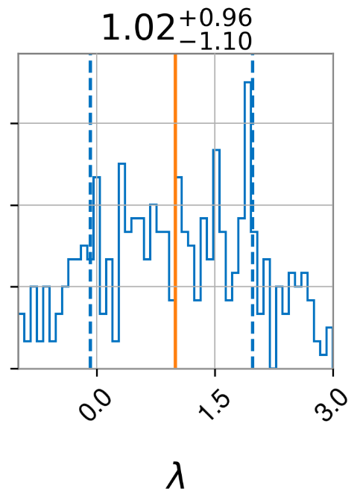
Varying Distance
Posterior
Distance

Slide 4
New Stuff
2-D Inferencing

Slide 5
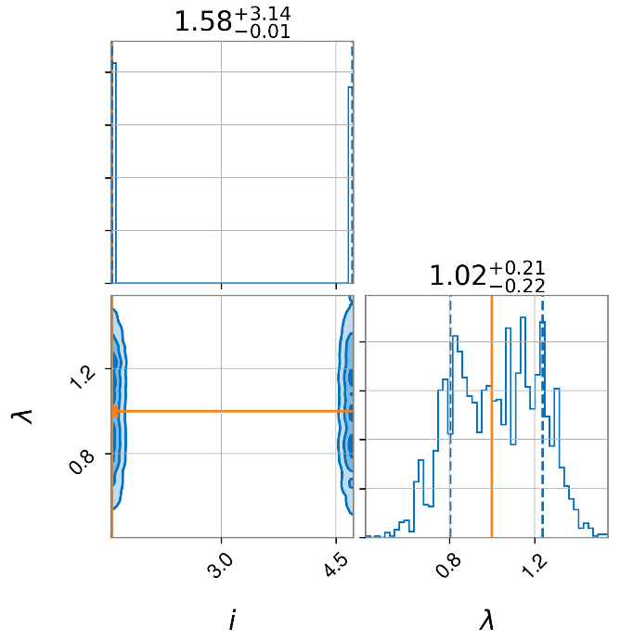


Inferring $ι$ and $λ$
$$ι$$

Slide 6
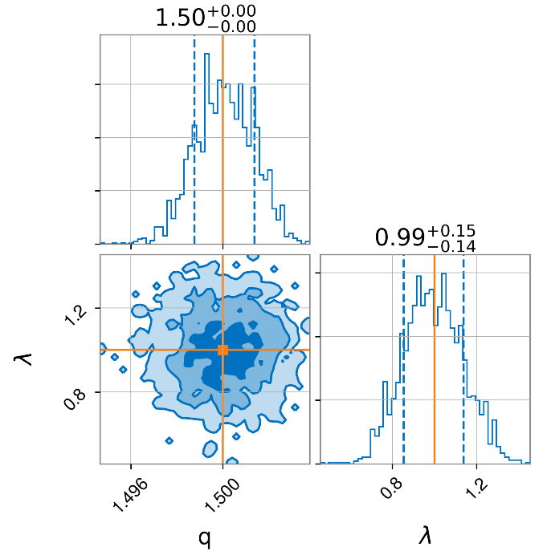
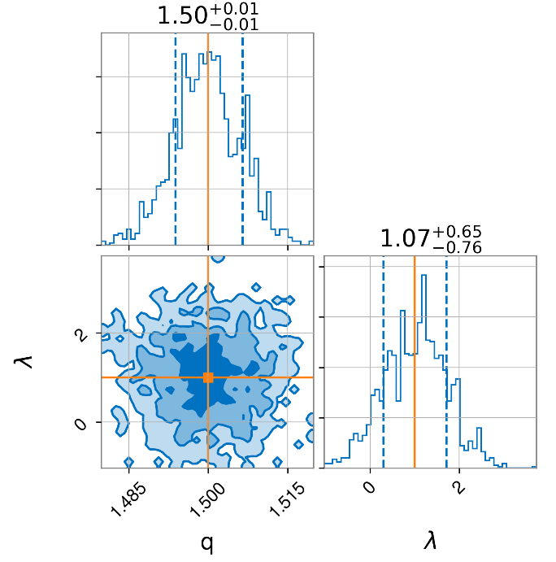
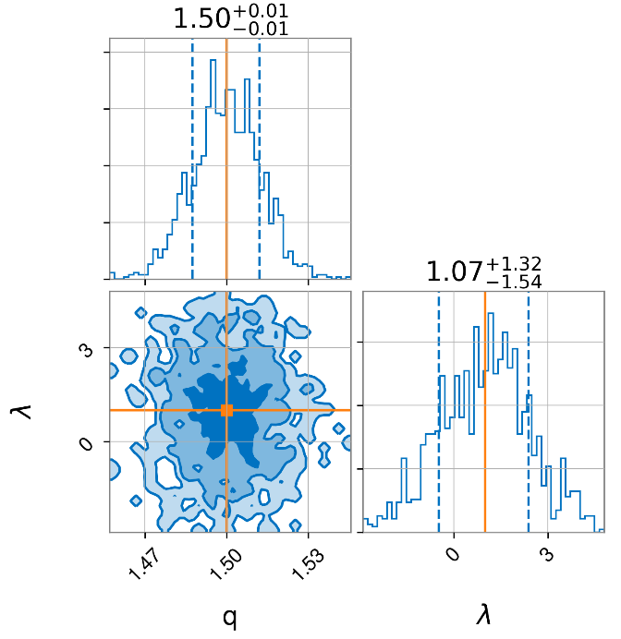
Varying Distance 2.0
Distance

Slide 7
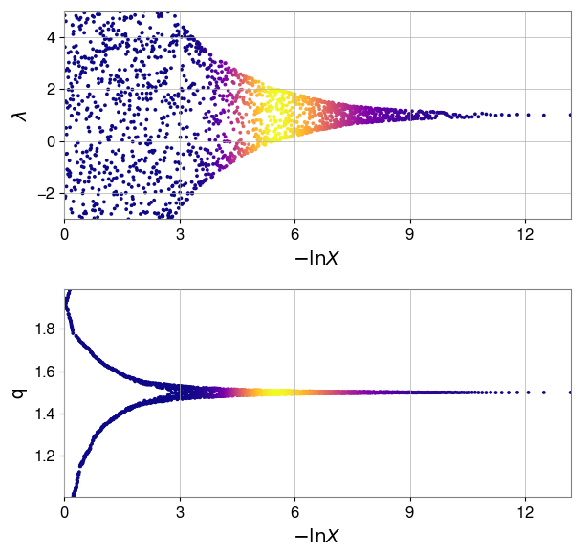
Varying Distance 2.0

