Slide 1
Progress Update (July 10, 2020)
Darin C. Mumma
Departments of Physics and Philosophy, Grove City College
Mentors: Alan Weinstein, Colm Talbot, Alvin K. Y. Li
LIGO Laboratory, California Institute of Technology
LIGO SURF 2020

Slide 2
Introduction
I. Updated frequency domain plots
II. Early BILBY output
III. Questions
IV. Next steps

Slide 3
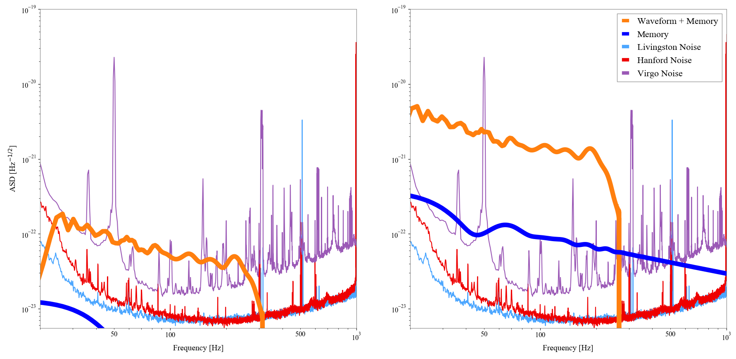
Old Plot

Slide 4
Organizing Windows
frequency_domain_transform(oscillatory, times, window_type=osc_window_type or mem_window_type)
osc_window_type = ...
or
mem_window_type = ...

Slide 5
Organizing Windows
Window Types provided by scipy.signal.windows.get_window
[https://docs.scipy.org/doc/scipy/reference/generated/scipy.signal.windows.get_window.html#scipy.signal.windows.get_window]
------------------------------------------------------------------------------
'boxcar': rectangular window = no window (essentially)
'triang': triangular window, nonzero endpoints
'blackman': 3rd order cosine sum, minimizes leakage, almost as good as Kaiser window at doing so
'hamming': single cosine with nonzero endpoints, minimizes first side lobe
'hann': hamming window but with zero endpoints
'bartlett': triangular window but with zero enpoints, used to taper with little fd modulation
'flattop': 5th order cosine sum, used to measure signal amplitude, makes main lobe flat
'parzen': not sure about this one
'bohman': or this one, either
'blackmanharris': generalized hamming = more cosines, hamming but better
'nuttall': similar to blackman-harris
'barthann': combo of bartlett and hann
('kaiser', beta): formed from Bessel functions, beta = 0(rectangle), 5(hamming), 6(hann), 8.6(blackman)
('gaussian', std_dev): use only in special cases
('general_gaussian', power, width): same here
('slepian', width): maximizes power in main lobe
('dpss', norm half-bandwidth): first term is slepian window
('chebwin', attenuation): uses Chebyshev polynomials, kinda complicated
('exponential', decay constant): seems like it will cut power too quickly
('tukey', taper fraction): tf = 0(rectangle), 1(hann)
------------------------------------------------------------------------------

Slide 6
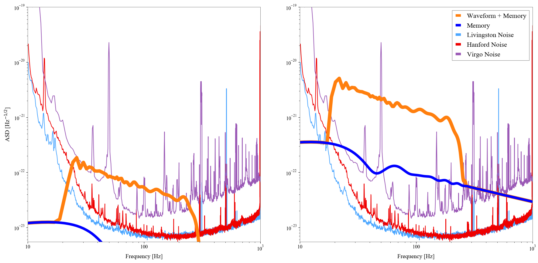
New Plot

Slide 7
BILBY Corner Plots

Slide 8
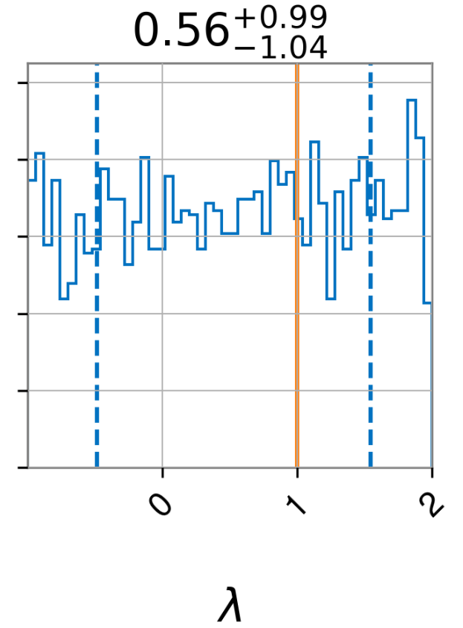
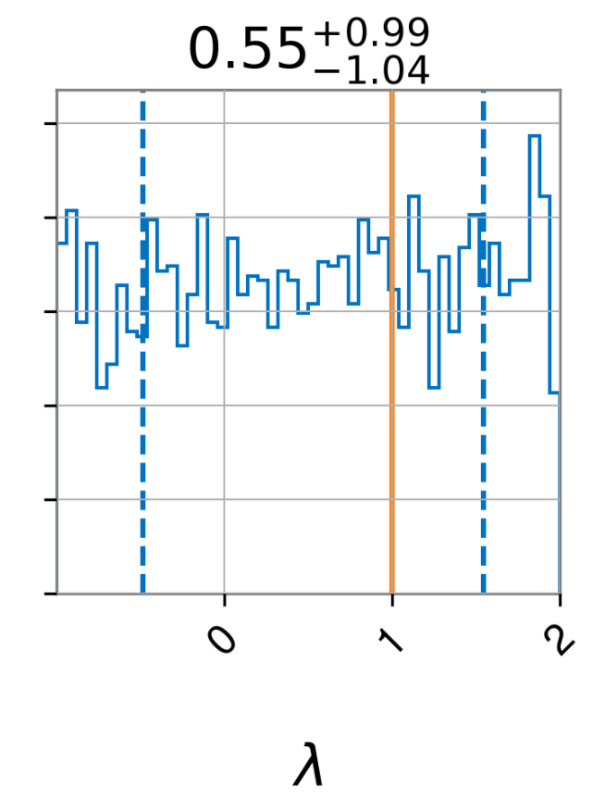
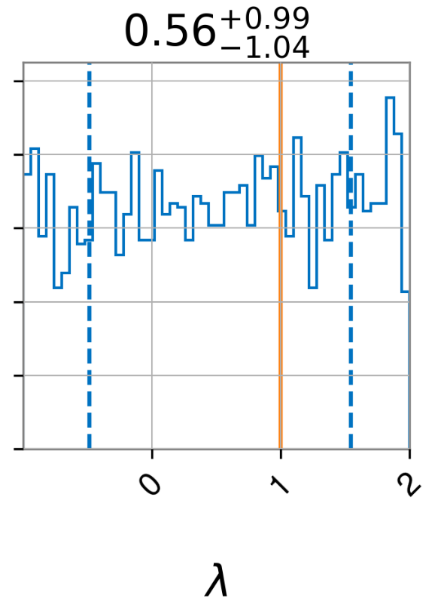
Varying Distance
Distance

Slide 9
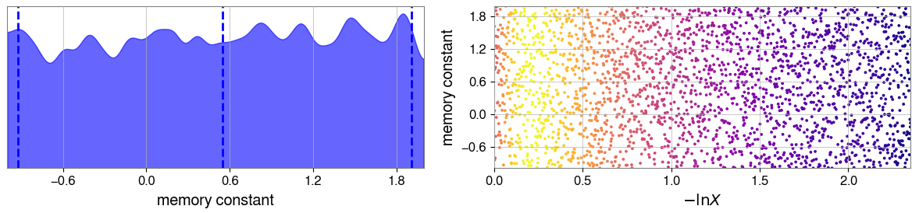
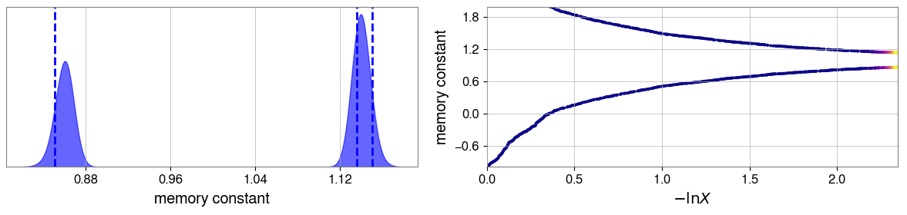
Fixed Output

Slide 10
Questions

Slide 11
Questions
Time Domain vs. Frequency Domain?
Criteria for Positive Result?
Process?

Slide 12
Next Steps

Slide 13
Next Steps
Soon…
Incorporate NRSur7dq4
Improve efficiency of BILBY code
Later…
BILBY parallel
Moving the process onto the LIGO cluster

