Slide 1
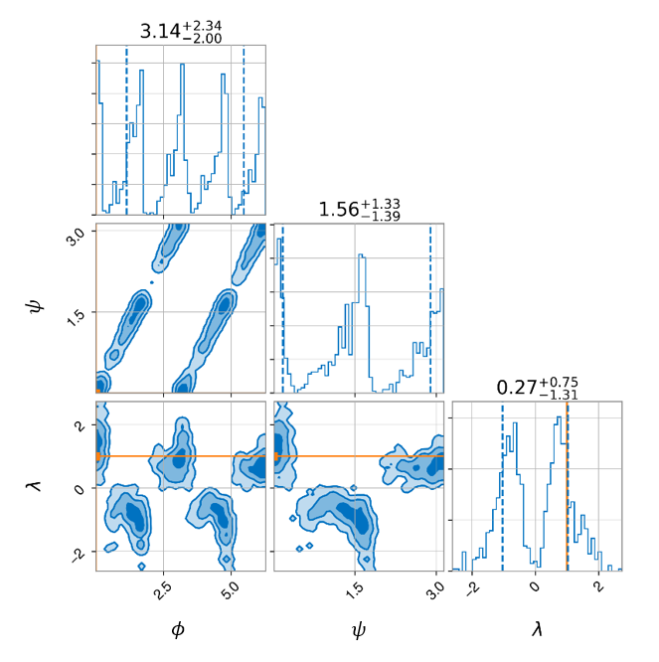
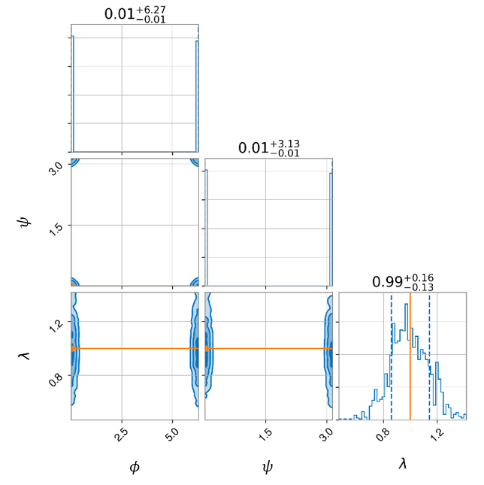
Figure 1. The injected waveform used to generate these posterior distributions is sourced by non-spinning components with $M_{tot}=60$solar masses, $q=1.5$, $ι=π/2$, $α=0$, $δ=0$, and $d_{L}=100$ Mpc. A uniform sampler with 100 live points was used for inferencing. (Left) (2, 2) mode only and (Right) all modes included.

Slide 2
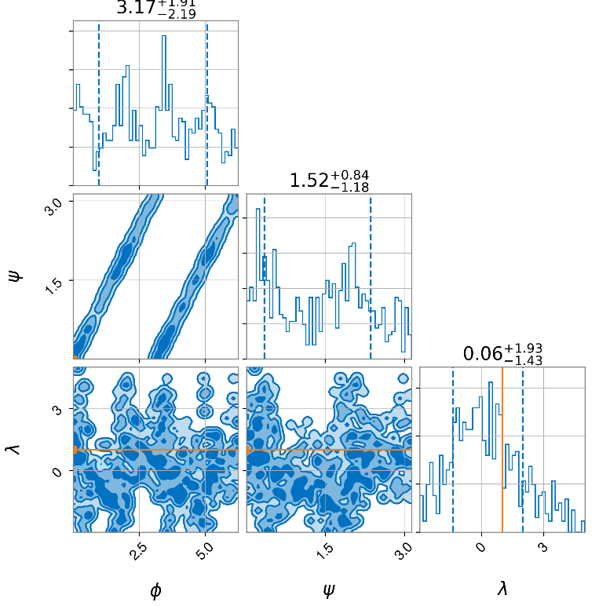
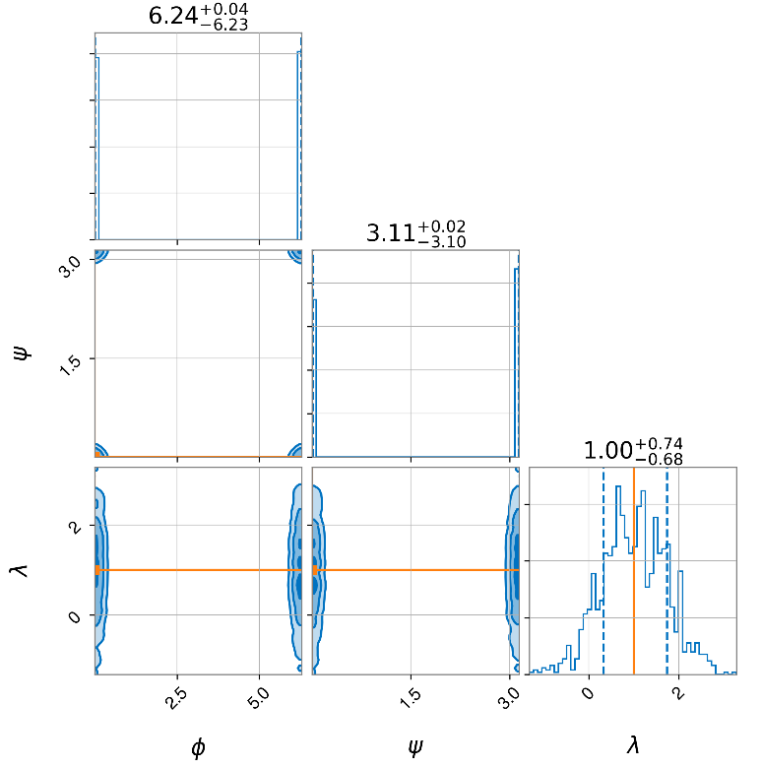
Figure 2. The injected waveform used to generate these posterior distributions is sourced by non-spinning components with $M_{tot}=60$solar masses, $q=1.5$, $ι=π/2$, $α=0$, $δ=0$, and $d_{L}=500$ Mpc. A uniform sampler with 100 live points was used for inferencing. (Left) (2, 2) mode only and (Right) all modes included.

Slide 3
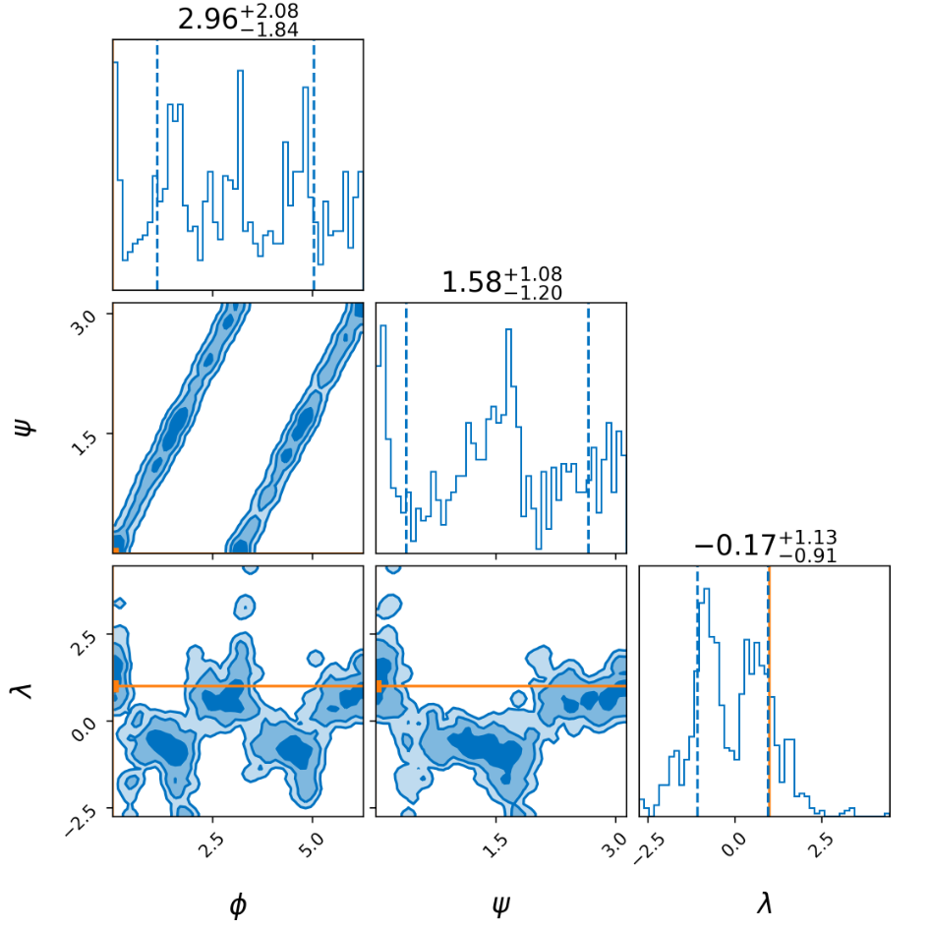
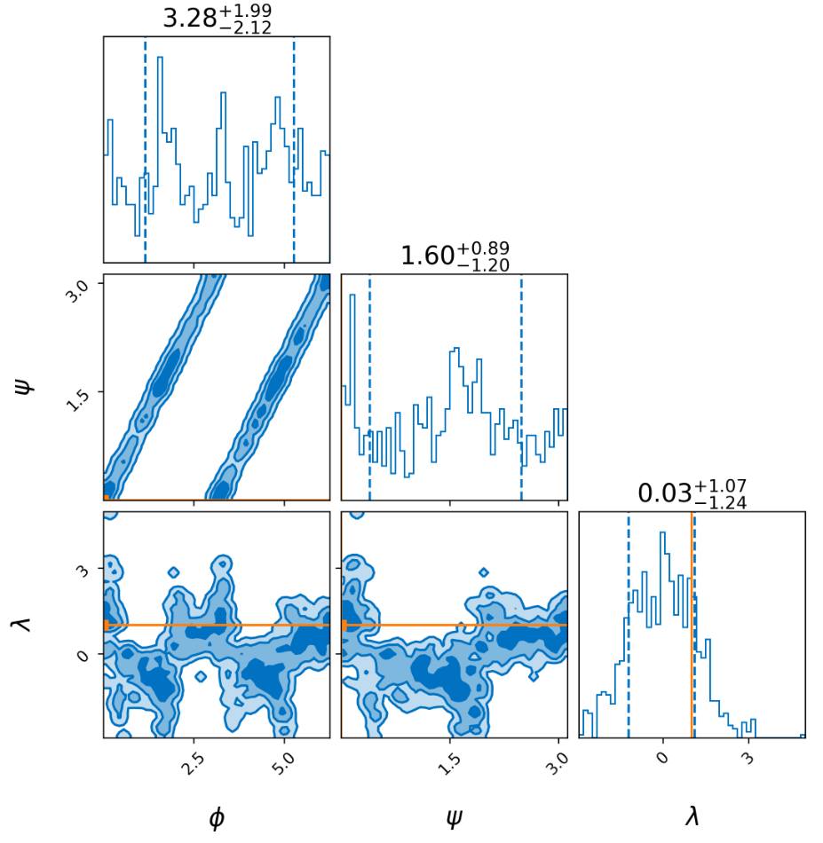
Figure 3. The injected (2, 2)-mode only waveform used to generate these posterior distributions is sourced by non-spinning components with $M_{tot}=60$solar masses, $q=1.5$, $ι=π/2$, $α=0$, $δ=0$. A uniform sampler with 100 live points was used for inferencing. (Left) $d_{L}=160$ Mpc and (Right) $d_{L}=200$ Mpc.

