Slide 1

Parameters
The subsequent plots’ parameters are the following:
$M=60M_{☉}$
$q=2$
S₁ $=0$
S₂ $=0$
$d_{L}=600Mpc$
$θ=π/2$
Approximants $=$ IMRPhenomD and NRSur7dq2

Slide 2
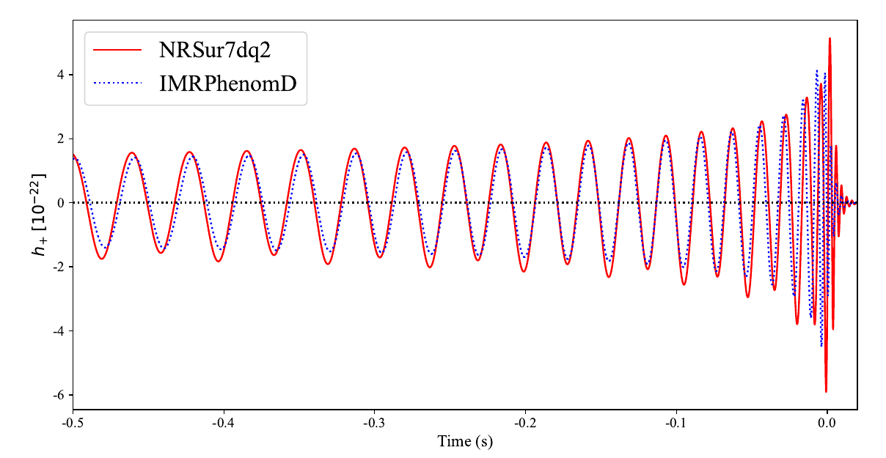
Original Waveforms

Slide 3
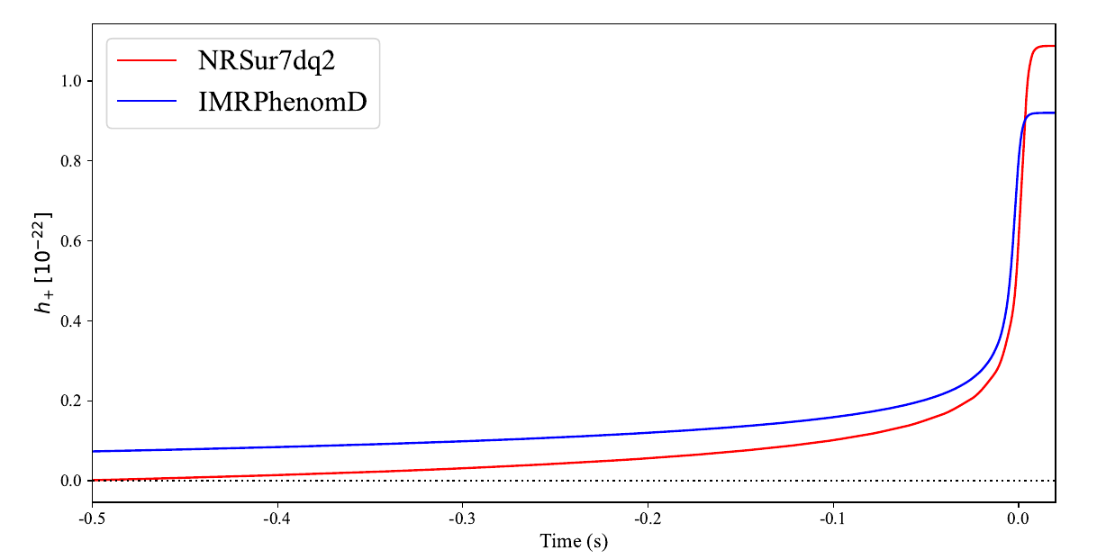
Memory

Slide 4
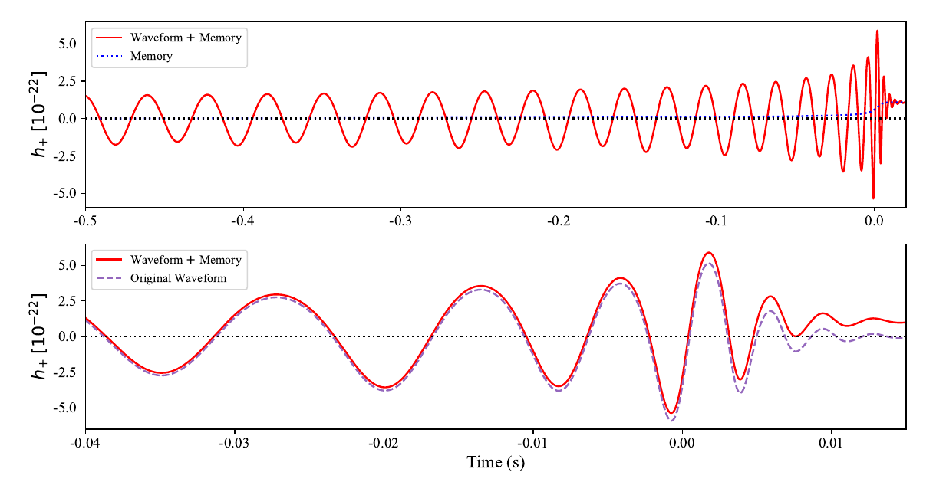
NRSur7dq2
Memory + Waveform

