Slide 1
Detectability of Nonlinear GW Memory
(July 24, 2020)
Darin C. Mumma
Departments of Physics and Philosophy, Grove City College
Mentors: Alan Weinstein, Colm Talbot, Alvin K. Y. Li
LIGO Laboratory, California Institute of Technology
LIGO SURF 2020

Slide 2
Introduction
I. Background
II. Problem
III. Solution
IV. Next steps

Slide 3
Background

Slide 4
What is Memory?

Slide 5
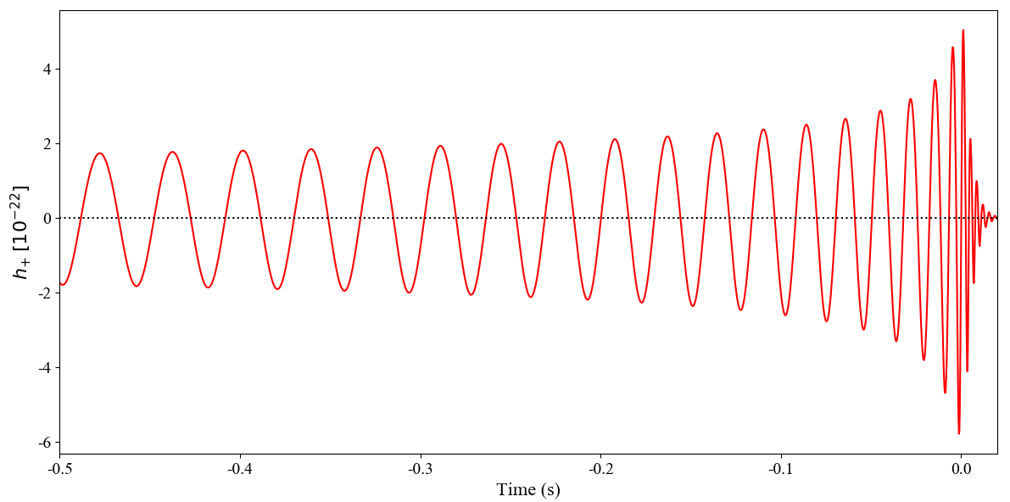
Time Domain Waveform

Slide 6
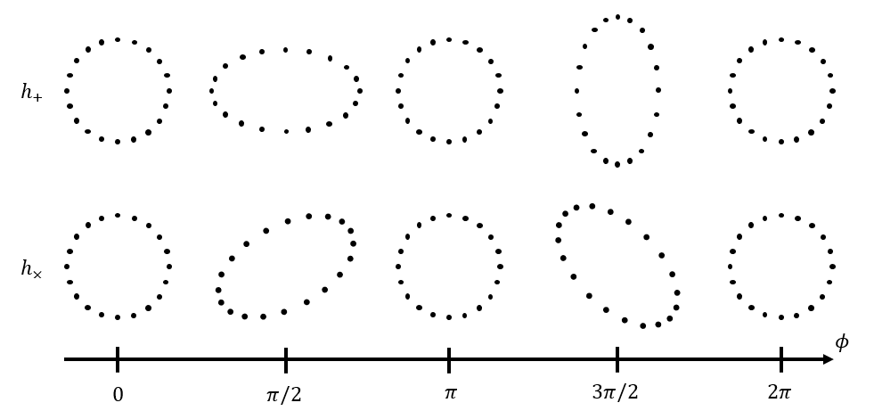
What is Memory?
d
d
d
d

Slide 7

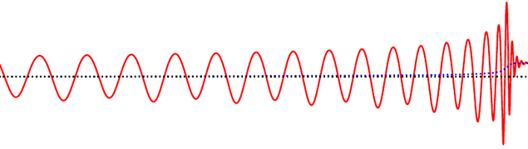
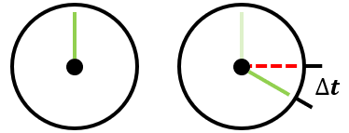

What is Memory?
Space
Time
$$\frac{1}{2}∆x$$

Slide 8
What is Memory?
Every waveform has two components: oscillatory and secular [1]
Two kinds of secular components: linear and nonlinear

Slide 9
Linear Memory
Independent of source’s past motion
e.g. integrable or conservative
Too small to detect [2]

Slide 10

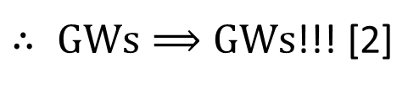


Nonlinear Memory
$$1. accelerating masses⟹GWs$$
$$2. mass∝energy$$
$$3. GWs=energy$$
$∴ GWs⟹GWs$!!! [2]

Slide 11
Nonlinear Memory
Depends on entire past motion of source
e.g. hereditary, nonintegrable, or nonconservative
More prominent than linear memory [1]
Typically 10 times weaker than oscillatory component [3]

Slide 12
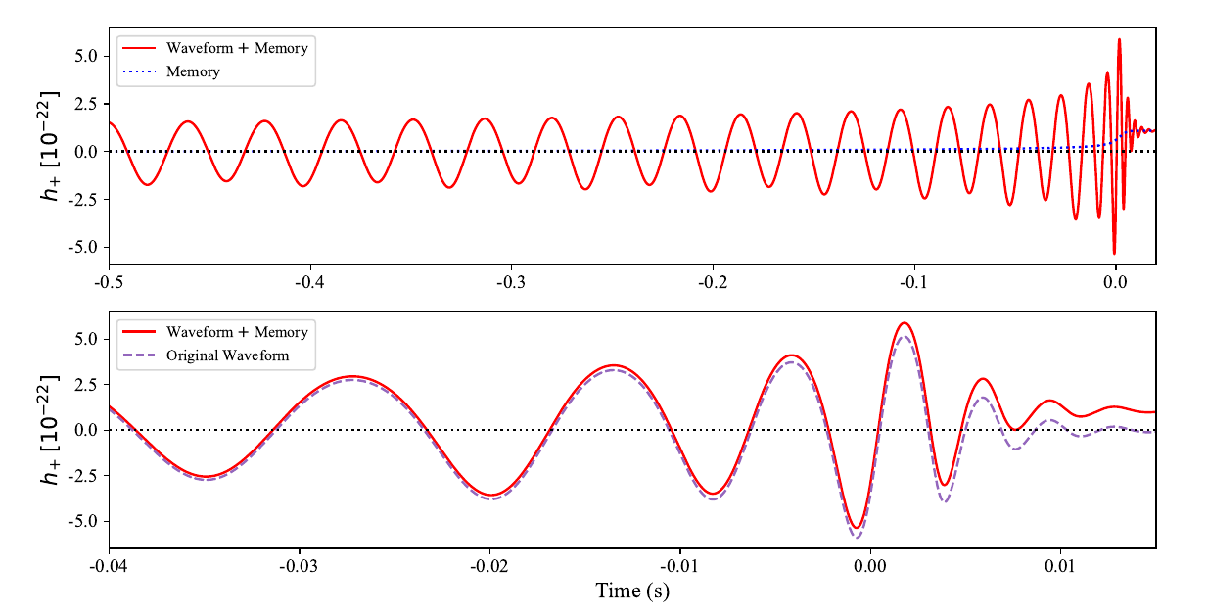


Time Domain Memory
$$h_{mem}$$
$$h_{mem}$$

Slide 13
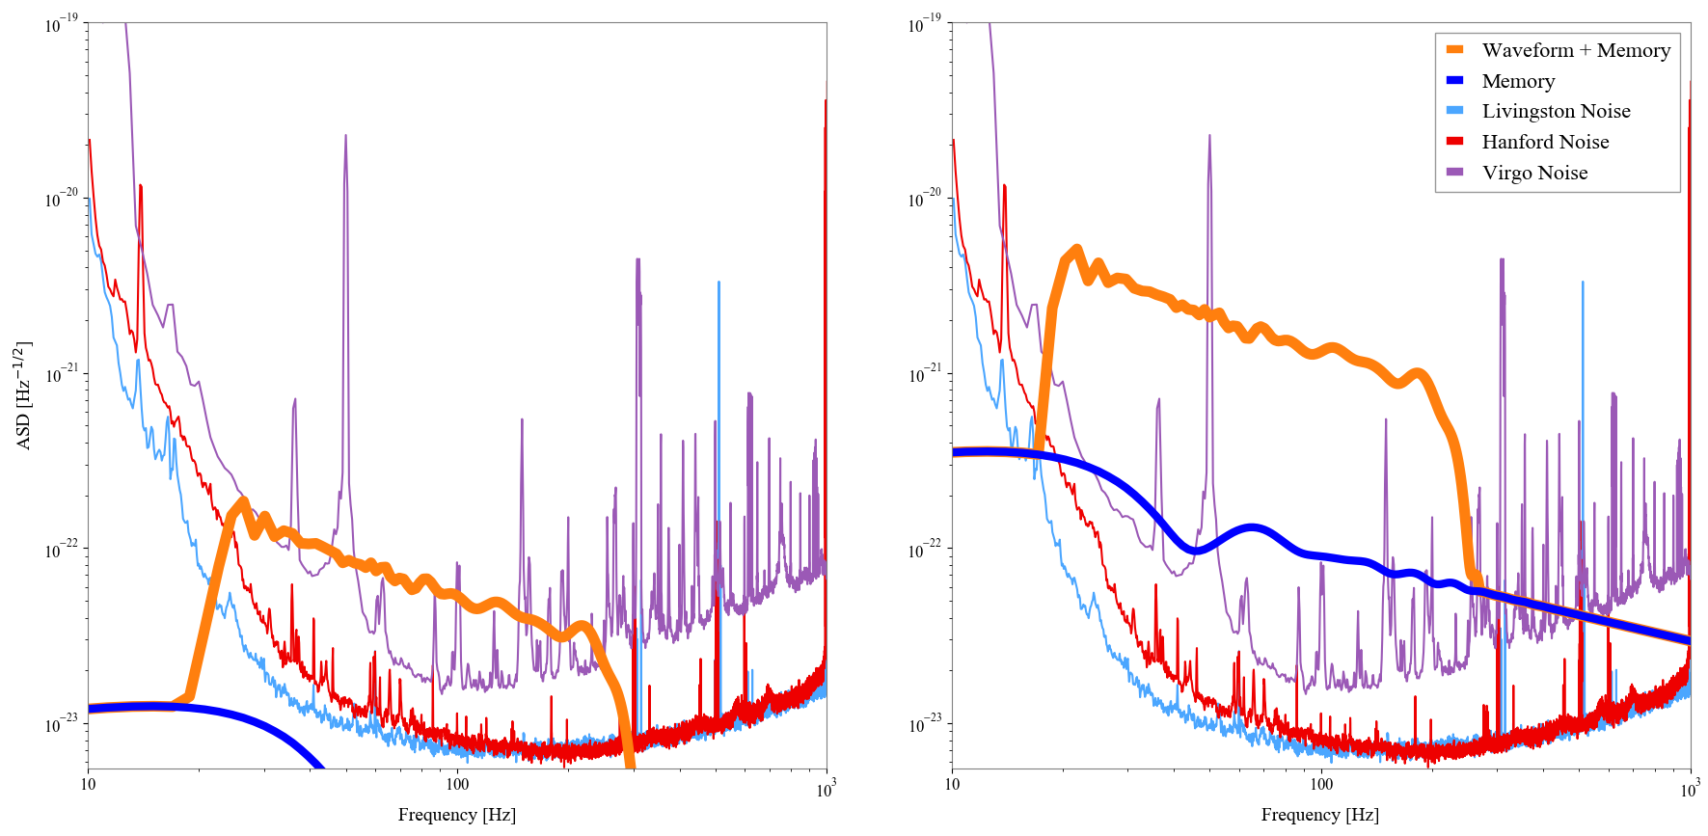
Frequency Domain Memory

Slide 14
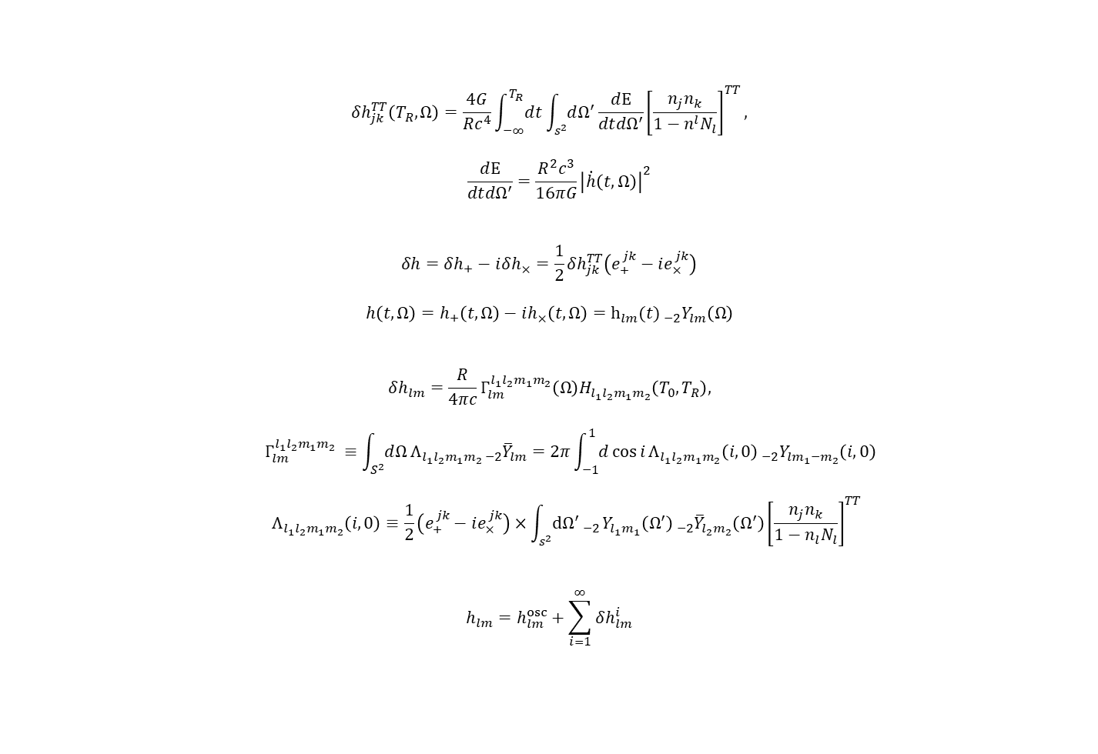
“The Equation Slide”
$$δh_{jk}^{TT}\left(T_{R},Ω\right)=\frac{4G}{Rc^{4}}\int_{−∞}^{T_{R}}{ⅆt}\int_{s^{2}}{ⅆΩ^{′}}\frac{ⅆE}{dt{dΩ}^{′}}{\left[\frac{n_{j}n_{k}}{1−n^{l}N_{l}}\right]}^{TT},$$
$$\frac{ⅆE}{dt{dΩ}^{′}}=\frac{R^{2}c^{3}}{16πG}{\left|\dot{h}\left(t,Ω\right)\right|}^{2}$$
$$δh=δh_{+}−ⅈδh_{×}=\frac{1}{2}δh_{jk}^{TT}\left(e_{+}^{jk}−ⅈe_{×}^{jk}\right)$$
$$h\left(t,Ω\right)=h_{+}\left(t,Ω\right)−ih_{×}\left(t,Ω\right)=h_{lm}{{(t)}_{ −2}Y_{lm}\left(Ω\right)}$$
$$δh_{lm}=\frac{R}{4πc}Γ_{lm}^{l_{1}l_{2}m_{1}m_{2}}\left(Ω\right)H_{l_{1}l_{2}m_{1}m_{2}}\left(T_{0},T_{R}\right),$$
$$Γ_{lm}^{l_{1}l_{2}m_{1}m_{2}} ≡\int_{S^{2}}{ⅆΩ}Λ_{{l_{1}l}_{2}m_{1}m_{2 }−2}{\overline{Y}}_{lm}=2π\int_{−1}^{1}{ⅆ}\cos{i}Λ_{{l_{1}l}_{2}m_{1}m_{2}}{\left(i, 0\right)}_{ −2}Y_{lm_{1}{−m}_{2}}\left(i,0\right)$$
$${ Λ}_{{l_{1}l}_{2}m_{1}m_{2}}\left(i,0\right)≡\frac{1}{2}\left(e_{+}^{jk}−ⅈe_{×}^{jk}\right)×\int_{s^{2}}{ⅆ{Ω^{′}}_{ −2}}Y_{l_{1}m_{1}}{\left(Ω^{′}\right)}_{ −2}{\overline{Y}}_{l_{2}m_{2}}\left(Ω^{′}\right){\left[\frac{n_{j}n_{k}}{1−n_{l}N_{l}}\right]}^{TT}$$
$$h_{lm}=h_{lm}^{osc}+\sum_{i=1}^{∞}{δh_{lm}^{i}}$$
(1)
where
(2)
where
(3)
and
(4)
(Courtesy of Talbot et al. [3])

Slide 15
Problem

Slide 16
Can we detect memory?

Slide 17
Under what circumstances can we detect memory?

Slide 18
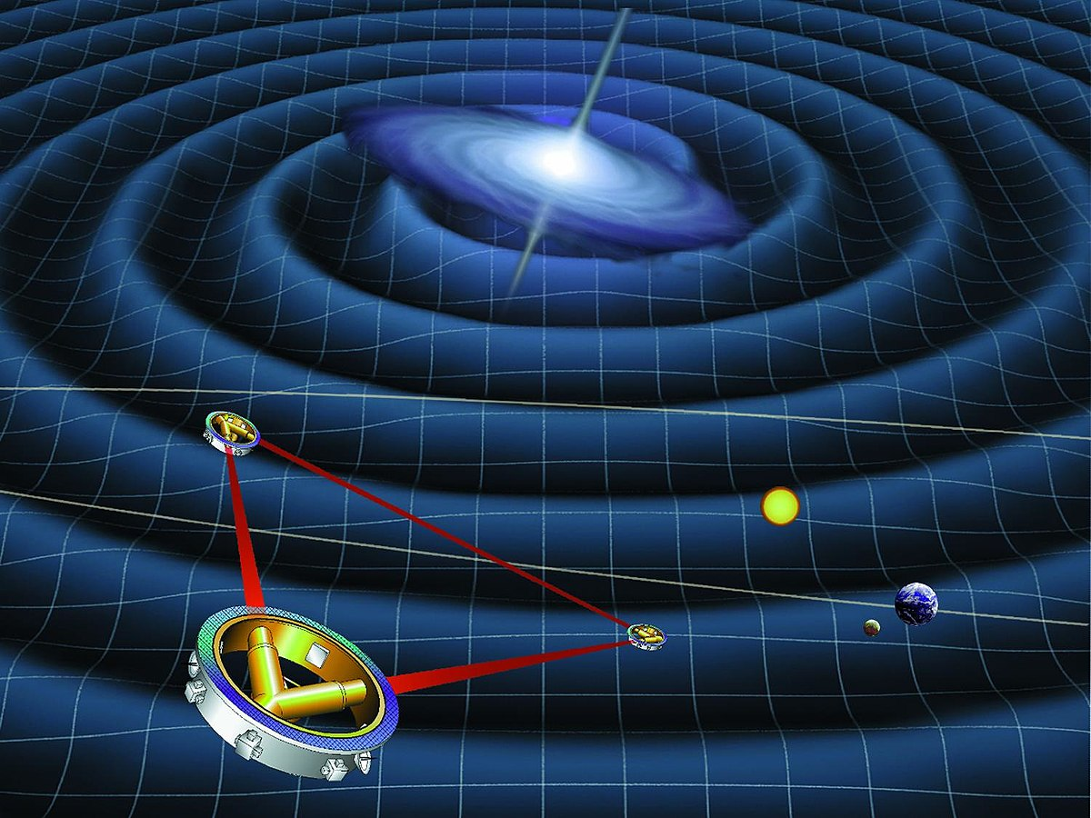
Importance
Verification of GR
Improve template bank
But, why now?
MANY new and exciting events [4]
More detectors than ever
Higher sensitivity per detector
Later…
LISA [1]
(Courtesy of NASA [5])

Slide 19
Solution

Slide 20

memory constant
$$h_{tot}=h+{λ h}_{mem}$$

Slide 21
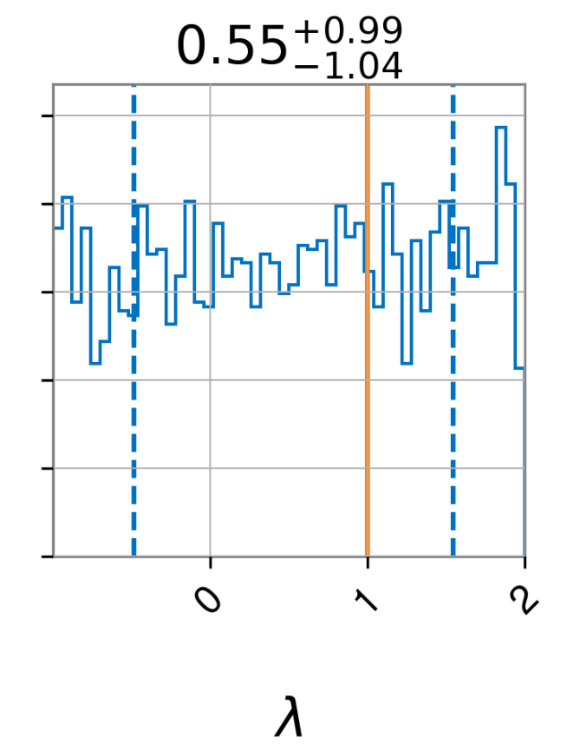
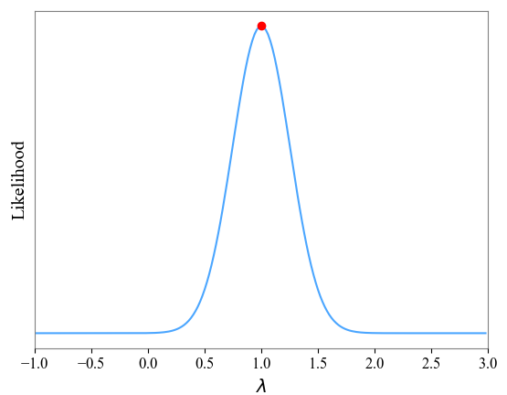
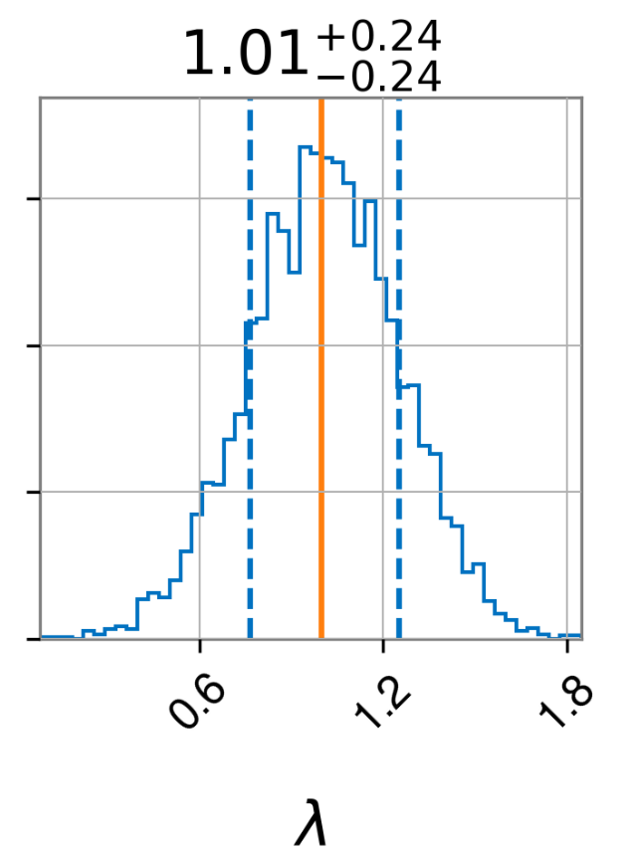

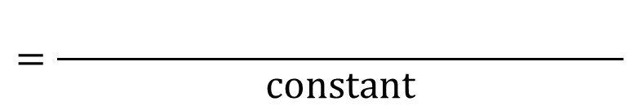



Bayes’ Theorem
$$P(H | D)=\frac{P(D | H) P(H)}{P(D) }$$
$$posterior=\frac{likelihood× prior}{evidence}$$
or
Likelihood
$$×$$
Prior
Posterior
$$=\frac{ylfkglfkfkglfkglfgkgflgkflk}{constant}$$
$$λ$$

Slide 22
Bayes’ Theorem
Prior
Data
Posterior

Slide 23
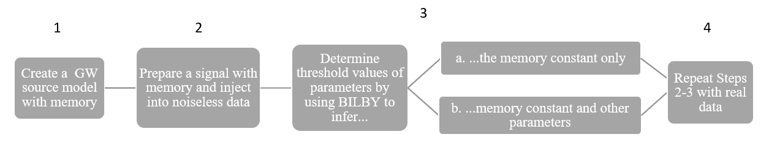
Where we began

Slide 24
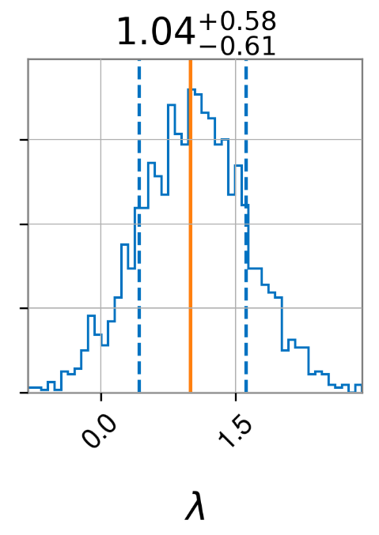
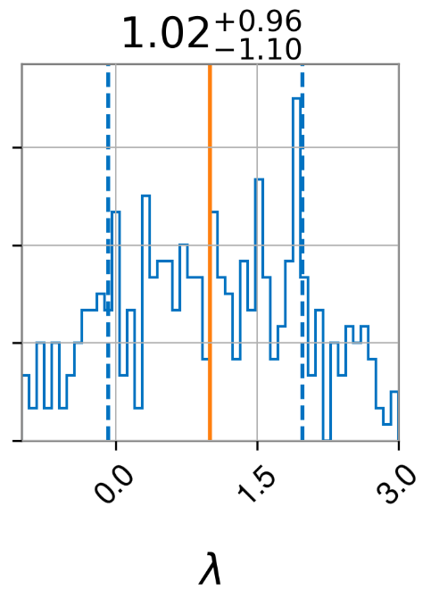
Varying Distance
Posterior
Distance
Figure 1. The injected waveform used to generate each plot is sourced by non-spinning components with $M_{tot}=60$solar masses, $q=1$, $ι=π/2$, $ψ=0,$ $φ=0$, $α=0$, $δ=0$. (Left) $d_{L}=100$ Mpc, (Center) $d_{L}=500$ Mpc, and (Right) $d_{L}=1000$ Mpc.

Slide 25
Where we are

Slide 26
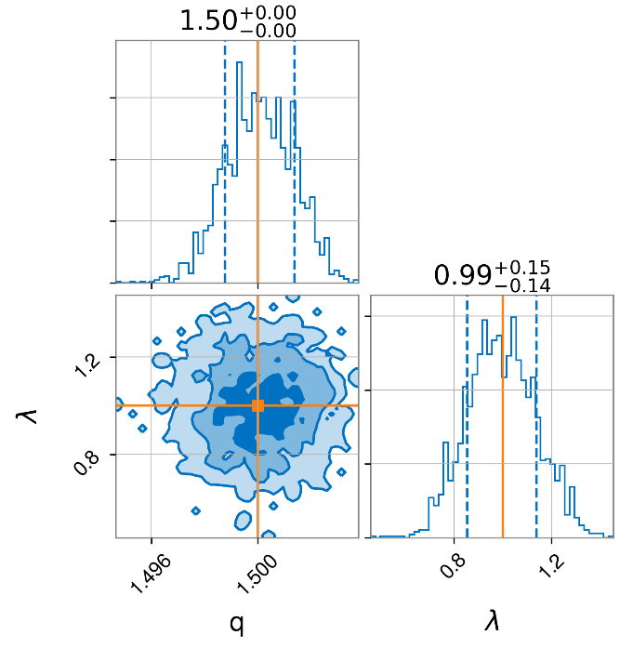
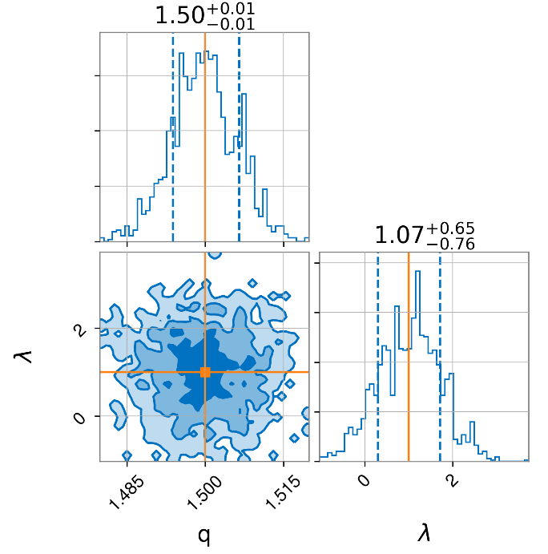
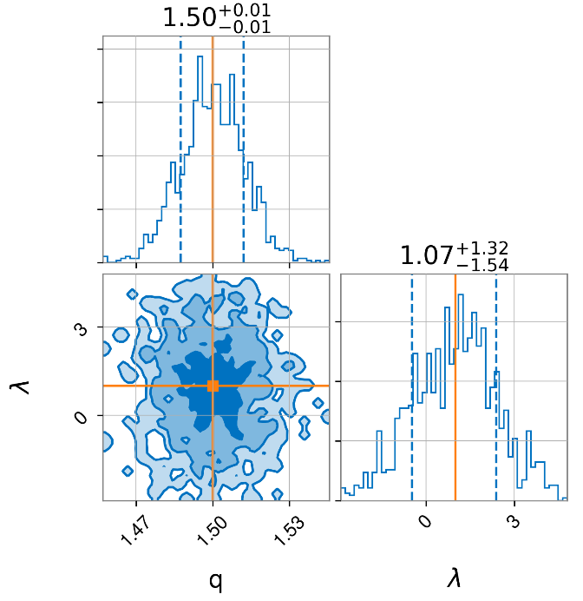
Varying Distance 2.0
Distance
Figure 3. The injected waveform used to generate each plot is sourced by non-spinning components with $M_{tot}=60$solar masses, $q=1.5$, $ι=π/2$, $ψ=0$, $φ=0$, $α=0$, $δ=0$. (Left) $d_{L}=100$ Mpc, (Center) $d_{L}=500$ Mpc, and (Right) $d_{L}=1000$ Mpc.

Slide 27
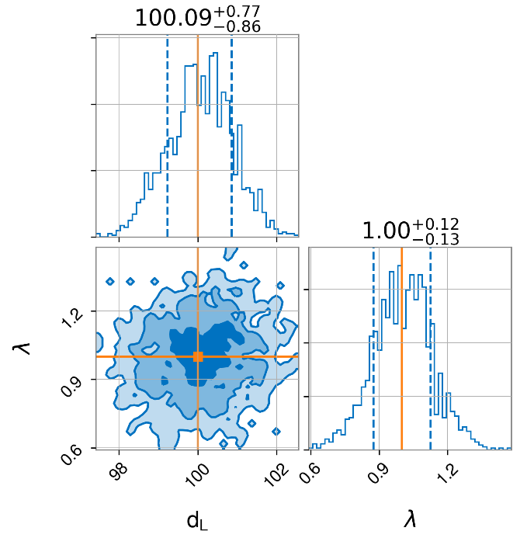
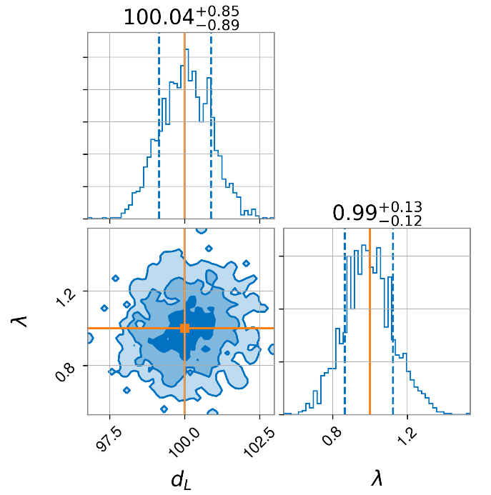
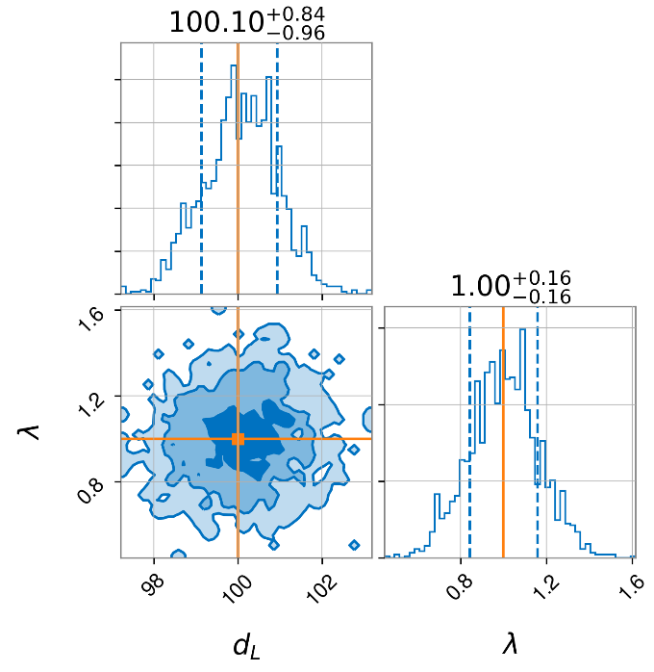
Varying Mass Ratio
Mass Ratio
Figure 4. The injected waveform used to generate each plot is sourced by non-spinning components with $M_{tot}=60$solar masses, $d_{L}=100$Mpc, $ι=π/2$, $ψ=0$, $φ=0$, $α=0$, $δ=0$. (Left) $q=1$, (Center) $q=1.5$, and (Right) $q=2$.

Slide 28
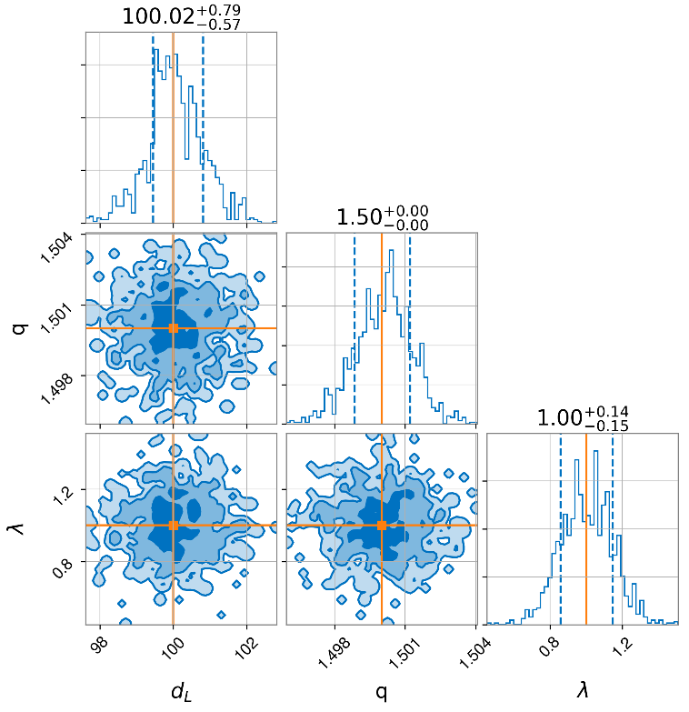
Inferencing 3.0
Figure 5. The injected waveform used to generate each plot is sourced by non-spinning components with $M_{tot}=60$solar masses, $q=1.5, d_{L}=100$Mpc, $ι=π/2$, $ψ=0$, $φ=0$, $α=0$, $δ=0$.

Slide 29

Bayesian vs. Frequentist
chi square
likelihood
$$\log\left(P\left(\left\{D_{i}{, f}_{i}\right\}|λ, H\right)\right)=−\frac{1}{2}\left[\sum_{i=1}^{n}{{\left(\frac{\left(D_{i}−\left(h_{i}+λh_{mem}\right)\right)}{σ_{i}}\right)}^{2}}+2\log\left(2πσ^{2}\right)\right]$$

Slide 30

Bayesian vs. Frequentist
$$\log\left(P\left(\left\{D_{i}{, f}_{i}\right\}|λ, H\right)\right)=−\frac{1}{2}\left[\sum_{i=1}^{n}{{\left(\frac{\left(D_{i}−\left(h_{i}+λh_{mem}\right)\right)}{σ_{i}}\right)}^{2}}+2\log\left(2πσ^{2}\right)\right]$$

Slide 31
Maximizing Likelihood
Figure 2. The injected waveform used to generate this likelihood distribution is sourced by non-spinning components with $M_{tot}=60$solar masses, $q=1$, $ι=π/2$, $ψ=0$, $φ=0$, $α=0$, $δ=0$, and $d_{L}=100$ Mpc. The red dot is the maximum computed through scipy.optimize.

Slide 32
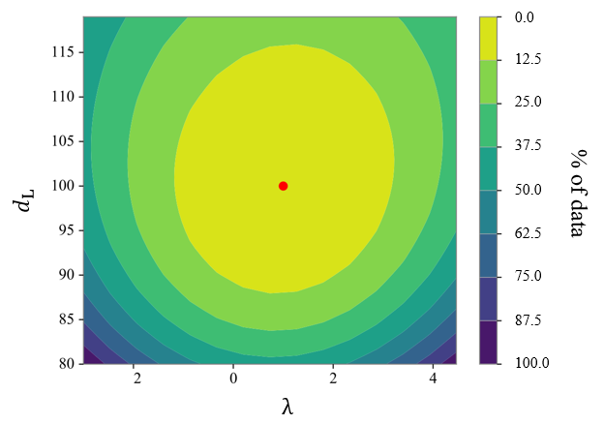
Maximizing Likelihood
Likelihood
Figure 6. The injected waveform used to generate this likelihood distribution is sourced by non-spinning components with $M_{tot}=60$solar masses, $q=1$, $ι=π/2$, $ψ=0$, $φ=0$, $α=0$, $δ=0$, and $d_{L}=100$ Mpc.
The red dot is the maximum computed through scipy.optimize. The colorbar indicates data spread rather than likelihood.

Slide 33
Next Steps

Slide 34

Next Steps
Incorporate NRSur7dq4
Explore higher dimensional
parameter spaces
Add Noise
?

Slide 35
References
[1] M. Favata. Classical Quantum Gravity, 27(8), 2010
[2] Kip S. Thorne. Phys. Rev. D, 45(2): 520-24, 1992
[3] C. Talbot et al. Phys. Rev. D, 98(6), 2018
[4] B. P. Abbott et al. Astrophys. J. Lett., 892(L3), 2020
[5] lisa.jpl.nasa.gov/gallery/lisa-waves
[6] pycbc.org
[7] iopscience.iop.org/article/10.1088/02649381/33/21/215004/meta
[8] github.com/colmtalbot/gwmemory
[9] lscsoft.docs.ligo.org/bilby/index

Slide 36
Questions?

