Slide 1
Progress Update (June 30, 2020)
Darin C. Mumma
Departments of Physics and Philosophy, Grove City College
Mentors: Alan Weinstein, Colm Talbot, Alvin K. Y. Li
LIGO Laboratory, California Institute of Technology
LIGO SURF 2020

Slide 2
Introduction
I. What I’ve completed
II. What I am working on
III. Where I plan to go next

Slide 3
Completed Tasks
In addition to attending all available GW lectures to date, I have completed…
The open data tutorials
Alvin’s written and coding problem sets
Reading up on Bayesian inference
Production of some GWMemory plots
Installation of relevant GW python packages on my Linux virtual machine
And started…
To learn how to use VIM

Slide 4
The Present
Cleaning up the GitHub Repository
Preparing my GW memory and noise plots for insertion in interim report 1
Completing interim report 1
Making NRSur7dq4 memory and waveform plotting available through GWMemory
Investigating HM’s, HM memory, and associated waveforms

Slide 5
What’s next
Adapting Bilby code with a PyCBC waveform model to include memory
and
Experimenting with the code

Slide 6
What’s next
GWMemory Plots

Slide 7

Parameters
The subsequent plots’ parameters are the following:
$M=60M_{☉}$
$q=1$
S₁ $=0$
S₂ $=0$
$d_{L}=600Mpc$
$θ=π/2$
Approximants $=$ IMRPhenomD and NRSur7dq2

Slide 8
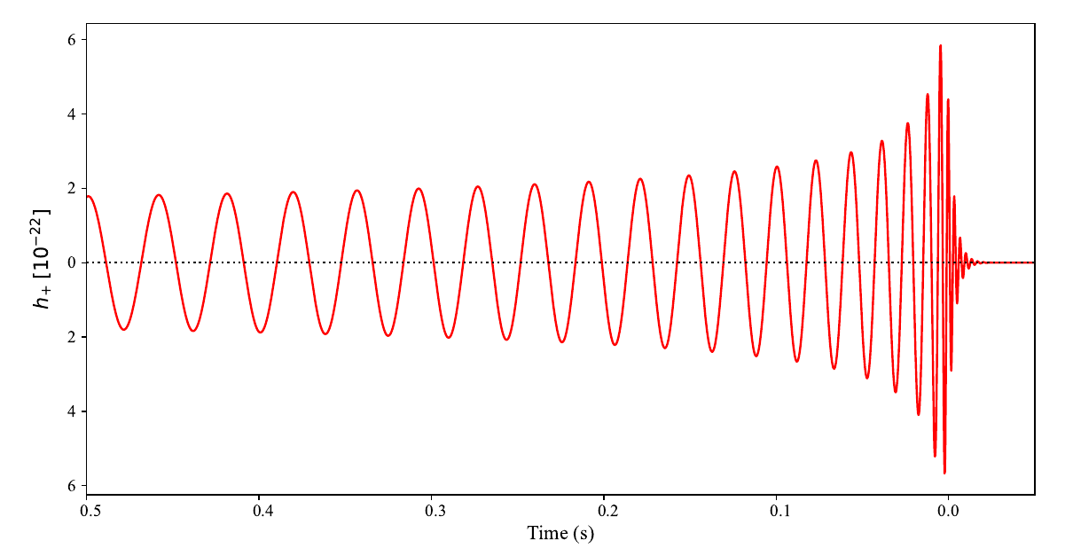
IMRPhenomD
Original Waveform

Slide 9
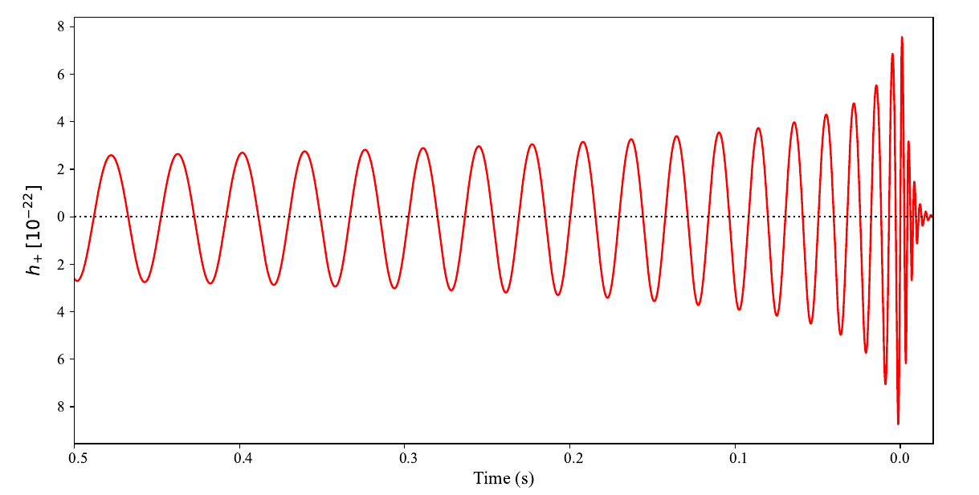
NRSur7dq2
Memory + Waveform

Slide 10
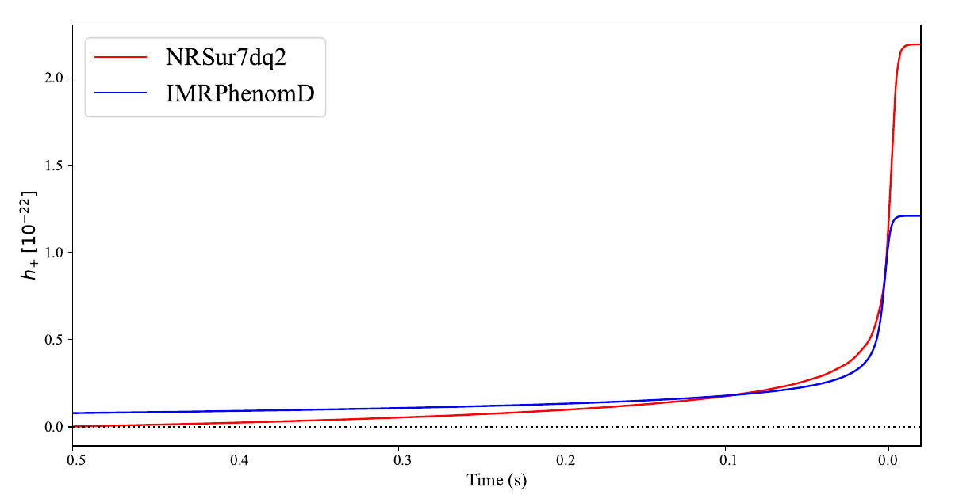
Memory
Unequal distances used!!!

Slide 11
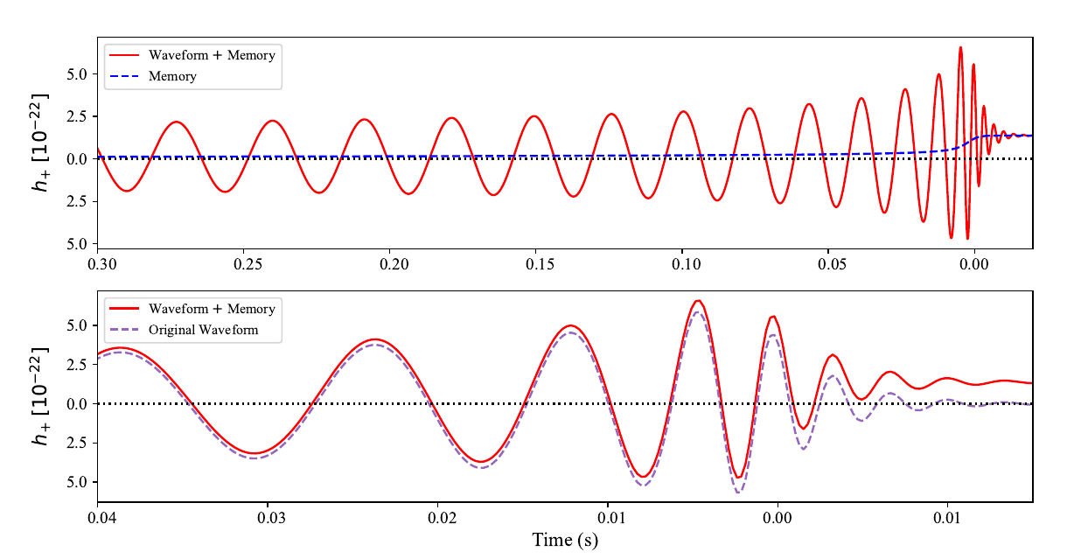
IMRPhenomD
Memory + Waveform

Slide 12
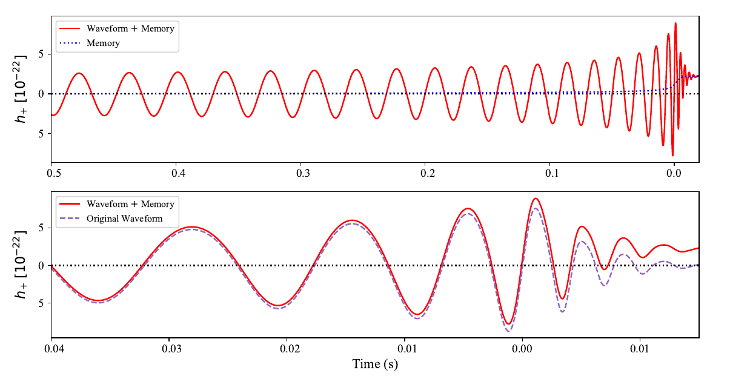
NRSur7dq2
Memory + Waveform

