Slide 1
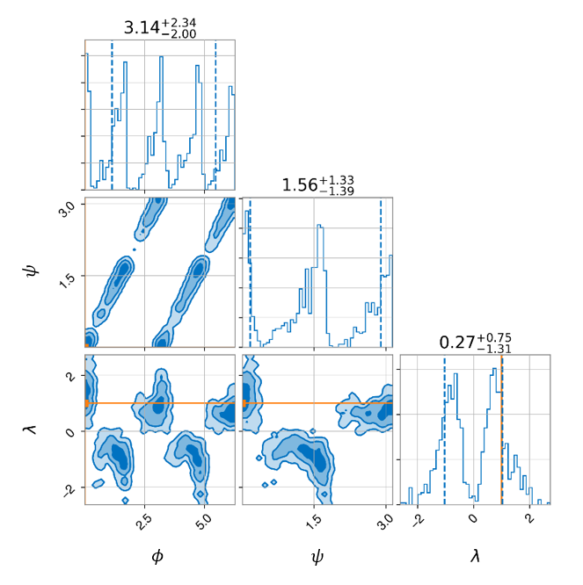
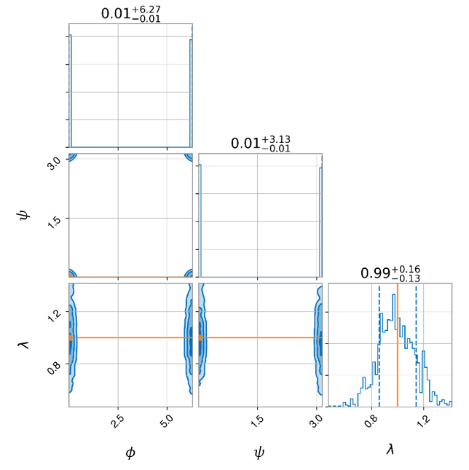
Figure 1. The injected waveform used to generate these posterior distributions is sourced by non-spinning components with $M_{tot}=60$solar masses, $q=1.5$, $ι=π/2$, $α=0$, $δ=0$, and $d_{L}=100$ Mpc. A uniform sampler with 100 live points was used for inferencing. (Left) (2, 2) mode only and (Right) all modes included.

