Slide 1

Background
Cleaning data from GMAT
Quantify differences between tether on vs. off
Eccentricity and altitude

Slide 2
Data analysis
Data manipulations within R
Orbital signalling
‘tidyverse’ package

Slide 3
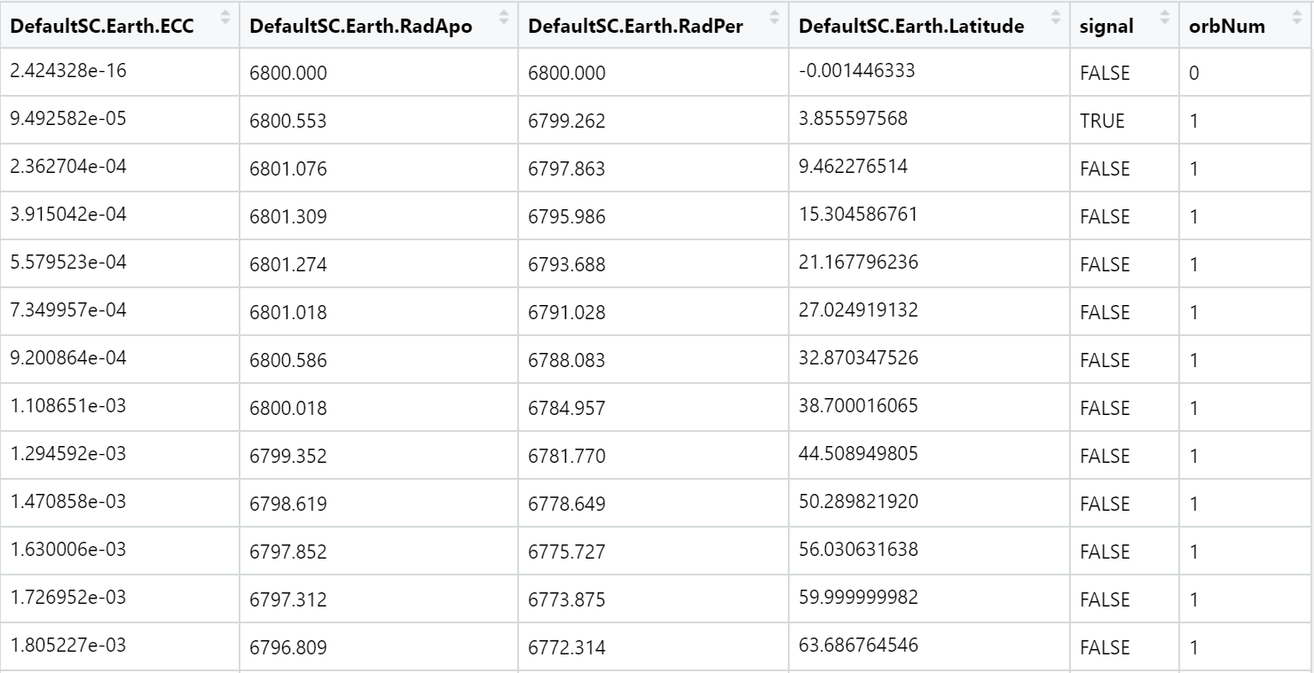
Data analysis
Data manipulations within R
Orbital signalling
‘tidyverse’ package

Slide 4
Data analysis
Data manipulations within R
Orbital signalling
‘tidyverse’ package
Nice plots!

Slide 5
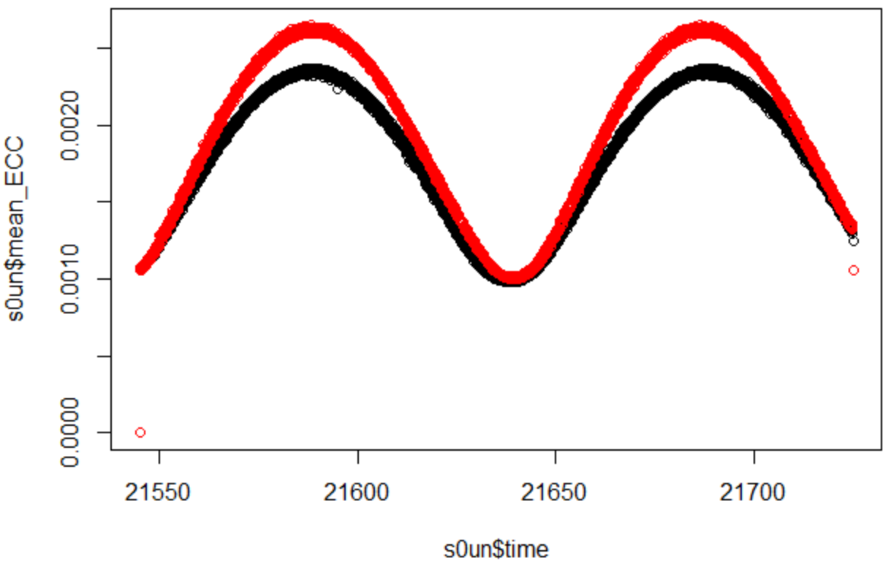
Data analysis
Data manipulations within R
Orbital signalling
‘tidyverse’ package
Nice plots
Eccentricity

Slide 6
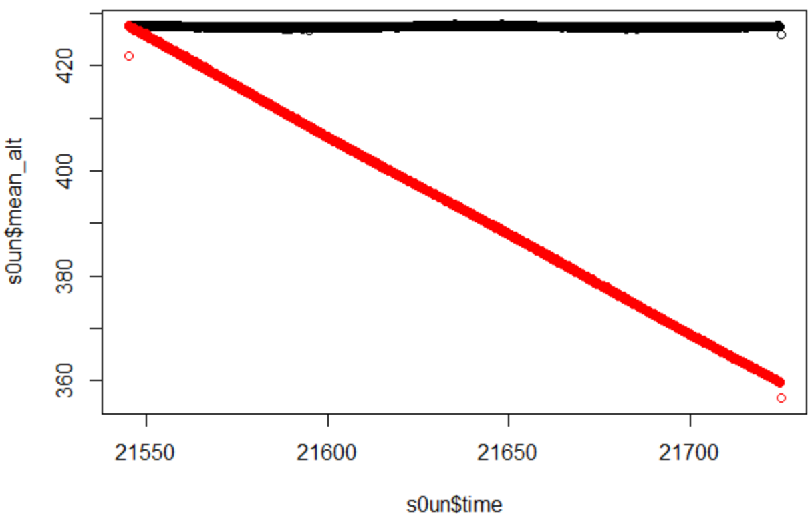
Data analysis
Data manipulations within R
Orbital signalling
‘tidyverse’ package
Nice plots
Eccentricity
Altitude

Slide 7
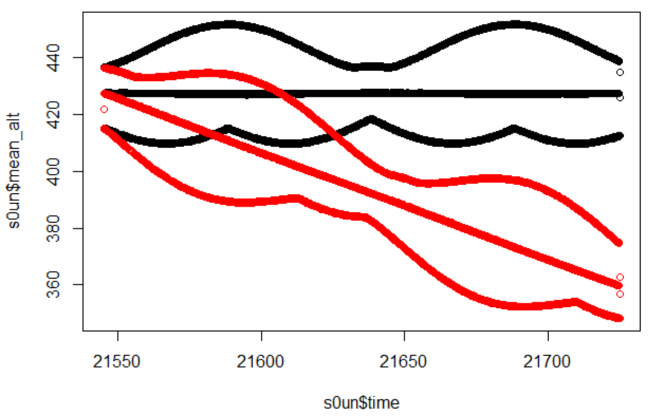
Data analysis
Data manipulations within R
Orbital signalling
‘tidyverse’ package
Nice plots
Eccentricity
Altitude
Max, mean, min

Slide 8
Next steps
Consult Darcy about orbital modelling
Why is eccentricity oscillating?
Are the difference significant?
Can we trust GMAT?
Other improvements …
Lightsail TLE’s
GMAT uncertainties
Adjusting parameters
Optimising

Slide 9
Sample Diagrams
Text here:
Build
Iterate
Test
Launch

