Slide 1
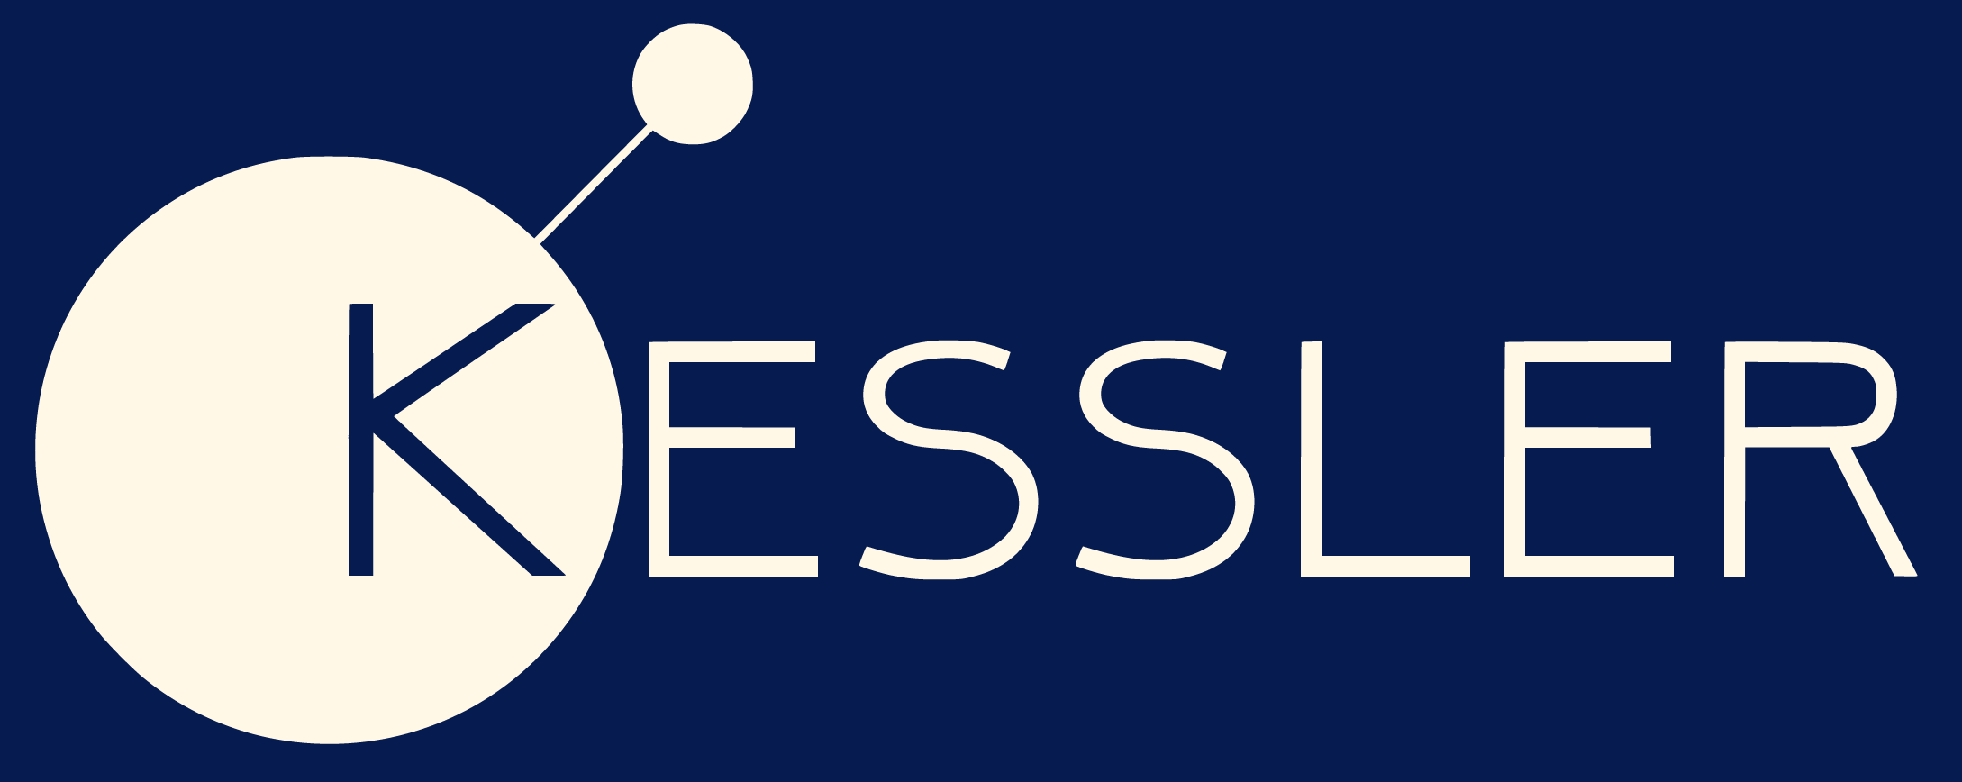
Orbital Modelling
GOAL: To figure out how much of a deviation in orbit is required for us to conclusively say the tether has worked
We think the best way to alter our orbit is to only turn the tether over one pole – we may be able to detect the significant deviation in eccentricity and perigee decline.
Currently we are using a program called GMAT to model the orbit of our CubeSat.
Although the simulations make sense for a tether that produces ~1mN of drag, Kessler will only produce 5-20uN which is far less.
Also, the eccentricity achieved for these small drag forces is only >0.01

Slide 2
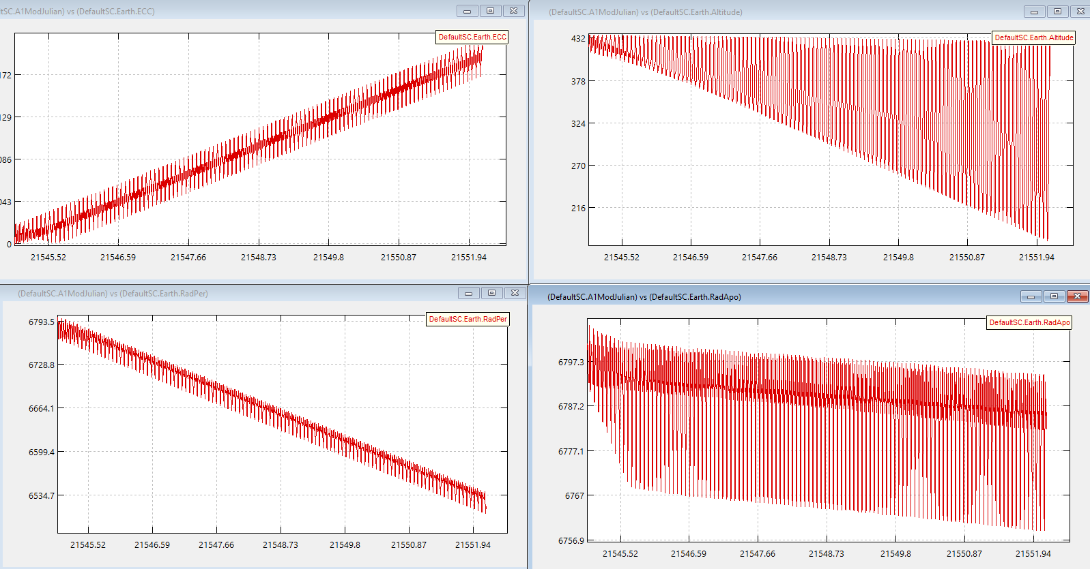
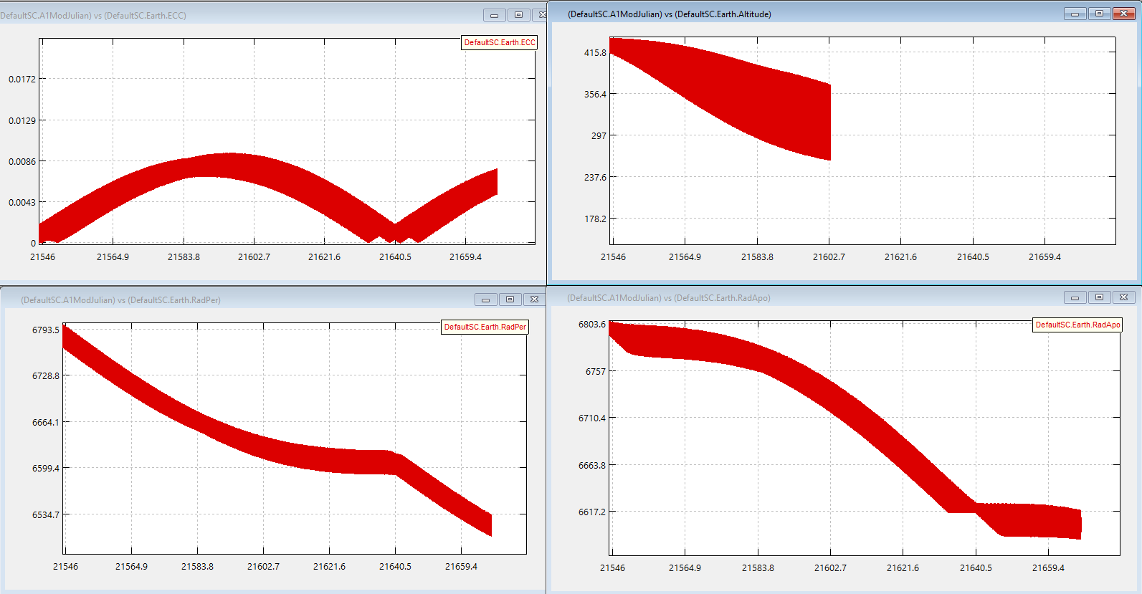
These diagrams show identical simulations for turning the tether on over only one pole, however the left uses a drag of 1mN and the right a drag of 0.1mN.
Even at 0.1mN GMAT starts giving unexpected results (and takes ages to run) – our tether will produce much less than this.

Slide 3
What to do next?
Figure out whether GMAT’s simulation for these small drag forces has any physical basis – or if they are wrong, figure out whether we can fix this.
Calculate a baseline case (not turning on tether) and compare to when we do turn on the tether.
Find out the uncertainties involved in terms of orbital prediction (simulation) and measurement. Are they small enough that we can conclusively say that our orbit has deviated from the baseline case?
Further research into whether measuring eccentricity is the best way about this – maybe other orbital characteristics may be more suitable

