Slide 1

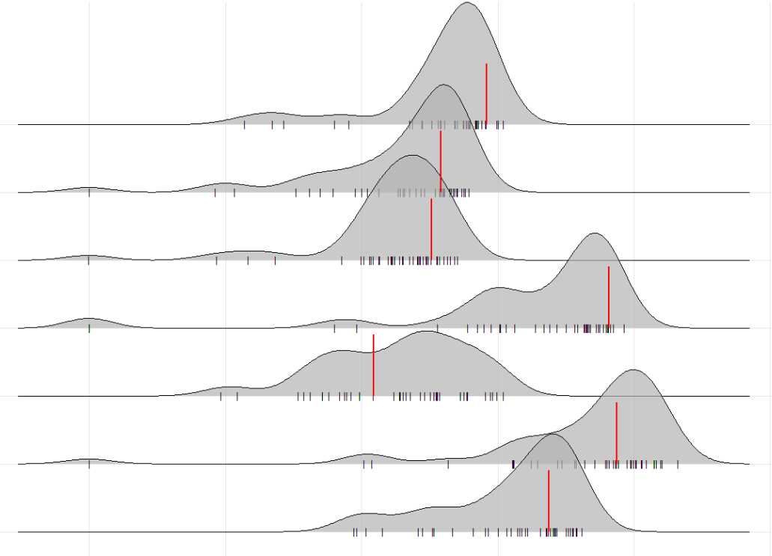
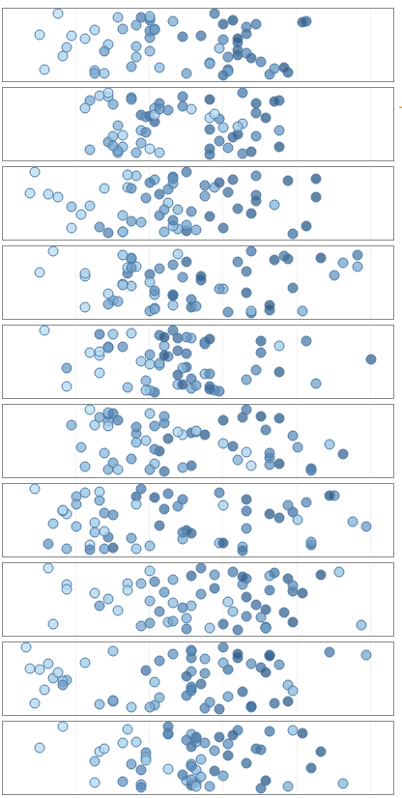
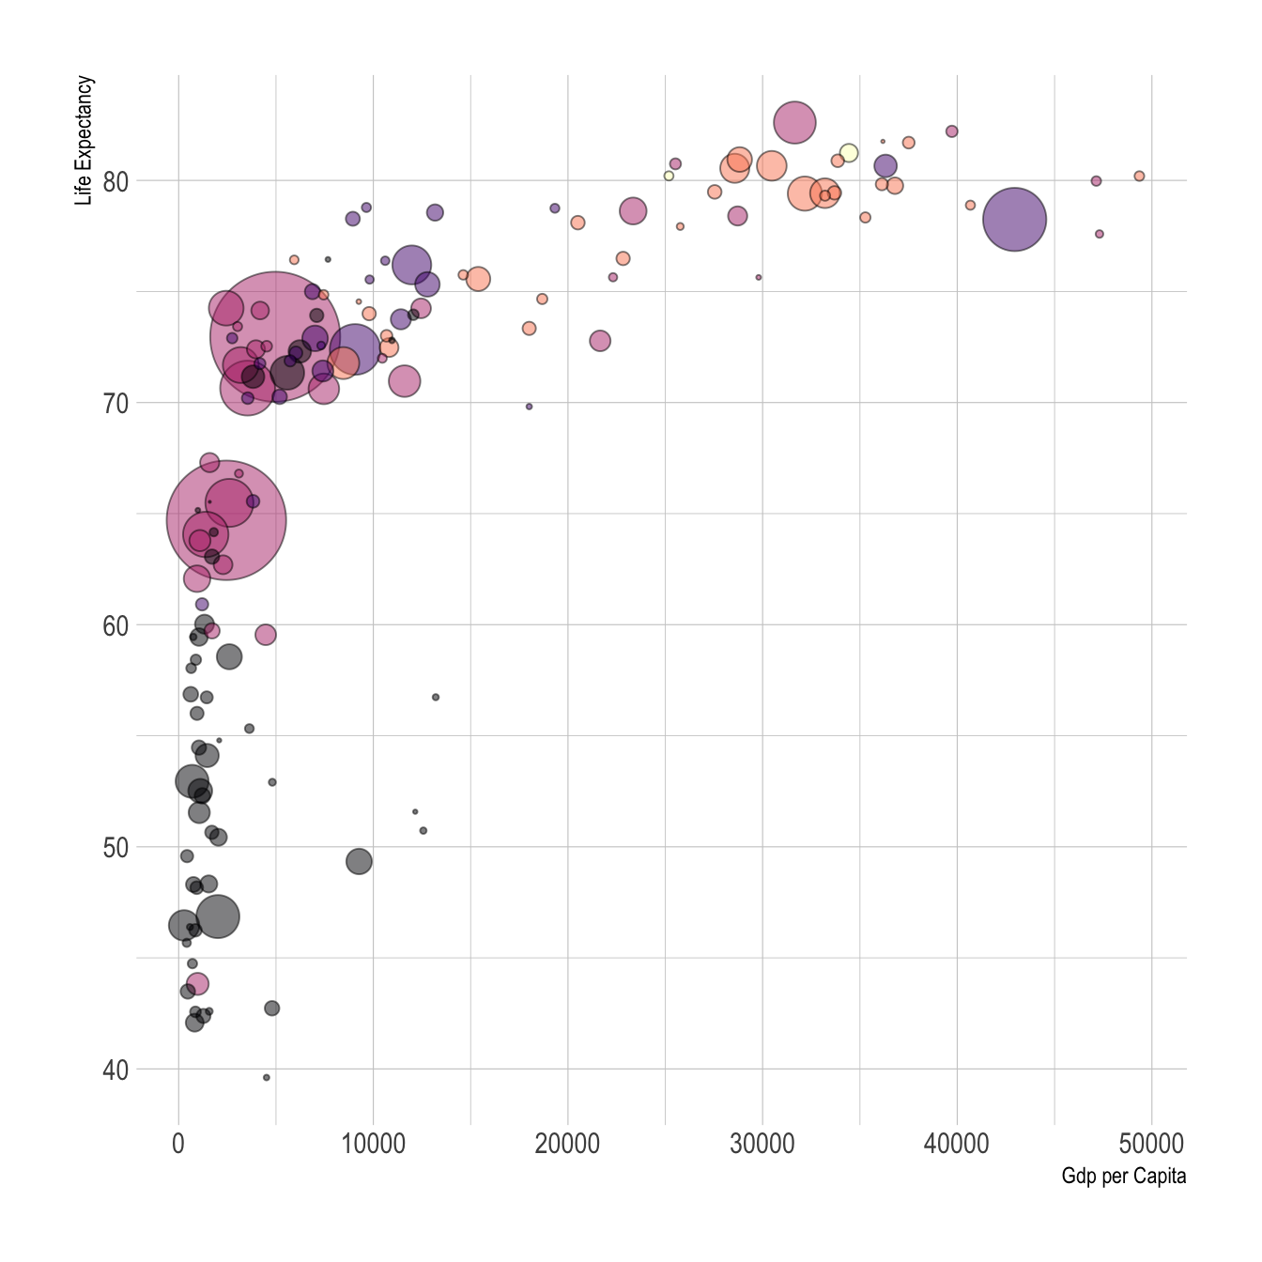
The Legends of League
An exploration of the most influential players in the history of professional League of Legends
League
Role
Team
Or search for a player
All
All
All
Players are clickable
400
Faker
462
Deft
405
Metrics:
Wins
Games played
Kills
Deaths
Assists
Time in game
Damage dealt
Gold earned
Total CS
First bloods
Penta kills
Bang
393
Metric
350
Karsa
365
Wins
300
2014
2016
2018
2020
2021
K+D/A
Win Rate
These ones are averaged metrics
Something like this,
No red line,
Probably dots or something (like a jitter plot?)
Clickable.
Maybe a drop down to select what to view
Metrics:
Kills per game
Deaths per game
Assists per game
KDA
Win rate
DPM
Damage Share
CSPM
CSD @ 15
XPD @ 15
GD @ 15
GPM
Gold Share
First blood rate
Wards per minute
Damage taken per minute
Kill participation
Game length
Vision score
Champion pool depth
DPM
Damage Share
CSPM
Gold Share
CSD @ 15
Maybe something like this…
Notes:
Help:Leaguepedia API - Leaguepedia | League of Legends Esports Wiki (gamepedia.com)

Slide 2
Faker
Most Played Champions
100
W73:L32
50
Name | Lee Sang-hyeok (이상혁)
Birthplace | South Korea
Birthday | May 7, 1996 (age 24)
Residency | Korea
Current Team | T1
Current Role | Mid
10
Azir
Ryze
Orianna
Galio
Corki
LeBlanc
Cassiopeia
2014
Team History
2021
2016
2018
2020
SK Telecom T1
T1
Average Career Statistics
3.6
(5th)
These ones are averaged metrics
Maybe a drop down to select what to view
Metrics:
Kills per game
Deaths per game
Assists per game
KDA
Win rate
DPM
Damage Share
CSPM
CSD @ 15
XPD @ 15
GD @ 15
GPM
Gold Share
First blood rate
Wards per minute
Damage taken per minute
Kill participation
Game length
Vision score
Champion pool depth
K+D/A
60%
(5th)
Win Rate
404
(5th)
DPM
36%
(5th)
Damage Share
11.3
(5th)
CSPM
30%
(5th)
Gold Share
+12
(5th)
CSD @ 15
Cumulative Statistics
Maybe not a graph
Maybe just cards
Or even just added to above
400
Assists: 387
Kills: 387
Select Metrics:
Wins
Games played
Kills
Deaths
Assists
Time in game
Damage dealt
Gold earned
Total CS
First bloods
Penta kills
Select Metrics
350
Deaths: 387
Kills + 2 more
300
2014
2016
2018
2020
2021

