Slide 1


AGENTIC APP WORKSHOP
AGENTIC APP
WORKSHOP
USACS Tech Committee · Workshop 1
Notes:
Welcome people in. This is USACS Tech Committee, workshop 1. They leave with a working campus agent. Theme is the Slidesgo AI in Marketing XL template (Orbitron titles, Darker Grotesque body).

Slide 2


YOU BUILD
BUILD
You add tools to a real app.
You watch the agent call your code.
You do not sit through a lecture.
Notes:
Set the contract. Pair people with slow laptops. Ask who has never used an API key and tell them that is fine.

Slide 3
TABLE OF CONTENTS
01
02
03
PROBLEM
THE LOOP
TOOLS
04
05
06
BUILD
FINAL BOSS
SHIP IT
A real Rutgers question
Think, act, observe
Functions the model can call
Dining, buildings, GPA
Course + food on Busch
What you walk out with
Notes:
Two minutes. Tonight is not a theory talk. They will run an app, then write tools.

Slide 4

THE
PROBLEM
01
Start with something they actually want answered.
Notes:
Pause. Then read the prompt on the next slide out loud.

Slide 5
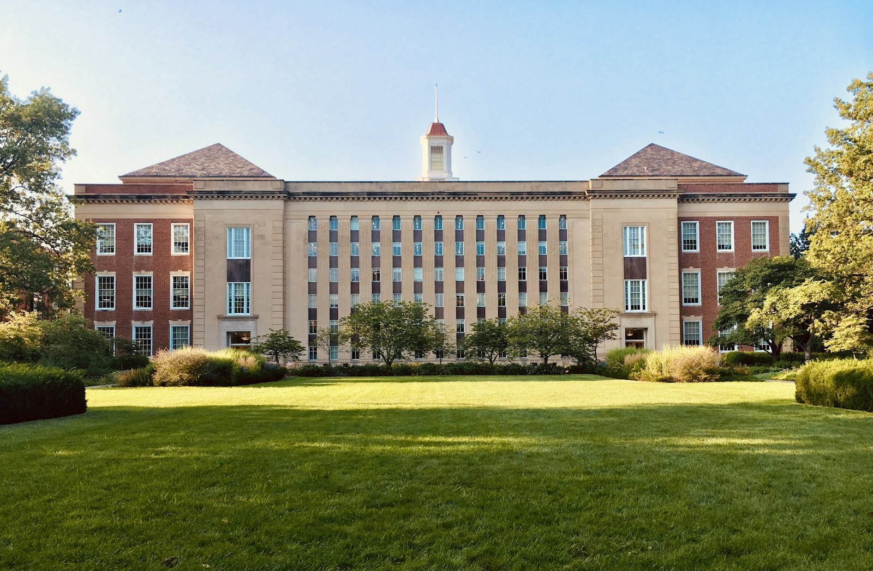
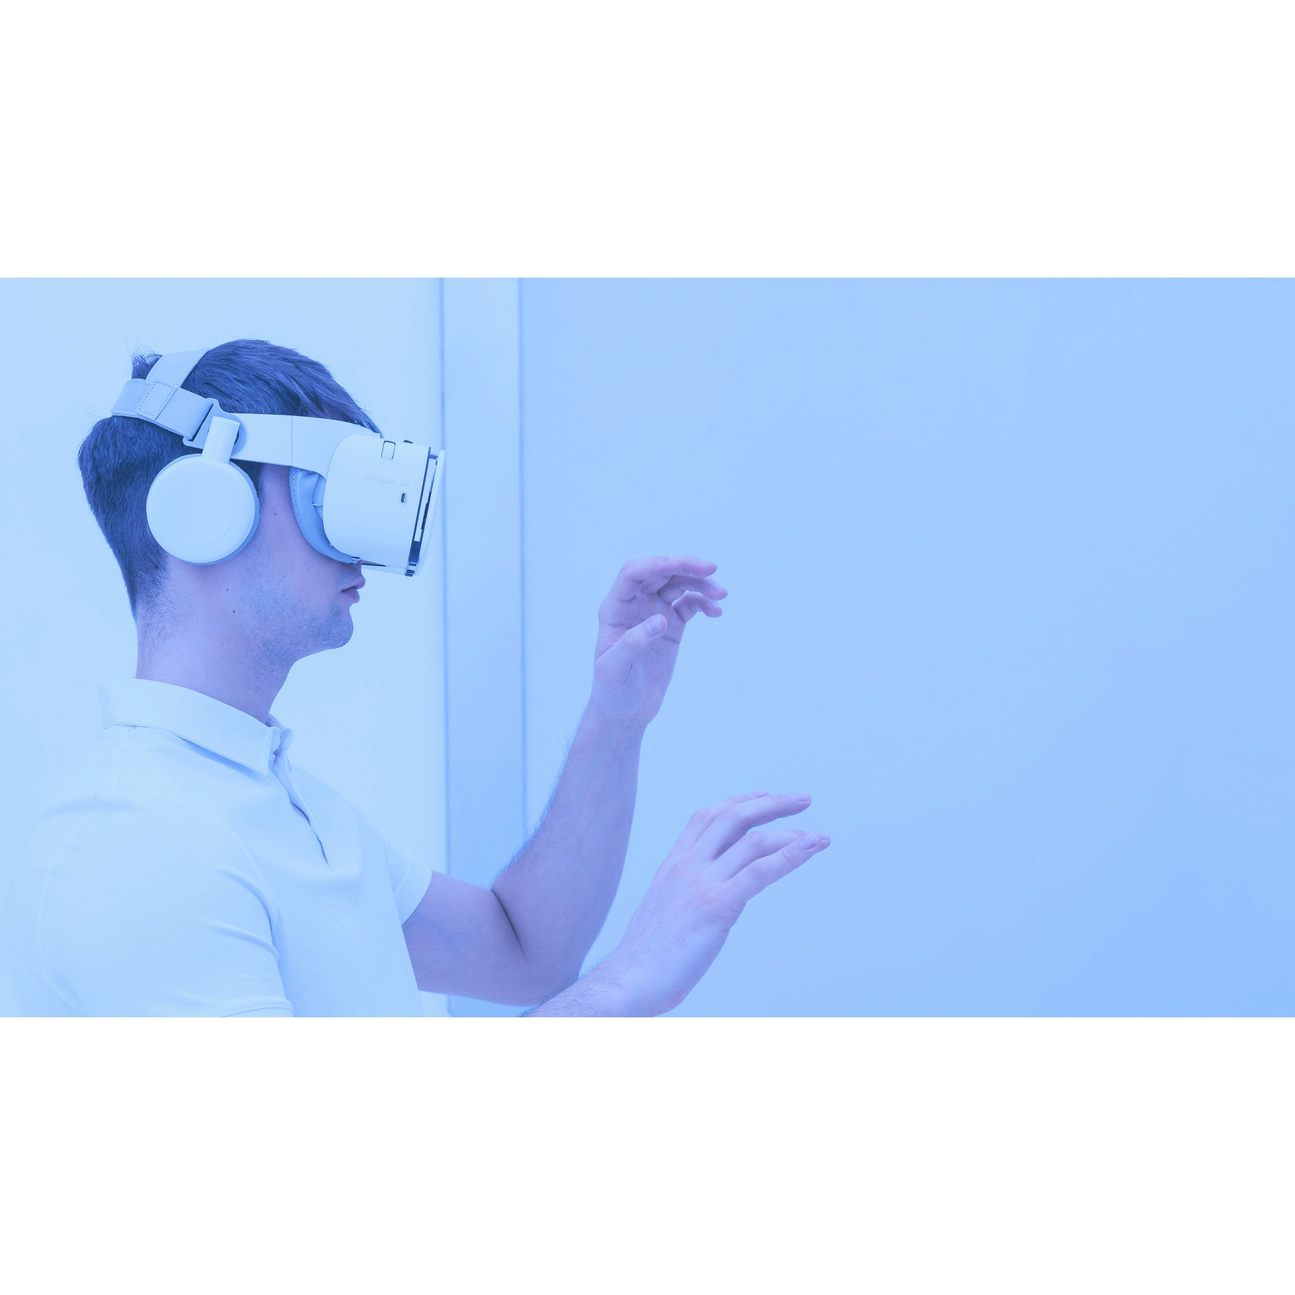
A REAL RUTGERS QUESTION
CS112 tomorrow. Food on Busch after.
Find the course. GPA for A, B+, and B. Dining nearby.
Raise a hand. Could a normal chatbot actually do this?
Yes: it can sound confident.
No: it cannot look anything up unless you give it tools.
5
Notes:
Read the prompt out loud. Take a real vote. This prompt is the north star for the Final Boss.

Slide 6
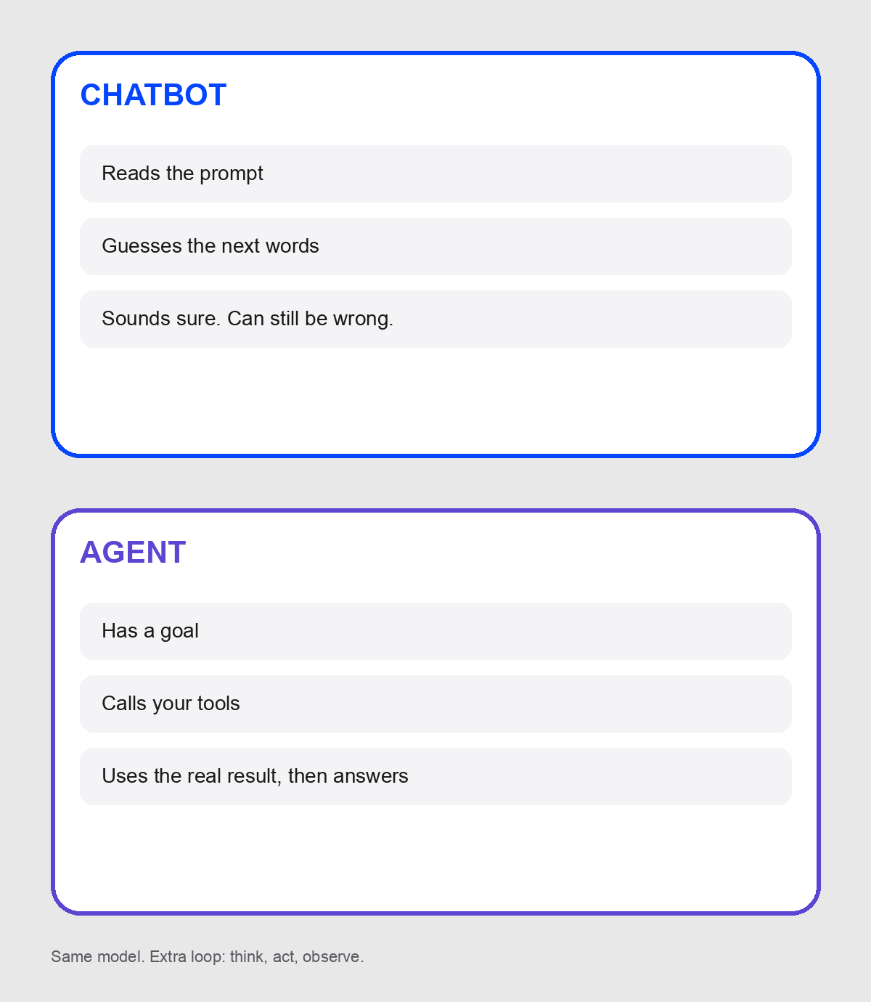

WHY AN AGENT, NOT A CHATBOT
6
A chatbot predicts words. An agent has a goal, calls your code, and keeps going.
Notes:
Walk the picture. Chatbot path is guess text. Agent path is call a tool, then use the real result. That is the whole why.

Slide 7
THINK ACT
THINK
7
ACT
Notes:
Think. Act. Observe. Repeat until you can answer. Same loop as Cursor, support bots, and research agents. Tonight it is Rutgers.

Slide 8
TOOLS ARE FUNCTIONS IT CAN CALL
CS112
BUSCH FOOD
GPA
8
getCourseInfo
findDining
calculateGrade
Notes:
The model picks a name and arguments. Your TypeScript runs. If it is not in the tools array, the agent cannot call it. Building and events work the same way.

Slide 9
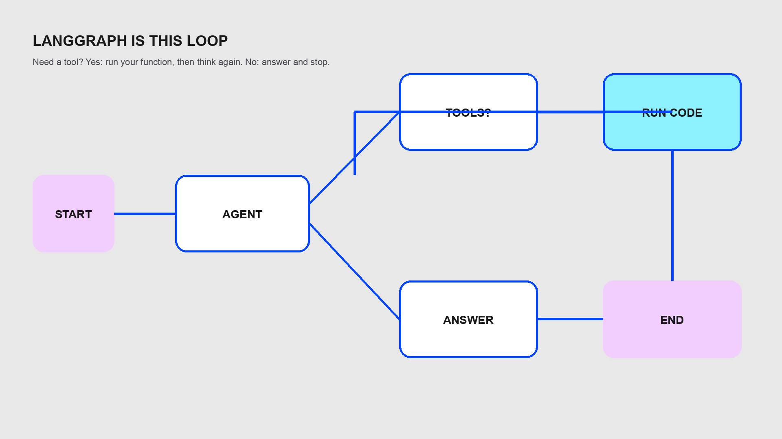

LANGGRAPH IS THIS LOOP
9
Notes:
Do not teach the LangGraph API. Teach the picture. START to agent. Need a tool? Yes goes to run code and back. No goes to answer.

Slide 10
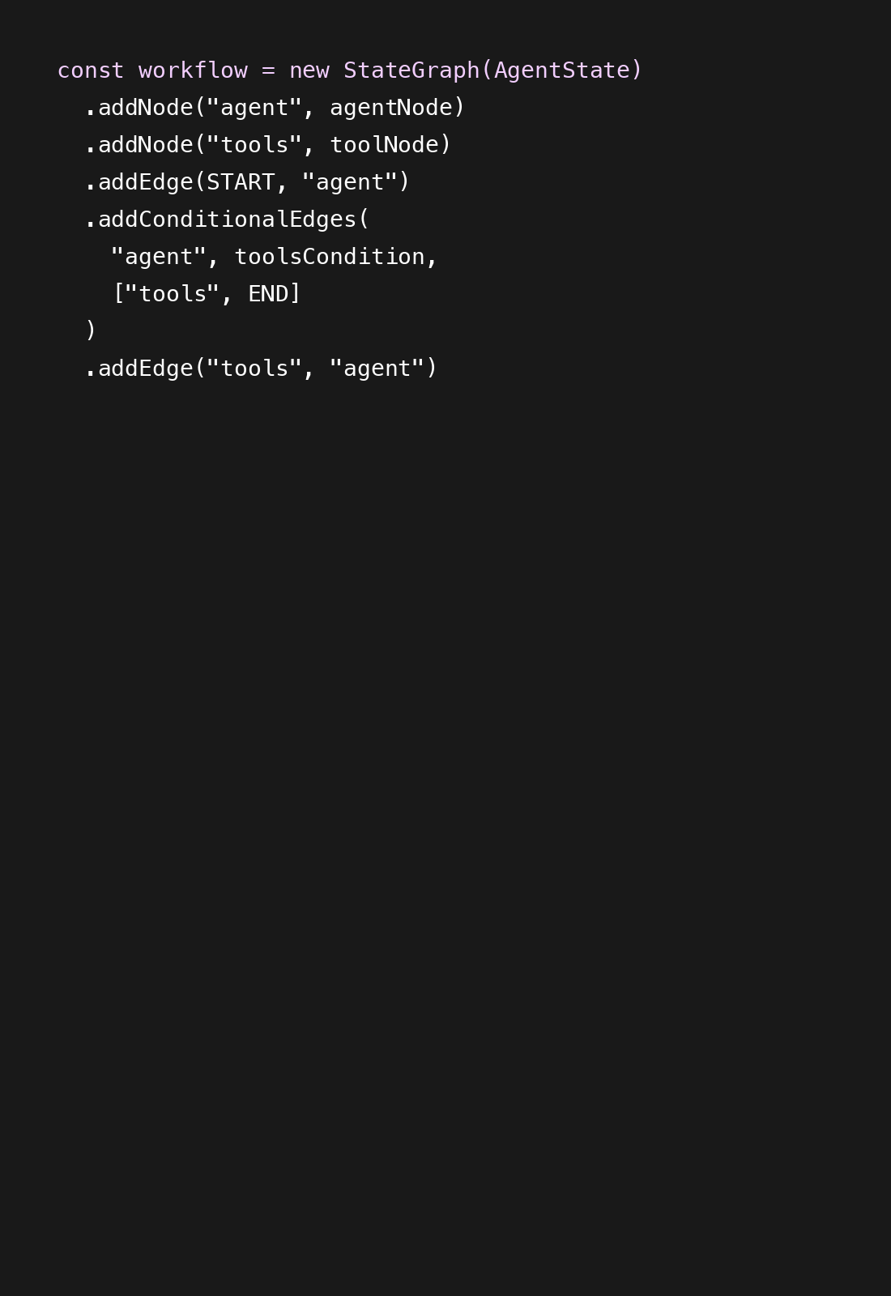

THE SAME LOOP IN GRAPH.TS
Read it. You do not have to write it.
START goes to agent.
toolsCondition is yes or no on tool_calls.
tools then back to agent.
That is tonight’s LangGraph.
10
Notes:
Walk line by line. This is the same picture they just saw, in code.

Slide 11


THE APP IS BUILT. YOU ADD SKILLS.
11
Live in agent/tools.ts. data/ has courses, dining, buildings, events. Ignore the rest until a tool works.
Notes:
Anxiety reducer. They will not write Next.js streaming. Click tools.ts. Point at export const tools = [getCourseInfo].

Slide 12

START THE APP
02
cp .env.example .env.local then ./run.sh
Notes:
Walk the room. Google AI Studio keys. Do not share one key for 50 people. Bypass starts the UI but chat will fail until a key exists.

Slide 13
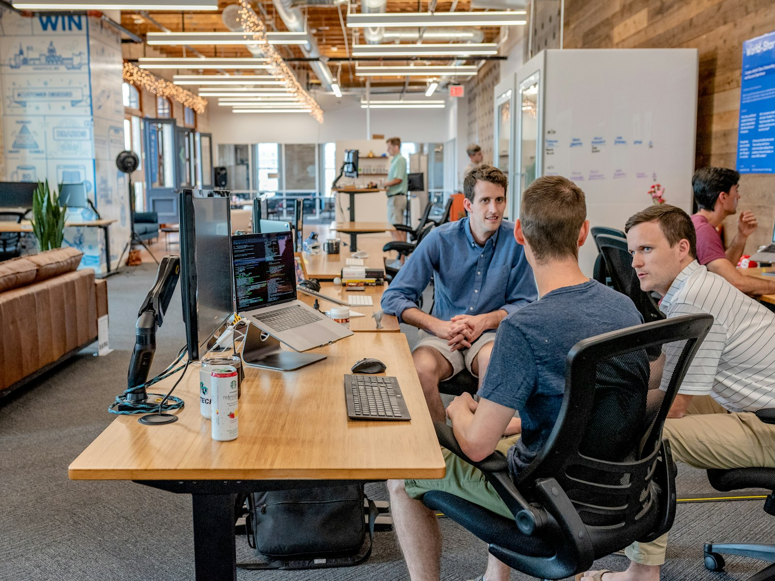
CHALLENGE 1 WATCH A TOOL FIRE
Ask: What is CS112 and where is it usually taught?
Want getCourseInfo in the log and a course card in chat.
This tool is already done.
Copy later: body, name, description, schema.
JSON.stringify keeps Gemini happy.
13
Notes:
Give 3 minutes. If a tool never appears, it is not registered.

Slide 14

THE RIGHT PANEL IS LANGGRAPH
REQUEST
DECIDE
CALL
ANSWER
Request received
Agent deciding
14
Calling getCourseInfo
Response generated
Notes:
If a tool never appears, it is not registered. If it errors, their function threw or returned bad JSON. Debug the log first.

Slide 15
CHALLENGE 2 GIVE IT DINING
15
Ask: Where can I eat on Busch? Import searchDining. Return kind: dining. Add findDining to the tools array.
Notes:
This is the aha. Same app, missing skill. Give 10 minutes. Two bugs: forgot the import, forgot the array. Do not show the answer key until most people have tried.

Slide 16
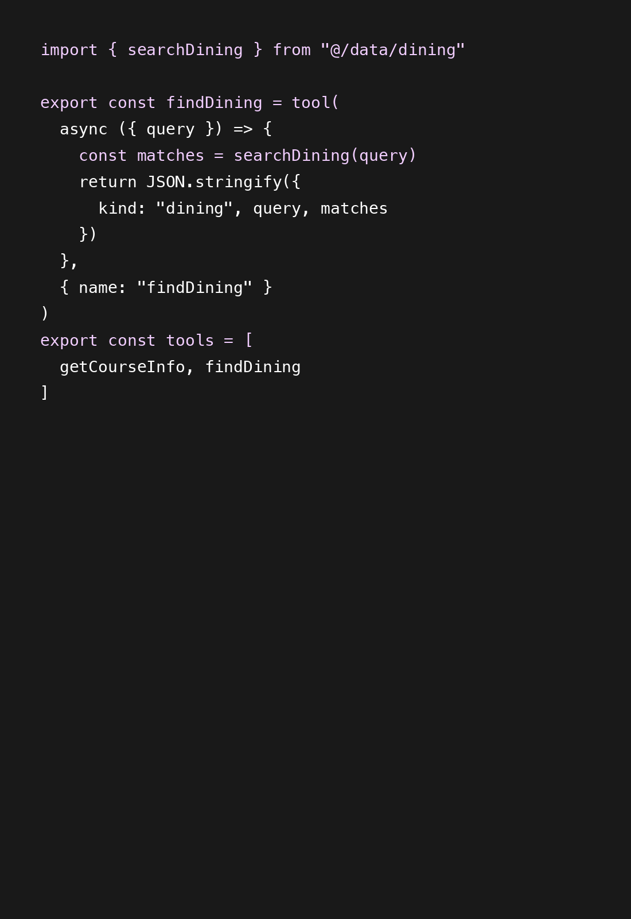
ANSWER KEY FIND DINING
Reveal after they attempt it.
searchDining already filters.
The last line is half of the bug reports.
findBuilding is the same shape.
16
Notes:
Leave this up while they catch up. The last line is half of the bug reports.

Slide 17
THEN GO FURTHER
BUILDING
EVENTS
GRADE
BREAK IT
Nicknames like Hill and CORE.
Filter by CS or campus.
17
Parse A, B+, B into a GPA.
Leave it out of the tools array.
Notes:
Same pattern as dining. Fast people do building and events. Grade is needed for the Final Boss. Normalize failure: I implemented it and forgot the array.

Slide 18
FINAL BOSS
18
CS112 tomorrow. Food on Busch after. Course info. GPA for A, B+, B. Dining nearby. A complete agent calls all three.
Notes:
Bring the room back. Run this on a volunteer laptop. Narrate the log. If a tool is missing, the agent uses the ones it has.

Slide 19
WHAT YOU BUILT
LLM
TOOLS
LANGGRAPH
UI
Decides which action to take.
Give the agent real capabilities.
19
Runs the request, tool, result loop.
Turns JSON into cards you can see.
Notes:
Have the room say it back. You do not need to know everything. You built something real. You can build the next thing. That is the USACS Tech Committee bar.

Slide 20
THANKS
THANKS
Stay for help. Keep building.
github.com/TheAryanAnode/
Agentic-App-Workshop-USACS
USACS Tech Committee
Please keep this slide for attribution
Notes:
Leave this up during Q and A. Solution branch has completed tools. Remind them not to commit .env.local. Keep this slide: Slidesgo free license requires attribution.

