Slide 1

YOUTUBE SPAM DETECTION
Artificial Intelligence for Cybersecurity
Antonio Osele

Slide 2


TABLE OF CONTENTS
01
04
Goal of the project
Classification
02
05
Data cleaning
Validation
03
06
Data analysis
Conclusions
Detecting spam messages
from YouTube comments
Use different algorithms
to classify the data
Import, clean and
preprocess the data
Evaluate the results with the
Stratified K-Folds cross-validator
Analyze the data to
understand it better
Project outcome and
possible improvements

Slide 3

YOUTUBE SPAM
YouTube comments are known for having lots of spam, ranging from self advertisement or irrelevant messages to straight up phishing and scam attempts. The goal of the project is to train a model able to detect such comments.

Slide 4

ABOUT THE DATASET
The dataset^{[1]} contained 1956 instances of real comments extracted from five of the most viewed videos on YouTube. Each instance was labeled as spam or ham. Other attributes are: comment ID, author, date.
^{[1]} https://archive.ics.uci.edu/ml/datasets/YouTube+Spam+Collection

Slide 5


DATA CLEANING
IMPORT
CLEAN
PREPROCESS
Import and concatenate
the datasets
Remove unnecessary
features
Add more useful
features

Slide 6



DATA ANALYSIS
HISTOGRAMS
HEATMAP
WORD CLOUD

Slide 7

DATASET DISTRIBUTION
Balanced data
The raw dataset was already fairly balanced. After the 70/30 split of training and testing data, the ratio between spam and ham doesn’t change very much.

Slide 8
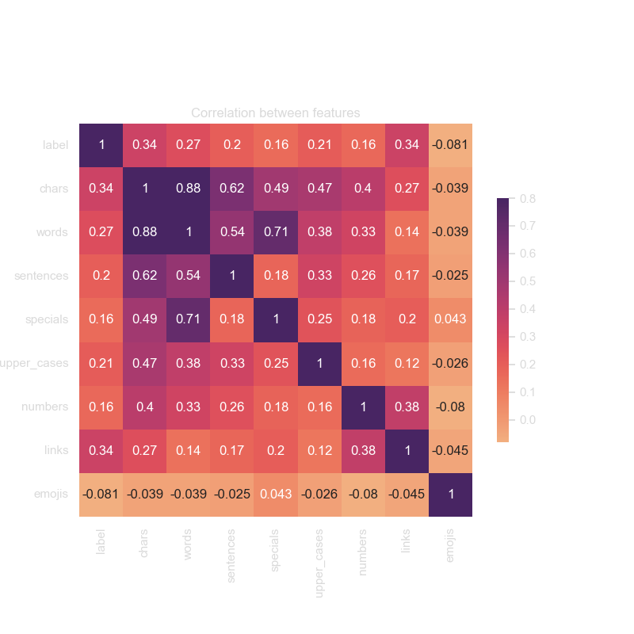
FEATURE CORRELATION
Links and emojis
Character count and links are more prevalent in spam, whereas emojis are slightly less present.

Slide 9
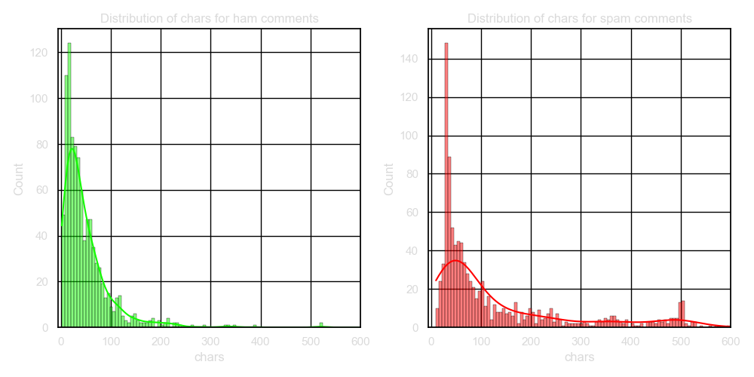
FEATURE DISTRIBUTION
Long comments
Ham comments are on average 200 characters or less. Spam comments instead tend to be longer, with a secondary peak at around 500 characters.

Slide 10
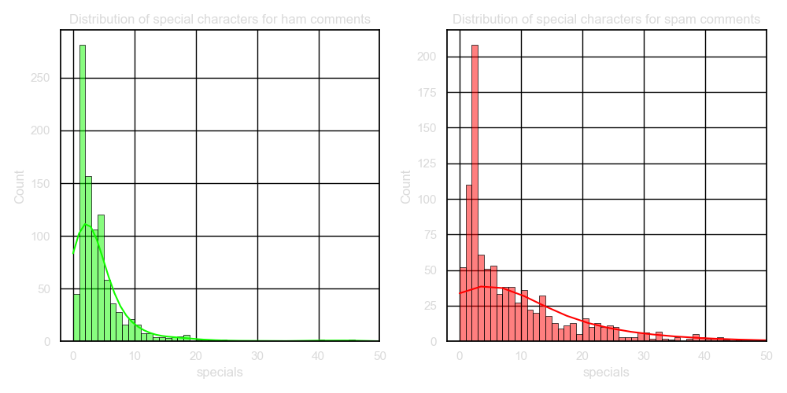
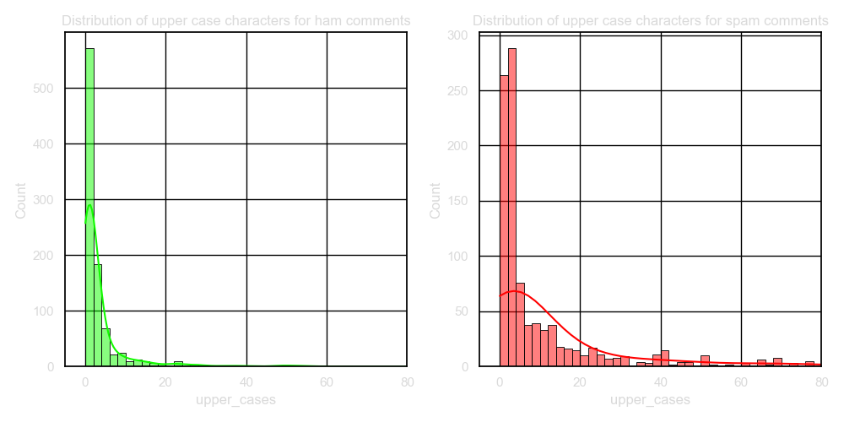
FEATURE DISTRIBUTION
Other characters
Something similar can be observed with the distribution of special and upper case characters, being more spread out in spam comments than in ham.

Slide 11
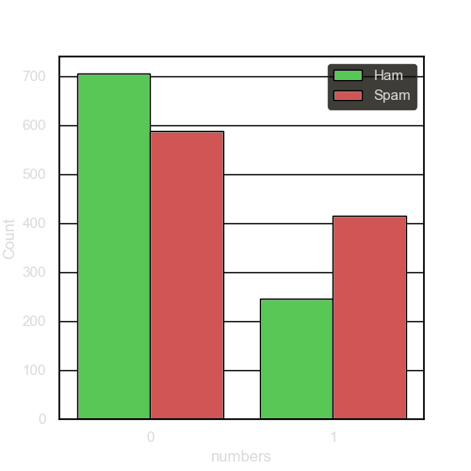
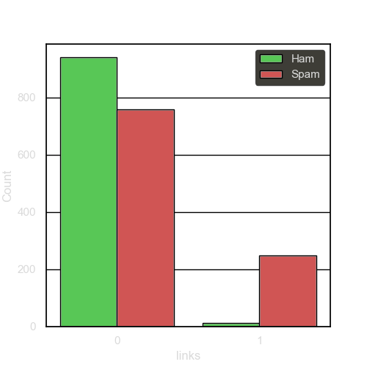
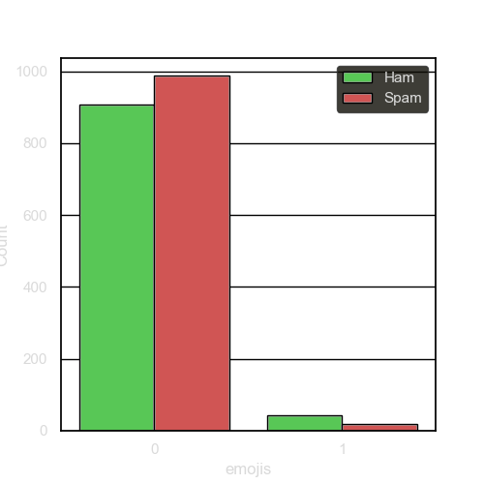
FEATURE DISTRIBUTION
Feature presence
Here we can see how spam are more likely to contain numbers and links. At the same time they don’t have as much emojis.

Slide 12
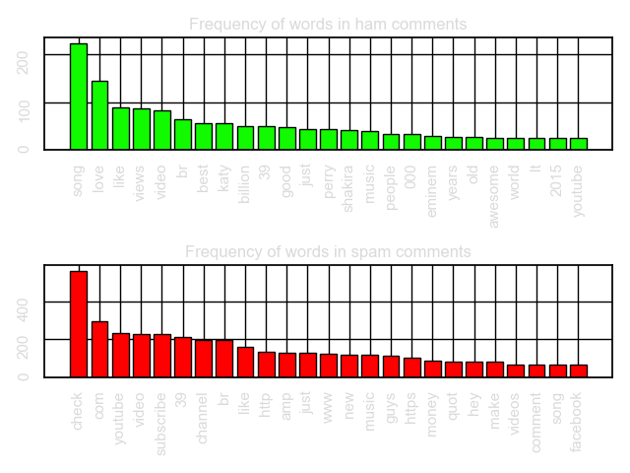
WORD FREQUENCY
Common words
It’s easy to see that ham comments engage normally with the video while spam comment are mostly self advertisement or phishing.

Slide 13
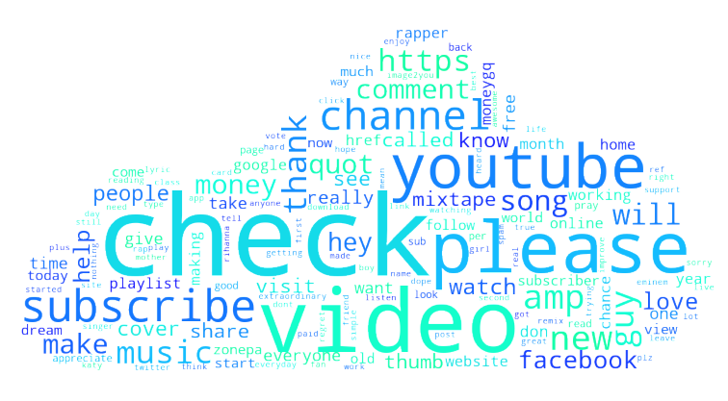
WORD CLOUD
Different view
A word cloud to show in a different way the most used words in spam comments

Slide 14
VECTORIZATION
Count Vectorizer was used to tokenize the text of the comments, remove accents, punctuation and stop words.

Slide 15
CLASSIFIERS
K-NEIGHBORS
simple, fast
sensitive to outliers
GAUSSIAN WITH RBF
versatile (different kernels)
inefficient if high features
SVM WITH SGD
fast, unbiased by outliers
sensitive to feature scaling
SVC
effective in high dimensions
sensitive to hyperparameters

Slide 16
CLASSIFIERS
MULTINOMIAL NB
fast, unbiased by outliers
assumes all features have the same relevance
COMPLEMENT NB
same as MNB but faster on text classification tasks
DECISION TREE
easy to explain and visualize
slow, prone to overfitting
RANDOM FOREST
very accurate
hard to interpret, prone to overfitting

Slide 17
METRICS
CLASSIFIER | CONFUSION MATRIX | ACCURACY | PRECISION | RECALL | F1
K-NEIGHBORS | [282 3] [ 88 214] | 0.844 | 0.986 | 0.708 | 0.824
GAUSSIAN WITH RBF | [277 8] [ 22 280] | 0.948 | 0.972 | 0.927 | 0.949
SVM WITH SGD | [270 15] [ 21 281] | 0.938 | 0.949 | 0.930 | 0.939
SVC | [276 9] [ 22 280] | 0.947 | 0.968 | 0.927 | 0.947
MULTINOMIAL NAIVE BAYES | [239 46] [ 19 283] | 0.889 | 0.860 | 0.937 | 0.896
COMPLEMENT NAIVE BAYES | [259 26] [ 20 282] | 0.921 | 0.915 | 0.933 | 0.924
DECISION TREE | [270 15] [ 12 290] | 0.954 | 0.950 | 0.960 | 0.955
RANDOM FOREST | [280 5] [ 15 287] | 0.965 | 0.982 | 0.950 | 0.966

Slide 18
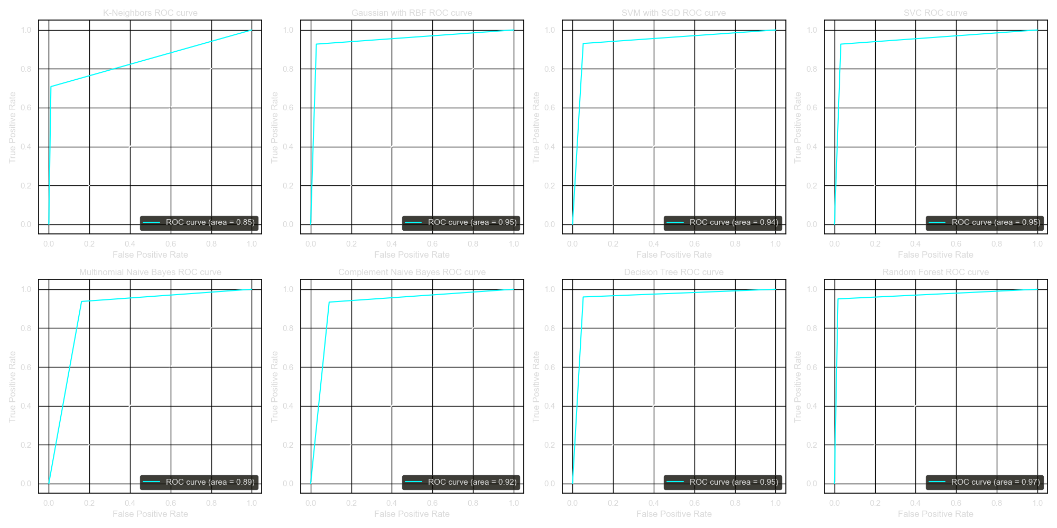
ROC CURVES

Slide 19
STRATIFIED K-FOLD CROSS-VALIDATOR
CLASSIFIER | CONFUSION MATRIX | AVG ACCURACY | AVG PRECISION | AVG RECALL | AVG F1
K-NEIGHBORS | [928 23] [308 697] | 0.831 | 0.860 | 0.835 | 0.828
GAUSSIAN WITH RBF | [910 41] [ 77 928] | 0.940 | 0.942 | 0.940 | 0.940
SVM WITH SGD | [889 62] [ 78 927] | 0.931 | 0.941 | 0.930 | 0.924
SVC | [884 67] [ 90 915] | 0.920 | 0.922 | 0.920 | 0.920
MULTINOMIAL NAIVE BAYES | [816 135] [ 97 908] | 0.881 | 0.884 | 0.881 | 0.881
COMPLEMENT NAIVE BAYES | [836 115] [100 905] | 0.890 | 0.892 | 0.890 | 0.890
DECISION TREE | [890 61] [ 72 933] | 0.932 | 0.934 | 0.926 | 0.929
RANDOM FOREST | [891 60] [ 67 938] | 0.935 | 0.938 | 0.936 | 0.930

Slide 20
CONCLUSIONS
RESULTS
POSSIBLE IMPROVEMENTS
Even if the dataset wasn’t very big it achieved acceptable results and the model is able to correctly classify most comments. Overall the initial goals of the project were reached.
Collect more data to expand the data set
Test with comments from other videos
Optimize classifiers hyperparameters

Slide 21
THANKS!
Antonio Osele
647926
a.osele@studenti.unipi.it

