Slide 1
Evaluation of Image Inpainting Algorithms and Their Optimization on the QIDK Platform
Team 19 — Black & White | Aryan Kulkarni, Ashwin Aravind, Tarsh Singh, Raghavendra Navneet Nawander
Prof: Dr. Deepak Gangadharan, IIIT Hyderabad Mentor / TA: Vedant
Progress checkpoint — September 2026

Slide 2
Problem Statement
Why image inpainting, and why on-device?
Image inpainting fills in missing, damaged, or masked regions of an image so the result looks natural — used for object removal, photo restoration, and generative photo editing.
Running these models on a phone (QIDK / Snapdragon) instead of the cloud means no upload latency, no server cost, and full data privacy — but mobile NPUs are far more constrained than a GPU workstation.
Our brief (Project 10)
Evaluate multiple image-inpainting algorithms and optimize their deployment on the QIDK — comparing accuracy, speed, and hardware efficiency across CPU / GPU / NPU.
2 / 7

Slide 3
Motivation
Domain Overview
On-device AI image editing — specifically image inpainting, filling in missing or masked regions — using GAN and diffusion models running locally on Snapdragon CPU / GPU / NPU via the QIDK.
Existing Work
Strong pretrained inpainting families already exist (AOT-GAN, LaMa, MI-GAN, Stable Diffusion Inpainting), but mostly benchmarked on cloud GPUs rather than mobile silicon.
Existing Gaps
No consolidated evaluation of accuracy / speed / energy trade-offs across GAN and diffusion inpainting on real Qualcomm edge hardware; ONNX→DLC conversion and INT8-quantization pain points are poorly documented.
Reason for this Domain
On-device inpainting removes upload latency, server cost, and privacy risk for photo-editing features — directly relevant to Qualcomm's on-device AI push and real camera / gallery apps.
2 / 7

Slide 4
Proposed Solution
What is the Plan of Action?
Deploy and benchmark four inpainting models on the QIDK, covering export (PyTorch/HF → ONNX), ONNX→DLC conversion, INT8 quantization, on-device execution across CPU / GPU / HTP, and a 200-image benchmark harness.
What are the current State-of-the-Art Solutions?
AOT-GAN and LaMa-Dilated (Fourier-convolution GAN, strong on large masks) as fast GAN baselines; MI-GAN as a mobile-optimized GAN; Stable Diffusion Inpainting for full text-guided generative inpainting.
What are the Key Features & Functionalities?
Native Hexagon HTP (NPU) execution for all three GAN models; an end-to-end on-device Stable Diffusion pipeline (custom tokenizer, VAE, latent masking, Euler scheduler); a single-command benchmark harness reporting PSNR / SSIM / LPIPS with live thermal and power telemetry.
3 / 7

Slide 5
Sensors Used & Diagrams
Compute Engines Used — the QIDK’s four compute paths
CPU
General purpose; slowest but most flexible. First working target for every model.
GPU
Good throughput for dense matrix ops; mid-point sanity check before NPU deployment.
HTP / DSP (NPU)
Hexagon Tensor Processor — the fast, low-power engine phones ship AI on. Needs INT8 models.
AIP
AI accelerator path exposed by SNPE for select model graphs; explored as an alternate NPU route.
Deployment Pipeline Diagram — trained model to on-device inference
1. Export
›
2. Convert
›
3. Quantize
›
4. Push
›
5. Run
›
6. Pull & Decode
PyTorch/HF → ONNX → .dlc (Qualcomm QAIRT) → INT8 calibration for the HTP → adb push to device → snpe-net-run on CPU/GPU/HTP → adb pull raw output, reassembled to PNG.
3 / 7

Slide 6
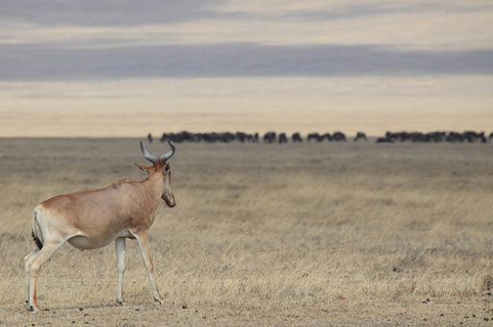

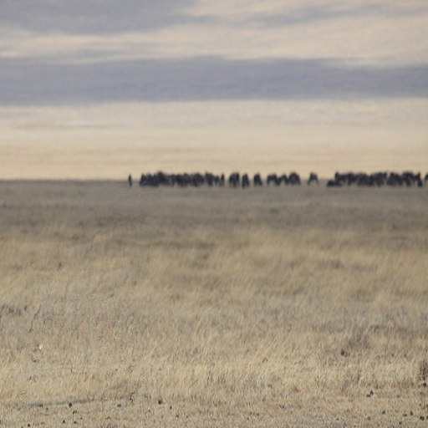
Initial Results
4
models running natively on the NPU
200
image pairs in our benchmark set
0.62 J
per repair — MI-GAN, our efficiency champion
28.3 dB
best global PSNR — AOT-GAN
Input
Mask
Output
Wildlife scene: the masked antelope is removed and the plains background is regenerated to match lighting and grass texture — a real, unedited output from our on-device GAN pipeline.
4 / 7

Slide 7
Project Status
Demonstration
Full GAN inpainting pipeline running natively on the Hexagon HTP (NPU) — AOT-GAN, LaMa-Dilated, and our own compiled MI-GAN.
End-to-end on-device Stable Diffusion pipeline generating real images from a text prompt (e.g. “A cat”, “A cinematic shot of sunset”) in ~15s, including full text-guided inpainting.
Challenges & Risks
HTP v79 driver mismatch (SNPE v2.47 vs v2.49) initially blocked NPU execution — resolved by syncing the full v2.49 HTP runtime stack.
MI-GAN ships as PyTorch only, with no ready .dlc — we exported to ONNX and compiled/quantized it in-house.
Stable Diffusion's pixel-alignment scores (PSNR/SSIM) trail the GANs — expected, since diffusion hallucinates plausible new content rather than matching ground truth; not a bug.
3 / 7

Slide 8
Timeline & Next Steps
Timeline for the Project
Timeline | Deliverables | Notes
Now (Sep 2026) | Full 200-pair benchmark completed on all 4 models | Live thermal/power telemetry; PSNR/SSIM/LPIPS captured
Next | Custom 9-input UNet for Stable Diffusion | Purpose-built latent input to fix SD's inpainting quality
Next | Model optimization pass | Complete LaMa .dlc pipeline; per-channel quantization; explore pruning
Next | Hardware optimization pass | HTP vs. GPU vs. CPU sweep; runtime tuning; delegate/init caching
Next | Adaptive model selection | Router picks the best model per image and system state
4 / 7

