Slide 1
EVALUATING METHODS FOR
RELIABLE QUESTION ANSWERING
OVER GOVERNANCE DOCUMENTS
Bachelor of Electrical Engineering (Honours) Thesis
Lucas Zheng Yi Lim | Curtin University | Semester Two 2026
Supervisor: Prof. Tom Gedeon • Co-supervisor: Rakib Hasan
Notes:
Good Afternoon everyone.
My name is Lucas Lim, and today I'll be presenting my honours thesis, titled Evaluating Methods for Reliable Question Answering over Governance Documents.
This research investigates how different enhancements to Retrieval-Augmented Generation, or RAG, can improve the reliability of answers generated from governance documents.
I'll be comparing five architectures based on their accuracy, verification capabilities, explainability and computational efficiency.

Slide 2


Slide 3
Why does reliability matter?
The context
The challenge
The gap
Governance documents define the organisational rules, responsibilities, conditions and exceptions.
Language models can produce fluent answers that are incorrect, incomplete or unsupported.
RAG retrieves evidence, but retrieval alone does not guarantee the correct interpretation of the governance text.
Retrieving relevant information does not guarantee that the generated response accurately reflects the source documents
EVALUATING METHODS FOR RELIABLE QUESTION ANSWERING OVER GOVERNANCE DOCUMENTS
02
Notes:
$$Governance documents contain important organisational rules, responsibilities and conditions that need to be interpreted correctly.$$
However, large language models can generate responses that sound convincing but may be incorrect or unsupported.
One approach to addressing this is Retrieval-Augmented Generation, or RAG, which retrieves relevant information from documents to support answer generation.$$
The problem is that even when the correct information is retrieved, the language model can still misinterpret it or generate an incorrect response.$$
This is the main problem my research addresses: how can we improve the reliability of generated answers beyond simply retrieving relevant information?

Slide 4
Research aim and objectives
Aim: evaluate methods for improving the reliability of RAG-based question answering over governance documents.
01 Compare
02 Evaluate
03 Understand
Baseline RAG against four enhanced architectures.
Answer correctness, similarity, and verification or explanation behaviour.
Computational overhead and reliability–efficiency trade-offs.
EVALUATING METHODS FOR RELIABLE QUESTION ANSWERING OVER GOVERNANCE DOCUMENTS
03
Notes:
$$The aim of this research was to evaluate different methods for improving the reliability of RAG-based question answering.
There were three main objectives.$$
First, to compare a baseline RAG system against four enhanced architectures.$$
Second, to evaluate their answer correctness, similarity and verification or explanation capabilities.$$
And finally, to investigate the computational costs associated with these enhancements.
This allows us to consider not only which architectures perform best, but also the trade-offs involved.

Slide 5
How the baseline RAG system works
Code Flow Chart
Governance
Documents
Chunk
+
Embed
ChromaDB
Retrieval
LLM Answer
Generation
→
→
→
→
Answer
QA Flow Chart
Question → Semantic Search → Relevant Evidence → Grounded Response
EVALUATING METHODS FOR RELIABLE QUESTION ANSWERING OVER GOVERNANCE DOCUMENTS
04
Notes:
Before discussing the enhancements, I'll briefly explain how the baseline RAG system works.$$
As shown in the diagram, the process begins with a collection of governance documents, which are divided into smaller chunks and converted into numerical representations called embeddings.
These embeddings are stored in ChromaDB, which acts as the vector database.$$
When a question is submitted, the system performs a semantic search to retrieve the most relevant document chunks.
These are then provided to a local large language model, alongside the question, to generate an answer.
The main advantage of RAG is that answers can be grounded in retrieved information rather than relying entirely on the model's pretrained knowledge.
However, the baseline doesn't include an additional mechanism to verify whether the generated answer is actually correct.

Slide 6
Five architectures compared
BASELINE RAG
Retrieve passages and generate an answer
RISE-inspired
Self-evaluate and selectively refine the response
RLVR-inspired
Verify against evidence and attempt correction
MMV
Use multiple language models for verification
XAI
Provide explanations and supporting evidence
Important: RISE and RLVR are inference-time inspired adaptations — no reinforcement-learning training was performed.
EVALUATING METHODS FOR RELIABLE QUESTION ANSWERING OVER GOVERNANCE DOCUMENTS
05
Notes:
Five architectures were evaluated in total, consisting of the baseline and four enhanced approaches.$$
The first was RISE-inspired, which introduces a self-evaluation and refinement mechanism. After generating an initial answer, the model evaluates its response and can selectively refine it if necessary.$$
The second was RLVR-inspired, which focuses on verification. It evaluates the generated answer against the retrieved evidence and attempts to correct it if an issue is identified.$$
The third was MMV, or Multi-Model Verification. This uses multiple language models to independently verify the generated answer, with the aim of improving verification reliability.$$
The final architecture was XAI, or Explainable Artificial Intelligence. Rather than focusing directly on answer accuracy, this approach provides explanations and supporting evidence to improve transparency.$$
One important distinction is that RISE and RLVR were implemented as inference-time adaptations inspired by their respective methods. No reinforcement-learning training was performed.
Together, these architectures allowed me to investigate different aspects of RAG reliability.

Slide 7
Experimental methodology
110
16
5
1
benchmark questions
question categories
architectures
common corpus
Corpus: IEEE Systems, Man, and Cybernetics Society governance documents
Correctness
Similarity and Semantic
Computational Efficiency
LLM-based assessment
ROUGE, BLEU, BERTScore
Latency and model calls
EVALUATING METHODS FOR RELIABLE QUESTION ANSWERING OVER GOVERNANCE DOCUMENTS
06
Notes:
To evaluate the architectures, I developed a benchmark consisting of 110 questions across 16 categories.
These questions were based on governance documents from the IEEE Systems, Man, and Cybernetics Society.
All five architectures were tested using the same document corpus and benchmark to provide a consistent comparison.
The evaluation focused on three main areas.$$
The first was answer correctness, assessed using an LLM-based evaluation process.$$
The second was similarity to reference answers, using ROUGE, BLEU and BERTScore to measure textual and semantic similarity.$$
And finally, computational efficiency was evaluated through response latency and the number of language model calls.
This allowed me to compare both the performance and computational requirements of each architecture.

Slide 8
Overall QA accuracy
Baseline
94.55%
RISE-Inspired
99.09%
RLVR-Inspired
97.27%
MMV
96.36%
XAI
95.45%
EVALUATING METHODS FOR RELIABLE QUESTION ANSWERING OVER GOVERNANCE DOCUMENTS
07
Notes:
Moving on to the results, this slide shows the overall question-answering accuracy.
The baseline achieved 94.55%, while all four enhanced architectures achieved higher measured accuracy.
RISE performed the best at 99.09%, correctly answering 109 out of 110 questions. This represents an improvement of approximately 4.55 percentage points over the baseline.
RLVR followed at 97.27%, while MMV and XAI achieved 96.36% and 95.45% respectively.
These results suggest that selective refinement can be effective in improving answer correctness.
However, it's important to recognise that MMV and XAI weren't primarily designed to improve accuracy. Their main objectives were verification and explainability, so accuracy alone doesn't fully represent their effectiveness.

Slide 9
Computational efficiency
Mean total response latency (seconds per question)
Baseline RAG
3.36 s
RISE-inspired
8.15 s
RLVR-inspired
11.14 s
MMV
31.68 s
XAI
15.07 s
Number of LLM calls { Baseline: 110 | RISE: 240 | RLVR: 280 | MMV: 440 | XAI: 220 }
EVALUATING METHODS FOR RELIABLE QUESTION ANSWERING
08
Notes:
While accuracy is important, computational efficiency is another major consideration.
The baseline was the fastest architecture, averaging 3.36 seconds per question.
RISE increased this to 8.15 seconds, while RLVR required 11.14 seconds.
XAI took approximately 15 seconds, and MMV was the slowest at 31.68 seconds per question.
These differences are largely associated with the additional processing and model calls required by each architecture.
For example, the baseline required 110 model calls across the benchmark, compared to 240 for RISE and 440 for MMV.
This demonstrates that additional verification and explanation mechanisms can introduce significant computational overhead.

Slide 10
Accuracy versus computational cost
Higher accuracy must be weighed against additional response time.
100
Accuracy (%)
RISE-inspired
Key observations
98
RISE: highest measured accuracy (99.09%) at 8.15 s.
RLVR-inspired
MMV
96
XAI
MMV: 96.36% accuracy with the highest latency (31.68 s).
Baseline RAG
94
0
10
20
30
Mean latency (seconds)
Results from thesis Sections 5.1 and 5.4 • 110-question benchmark
EVALUATING METHODS FOR RELIABLE QUESTION ANSWERING
09
Notes:
This graph combines the previous results by comparing accuracy against average response latency.
Ideally, we want an architecture towards the top-left, representing high accuracy with low computational cost.
From this comparison, RISE stands out, achieving the highest accuracy at 99.09%, with a relatively moderate response time of 8.15 seconds.
In contrast, MMV had the highest latency without achieving a corresponding improvement in answer accuracy.
However, MMV's main objective is verification rather than improving the generated answer itself.
So, based specifically on accuracy and latency, RISE demonstrated the strongest trade-off in this experiment, but that doesn't necessarily make it the best architecture for every application.

Slide 11
What do the results mean?
Selective refinement
Verification is fallible
Efficiency trade-off
RISE-inspired refinement achieved the highest measured accuracy (99.09%).
Selective refinement demonstrated potential for improving initially generated answers.
RLVR triggered 28 correction attempts, but only one initially incorrect answer was successfully corrected.
Additional verification stages could introduce incorrect judgments or unnecessary processing.
Refinement and correction mechanisms can improve accuracy but introduce additional computational costs.
MMV and XAI primarily provide verification and explainability.
Increased computational complexity does not necessarily improve answer correctness.
Key lesson: Improving RAG reliability requires balancing answer correctness, verification effectiveness, and computational efficiency
EVALUATING METHODS FOR RELIABLE QUESTION ANSWERING OVER GOVERNANCE DOCUMENTS
10
Notes:
There are three main observations from these results.$$
The first relates to selective refinement.
RISE achieved the highest measured accuracy, suggesting that allowing a model to evaluate and selectively improve its own responses can be an effective approach.$$
The second observation is that verification mechanisms aren't necessarily reliable themselves.
For example, RLVR triggered 28 correction attempts across the benchmark, but only one initially incorrect answer was successfully corrected.
This highlights an important limitation: introducing a verification stage doesn't guarantee that the verification judgement will be correct.
A verifier may incorrectly identify a valid answer as problematic, potentially resulting in unnecessary processing or incorrect corrections.$$
The third observation concerns the different objectives of the architectures.
While RISE and RLVR focus on improving answer correctness, MMV and XAI primarily address verification reliability and transparency.
Any observed differences in answer accuracy for MMV and XAI may therefore result from variability in the answer generator rather than the enhancements themselves.$$
Ultimately, improving RAG reliability requires balancing answer correctness, verification effectiveness, explainability and computational efficiency.

Slide 12
Limitations and future work
Limitations
Future directions
Single governance-document corpus
Limited benchmark of 110 questions
Dependence on automated LLM evaluation
Verification and explanation inconsistencies
Limited generalisability to other domains
Expand benchmark and document diversity
Introduce independent human evaluation
Improve verification and correction reliability
Optimise selective refinement to reduce overhead
Investigate additional architectures and configurations
EVALUATING METHODS FOR RELIABLE QUESTION ANSWERING OVER GOVERNANCE DOCUMENTS
11
Notes:
Although the results were promising, there are several limitations to consider.$$
Firstly, the research was conducted using a single governance-document corpus and a benchmark of 110 questions, which limits how well the findings may generalise to other applications.
Another limitation was the reliance on automated LLM-based evaluation, which may introduce inaccuracies in the assessment process.
Additionally, the verification and explanation mechanisms demonstrated some inconsistencies.$$
For future work, I would recommend expanding the benchmark to include more diverse documents and introducing independent human evaluation.
Another important direction would be improving verification reliability and optimising selective refinement to reduce computational overhead.

Slide 13
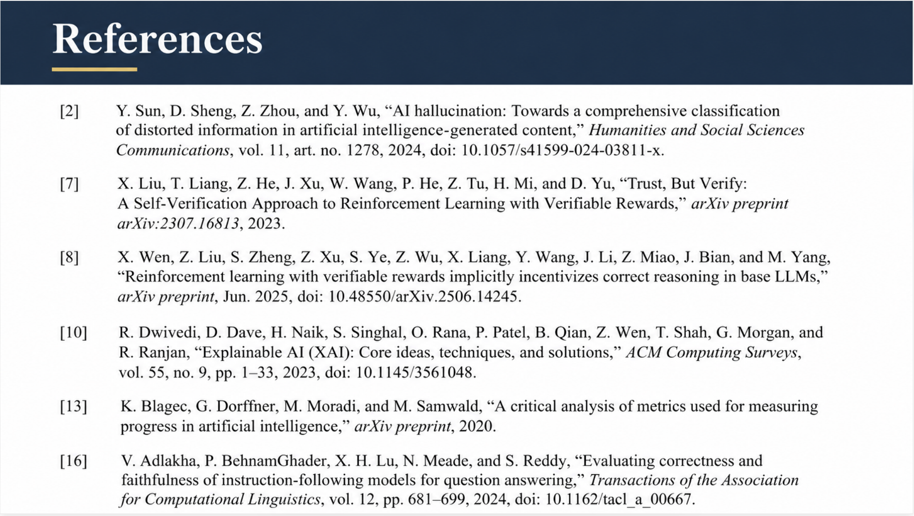

Slide 14
Conclusions
RISE-inspired refinement achieved the highest measured accuracy (99.09%) across the 110-question benchmark, demonstrating its potential to improve answer correctness.
2. Different architectures address distinct aspects of RAG reliability, including correctness, verification, and explainability.
3. No single architecture is universally optimal; selection depends on system requirements and the trade-offs between reliability and computational efficiency.
Thank you • Questions?
Notes:
To conclude, this research demonstrated that different RAG enhancements provide different benefits.$$
RISE achieved the highest measured answer accuracy at 99.09%, with a relatively moderate computational cost.$$
However, other architectures address important aspects of reliability, including verification and explainability.$$
Ultimately, no single architecture is universally optimal. The most suitable approach depends on the requirements of the system and the balance between accuracy, verification, transparency and computational efficiency.
Thank you for listening. I'm happy to take any questions.

