Slide 1
Async-Sensitive Data Management
PROSPER
Motivated by: Rethinking the Evaluation of Asynchronous I/O
Noah Lewis
11/11/2026

Slide 2
Outline
P – Problem (with measured evidence from our study of 5 async I/O systems)
R – Rewards
O – Old approaches
S – Stumbling blocks
Proposed solution: an async-sensitive DM built on PDC
E – Evaluation
R – Real-world use cases
Open questions

Slide 3
P - Problem
Data management work (data movement between devices/storage tiers, I/O forwarding, I/O buffering, I/O aggregation) is commonly executed asynchronously with client applications on a shared set of computing resources.
This can lead to significant interference between the client application and the data management work (Jain et al. ’22 [Flash-X]; Tseng et al. ’21; Tarraf et al. ’24; our measurements).
From a user’s perspective, the primary goal is to minimize total workload runtime, which commonly leads to using async I/O. However, async I/O can decrease observed I/O time while increasing client compute time. When summed, the total workload may not improve and can be drastically worse (measured: PDC 0.73×, non-blocking MPI-IO 0.63× of sync).
Modern DMs by and large optimize internally without considering how these optimizations affect the client. For example, I/O aggregation may congest the network; for a network-bound client this can significantly increase overall workflow time.
Notes:
0.73x = PDC with DGEMM; 0.63x = non-blocking MPI-IO with the spin kernel (async slower than sync).

Slide 4
P – Promise vs. reality
Synchronous
compute
I/O
t_comp + t_io
Async, ideal (what sleep shows)
compute
≈ max(t_comp, t_io)
Async, compute-side interference
compute
inflation
compute slows down
Async, I/O-side interference
compute
exposed I/O
I/O didn’t progress
The background engine needs CPU, memory bandwidth and the network, the same resources the computation uses. A sleep() phase uses none of them, so it cannot show either failure mode.

Slide 5
P – How we measured it
1 node: 2× Xeon Gold 5418Y (48 cores, 96 HW threads), 256 GB, 4× NVMe RAID-0, RTX 5000 Ada
48 MPI ranks, one per core; background threads share the rank’s HW thread
10 steps, 12 GiB/step, 120 GiB/run (sweeps: 0.75–48 GiB/step)
t_comp = 1.25 × sync I/O time, so sleep can hide the I/O fully (as in prior work)
Surrogates do fixed work, calibrated to the same standalone duration
DM | Async engine
POSIX AIO | glibc helper thread
MPI-IO iwrite | MPICH progress thread
HDF5 async VOL | Argobots thread
ADIOS2 BP5 | AsyncWrite=Guided
PDC | server on reserved core + client progress thread
Surrogate | Resource exercised
sleep | none
spin | one core (ALU)
DGEMM | CPU, caches
STREAM | memory bandwidth
halo | MPI, memory copies
heat (mini-app) | CPU + memory + MPI

Slide 6
P – Metrics
Run time vs. sleep prediction: observed async run time ÷ (async run time with sleep, corrected for compute length). Above 1 means the application runs longer than a sleep evaluation predicts.
End-to-end speedup: T_sync / T_async. What most prior work reports; inherits the noise of the sync run.
Cost attribution: T_async = compute as in sync + compute inflation + exposed I/O.
Compute slowdown: t_comp_async / t_comp_sync.
Exposed I/O: I/O wait per step in async mode / sync I/O time.
Reporting only I/O time hides inflation; reporting only compute time hides exposed I/O. End-to-end time captures both, and these are the quantities an adaptive DM must estimate online.

Slide 7
P – Baseline: I/O only
DM | Sync s/step | Async s/step | Async / sync | Sync GB/s
POSIX AIO | 1.26 | 1.77 | 1.41 | 10.3
MPI-IO | 8.69 | 16.25 | 1.87 | 1.5
HDF5 async VOL | 10.69 | 5.84 | 0.55 | 1.2
ADIOS2 BP5 | 1.85 | 2.61 | 1.40 | 6.9
The DMs differ by an order of magnitude; collective I/O caps MPI-IO and HDF5 at 1.5 / 1.2 GB/s.
Non-blocking MPI-IO is 1.80–2.06× slower than blocking at every size, even with nothing to overlap (progress thread starved).
POSIX and HDF5 async reach 0.52 / 0.55 of sync at large sizes by pipelining consecutive writes.
12 GiB/step, 48 ranks, 5 steps, mean of 2 runs.

Slide 8
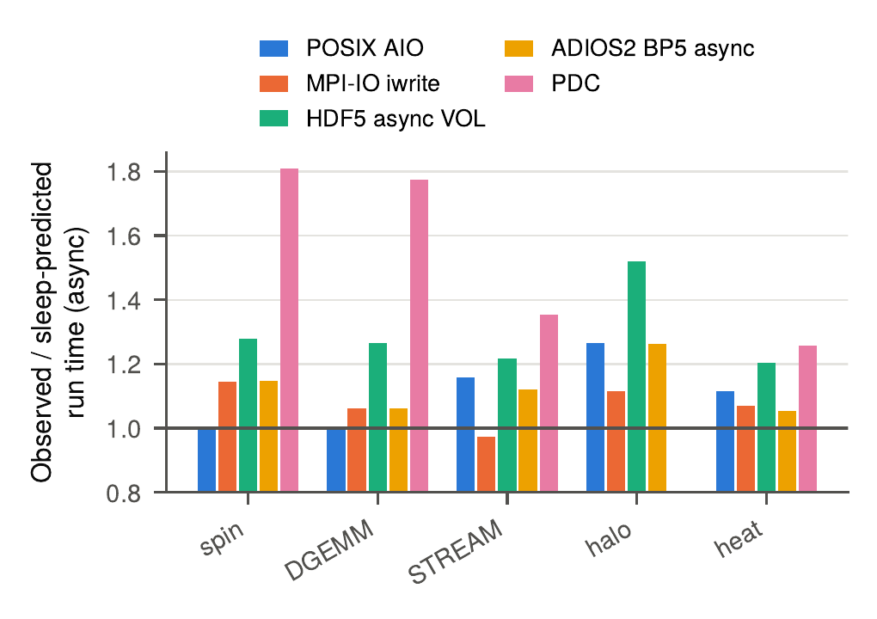
P – Longer than sleep predicts
21 of 24 configurations run at least 5 % longer than the sleep prediction.
Up to 81 % longer (PDC with spin), despite PDC’s server on a reserved core.
PDC +26 to +81 %
HDF5 async VOL +20 to +52 %
ADIOS2 +5 to +26 %
POSIX AIO 0 to +26 %
MPI-IO −3 to +14 %

Slide 9
P – Excess per DM and kernel
DM | spin | DGEMM | STREAM | halo | heat
POSIX AIO | +0 % | +0 % | +16 % | +26 % | +12 %
MPI-IO iwrite | +14 % | +6 % | -3 % | +11 % | +7 %
HDF5 async VOL | +28 % | +27 % | +22 % | +52 % | +20 %
ADIOS2 BP5 | +15 % | +6 % | +12 % | +26 % | +5 %
PDC | +81 % | +77 % | +35 % | n/a | +26 %
Each DM has a different weak spot.
HDF5 and PDC are hurt by anything that uses the CPU.
POSIX AIO is unaffected by pure CPU work but not by memory traffic or MPI.
halo is the worst case for POSIX, HDF5 and ADIOS2.
PDC halo run hung (no result).
Observed / sleep-predicted async run time − 1. Single runs; effects of a few % are within run-to-run noise.

Slide 10
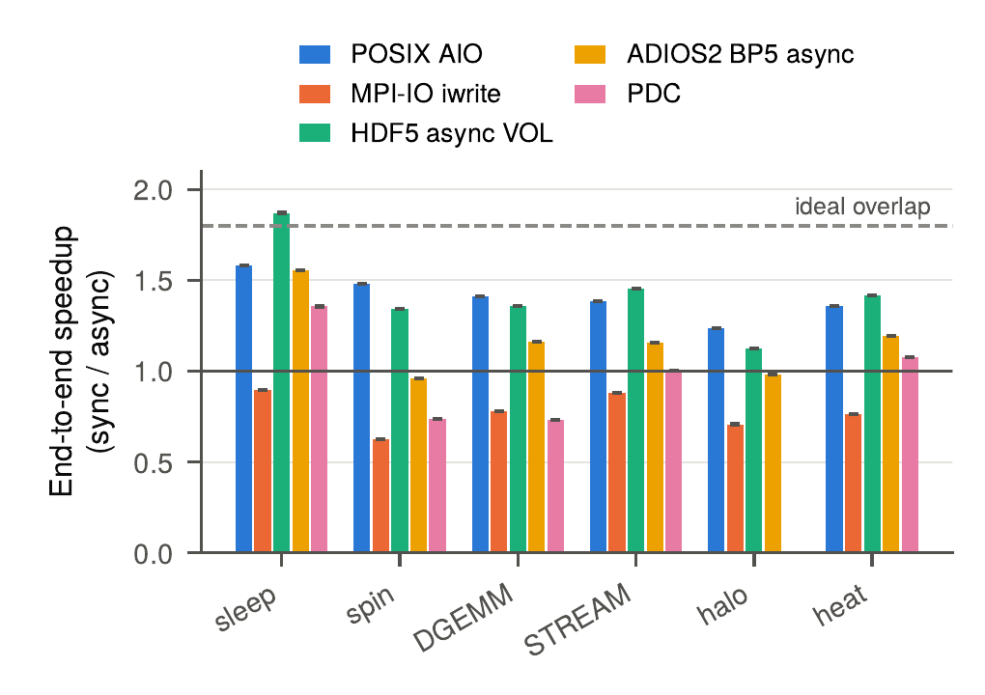
P – Sleep overstates speedup
Every working surrogate lowers the speedup that sleep shows.
POSIX: 1.58× (sleep) → 1.24× (halo)
HDF5: 1.87× → 1.13× (halo)
ADIOS2: 1.55× → 0.96× (spin)
PDC: 1.36× → 0.73× (DGEMM)
MPI-IO: 0.90× → 0.63× (spin); slower than blocking in every configuration

Slide 11
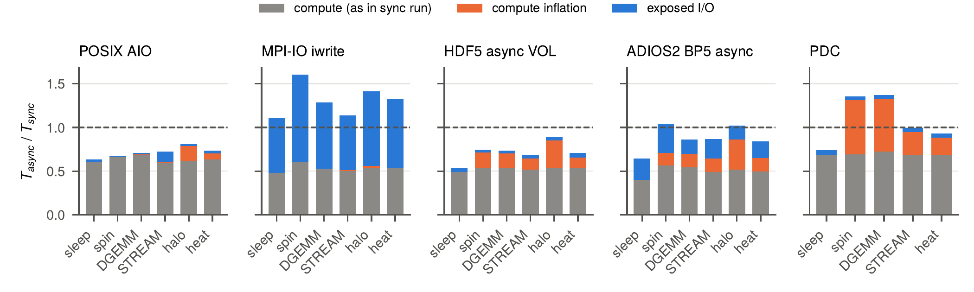
P – Where the cost appears
POSIX, HDF5, ADIOS2, PDC: little I/O stays exposed; the loss is a longer compute phase (orange). An I/O-time-only report would call this nearly complete hiding.
MPI-IO: compute is undisturbed (0.96–1.04×), but the write barely progresses: 117 s exposed with sleep, 146 s with spin.
Notes:
Gray = compute as in sync run; orange = compute inflation; blue = exposed I/O; normalized to T_sync. MPI-IO's 'odd behaviour' is this I/O-side failure: the MPICH progress thread is starved on the shared HW thread.

Slide 12
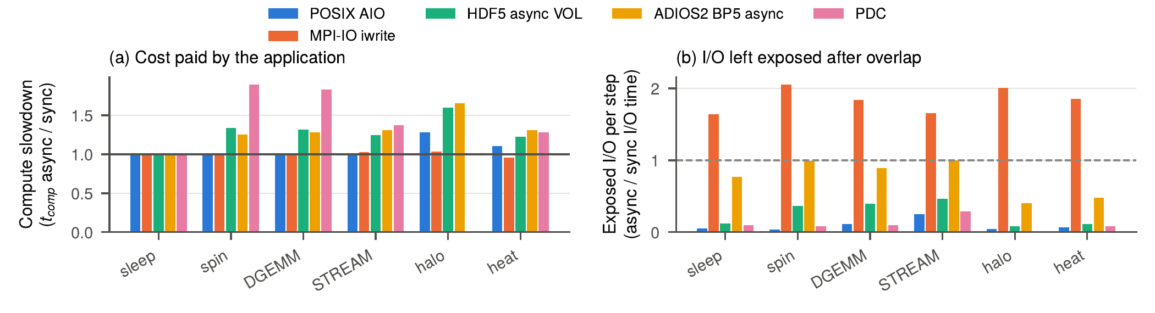
P – Slowdown vs. exposed I/O
Compute slowdown: PDC 1.90× (spin), ADIOS2 1.65× (halo), HDF5 1.60× (halo; spin alone 1.34×), POSIX 1.28× (halo).
MPI-IO exposed I/O per step is up to 2.06× the sync I/O time.

Slide 13
P – DMs differ in sensitivity
DM | spin | DGEMM | STREAM | halo | heat | Engine behaviour
POSIX AIO | 1.00× | 1.01× | 1.02× | 1.28× | 1.11× | one helper thread, mostly blocked on write-back
MPI-IO iwrite | 1.00× | 0.99× | 1.02× | 1.04× | 0.96× | progress thread starved; cost is exposed I/O
HDF5 async VOL | 1.34× | 1.31× | 1.25× | 1.60× | 1.23× | Argobots thread on the rank’s HW thread
ADIOS2 BP5 | 1.26× | 1.29× | 1.31× | 1.65× | 1.31× | Guided mode writes during compute blocks
PDC | 1.90× | 1.83× | 1.37× | n/a | 1.29× | client progress thread polls every 1 ms
Compute-phase slowdown (t_comp_async / t_comp_sync), 12 GiB/step, fully subscribed.
No single DM is best for all workloads: the right engine, placement and schedule depend on what the client is doing.

Slide 14
P – Communication is hit hardest
halo (MPI exchange) is the most sensitive surrogate for POSIX, HDF5 and ADIOS2:
  POSIX AIO: 0 % excess with spin, +26 % with halo
  HDF5 async VOL: +28 % with spin, +52 % with halo
  ADIOS2: +15 % with spin, +26 % with halo
Contention reaches the application through MPI and shared-memory traffic, not only the CPU.
On one node, halo uses shared memory only. On a cluster, MPI and PFS traffic share network links, so the effect is expected to be larger (untested).
Consistent with the problem statement: DM aggregation that congests the network hurts a network-bound client.

Slide 15
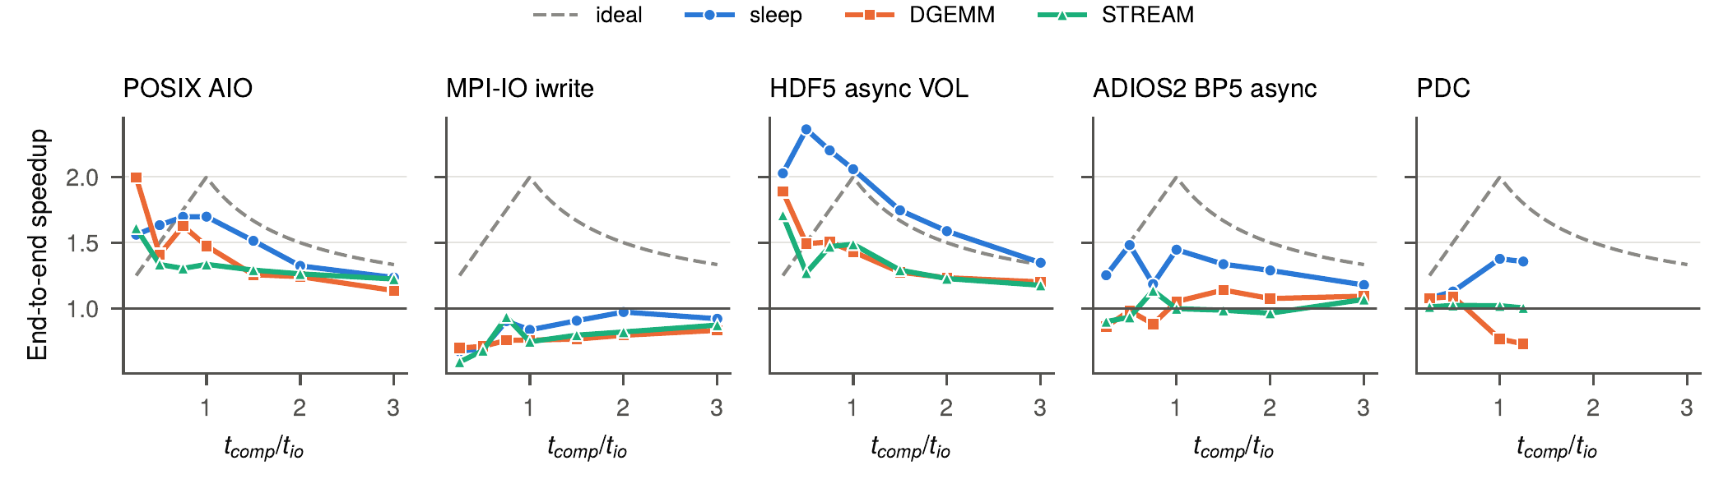
P – Compute-to-I/O ratio
For t_comp ≥ t_io, sleep beats DGEMM/STREAM at every ratio: by 13/13 % (POSIX), 30/29 % (HDF5), 21/31 % (ADIOS2).
PDC: DGEMM slowdown ≈ 1.85× at every ratio, but it only costs run time once the slowed compute is longer than the I/O (best 1.09× at ratio 0.5; below 1× at ratio ≥ 1).

Slide 16
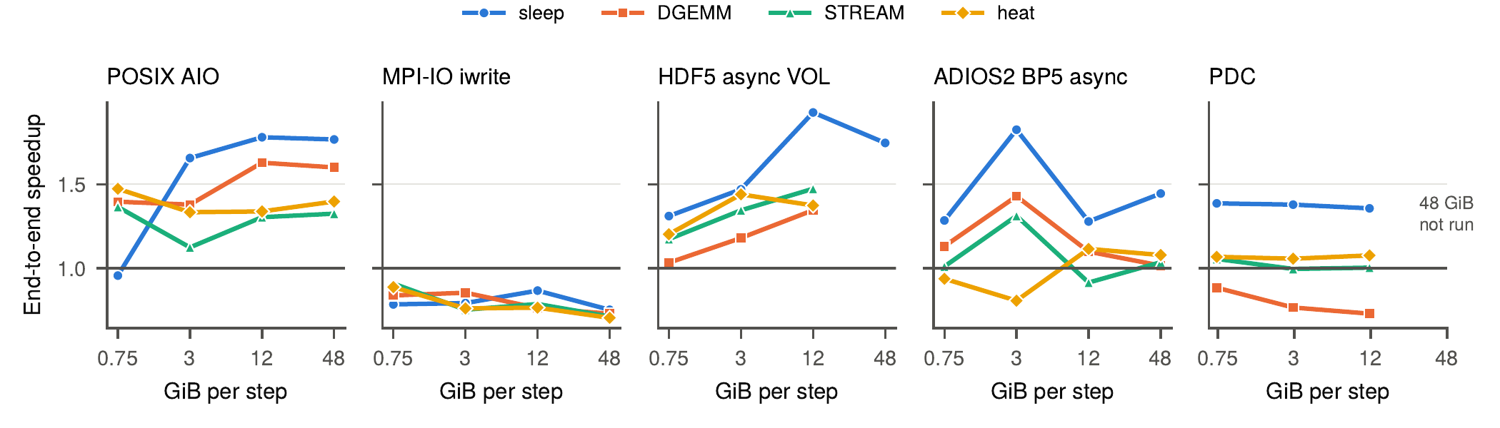
P – Output size
HDF5 at 12 GiB/step: 1.93× with sleep vs 1.37× with heat; the gap grows with size.
48 GiB/step (480 GiB/run): POSIX 1.77× sleep vs 1.32–1.60× working; ADIOS2 1.44× vs 1.02–1.08×.
PDC with DGEMM is slower than sync at every size (0.88× → 0.73×).

Slide 17
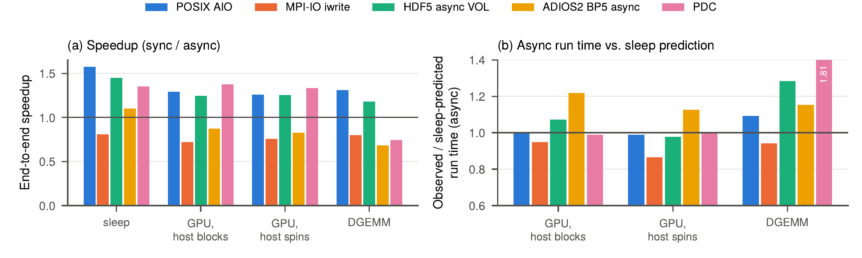
P – GPU-resident compute
Hypothesis (Prof. Byna): kernels on GPU, I/O on CPU → low impact. Mostly supported: async run time is within 0–7 % of the sleep prediction for POSIX, HDF5, PDC; MPI-IO is faster. Same 4 ranks on CPU DGEMM: +9 % POSIX, +28 % HDF5, +81 % PDC.
Not yet proven: ADIOS2 still +13–22 %; 4 ranks share one GPU; data movement to/from a running kernel (and GDS) not studied.

Slide 18
R – Rewards (Benefits if Solved)
Reduced client/DM interference.
Reduced workload runtime.
Never worse than sync: avoid cases like PDC + DGEMM (0.73×) or non-blocking MPI-IO (0.63×).
Measured headroom:
  up to 81 % longer run time than the sleep upper bound (PDC)
  HDF5 with halo reaches 1.13× vs 1.87× with sleep
  placement alone moves MPI-IO + DGEMM from 0.75× to 1.06×
  a free HW thread cuts PDC’s spin slowdown from 1.89× to 1.02×
Reserve cores only when it pays (reserving halves the ranks).

Slide 19
O – Old Approaches (Existing Solutions)
Approach | Gap shown by our data
Switch to sync when async gives no gain (Ravi et al. ’23) | Model matches sleep, not real compute (heat +5–26 %)
Reserve a core for the background thread (HDF Group) | Helps HDF5 / MPI-IO but halves the ranks
Dedicated DM servers or cores (PDC, Damaris) | PDC still +81 %: client progress thread on app cores
Compute-block hints (ADIOS2 Guided) | Writes when compute needs the core: 1.26–1.65× slowdown
Interference-aware burst-buffer scheduling (Harmonia) | Across applications at the burst buffer, not app vs. in-node DM
https://dl.acm.org/doi/10.1177/10943420211016511
https://ieeexplore.ieee.org/document/10177439/
https://sdm.lbl.gov/~sbyna/research/papers/2021/2021-TPDS-Tang-async-IO-HDF5.pdf

Slide 20
O – Evaluated with sleep()
Surveyed 17 evaluations and benchmarks (HDF5, ADIOS, PDC, POSIX, DL I/O).
Of the 14 that evaluate I/O: 6 use sleep(), 3 an unspecified compute phase, 2 no compute phase.
Only 3 run the I/O against a computation that can be slowed down by it (Jain ’22, Tarraf ’24, IMB-IO).
Sleep-based studies report I/O-side metrics only; none reports compute-phase slowdown.
Benchmark tools make sleep the default: h5bench, adios_iotest and DLIO expose the compute phase as a sleep duration.
Evaluations with real computation find smaller benefits and attribute the loss to CPU, memory-bandwidth or network contention.

Slide 21
O – Survey of evaluations
Work | Stack | Compute phase | Described | App-side cost | Cores stated | Real app
h5bench | HDF5 | sleep | ✓ | ✗ | ? | ✗
Tang et al. ’19 | HDF5 async | unspecified “simulated” | ✗ | ✗ | ? | ✗
Tang et al. ’22 | HDF5 async | sleep | ✓ | ✗ | ~ | ~
Ravi et al. ’23 | HDF5 async | sleep (30 s) | ✓ | ✗ | ~ | ?
Tang et al. ’18 | PDC | sleep | ✓ | ✗ | ✓ | ✗
Tang et al. ’19b | PDC | unspecified | ✗ | ✗ | ✓ | ~
Skel | ADIOS | none (I/O-only) | n/a | ✗ | n/a | ✗
adios_iotest | ADIOS2 | sleep or busy loop | ✓ | ✗ | n/a | ✗
DLIO | DL loaders | sleep (GPU-profiled) | ✓ | ~ | ? | ✗
Harmonia | burst buffer | unspecified math kernels | ~ | ? | ? | ✓
Gossman et al. ’21 | VeloC/POSIX | none (flush timed alone) | n/a | ✗ | ? | ✗
Jain et al. ’22 | HDF5 async | real (Flash-X) | ✓ | ✓ | ? | ✓
Tseng et al. ’21 | generic | CPU/memory stressors | ✓ | ✓ | ? | ✓
Tarraf et al. ’24 | various | real (WaComM++, HACC-IO) | ✓ | ✓ | ? | ✓
IMB-IO | MPI-IO | calibrated CPU kernel | ✓ | ✓ | n/a | ✗
COMB | MPI comm. | busy work | ✓ | ✓ | n/a | ✗
Denis & Trahay | MPI comm. | busy work | ✓ | ✓ | n/a | ✗
Rows 1–11: compute phase cannot slow down. Rows 12–17: compute consumes resources. ✓ yes ~ partly ✗ no ? not determinable

Slide 22
O – Evaluations without sleep()
From our survey:
  Jain et al. ’22: HDF5 async VOL in Flash-X; 1.5× end-to-end vs 4.5–4.9× I/O-time speedups reported with sleep
  Tarraf et al. ’24: real applications (WaComM++, HACC-IO)
  Tseng et al. ’21: CPU and memory stressors against background I/O
  Harmonia ’18: interference-aware burst-buffer scheduling with real applications
  IMB-IO, COMB, Denis & Trahay: calibrated busy work (MPI-IO / MPI communication)
To add / review:
  Runway (suggested by Prof. Byna), not yet in the survey
  Forward-citation search from Runway, Flash-X and Tarraf ’24 for other evaluations that report compute-side cost

Slide 23
O – Sync/async switch model
DM | t_comp / t_io | Model (Ravi ’23) | Sleep | Heat mini-app | Heat excess | Worst excess
POSIX | 1.72 | 1.58× | 1.58× | 1.36× | +12 % | +26 % (halo)
MPI-IO | 1.12 | 1.89× | 0.90× | 0.77× | +7 % | +14 % (spin)
HDF5 | 1.10 | 1.91× | 1.87× | 1.42× | +20 % | +52 % (halo)
ADIOS2 | 0.99 | 1.99× | 1.55× | 1.19× | +5 % | +26 % (halo)
PDC | 2.28 | 1.44× | 1.36× | 1.08× | +26 % | +81 % (spin)
For POSIX and HDF5 the sleep speedup equals the analytical overlap model, so sleep cannot test the model.
The heat mini-app gets a lower speedup with every DM.
Same gap as in the literature: 4.5–4.9× I/O-time speedups with sleep vs 1.5× end-to-end in Flash-X.

Slide 24
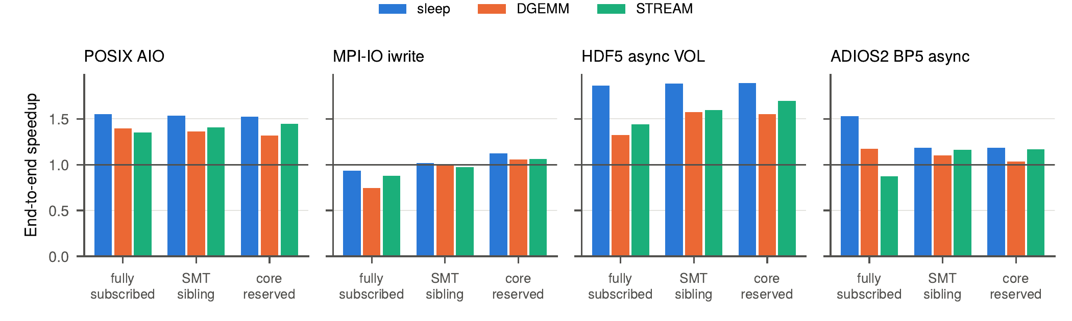
O – Reserving cores
HDF5 + DGEMM: 1.32× (fully subscribed) → 1.57× (SMT sibling) / 1.55× (core reserved); sleep still 1.89×.
MPI-IO + DGEMM: 0.75× → 1.06× with a reserved core. POSIX insensitive; ADIOS2 no consistent gain.
Core reserved = 24 ranks instead of 48. A sleep evaluation cannot tell whether that trade-off is worth it.

Slide 25
O – Dedicated servers (PDC)
PDC runs its server on a reserved core, but each client rank runs a Mercury progress thread that polls every 1 ms on the rank’s HW thread.
That thread uses 40–50 % of a core.
Giving each client its SMT sibling: spin slowdown 1.89× → 1.02×, run time 613 s → 348 s (within 2 % of the sleep prediction).
With DGEMM, slowdown only falls 1.85× → 1.30×; still +32 % vs sleep.
Moving the DM server off the application’s cores does not remove interference when the client library itself needs CPU.
A blocking or event-driven progress mode would likely remove most of it.

Slide 26
S – Stumbling Blocks (Challenges)
Workload characterization – client workflows must be characterized dynamically at runtime (compute / network / memory bound). This information is then used to modify the DM to reduce interference and improve overall runtime.
Parameter optimization – a list of parameters to adjust dynamically is needed to reduce interference between async DM work and client compute. Knowing which parameters to tune and how they affect one another is a well-known difficult problem.
Interference recognition – interference happens at many levels: within an application between data movements (to GPU, PFS, or local SSDs), and between users on the PFS. Recognizing it is critical for knowing how to adjust the DM.
Workflow and DM prediction models – models are needed to tell whether observed client and DM times are inflated. Without running both in isolation (often impossible on shared HPC systems), the DM cannot evaluate observed performance.

Slide 27
S – Evidence from the study
Workload characterization: the profile that matters differs by DM: CPU (HDF5, PDC), memory bandwidth (POSIX +16 %), MPI (worst case for 3 of 5). GPU-resident phases are the easy case.
Parameter optimization: measured knobs with large effects: placement (0.75× → 1.06×), progress mode (1.89× → 1.02× slowdown), sync fallback. Reserved cores halve the ranks.
Interference recognition: invisible in I/O time for 4 of 5 DMs, invisible in compute time for MPI-IO. Needs end-to-end attribution, and traces to find the subsystem.
Prediction models: the overlap model matches sleep, not reality. The DM needs a reference compute time without I/O; noise (8 % median) limits resolution.

Slide 28
S – Measurement pitfalls
Sleep slows the sync baseline: after a sleep phase, sync I/O is slower by 17 % (POSIX), 50 % (MPI-IO), 21 % (HDF5), 98 % (ADIOS2). Likely idle-core power states. This inflates sleep speedups further.
HDF5 async VOL wait defect: H5ESwait slept a full second when it failed to reacquire the global lock, plus 100 ms polling. Patched to 1 ms.
Noise: repeated I/O-only runs differ by a median 8 %, up to 62 %.
Unpinned threads: compute phases reached only 30–75 % of their target length, so placement must be controlled (or managed by the DM).

Slide 29
S – Limits of our measurements
Single node with local NVMe: no contention on network links shared by MPI and PFS traffic.
Client cache emulated with a cgroup memory limit, not a real PFS client.
One run per configuration (only I/O-only baselines repeated).
GPU: 4 ranks share one GPU; production nodes typically have one GPU per rank.
PDC: one server; not run at 47 GiB/step or ratios above 1.25; async halo run hung.
Surrogates, not full applications; the heat mini-app is the closest stand-in.

Slide 30
Proposed Solution – Requirements
Observation | Requirement for an async-sensitive DM
Cost appears as compute inflation or exposed I/O, depending on the DM | Measure end-to-end time and attribute it online
Each DM is sensitive to a different resource | Characterize the client’s resource profile at runtime
Communication-heavy phases suffer most | Schedule background I/O away from communication
Polling progress threads use 40–50 % of a core | Prefer blocking / event-driven progress
Placement helps but costs ranks | Choose placement by expected gain vs. lost compute
Inflation is free while t_comp < t_io | Track which side is on the critical path
Async can be slower than sync (0.63–0.96×) | Fall back to sync when there is no gain
GPU-resident compute leaves the host mostly idle | Be aggressive when the host is idle
Run-to-run noise: 8 % median, up to 62 % | Robust control that does not react to one step

Slide 31
Proposed Solution
An async-sensitive DM built into PDC (client library + server).
Goal: minimize the client’s end-to-end time, not PDC’s I/O time.
Profile: characterize the client online (CPU-, memory-, communication-bound, or host-idle GPU phases).
Attribute: split each step into compute, compute inflation and exposed I/O; know which side is on the critical path.
Adapt: set PDC’s interference-related parameters per workload: progress mode and placement, consistency, partitioning, transfer timing and batching, server cache and flush.
Guard: never worse than sync (fall back to POSIX consistency); do not react to a single noisy step.

Slide 32
Proposed Solution – Why PDC
PDC already moves the heavy DM work to servers on reserved cores.
The interference that remains is concentrated in a small, well-defined place: the client library on application cores (Mercury progress thread and wait loop).
It is the worst case we measured (up to +81 %, below 1× speedup with DGEMM), and it is recoverable: giving the progress thread an SMT sibling cut the spin slowdown from 1.89× to 1.02×.
PDC exposes per-object properties (consistency, partitioning) and server settings (cache, flush) that a controller can set at runtime.
GPU-resident compute already matches the sleep prediction (0–1 %), so the problem is specific to host-side compute.

Slide 33
Proposed Solution – Architecture
Client application
compute phases
MPI communication
GPU kernels + D2H
PDC region transfers
Profiler
counters, MPI, GPU,
phase hints, traces
Interference estimator
inflation, exposed I/O,
critical path
Policy controller
workload class → action,
fallback
PDC client library: progress mode / placement · consistency · partitioning · transfer timing / batching
PDC server (reserved core): region cache size · flush timing · storage target

Slide 34
PDC parameters – client side
Parameter | How it is set (default) | Effect on client interference
Mercury progress mode | NA_NO_BLOCK (“busy mode”) unless built with PDC_ENABLE_MULTITHREAD (OFF) | HG_Progress busy-spins on the rank’s HW thread; blocking mode should cut CPU use
Progress loop timing | hard-coded: HG_Progress 100 ms, then usleep 1 ms | poll rate / backoff trades CPU for completion latency
Progress thread placement | inherits the rank’s binding (no affinity set) | measured: SMT sibling cut spin slowdown 1.89× → 1.02×
Wait loop on app thread | hard-coded usleep(1 ms) loop, HG_Progress in waits | app thread spins while waiting: cost shows as exposed I/O
Consistency | PDCprop_set_obj_consistency_semantics (EVENTUAL) | POSIX blocks at start until the server has the data: no overlap, no inflation
Region partitioning | PDCprop_set_obj_transfer_region_type (REGION_STATIC) | STATIC splits each region over all servers; LOCAL keeps traffic node-local; DYNAMIC balances load
Client buffer packing | automatic for non-contiguous multi-dim regions | malloc + memcpy on the app core (memory bandwidth); 1-D contiguous is zero-copy
Transport | HG_TRANSPORT (ofi+tcp); shared memory (auto_sm) only with PDC_USE_SHARED_SERVER (build, OFF) | node-local traffic goes through the TCP stack (CPU on both ends) unless shared memory is on; RDMA providers offload to the NIC
Client-to-server mapping | PDC_NCLIENT_PER_SERVER, PDC_CLIENT_LOOKUP | number of clients competing for one server
Source: PDC develop branch (2c30834b, 2026-11-10). Our runs used 0.7-398 (git 1ad9b312, not public); verify hard-coded values on that build.
Notes:
The progress thread (hg_progress_fn in src/api/pdc_client_connect.c) loops HG_Trigger -> HG_Progress(ctx, 100) -> usleep(1000). Unless PDC is built with PDC_ENABLE_MULTITHREAD, Mercury is initialized with na_init_info.progress_mode = NA_NO_BLOCK on both client and server, so HG_Progress busy-polls instead of blocking on a file descriptor. This matches the 40-50 % of a core measured in the paper.

Slide 35
PDC parameters – server side
Parameter | How it is set (default) | Effect on client interference
Servers per node, placement | launch (mpiexec binding) | reserved cores cost compute ranks; co-located servers compete with the app
Server progress mode | NA_NO_BLOCK unless PDC_ENABLE_MULTITHREAD; HG_Progress 100–200 ms | burns its core; harmful if that core or its SMT sibling is shared with the app
Server threads | PDC_ENABLE_MULTITHREAD (build, OFF); PDC_SERVER_NTHREAD (4) | more server threads need more cores (same flag also turns off busy progress)
Region cache | PDC_SERVER_CACHE (build, ON); PDC_SERVER_CACHE_MAX_SIZE (32 GB) | absorbs writes at memory speed, but competes for node memory and bandwidth (we used 24 GB)
Cache flush timing | PDC_SERVER_IDLE_CACHE_FLUSH_TIME (2–3 s) | when write-back starts; could be aligned with client phases
Storage target | PDC_DATA_LOC, PDC_BB_LOC, PDC_BB_WRITE_PERCENT (0 %) | which tier absorbs the writes
PFS striping | PDC_NOST_PER_FILE, PDC_LUSTRE_STRIPE_SIZE (Lustre build) | network / PFS traffic pattern
Read path | PDC_DATA_SIEVING (on), PDC_SORT_READ (off) | fewer, larger reads vs. extra data moved
Metadata checkpoint | PDC_ENABLE_CHECKPOINT (ON), PDC_DISABLE_CHECKPOINT, PDC_CHECKPOINT_TMPFS | extra I/O when the server closes
Source: PDC develop branch (2c30834b, 2026-11-10). Our runs used 0.7-398 (git 1ad9b312, not public); verify hard-coded values on that build.
Notes:
Not interference-related and left out: PDC_USE_SQLITE3 / ROCKSDB / FastBit / IDIOMS (metadata & query), Julia, Cray DRC, ZFP, PDC_TMPDIR, HG_HOST, PDC_LOOKUP_ON_DEMAND. PDC_SERVER_CACHE_NO_FLUSH disables flushing (testing only).

Slide 36
PDC parameters – API and timing
When to start: PDCregion_transfer_start relative to compute and communication phases (the schedule window).
Batching: PDCregion_transfer_start_all / wait_all; contiguous requests are merged only above 50 requests (hard-coded PDC_MERGE_TRANSFER_MIN_COUNT).
Collective start: PDCregion_transfer_start_coll / start_all_coll add an MPI collective on the client communicator.
Wait vs. status: PDCregion_transfer_wait spins on the app thread; PDCregion_transfer_status checks without blocking.
Flush: PDCobj_flush_all_start and PDC_ENABLE_WAIT_DATA (build) decide when data must reach storage.
Instrumentation: PDC_TIMING (build), PROFILE_ENABLE, PDC_DEBUG: overhead vs. telemetry for the profiler.
Our benchmark used: REGION_STATIC, EVENTUAL (default), 1-D contiguous regions (zero-copy), one transfer per step, ofi+tcp, 1 server, 24 GB cache; build flags of our install still to be confirmed.

Slide 37
Proposed Solution – Attribution
Per step, the DM needs the decomposition measured offline in the study: compute as in sync + compute inflation + exposed I/O.
The hard part is the reference compute time (t_comp_sync), which is not observable while async I/O runs:
  probe steps: occasionally run a step with POSIX consistency or the progress thread parked
  or predict it from hardware counters and earlier steps
Critical-path test:
  t_comp_async < t_io: inflation is hidden, so keep transfers asynchronous
  t_comp_async ≥ t_io: inflation costs run time, so make the client library less intrusive
Act only when the predicted change exceeds the noise band (≈ 8 %); fall back to sync if the gain is negative.

Slide 38
Proposed Solution – Policy
Client profile | Starting action in PDC | Evidence
Host idle (GPU-resident) | keep EVENTUAL async with defaults | PDC within 0–1 % of sleep prediction
CPU-bound, fully subscribed | progress thread to SMT sibling; blocking progress mode | spin slowdown 1.89× → 1.02×
Memory-bandwidth-bound | avoid client packing copies; hold server cache drain during the phase | STREAM +35 %
Communication-bound | start transfers outside MPI phases; REGION_LOCAL partitioning | halo worst case for 3 DMs; PDC halo hung
t_comp < t_io | stay async; the slowdown is hidden | PDC best 1.09× at ratio 0.5
t_comp ≥ t_io | minimize client-side CPU use | DGEMM below 1× at ratio ≥ 1
Predicted gain ≤ 0 | POSIX consistency (sync); re-probe periodically | PDC + DGEMM 0.73×
Starting points only; the controller refines them from the observed attribution.

Slide 39
Proposed Solution – Control loop
Observe: per-step timers, hardware counters, MPI, GPU and PDC client/server telemetry.
Attribute: compute inflation vs. exposed I/O; critical path.
Decide: policy with hysteresis and a gain guard.
Act: set PDC parameters for the next step(s).
Design questions:
  granularity: per step, per phase, or per transfer?
  which parameters can change at runtime vs. only at init or build time?
  use application hints when present, infer phases otherwise?
  node-local first; cross-job PFS interference later

Slide 40
Proposed Solution – RQs
RQ1: Which PDC client/server components congest under each client workload type? (tracing study)
RQ2: Can the client’s resource profile be detected online, cheaply and early enough to act?
RQ3: Can compute inflation and exposed I/O be estimated online without a clean sync reference?
RQ4: Which PDC parameters recover most of the gap to the sleep upper bound, and at what resource cost?
RQ5: Does an adaptive policy beat the best static PDC configuration on mixed / phased workloads?

Slide 41
E - Evaluation
Workloads:
  aio_bench surrogates (spin, DGEMM, STREAM, halo, heat, GPU) and phased compute/communication workloads
  real applications: Flash-X, VPIC-IO, WaComM++, HACC-IO, a DL loader (DLIO)
Baselines: PDC with POSIX consistency (sync); default PDC async; PDC with the progress thread on an SMT sibling; PDC with blocking progress; best static PDC configuration from a sweep; sleep as upper bound; HDF5 async VOL for comparison.
Metrics: end-to-end time (primary); attribution (inflation vs exposed I/O); cores used by PDC; gap closed to the sleep upper bound; controller overhead.
Repeated runs with confidence intervals.

Slide 42
E – First step: tracing
Run PDC (HDF5 async VOL for comparison) alongside each client kernel, with sync and async transfers.
Trace both PDC (client library and server) and the client with DFTracer / Data Crumbs.
Compare the traces per kernel against the sleep and sync references.
Questions the traces answer:
  Which PDC stage stretches under each kernel: progress polling, RPC handling, bulk transfer, server cache insert, flush?
  Is the client inflation in compute, MPI waits, or memory stalls?
Goal: pinpoint the components that congest under each workload type, and frame the problem concretely.
Notes:
From the discussion with Prof. Byna: end-to-end and compute-time differences are already observed, so the next step is DFTracer traces, on both the client and the DM side.

Slide 43
E – Experiment plan
# | Experiment | Varies | Answers
0 | DFTracer / Data Crumbs traces, PDC client + server + app | kernel, sync / async | RQ1
1 | Observed I/O vs completion times per kernel | kernel, sync / async | is the difference significant?
2 | Profiler accuracy | workload class, sampling rate | RQ2
3 | Online attribution vs offline ground truth | probe frequency | RQ3
4 | PDC parameter ablation | progress mode/placement, consistency, partitioning, cache/flush | RQ4
5 | Adaptive vs static and best static | phased workloads, real apps | RQ5
6 | GPU data movement to/from running kernels, GDS | transfer volume, GDS on/off | GPU low-impact hypothesis
7 | Multi-node, more PDC servers, real PFS | nodes, servers, network | network contention

Slide 44
R - Real-world Use Cases
Simulation checkpointing through PDC on fully subscribed CPU nodes (Flash-X, VPIC-IO, HACC-IO style output).
Communication-heavy stencil codes, where PDC transfers and MPI share the network (halo is the worst case).
GPU codes staging output through the host before a PDC transfer (host mostly idle).
In-situ analysis and staging workflows that keep data in PDC server caches.
Deep-learning data loading that overlaps reads with GPU training steps (evaluated with sleep today).
Shared, multi-tenant systems where every reserved core has to be justified.

Slide 45
Summary
Async I/O is evaluated with sleep(). With real computation, applications ran longer than predicted in 21 of 24 configurations (up to 81 %, PDC), and some DMs were slower than sync.
For PDC the cost comes from the client library on application cores: a busy-polling Mercury progress thread, even though the server has its own core.
Proposal: an async-sensitive PDC that profiles the client, attributes lost time online, and adapts its progress, consistency, partitioning, timing and cache/flush settings; never worse than sync.
Next: DFTracer / Data Crumbs traces of PDC under each kernel (client and server side); GPU data-movement study.

Slide 46
Open Questions
For discussion

Slide 47
Open questions: problem
Which async I/O evaluations do not use sleep()? Runway (to review); others beyond Flash-X, Tarraf ’24, Tseng ’21, IMB-IO?
What difference is significant enough to justify the tracing study, given 8 % median run-to-run noise?
DFTracer or Data Crumbs: overhead under contention, and coverage of Mercury / Argobots threads, MPI and GPU events?
Does halo interference grow on a cluster where MPI and PFS traffic share network links?
GPU hypothesis: does low impact still hold with data movement to/from a running kernel and GPUDirect Storage on PCIe?
Is the slower sync baseline after sleep caused by idle-core power states?

Slide 48
Open questions: PDC
Does blocking progress (a PDC_ENABLE_MULTITHREAD build) remove most of the client interference, and what does it cost in transfer latency?
Why does the PDC async halo run hang?
Which parameters can change at runtime, and which need re-initialization or a rebuild (progress mode and shared memory are build flags today)?
Does node-local shared memory (PDC_USE_SHARED_SERVER build) reduce interference vs. ofi+tcp? Does more servers per node help?
Do the hard-coded values (progress loop, merge threshold) match our build (git 1ad9b312)?
Implement inside PDC directly, or as a layer that drives PDC through its API and environment?

