Slide 1
RNA modification identification using nanopore direct RNA sequencing

Slide 2
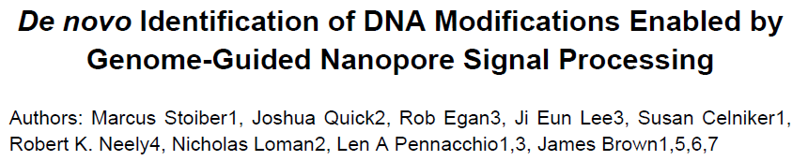
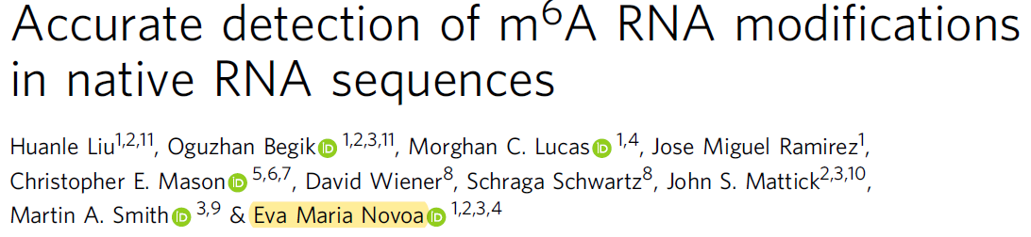
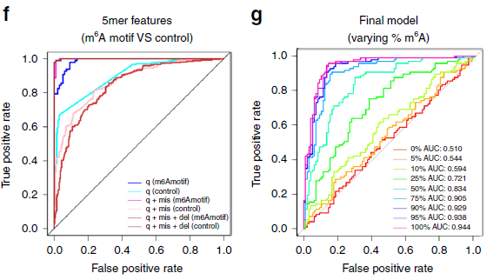
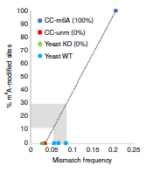
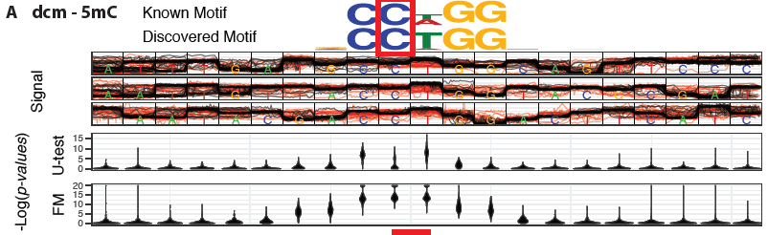
biorxiv, April 2017
Nature Communication, 2019 Sep
Tombo/nanoraw: https://nanoporetech.github.io/tombo/
resquiggle the genome to associate raw nanopore signal with genomic positions and unsupervised statistical testing
nomalized raw signal
EpiNano: https://github.com/enovoa/EpiNano
SVM model trained on IVT comprised all possible 5-mers using canonical A or m6A
base-called “errors” information: base quality, deletion frequency and mismatch frequency
no need for prior external or additional training data
effective visualization of raw nanopore signal in genomic contexts
reasonable accuracy at more than 25% of methylation ratio
linear regression to estimate the stoichiometry
DRS of polyA(+) from S. cerevisiae wt and ime4Δ
modification type depends on the non-modified control data
aligner not splice-aware
limited to m6A modification
not used to DRACH k-mer with more than one A

Slide 3
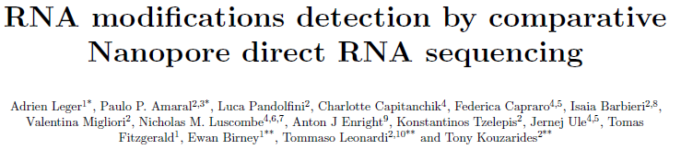
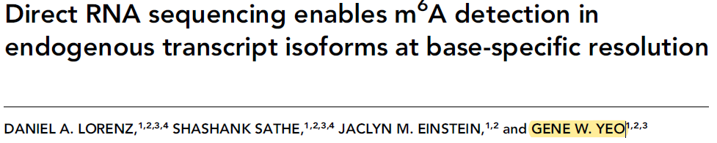
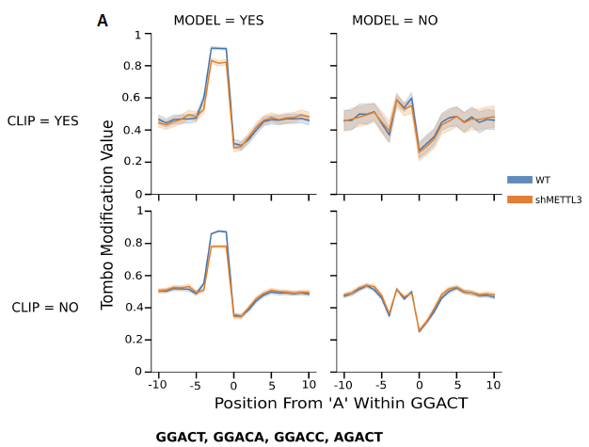
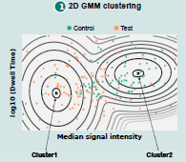
biorxiv, 2019 Nov
RNA, 2020 Jan
Nanocompore: https://github.com/tleonardi/nanocompore
various statistical test: Kolmogorov-Smirnov (KS),Mann-Whitney (MW) and Welch’s t-test.
median signal intensity and the log10(dwell time)
single-molecule modification probabilities from GMM clustering
MINES: https://github.com/YeoLab/MINES
random forest classifier trained on known miCLIP sites
fraction modification values calculated by tombo
a separate model for each 5mer within the DRACH motif
single site, isoform-level resolution
DRS of polyA(+) from HEK-WT, HEK-shMETTL3, HMEC-WT, HMEC-ALKBH5
does not require a training set
allows replicates to model biological variability
single molecule resolution, modification stoichiometry and combinatorics.
applied as-is to any RNA modification
DRS and miCLIP of polyA(+) from METTL3 KD and WT MOLM13 cells
limited to m6A sites within 4 specific DRACH sequences with AUC values >0.67
affected by the same biases and/or limitations as miCLIP
non-modified control data required: knock-downs, knock-outs, cDNA or IVT samples
modification type depends on the control data
unsuitable for the identification of very low frequency modifications

Slide 4
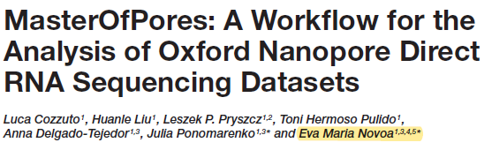
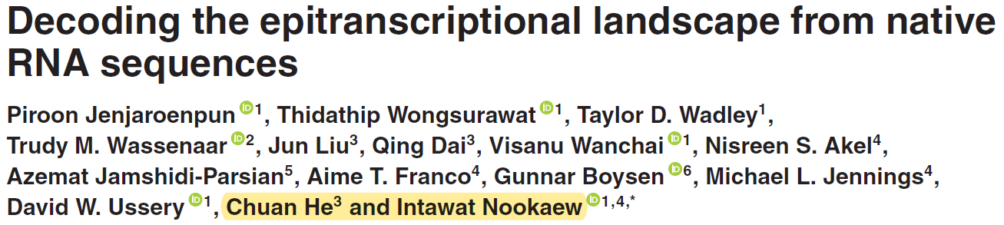
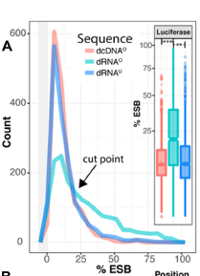
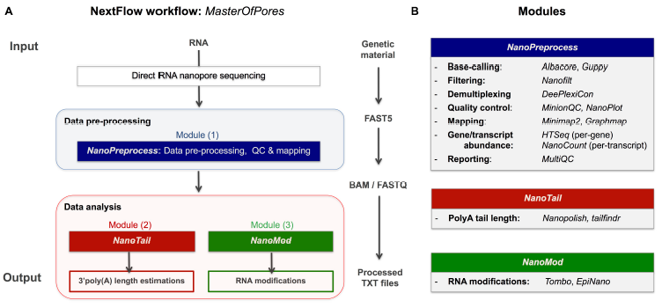
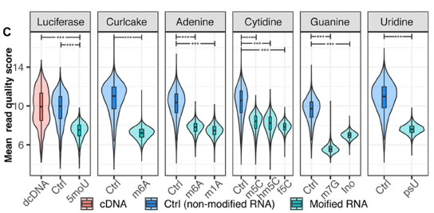
frontiers in Genetics, 2020 Mar
NAR, 2020 July
MasterOfPores: https://github.com/biocorecrg/master_of_pores
NextFlow framework to construct a standadized workflow to analyze DRS data
pre-processing and data analysis modules
one MinION run takes ~2h on a CPU cluster using 100 nodes and ~1h on a single GPU
ELIGOS: https://gitlab.com/piroonj/eligos2
Fisher’s exact test between the native RNA and a reference (IVT RNA, unmodified in vitro transcription RNA or a background error model (rBEM))
percent Error of Specific Bases (%ESB) differences
IVT of human mRNA to construct rBEMs of all pentamers
workflow management systems together with Linux containers
highly reproducible, scalable and parallelizable
support of differen batch schedulers, cloud platforms, GPU computing
sequence context, background errors, homopolymeric sequence
m6A, m1A, m5C, hm5C, f5C, psU, m7G, Ino
DRS and cDNA of IVT comprised all possible 5-mers using modified base or non-modified base such as B5(NNNNN containing at least one A)B5
DRS of Mettl3 KO, Mettl14 KO and control mESCs, various rRNA
requires two samples to detect RNA modifications
modification type not specified, not used to m5C
High %ESB values more frequently obtained with the native RNA

Slide 5
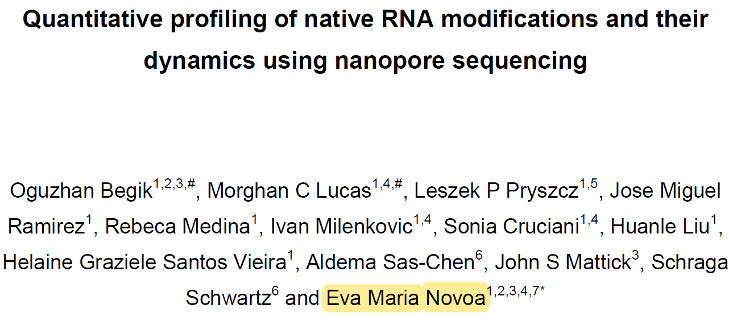
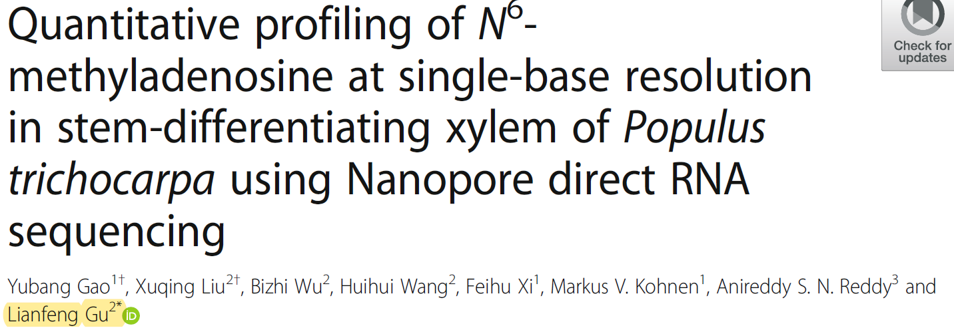
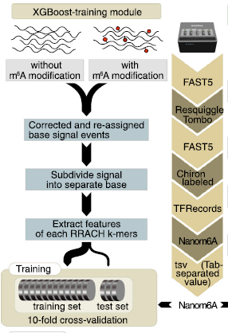
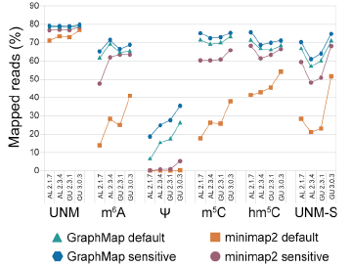
biorxiv, 2021 Jan
Genome Biology, 2021 Jan
nanoRMS: https://github.com/novoalab/nanoRMS
base-calling error features to identify the modified sites, KNN and k-means to bin read into two clusters accroding to per-read current intensity/trace features
Nanom6A: https://github.com/gaoyubang/nanom6A
XGBoost model trained on Epinano IVT dataset
mean, standard deviation, median, and dwell time of each read
Compare with published tools on several datasets
quantitative profiling of m6A in stem-differentiating xylem of Populus trichocarpa, 80% m6A sites validated by MeRIP-Seq and m6A-REF-seq
pseudouridine and 2'-O-methylation
quantitative identification, even at very low modification stoichiometriess
support RNA modification stoichiometry estimation using both nanopolish and tombo resquiggling
systematically analyze the features for different modifications and mapping tools
limited to m6A RRACH k-mers
base-calling errors features are not suitable for all modifications and sequence context
detection low stoichiometry was only possible when using comparison of pairwise conditions.

Slide 6
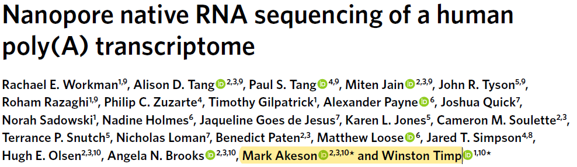
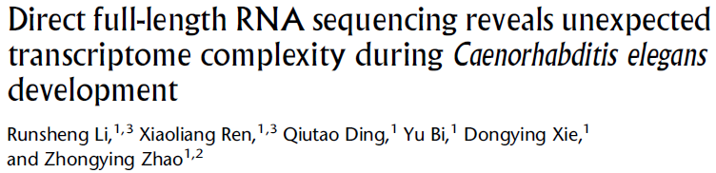

Nature Methods, 2019 Dec
Genome Research, 2020 Feb
DRS of polyA(+) of C. elegans embryo (EMB), L1 larva (L1), and young adult (YA)
full-length reads
TrackCluster: novel isoform identification and quantification
alternative use of promoter or polyadenylation sites
UTR extensions or truncations at the 5′ or 3′ end
new combinations of exons within the gene body
intron retention
isoform fusion
RNA modifications
DRS and cDNA seq of polyA(+) from GM12878, 30 flow cells in 6 laboratories, 9.9 million aligned reads
Isoform detection and analysis, allele-specific expression, poly(A) tail length, m6A and RNA editing
eLife, 2020 Jan
DRS and Illumina seq of polyA(+) and 5'-capped mRNAs from Arabidopsis wt, vir-1 mutant and VIR-GFP complemented seedlings, ERCC RNA spike-in
transcriptoin start site, novel splice sites and isoforms, m6A modifications, alternative polyadenylation site, poly(A) tail length

