Slide 1


Transposable elements quantification using RNA sequencing
Dingjie Wang, PhD
Department of Biomedical Informatics
Ohio State University
Feb. 19, 2021
Notes:
Today, I will present my recent work. In this project, we use long reads sequencing to reveal the transcritional dynamic landscape during early zebrafish embryogenesis.

Slide 2
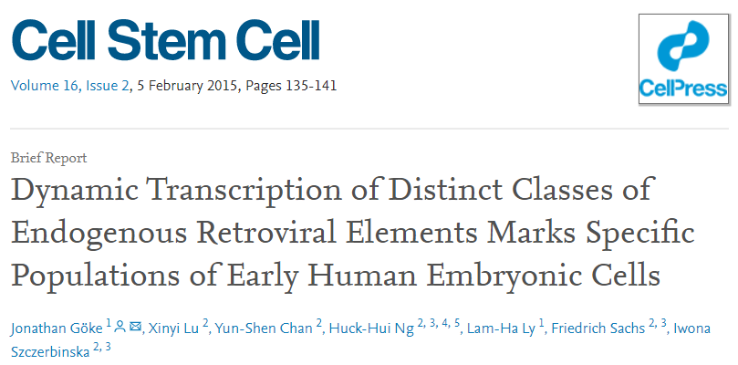
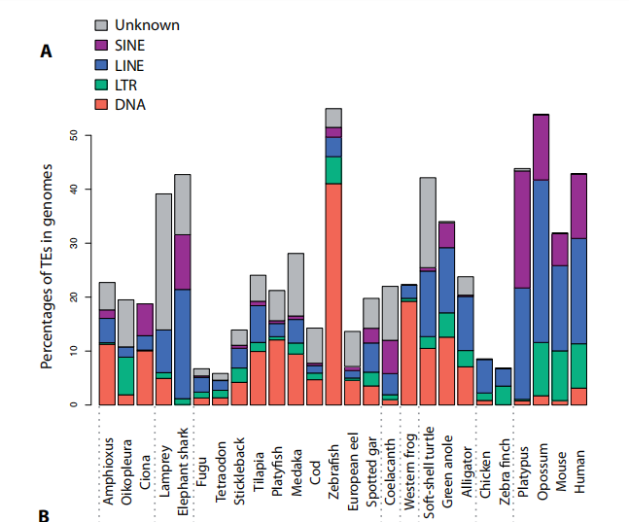
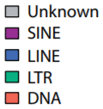
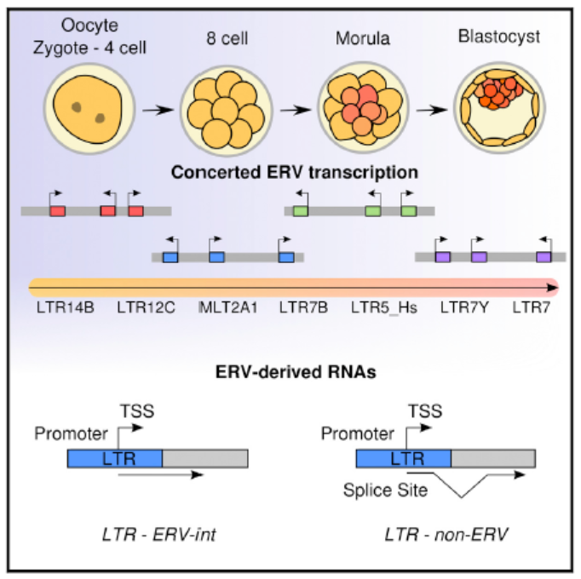
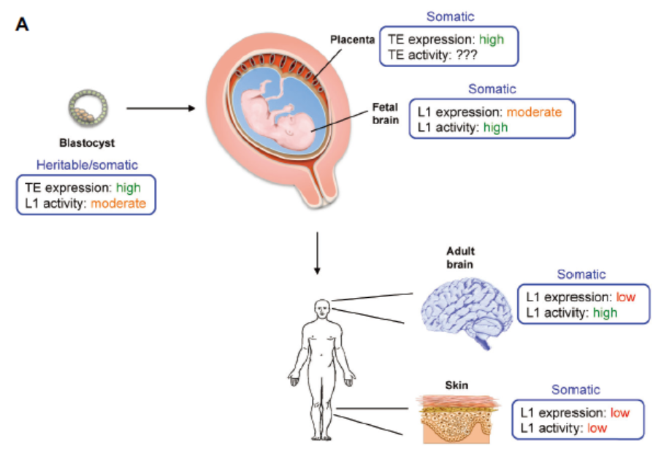
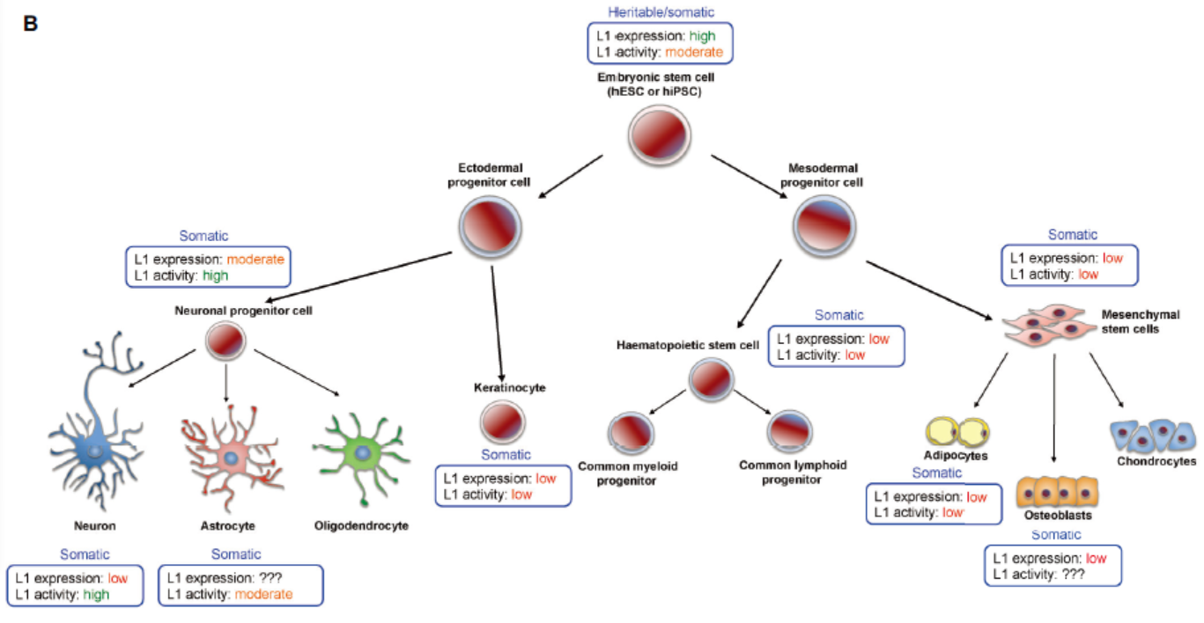
Background
Percentages of TEs in the different vertebrate and nonvertebrate genomes
Question: For these TEs with high repetitive sequences, how to achieve accurate quantification?
Ref. Chalopin D, et al. Genome biology and evolution, 2015, 7(2): 567-580.
Tissues
LINE-1 expression and activity in humans: from tissues to cells.
Cell Lines
Garcia-Perez J L et al. Development, 2016, 143(22): 4101-4114.
Notes:
We can significantly reduce the ambiguous mapping fraction.

Slide 3
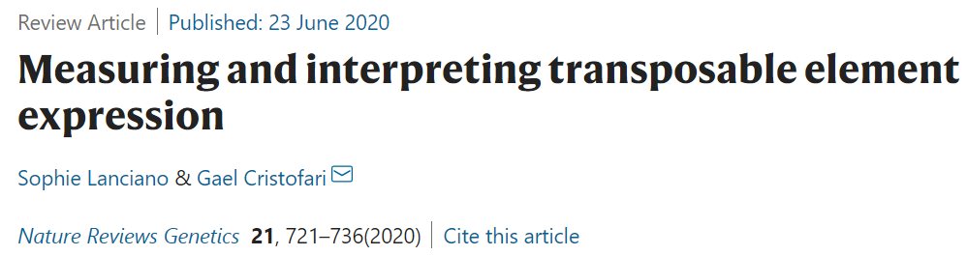
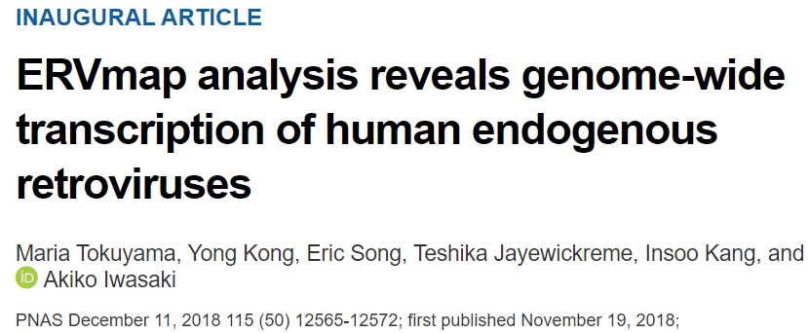
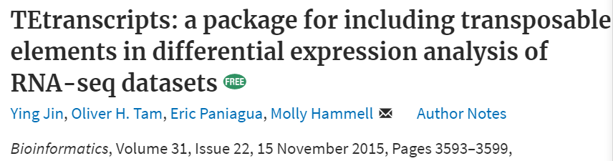
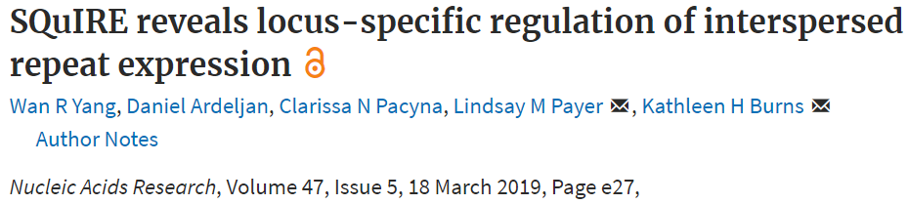
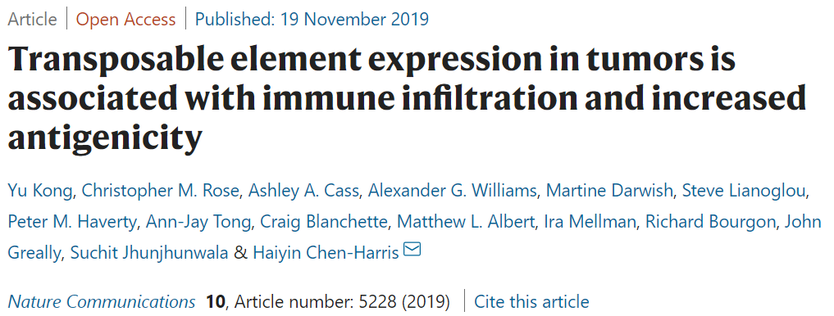

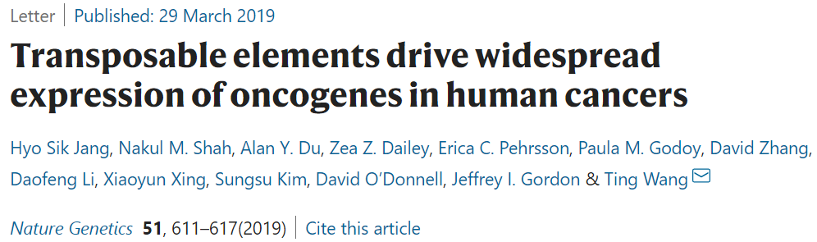
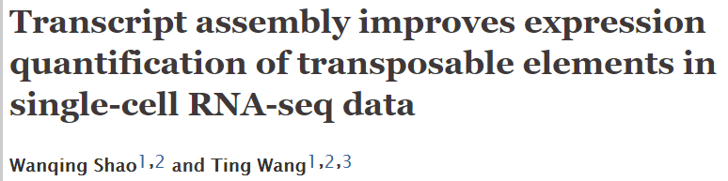
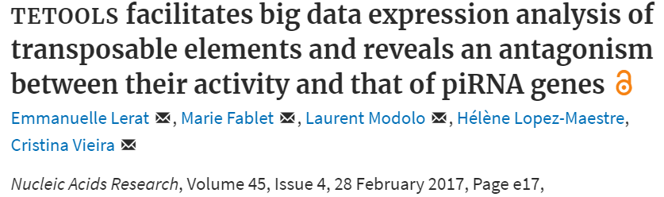
Recent research advances
Review paper:
Quantification at subfamily-level
Quantification at locus-level
One of the most used tools, tested on a wide variety of organisms (citation >150)
TElocal: A package for quantifying transposable elements at a locus level of RNA-seq datasets.
https://github.com/mhammell-laboratory/TElocal
Quantification in single-cell RNA-seq dataset

Slide 4
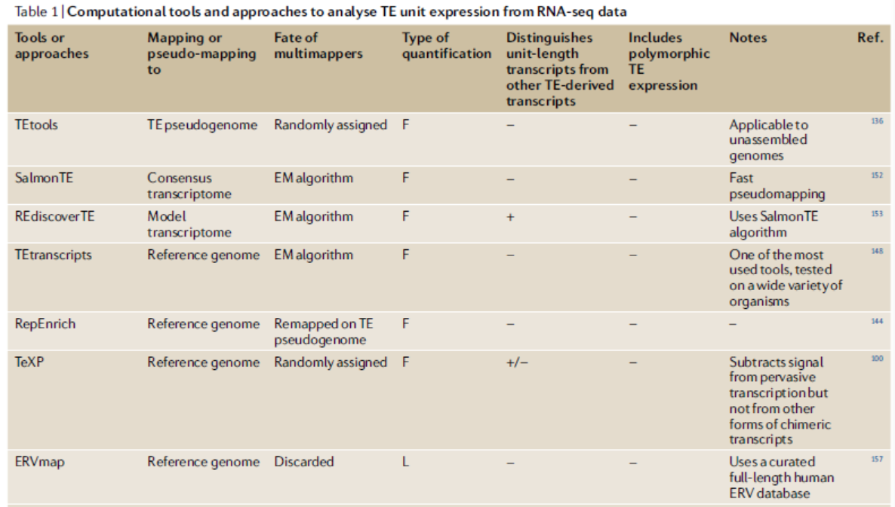
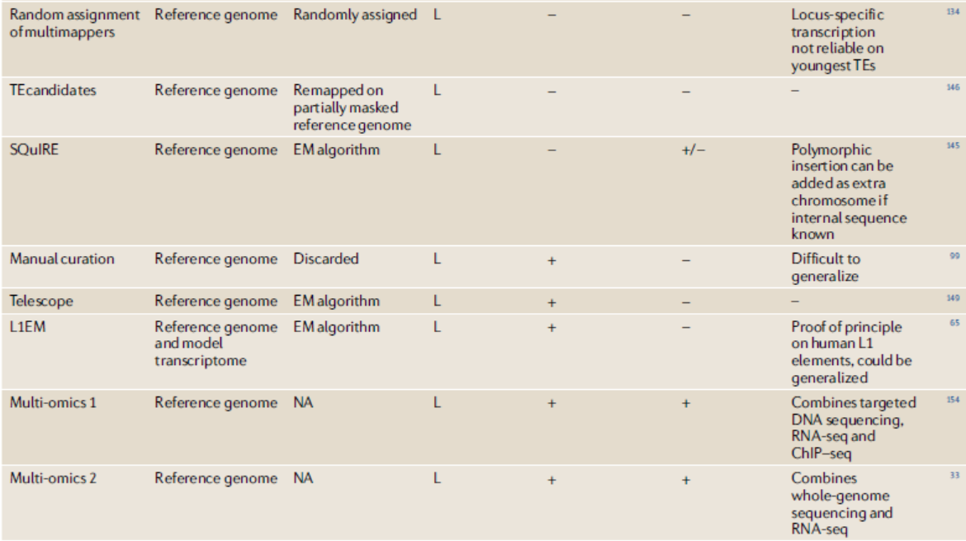
Recent research advances
How to treat multi-mapping reads:
Discarded
Randomly assigned
EM algorithm
Lanciano S, Cristofari G. Nature Reviews Genetics, 2020, 21(12): 721-736.

Slide 5
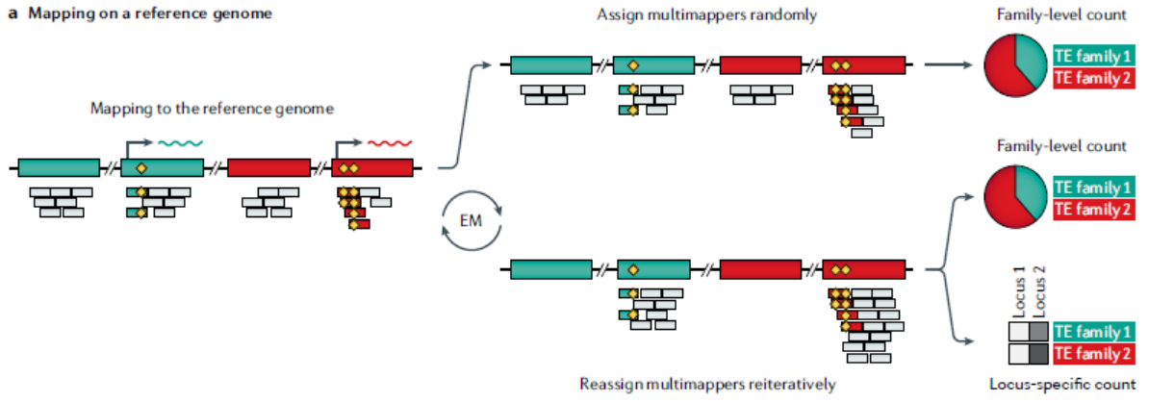
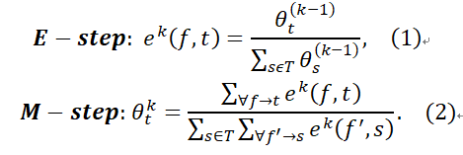
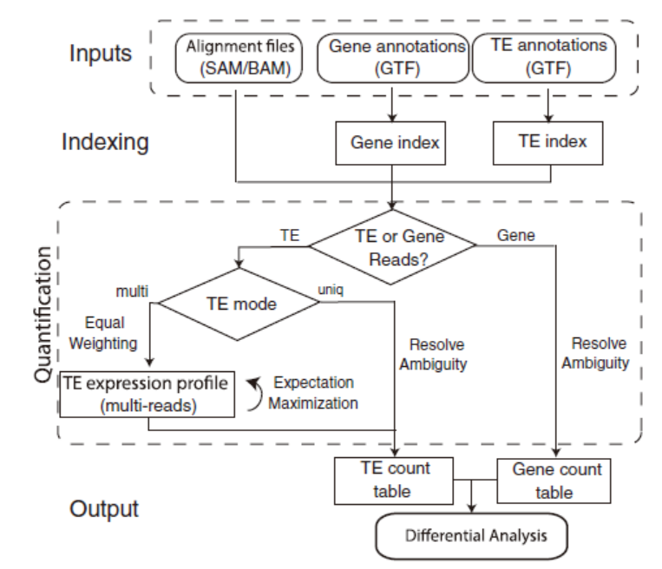
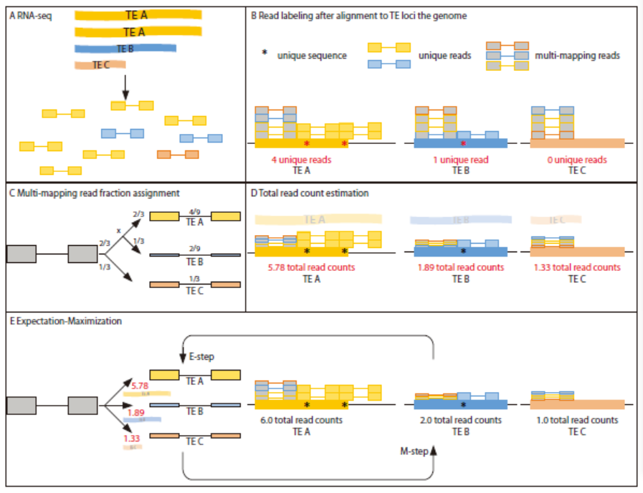







How to achieve the initial assignment of multi-mapping reads?
Lanciano S, Cristofari G. Nature Reviews Genetics, 2020, 21(12): 721-736.
TEtranscripts: equal assignment
SQulRE: the initial assignment is based on unique reads proportion
Normalized by the number of unique read positions
Jin Y, Tam O H, Paniagua E, et al. Bioinformatics, 2015, 31(22): 3593-3599.
Yang W R, et al. Nucleic acids research, 2019, 47(5): e27-e27.

Slide 6
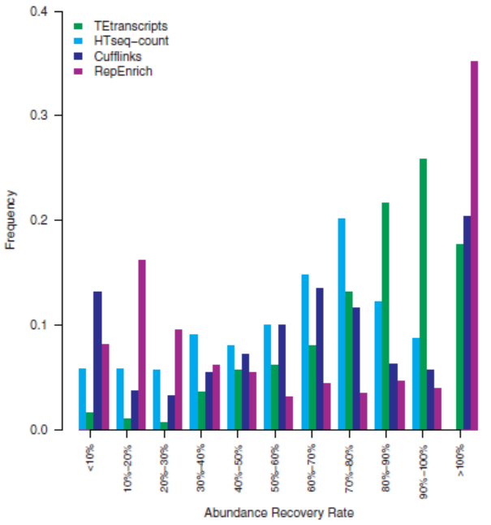
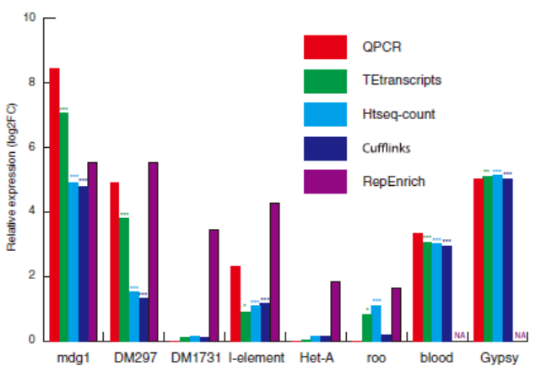

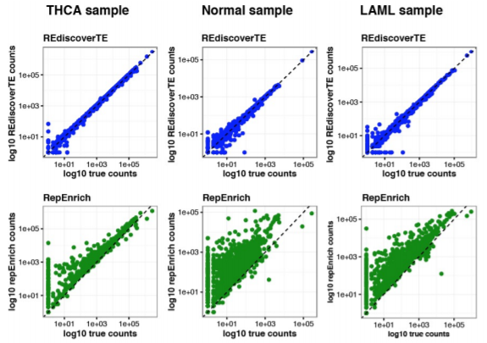
Jin Y, Tam O H, Paniagua E, et al. Bioinformatics, 2015, 31(22): 3593-3599.
Limitation of current methods:
All methods are based on short read RNA-seq dataset;
Most of methods only focus on the quantification at subfamily-level;
There is no good methods to assign multi-mapping reads to each TE loci.
Lack of method based LR or LR+SR for TE quantification.
Kong Y, et al. Nature communications, 2019, 10(1): 1-14.

