Slide 1

Single-cell sequencing technology
Yunhao Wang Ph.D.
July 23, 2020
Department of Biomedical Informatics
Ohio State University

Slide 2
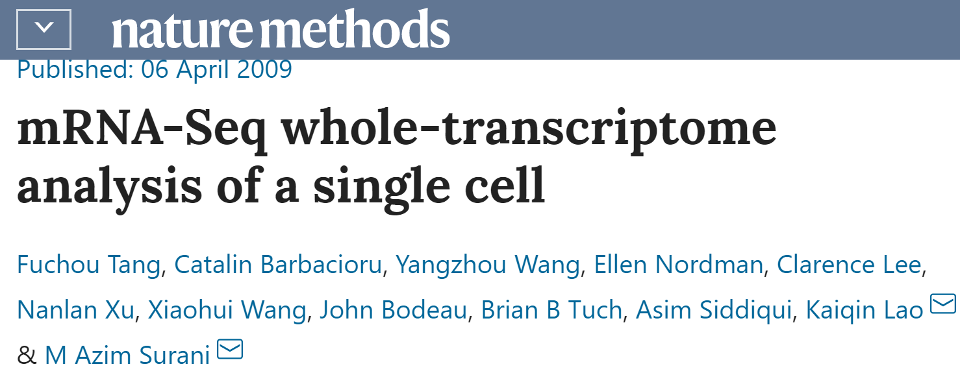
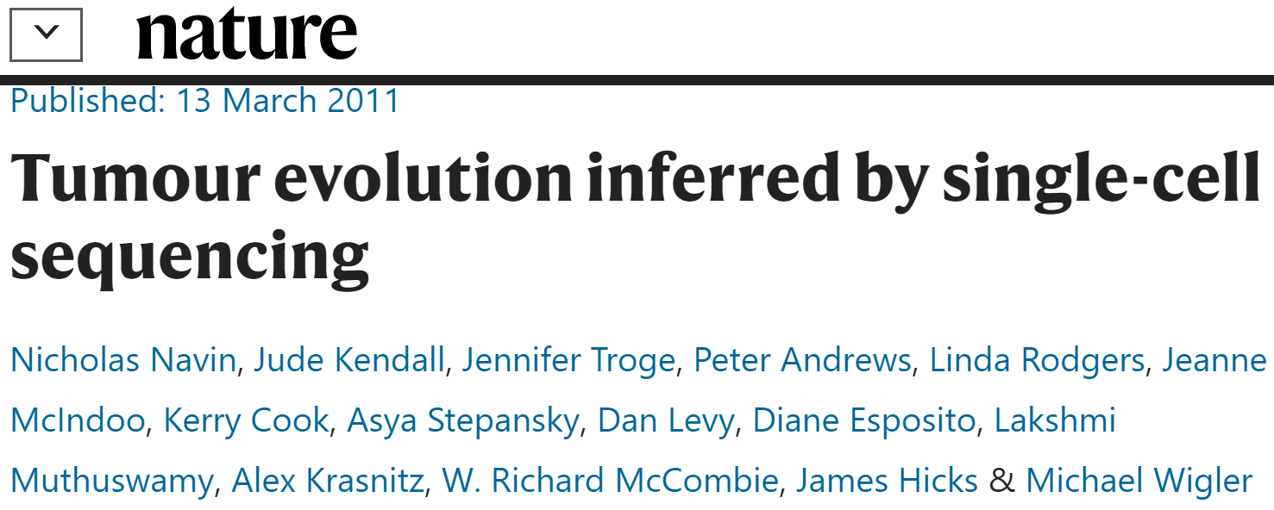

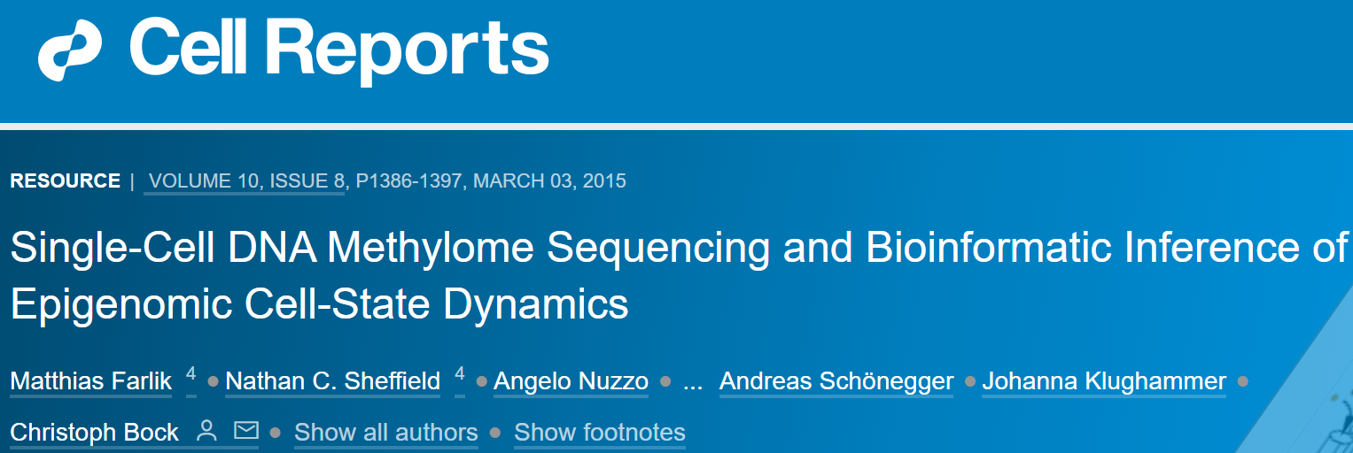
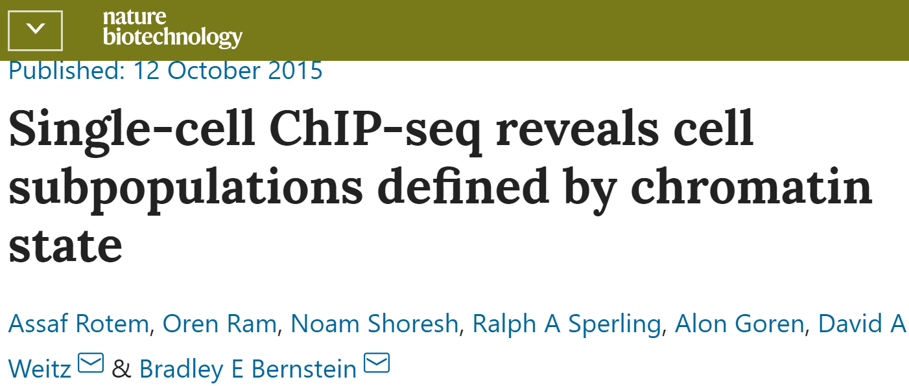
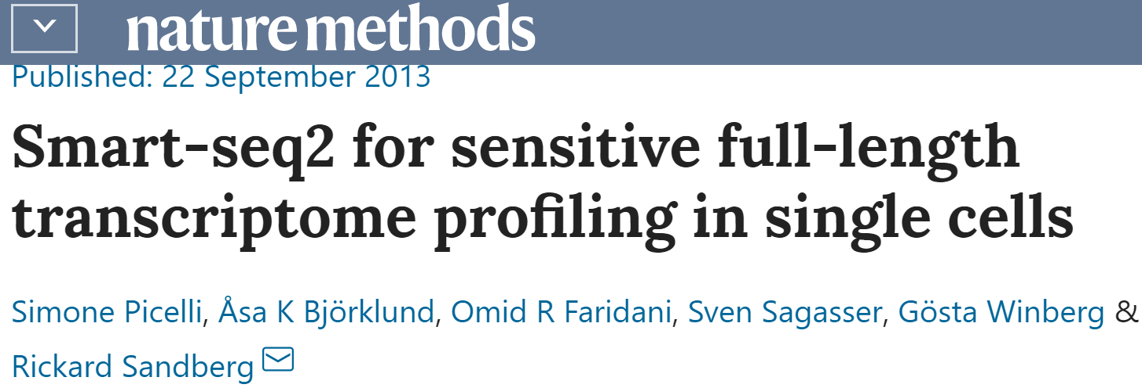


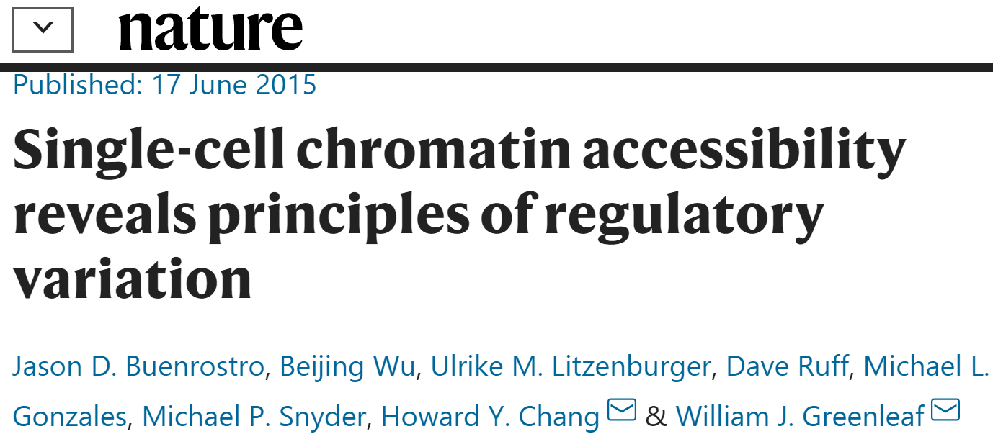
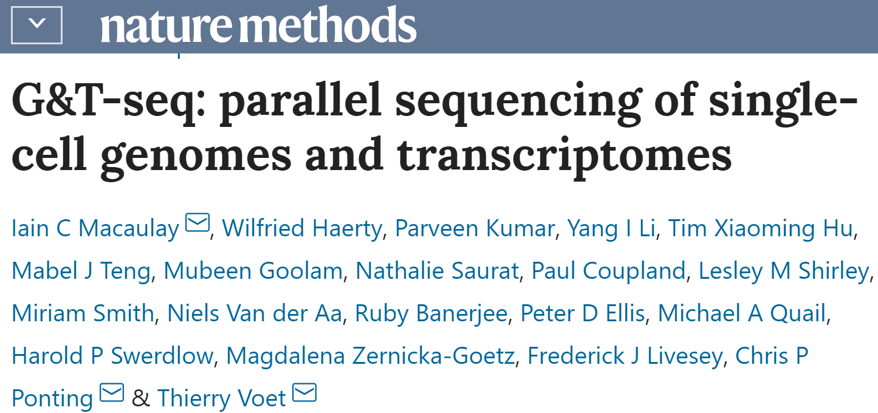
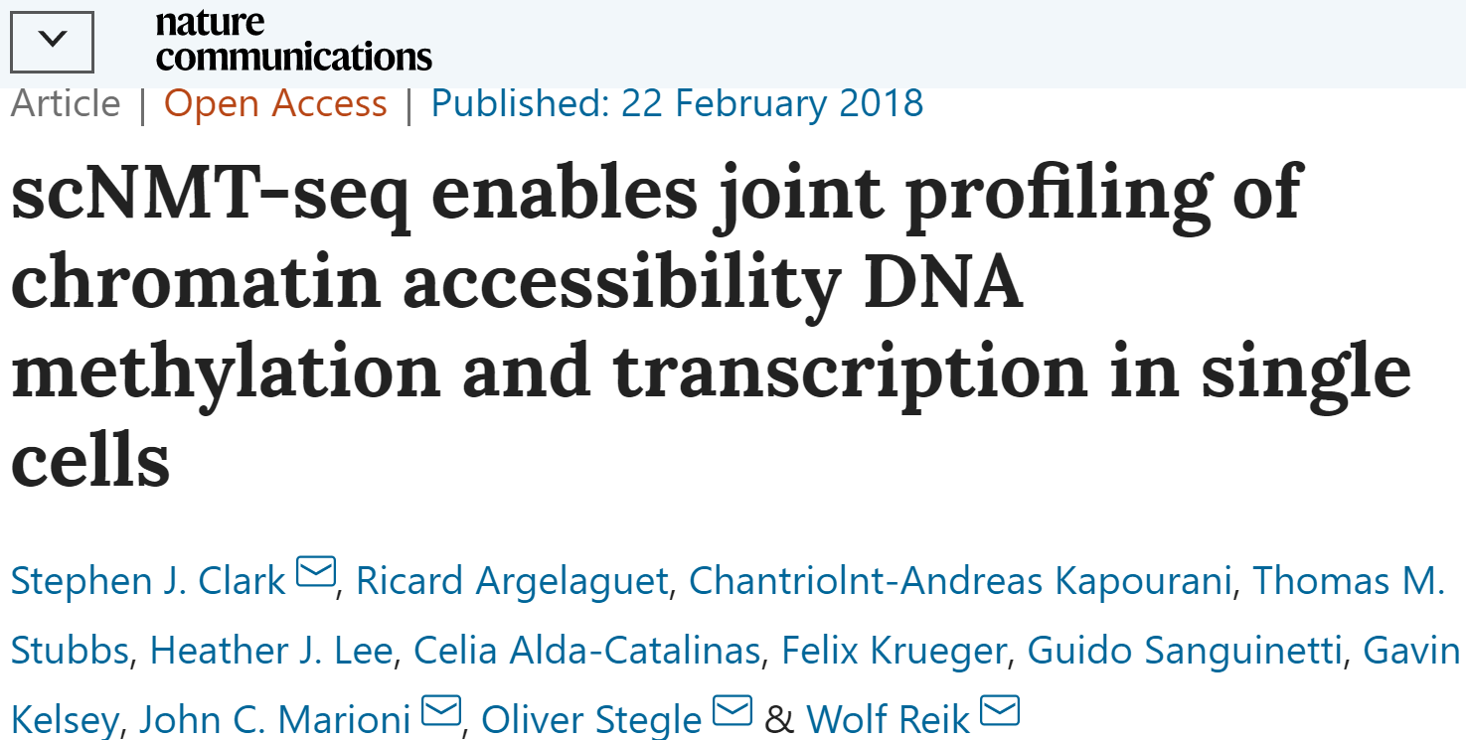
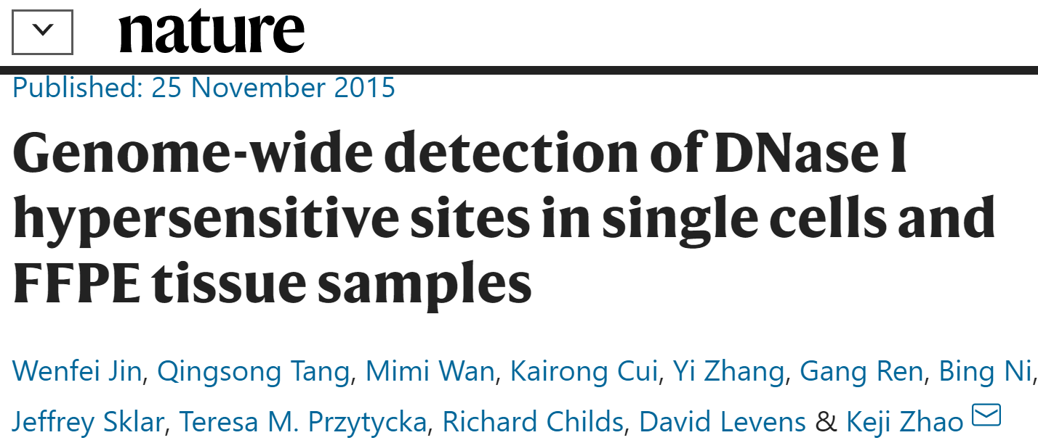
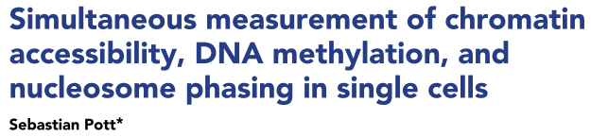
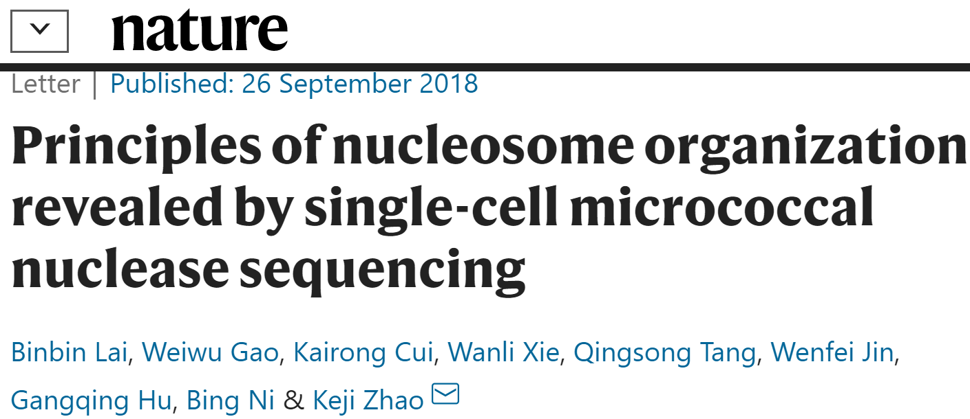
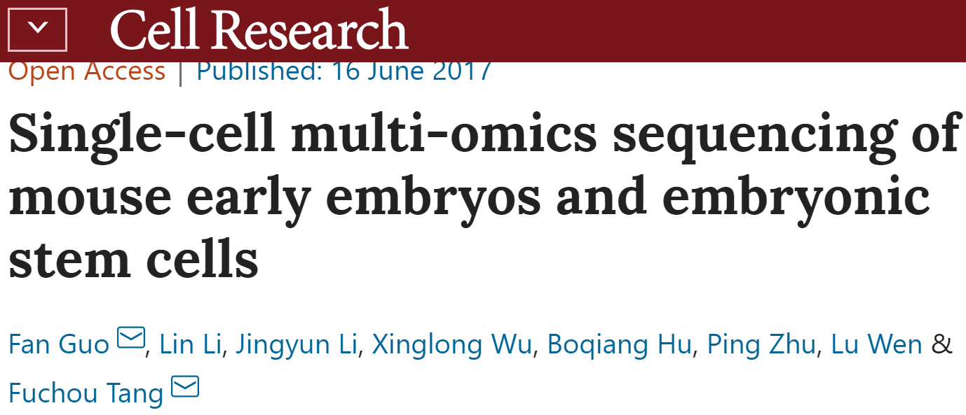
Timeline of single cell sequencing milestones since 2009
2009: scRNA-seq
2011: scWGS
2013: scHi-C
2015: scWGBS-seq
2015: scChIP-seq
2013: single-cell full-length RNA-seq
2012: scExome-seq
2015: scDamID-seq
2015: scATAC-seq
2015: scG&T
Genome + Transcriptome
2018: scNMT-seq
Transcriptome + Epigenome
2015: scDNase-seq
2017: scNOMe-seq
2017: scTrio-seq
Genome + Transcriptome + Epigenome
2018: scMNase-seq
2017: scCOOL-seq

Slide 3
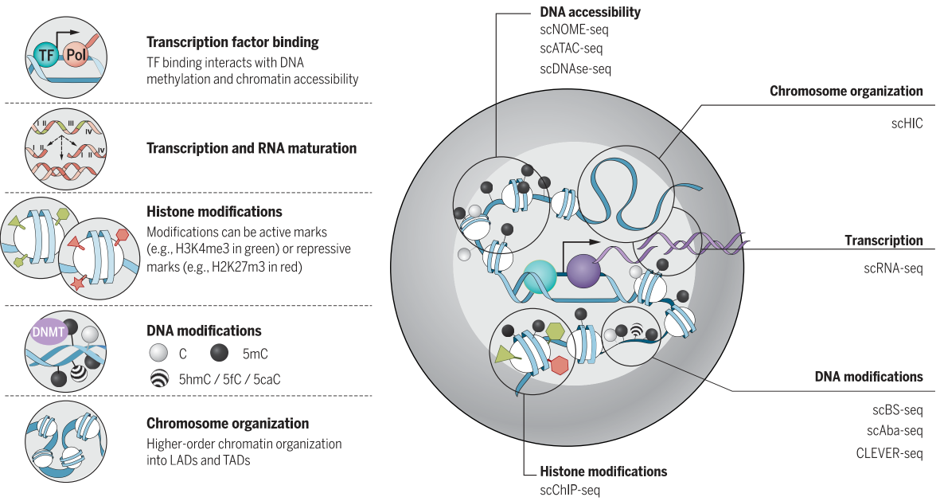
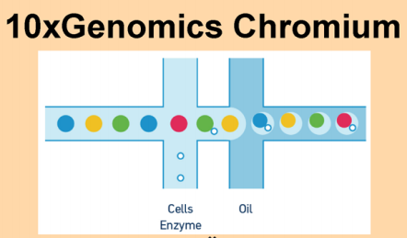
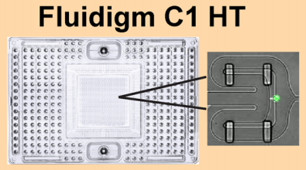
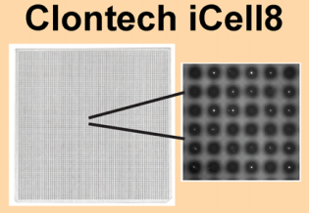
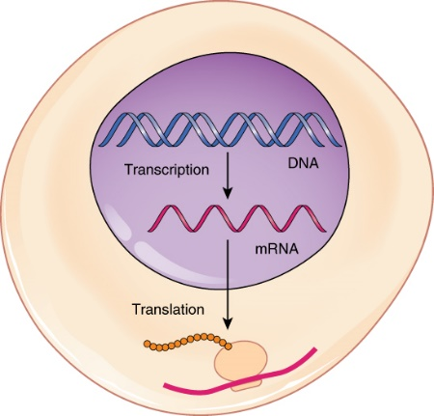
scRNA-seq vs single-cell genome/epigenome sequencing
Sequencing usually requires
Nanogram – microgram
How to perform single-cell sequencing?
A single diploid mammalian cell
DNA
Two copies: paternal and maternal
~6 pg
RNA
360,000 mRNA molecules; 12,000 different transcripts
10-30 pg total RNA, 1-5% of them are mRNA
PCR amplification
Pull single cells together (barcoding)
Kelsey, et al. Science (2017); Wang, et al. bioRxiv (2019); https://open.oregonstate.education/aandp/chapter/3-4-protein-synthesis/

Slide 4
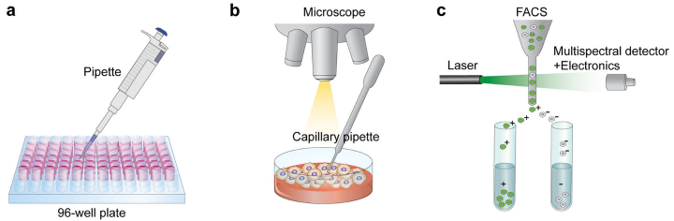
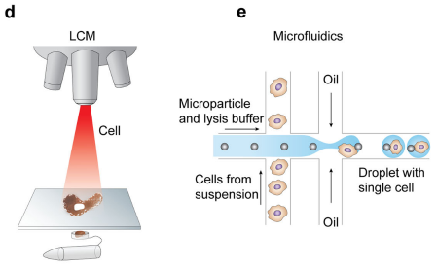
Single-cell isolation
Flow-activated cell sorting
Laser capture microdissection
Hwang, et al. Exp Mol Med (2018)

Slide 5
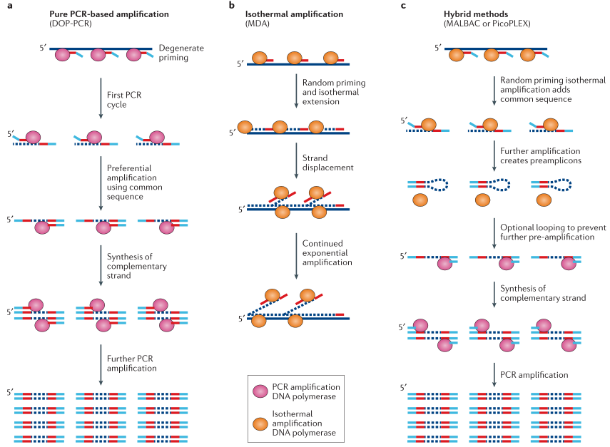
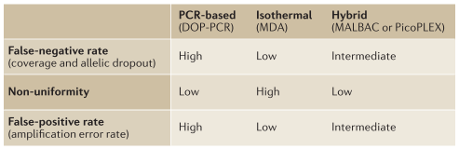
Whole-genome amplification + Cell barcoding
Errors/issues during WGA
Loss of coverage
MDA: 84%
MALBAC: 72%
DOP-PCR: 39%
Decreased coverage uniformity
Allelic imbalance/allelic dropout
Errors during PCR amplification
Gawad, et al. Nat Rev Genet (2016)

Slide 6
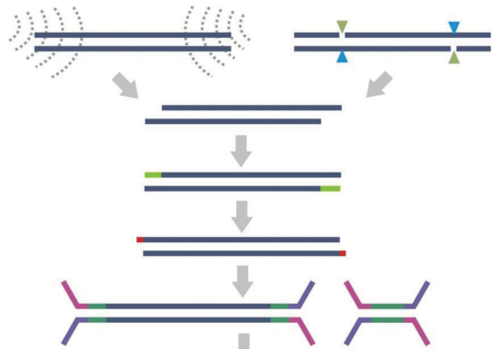
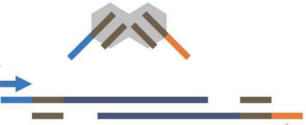
Barcoding in a PCR-free way
DNA ligase-based
Transposase-based
(simper, faster)
Sonication Enzyme
Tn5 transposase complex with adaptors
Fragmentation
End repair
dA addition
A
A
“Cut and Insert”
Adaptor ligation
Single-cell single-molecule long-read sequencing (transposase-based barcoding + PacBio/ONT)
Large cell number: an automatic platform (e.g., 10X)
Cost: Tn5 complex with different barcodes
Adey, et al. Genome Biol (2010)

Slide 7
Thanks

