Slide 1

Regulation of transposable element transposition at the final layer
Yunhao Wang Ph.D.
August 7, 2020
Department of Biomedical Informatics
Ohio State University

Slide 2
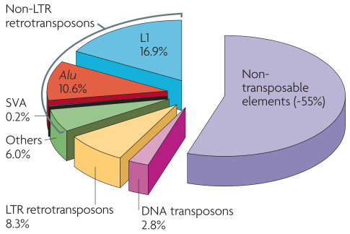
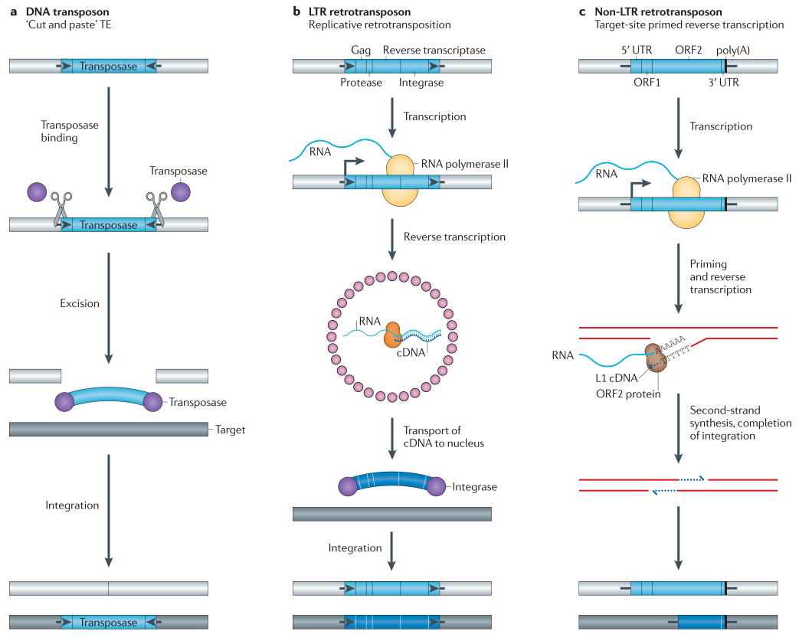
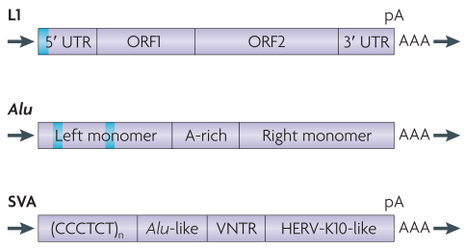
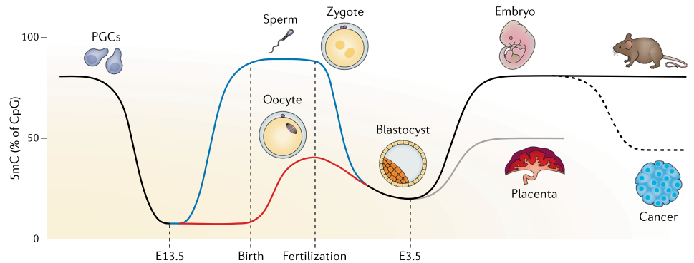
Transposable element (TE)
“Cut-Paste”
“Copy-Paste”
“Copy-Paste”
~45% of human genome
DNA
LTR
(e.g., HERV)
Active TEs
~6 kb; >50,000 copies
~300 bp; >1 million copies
~2 kb; ~3,000 copies
Transposition/mobilization
Cordaux, et al. Nat Rev Genet (2009); Levin et al. Nat Rev Genet (2011); Deniz, et al. Nat Rev Genet (2019)

Slide 3
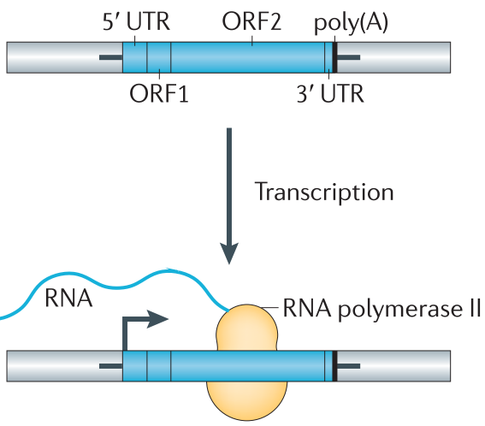
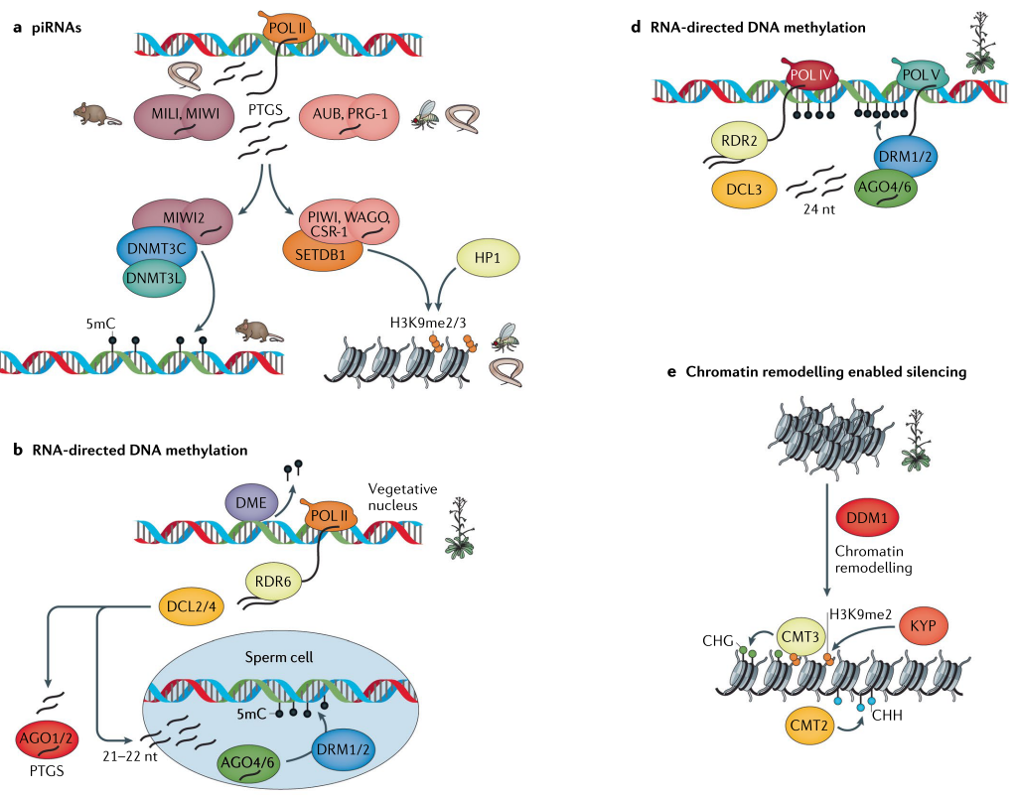
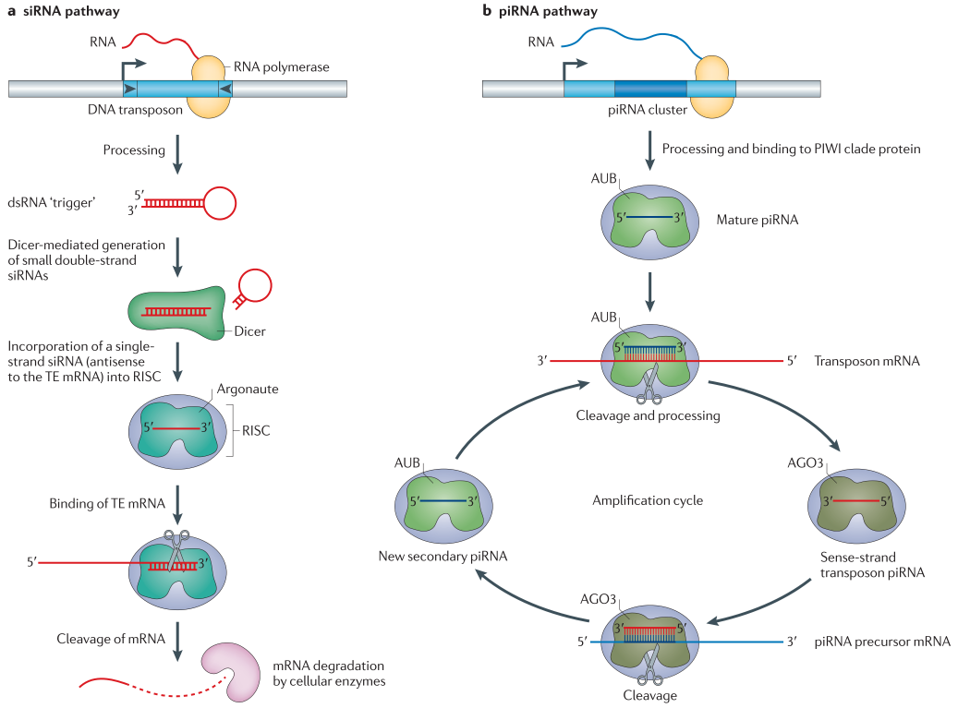
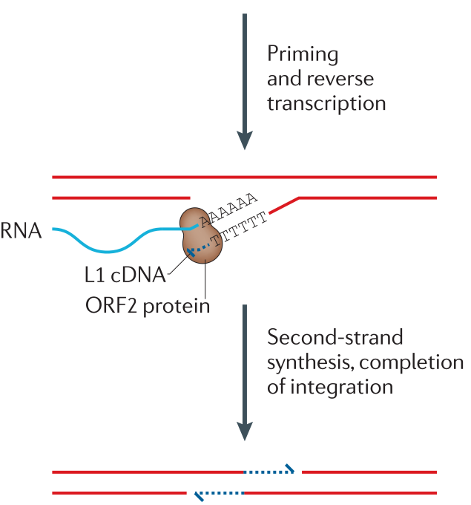
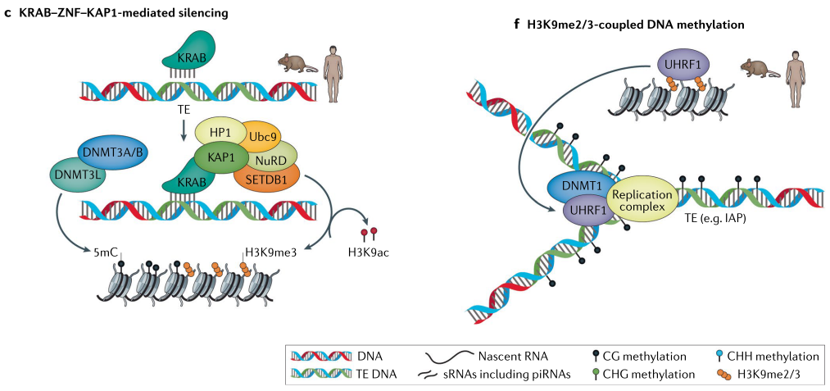

Regulation of TE activity at different layers
L1 transposition process
First-layer defense: Transcription repression
DNA methylation
Histone modification
Transcription factor
Second-layer defense: mRNA degradation
Small interfering RNA
miRNA
piRNA
Origin/Donor
mRNA
DNA
Final-layer defense:
Receiver (target genomic region)
Sequence feature
Epigenetic status
…
DNA
?
Target/Receiver
insertion site
Levin et al. Nat Rev Genet (2011); Deniz, et al. Nat Rev Genet (2019)

Slide 4
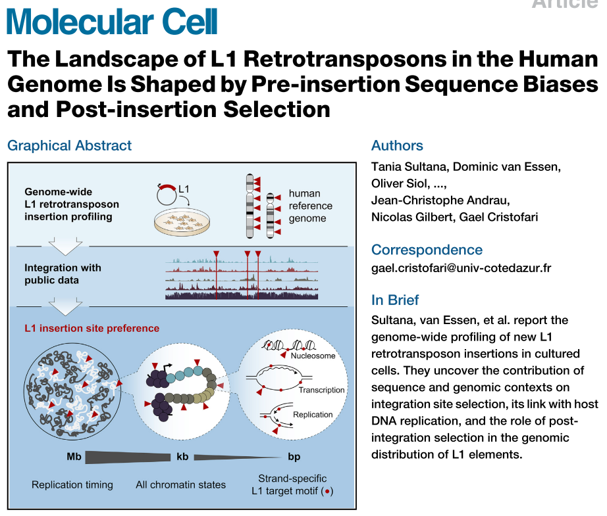
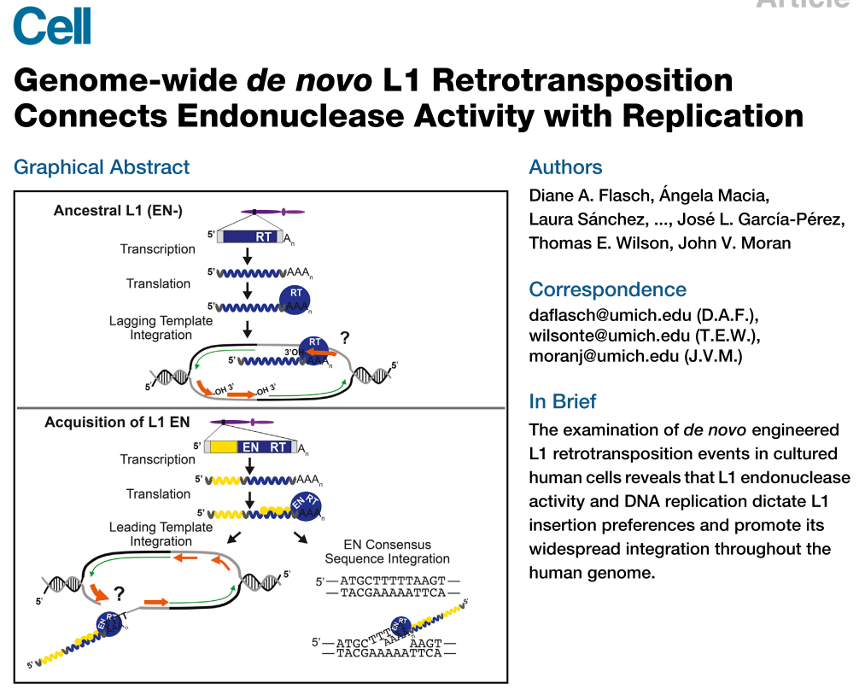
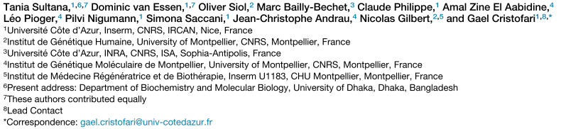
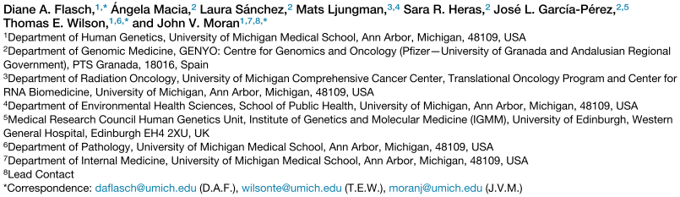


Regulation of L1 transposition at the final layer: insights from in vitro studies
Ion Torrent
~400 bp
WGS
HeLa cell line
1565 insertions
PacBio
300-1200 bp
Target
4 human cell lines
>88,000 insertions

Slide 5
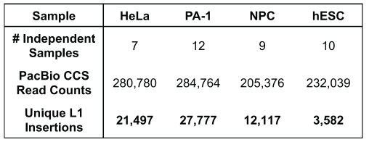

Genomic/epigenomic feature of L1 insertion sites
HeLa: epithelial, adenocarcinoma
PA-1: epithelial, teratocarcinoma
hESC: H9 cell line
NPC: H9-derived neural progenitor cells
Sequence
Homogeneous throughout the genome
Genic
Intergenic
Functional elements (enhancer, promoter)
No/weak association with
Gene transcription
Histone modifications
Chromatin accessibility

Slide 6
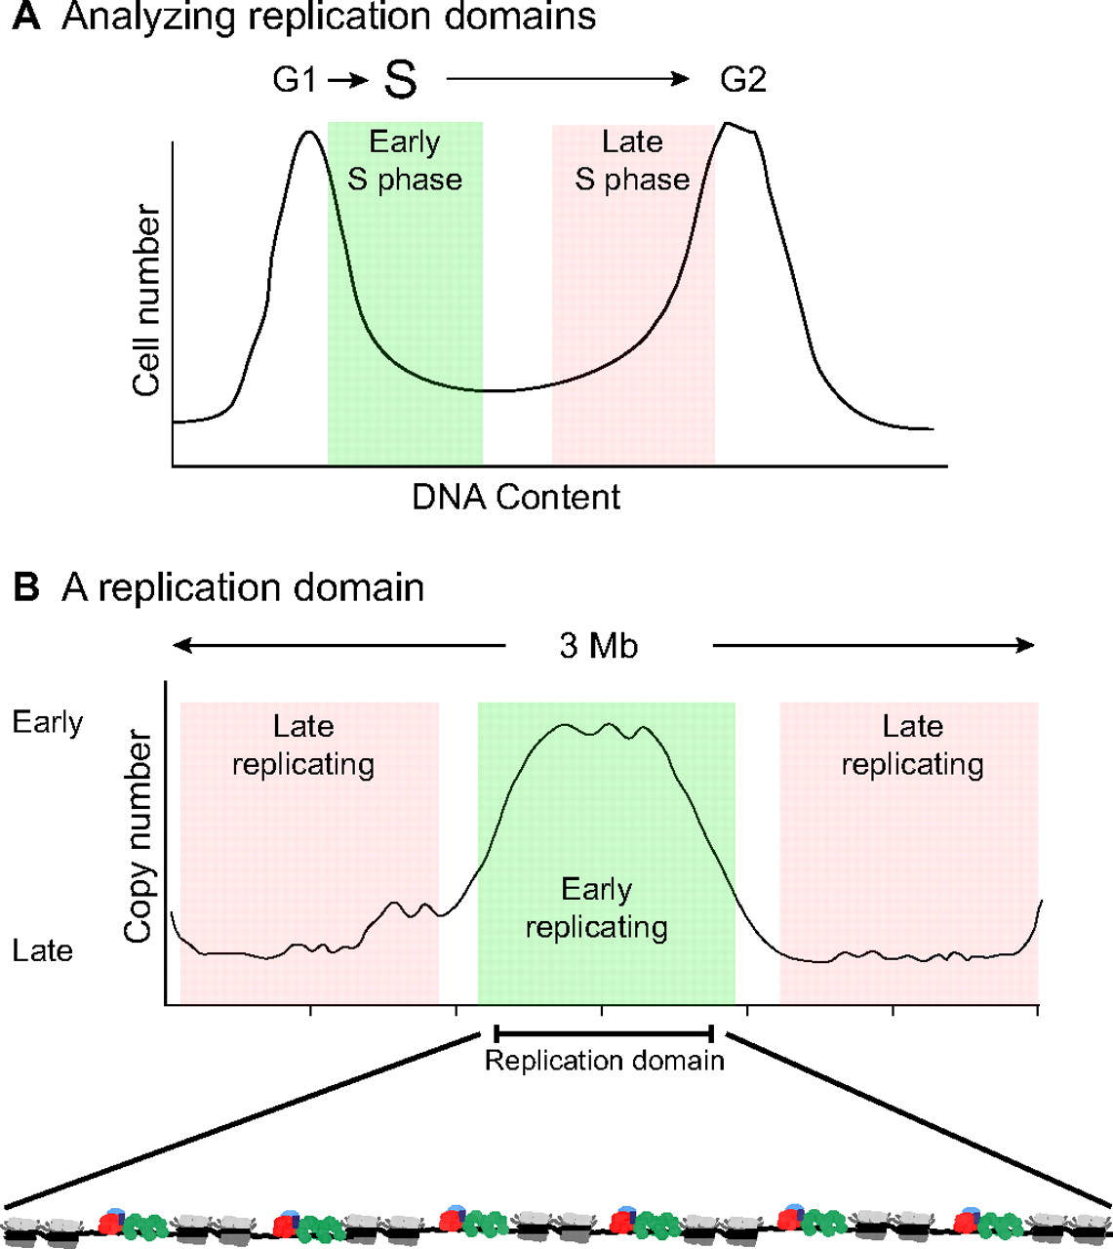
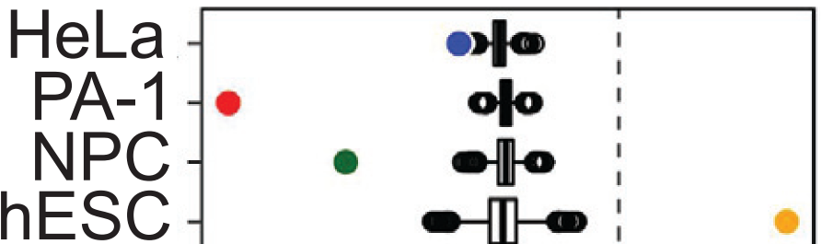

L1 insertion vs Replication timing: early (hESC) or late (PA-1) S phase of cell cycle
DNA replication
Fraction of L1 insertions at the early replication region

Slide 7
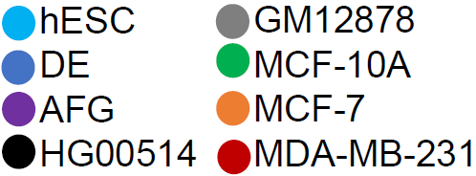
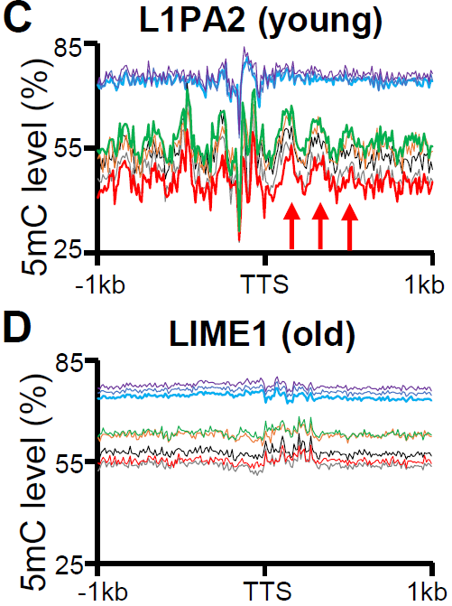
Differential DNA methylation pattern between cell types?
hESC: human embryo stem cell
DE: definitive endoderm
AFG: anterior foregut
HG00514/GM12878: lymphocyte
MCF-10A: epithelial, breast tissue
MCF-7/MDA-MB-231: breast cancer

Slide 8
Limits and Directions
Blind to the full-length of L1 insertions
3’end PacBio target sequencing (Cell)
Short-read sequencing (Mol Cell)
No matched data for epigenetics data
Before and after L1 insertion
No DNA methylation or nucleosome positioning analyses
Association
Full-length insight of L1 insertion
MeSMLR-seq
Matched data for epigenetic markers
DNA methylation
Chromatin accessibility
Nucleosome positioning
MeSMLR-seq + Others
TE/L1 insertion
DNA replication
DNA methylation
Nucleosome positioning

Slide 9
Thanks

