Slide 1

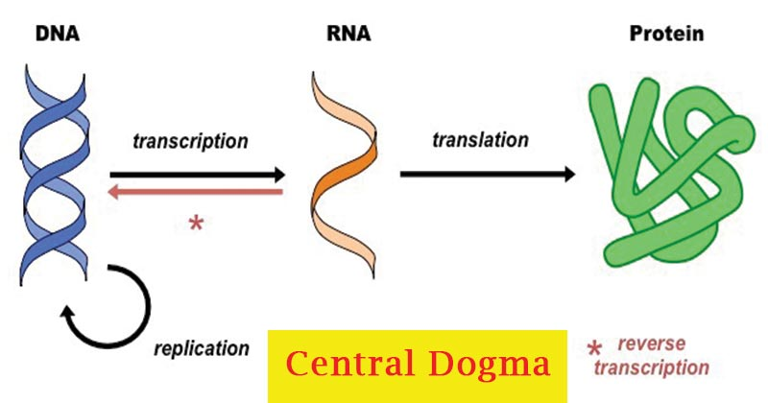
DNA, RNA and protein sequencing by biological nanopores
Yunhao Wang Ph.D.
August 21, 2020
Department of Biomedical Informatics, Ohio State University
https://microbenotes.com/central-dogma-replication-transcription-translation/

Slide 2

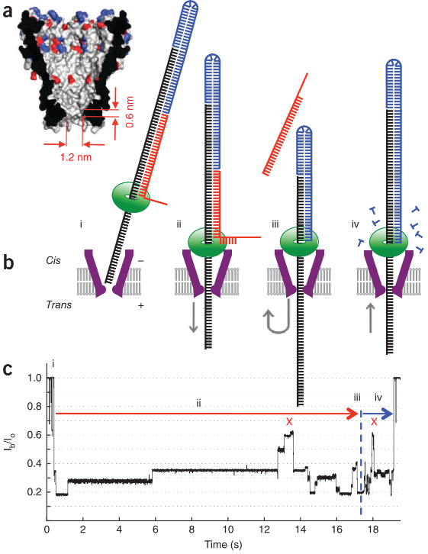

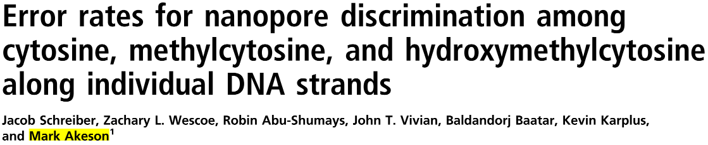
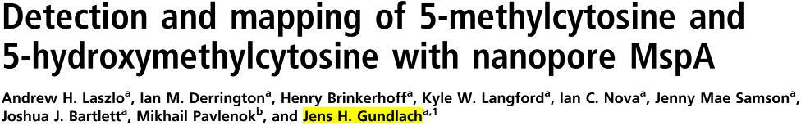
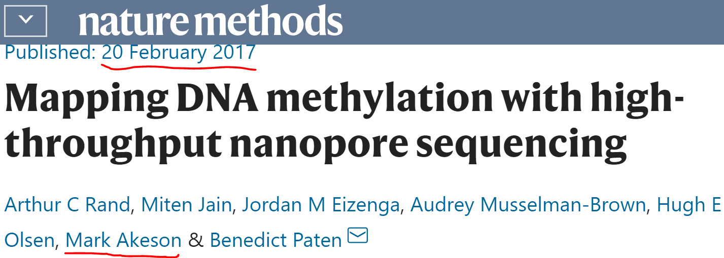
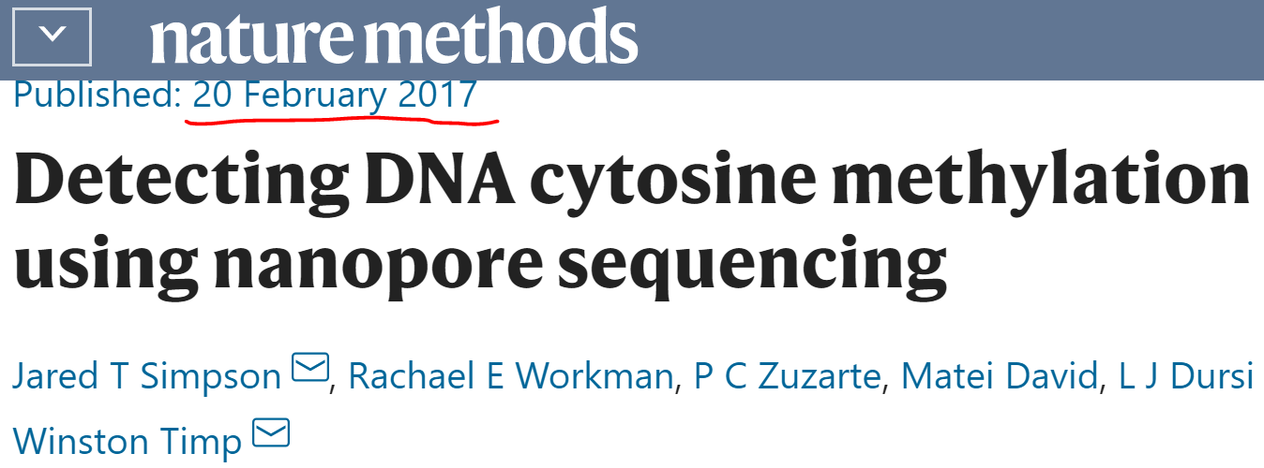
Paper 1: Automated forward and reverse ratcheting of DNA in a nanopore at 5- Å precision Gerald M Cherf @ UCSC; Mark Akeson @ UCSC; 2012
Paper 2: Reading DNA at single-nucleotide resolution with a mutant MspA nanopore and phi29 DNA polymerase Elizabeth A Manrao @ U of Washington; Jens H Gundlach @ U of Washington; 2012
Topics
Nanopore DNA sequencing
Methods
Akeson: α-hemolysin (pore) + phi29 DNA polymerase (motor)
Gundlach: MspA + phi29
ONT: CsgG for R9.4 flow cell
Results
Four canonical bases (A, T, C, G)
Chemically-modified bases (e.g., 5mC, 5hmC)
Pore
Motor protein
Ionic current changes

Slide 3
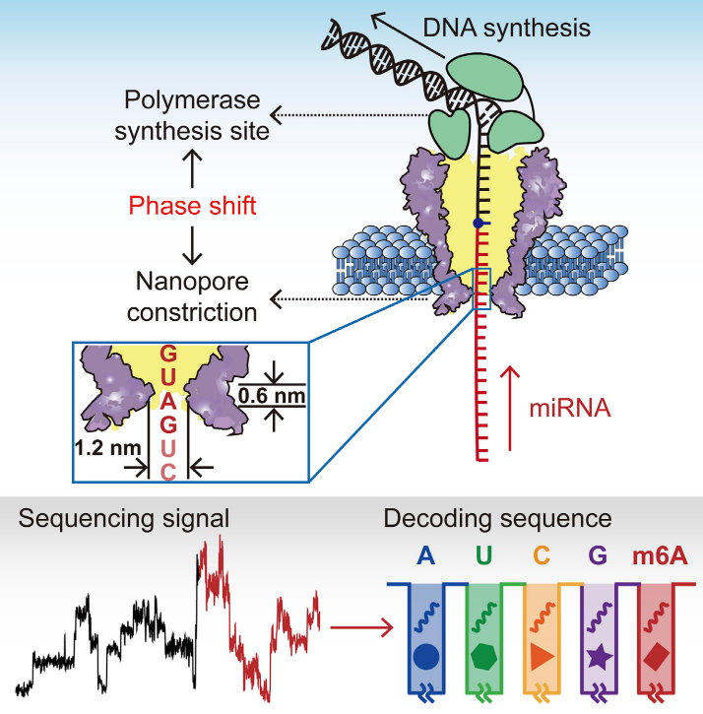

Paper 1: Highly parallel direct RNA sequencing on an array of nanopores Daniel R Garalde; Daniel J Turner @ ONT; Nature Methods, 2018
Paper 2: Direct microRNA sequencing using nanopore-induced phase-shift sequencing Jinyue Zhang; Shuo Huang @ Nanjing University, China; iScience, 2020
Topics
Nanopore direct RNA sequencing
Methods and data
Turner/ONT: CsgG; long stretch
Nanopore configuration
Motor proteins
Huang: MspA; short stretch
miRNA (~22 nt)
Results
Four canonical bases (A, U, C, G)
Chemically-modified bases (e.g., m6A)
Library preparation
To protect the sequencing library from enzymatic extension in the solution

Slide 4
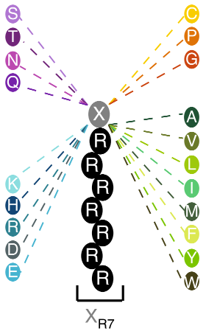
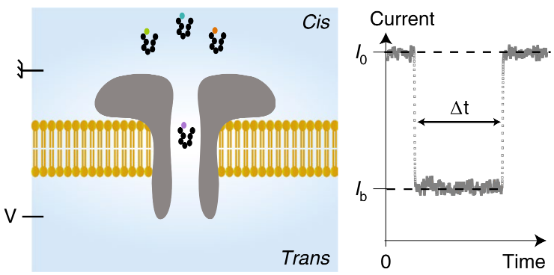
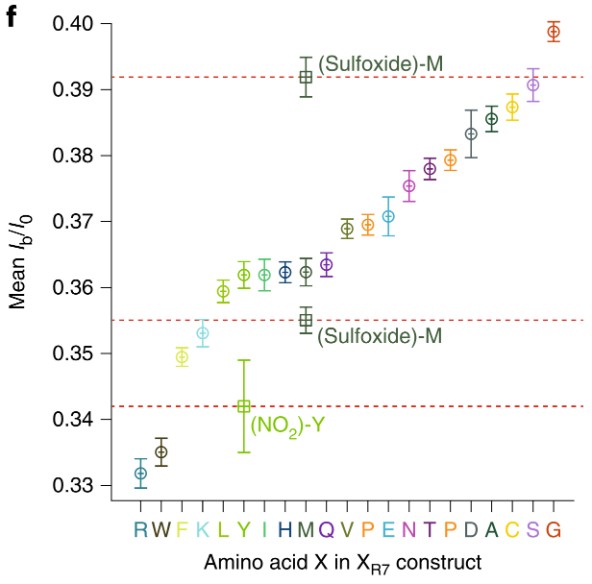
Electrical recognition of the twenty proteinogenic amino acids using an aerolysin nanopore Hadjer Ouldali; Abdelghani Oukhaled @ Université Paris-Seine (巴黎第十一大学), France; 2020
Library preparation Sequencing
Topics
Nanopore protein sequencing
Methods
Aerolysin
Results
13 of 20 natural amino acids with WT aerolysin
All 20 amino acids with the help of chemical modifications, instrumentation advances and nanopore engineering
Outlook
Residue-by-residue protein sequencing
Residue-specific post-transcriptional modification detection
A peptide chain continuously passes through the nanopore?
Tether a protein digestion enzyme to the aerolysin?
A cationic carrier of seven arginine amino acids (R7)

