Slide 1


Build a human reference genome
Yunhao Wang Ph.D.
September 25, 2020
Department of Biomedical Informatics, Ohio State University

Slide 2


Initial sequencing and analysis of the human The Sequence of the Human Genome Human Genome Project Celera Genomics
Eric S. Lander J. Craig Venter
Release of human reference genome
Release date | GRC version | NCBI version | UCSC version
Dec 2013 | GRCh38 |  | hg38
Feb 2009 | GRCh37 |  | hg19
Mar 2006 |  | NCBI 36 | hg18
May 2004 |  | NCBI 35 | hg17
Jul 2003 |  | NCBI 34
Apr 2003 |  | NCBI 33
Human gene annotation library
 | RefSeq NCBI UCSC | Ensembl / GENCODE
ID | Multiple loci | Unique
Criteria | Stringent | Basic: stringent Comprehensive: loose

Slide 3
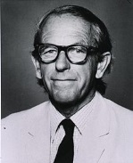
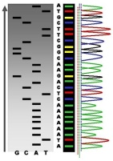
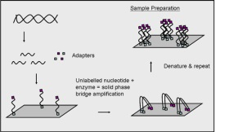
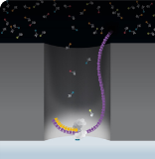
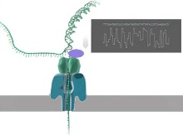
History of DNA sequencing technologies
Sanger Illumina PacBio ONT
1977 2006 2009 2014
First Second Third
Length <1 kb 2 x 150 bp >10 kb (up to 2.3 Mb)
Accuracy >99% ~99% >90%
Throughput low high high
Cost high high ->low ?

Slide 4
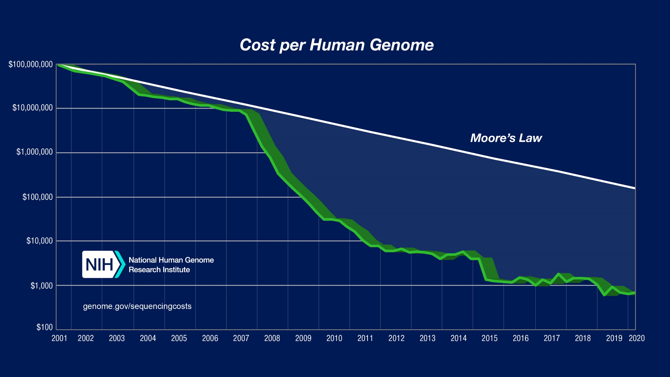

Slide 5
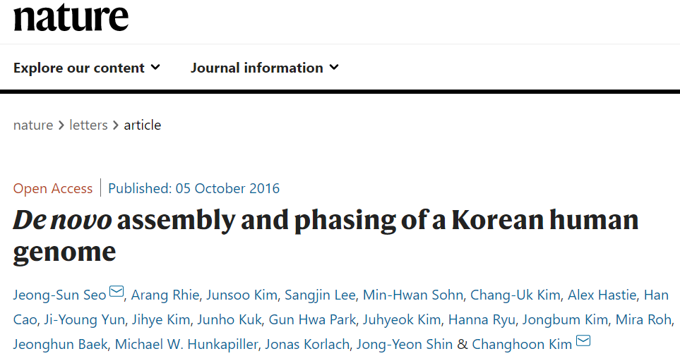
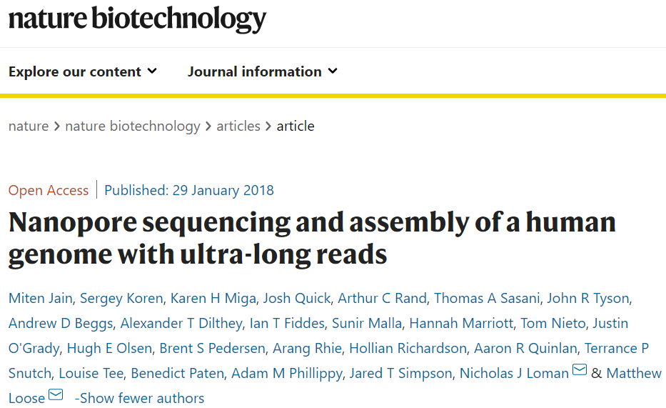
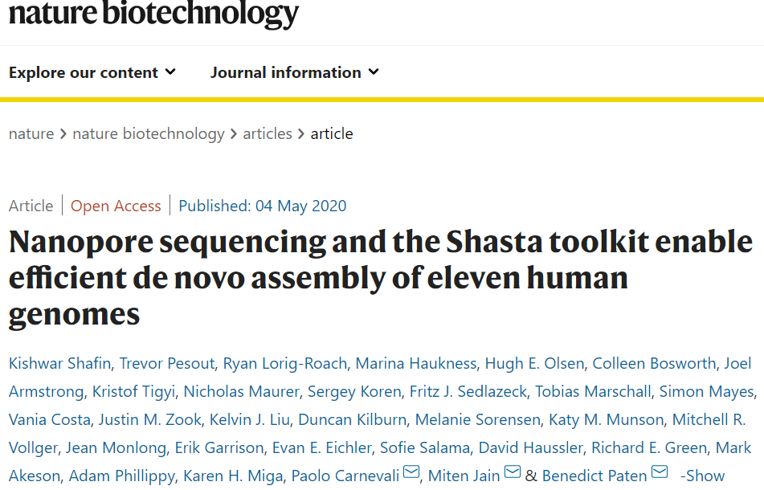
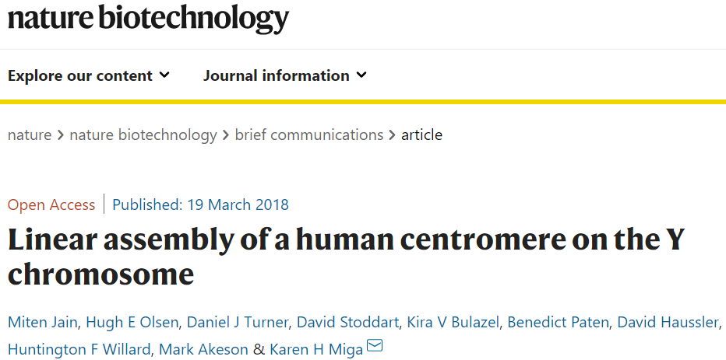
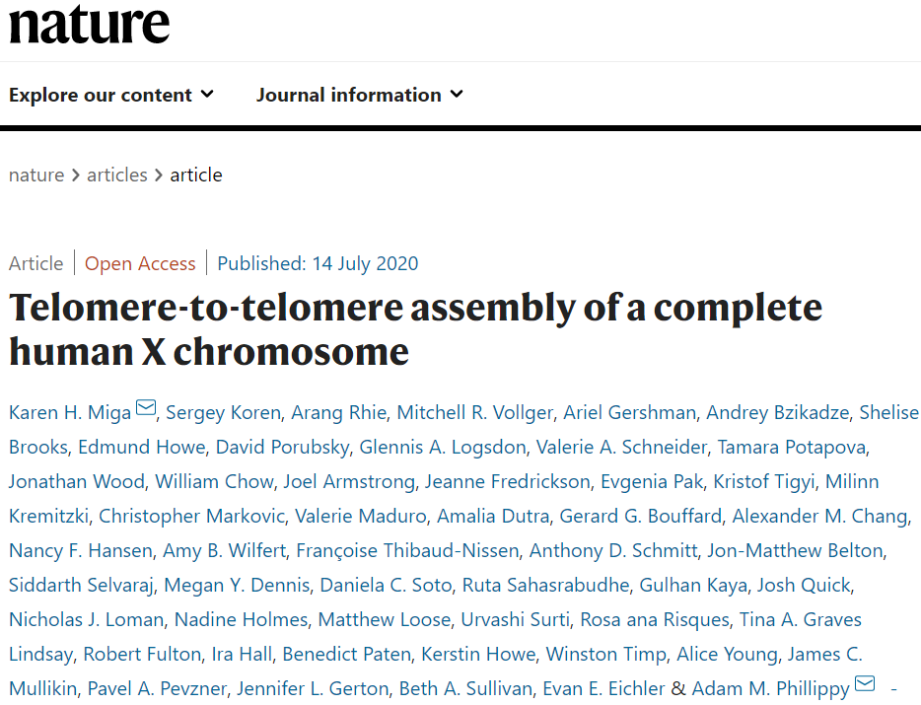
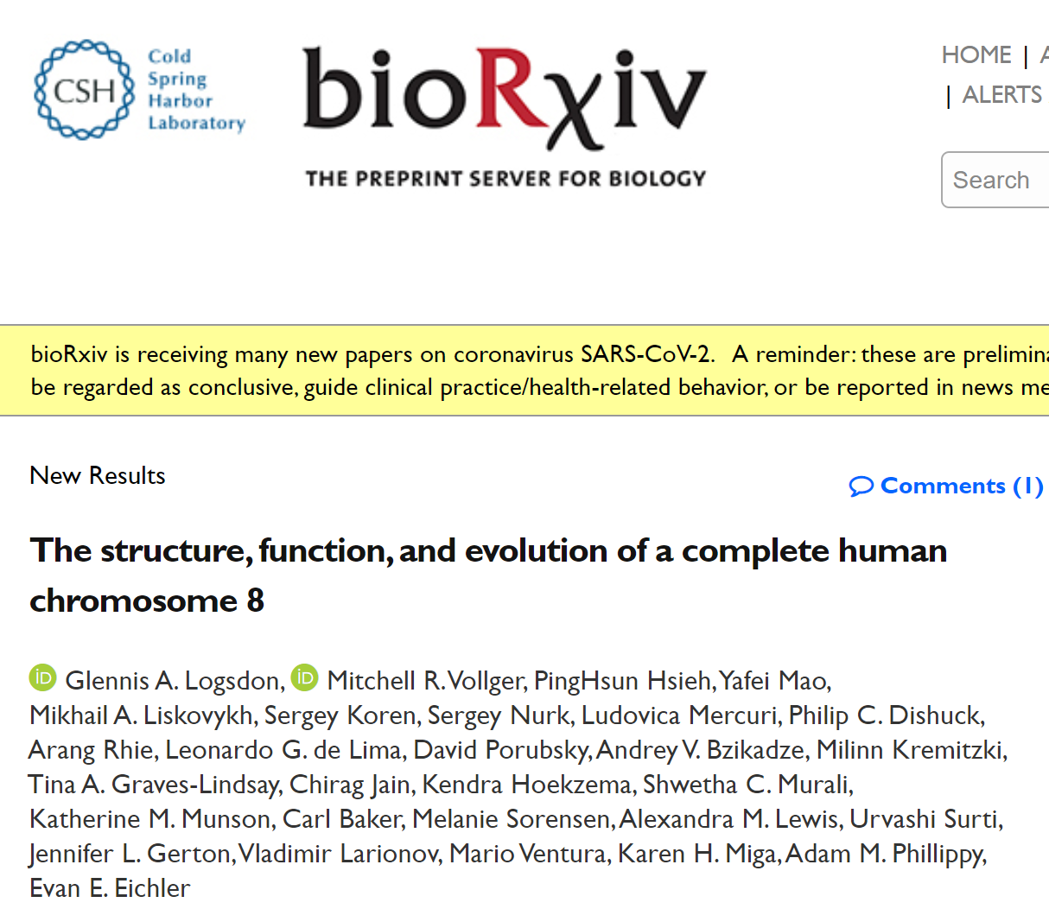

Slide 6

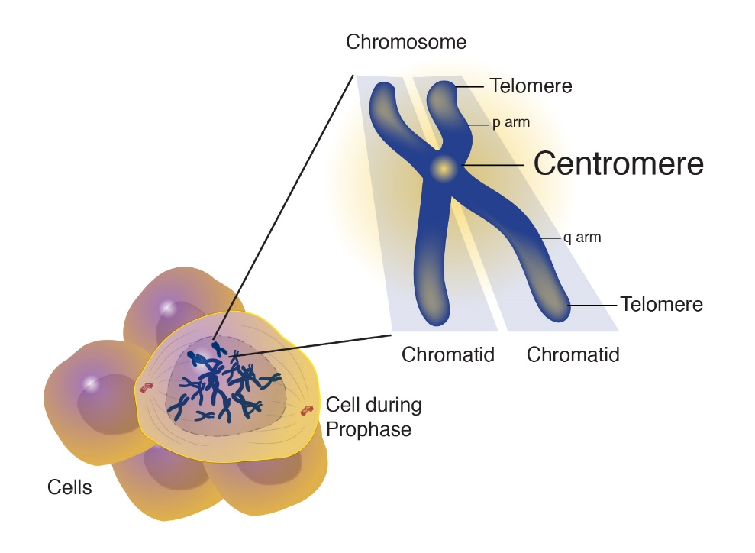
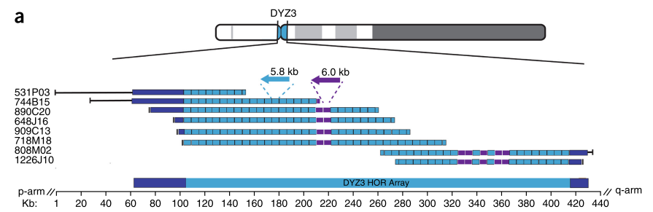
Linear assembly of a human centromere on the Y chromosome Miten Jain; Karen H Miga @ UCSC; 2018
Topics
Genome assembly
Methods
ONT + Illumina
Results
Complete assembly of tandemly repeated satellite DNAs (~350 kb)
The first view for the array repeat organization and structure in a human centromere

Slide 7

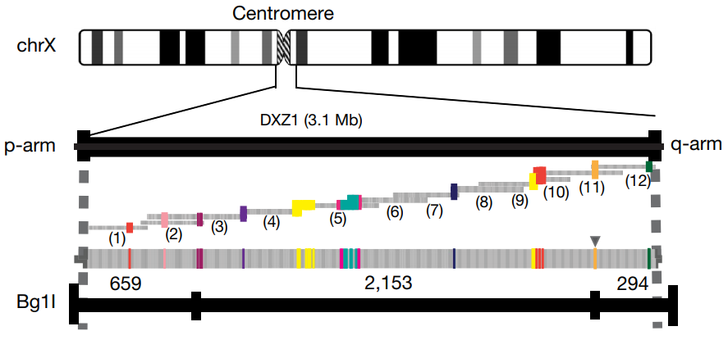
Telomere-to-telomere assembly of a complete human X chromosome Karen H Miga @ UCSC; Adam M. Phillippy @ NHGRI; 2020
Topics
Genome assembly
Methods
ONT + PacBio + 10X - Illumina
Results
The first finished human X chromosome
3.1 Mb centromeric satellite DNA array
Close 29 gaps (1.1 Mb in total)

Slide 8

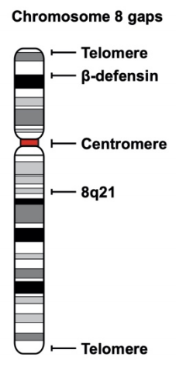
The structure, function, and evolution of a complete human chromosome 8 Evan E. Eichler @ University of Washington; 2020
Topics
Genome assembly
Methods
ONT + PacBio + Bionano
Results
The first linear assembly of a human autosome
Close 5 long-standing gaps
2.08 Mb centromeric satellite DNA array
644 kb defensing copy number polymorphism
863 kb variable number tandem repeat

