Slide 1

First decade of single-cell sequencing
Yunhao Wang Ph.D.
January 22, 2021
Department of Biomedical Informatics
Ohio State University

Slide 2

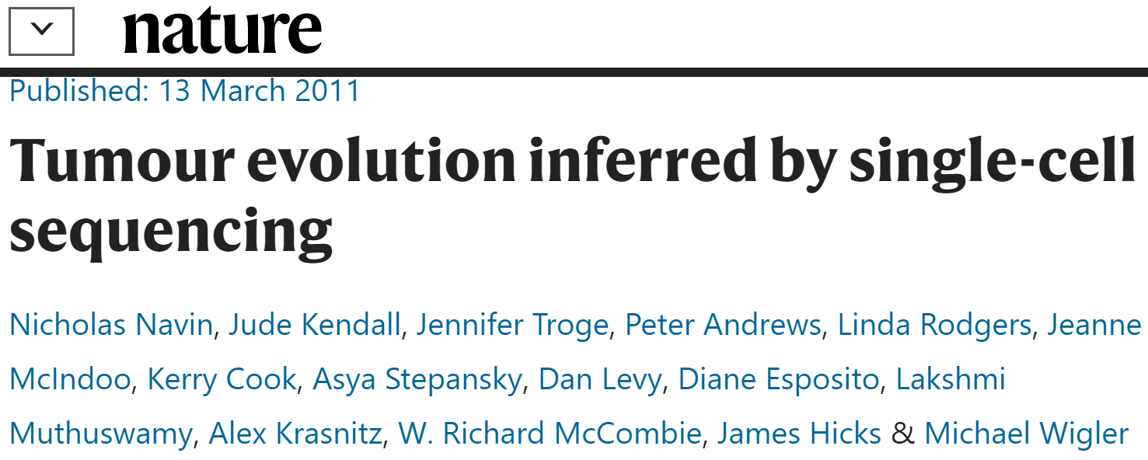


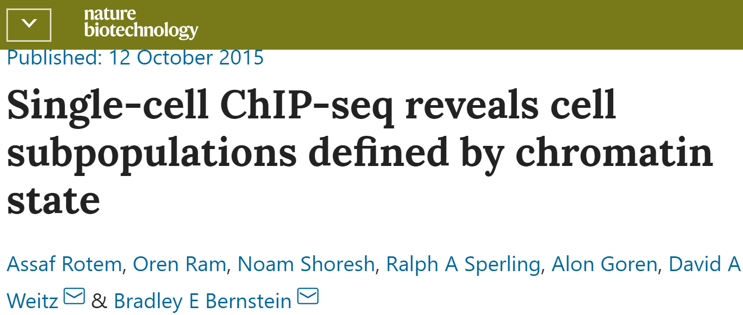




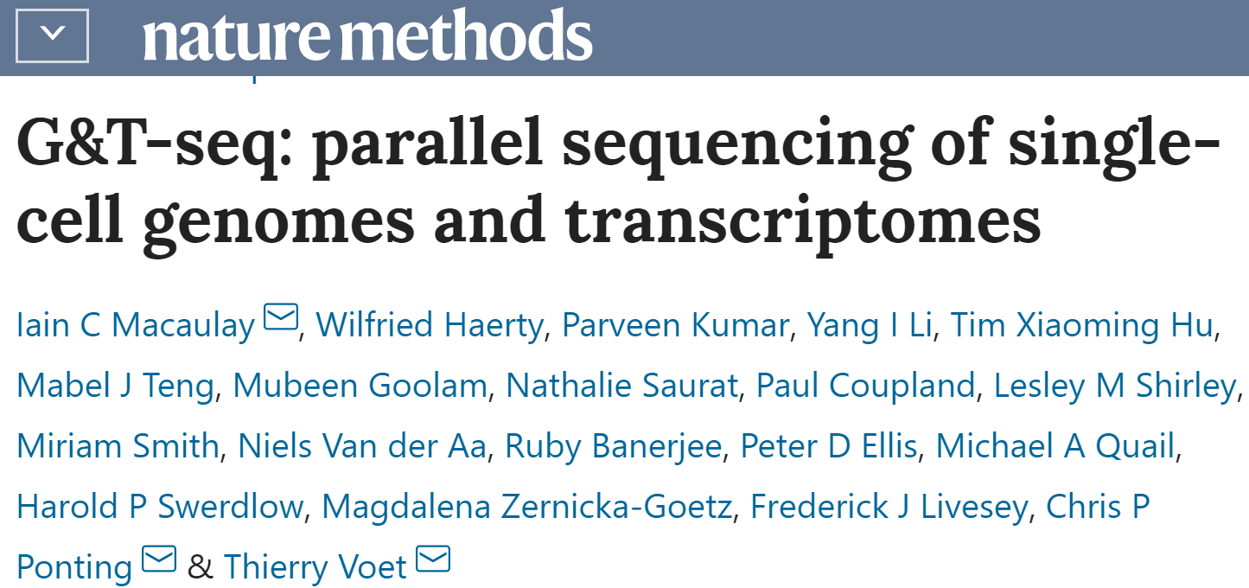
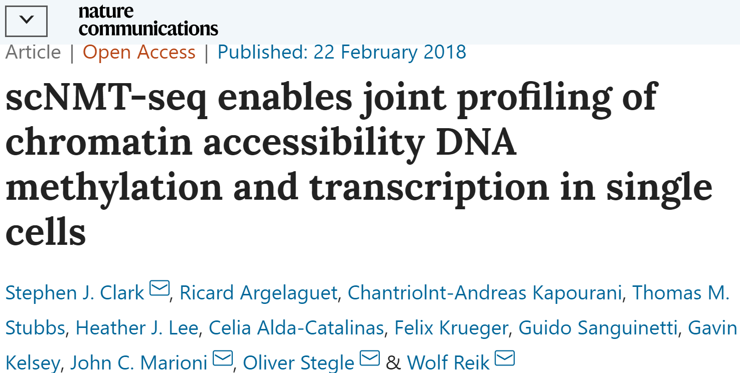

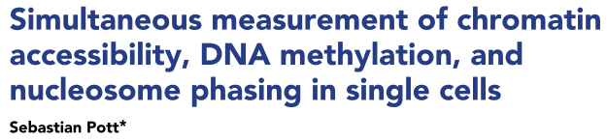
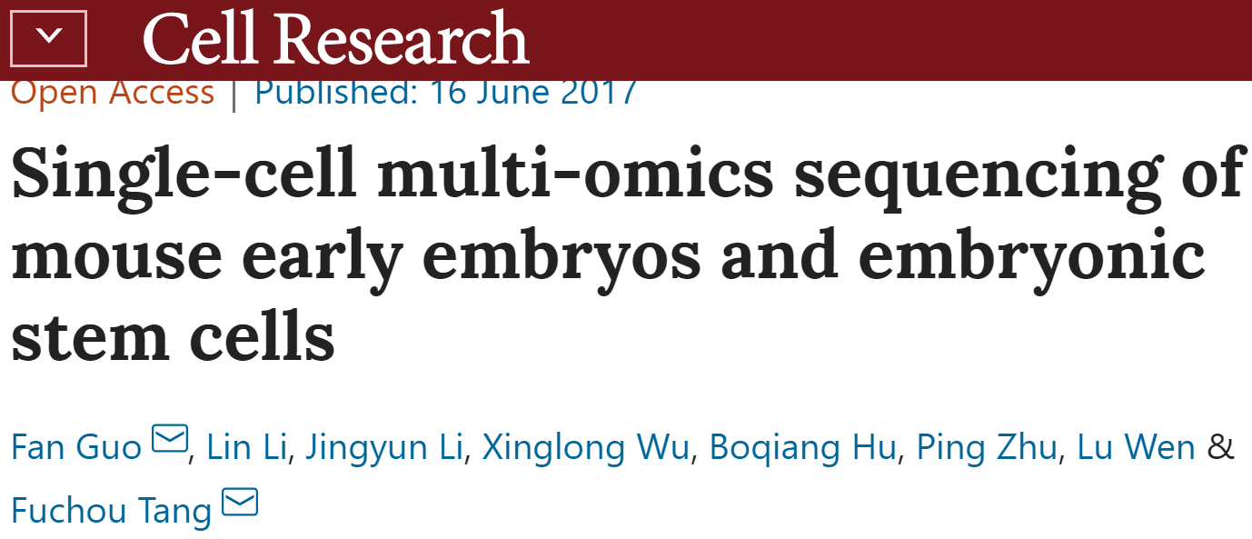

Milestones of single cell sequencing since 2009
Transcriptome
Genome
Epigenome
2009: scRNA-seq
2011: scWGS
2013: scHi-C
2015: scWGBS-seq
2015: scChIP-seq
2015: scDamID-seq
2012: scExome-seq
2015: scDNase-seq
2015: scATAC-seq
Multiomics
2015: scG&T
(genome & transcriptome)
2018: scNMT-seq
(transcriptome & epigenome)
2018: scMNase-seq
2017: scNOMe-seq
2017: scTrio-seq (genome & transcriptome & epigenome
2019: scCUT&RUN
2017: scCOOL-seq

Slide 3
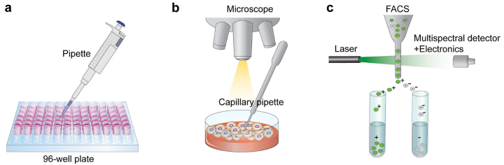
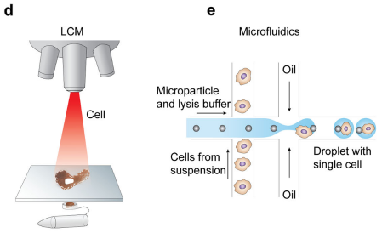
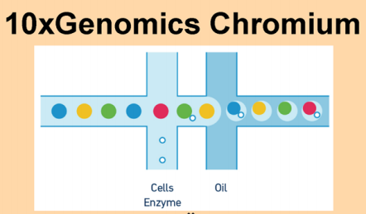
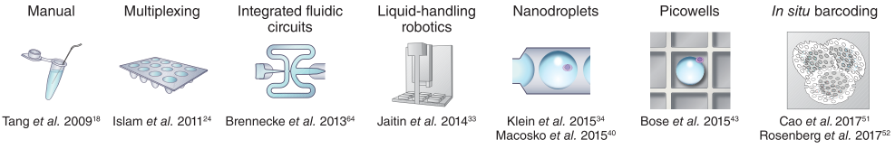
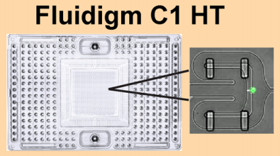
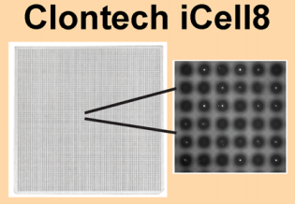
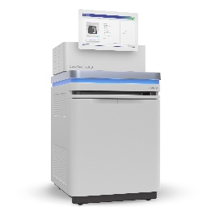
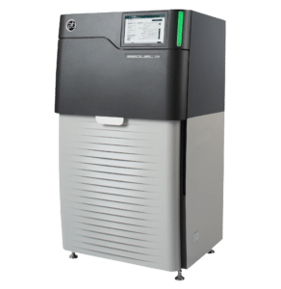
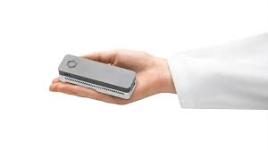
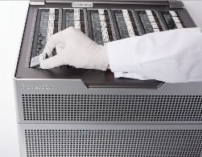
Typical single-cell experimental/technical pipeline
Step 1: Single cell isolation
Flow-activated cell sorting
Laser capture microdissection
Step 2: Library preparation (cell capture and lysis, PCR-based barcoding)
Step 3: Sequencing
Hwang, et al. Exp Mol Med (2018); Wang, et al. bioRxiv (2019); Svensson, et al. Nat Protoc (2018)

Slide 4
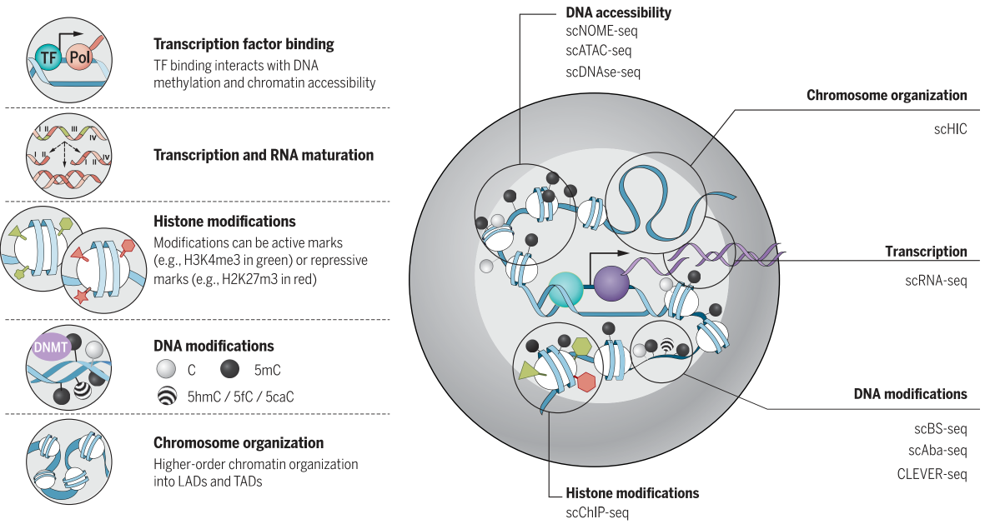
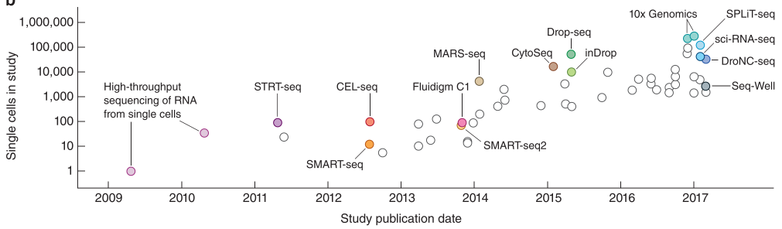
More challenges for single-cell genome/epigenome sequencing
A single diploid human cell (~3GB genome size)
DNA
Two copies: paternal and maternal
~6 pg
RNA
360,000 mRNA molecules; 12,000 different transcripts
10-30 pg total RNA, 1-5% of them are mRNA
Sequencer
Nanogram – microgram
Development of scRNA-seq
Solution
PCR amplification
Pool many single cells – cell barcoding
PCR-based barcoding
PCR-free barcoding (transposase)
Kelsey, et al. Science (2017); Svensson, et al. Nat Protoc (2018)

Slide 5
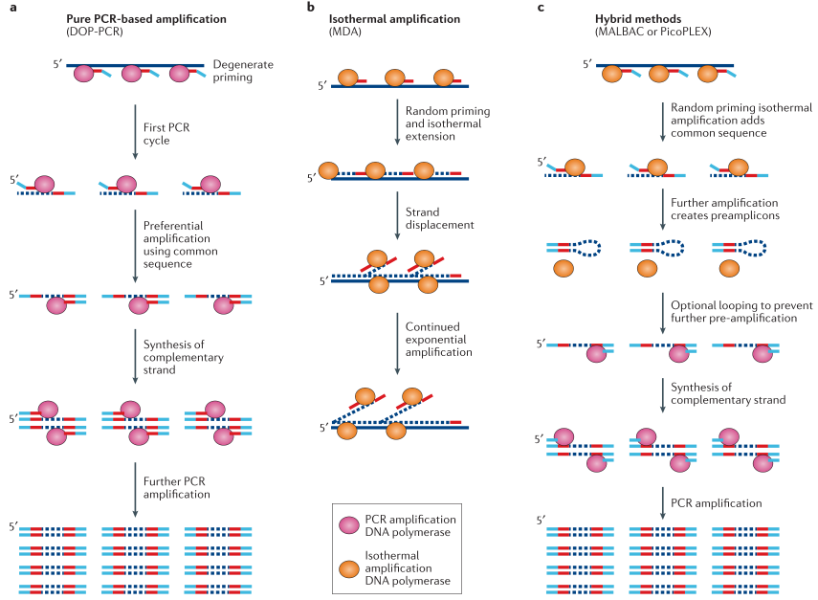
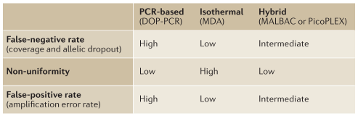
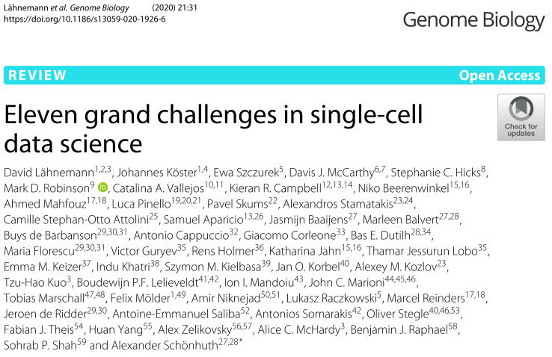
Typical single-cell genome/epigenome sequencing: amplification first
Errors/issues during WGA
Loss of coverage
MDA: 84%
MALBAC: 72%
DOP-PCR: 39%
Decreased coverage uniformity
Allelic imbalance/allelic dropout
Errors during PCR amplification
Gawad, et al. Nat Rev Genet (2016)

Slide 6

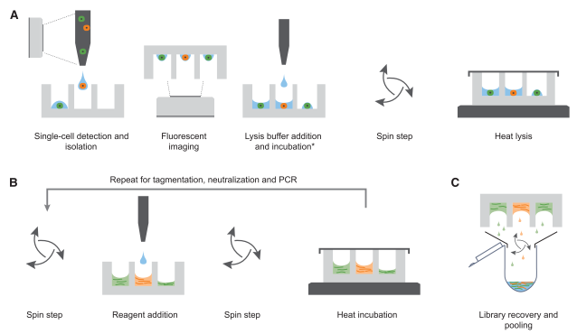

Single-cell genome sequencing with PCR-free barcoding
Barcoding first, then PCR amplication
Increase coverage uniformity compared to pre-amplification methods
Copy number variation analysis
On average, <15% genome coverage per single cell

Slide 7
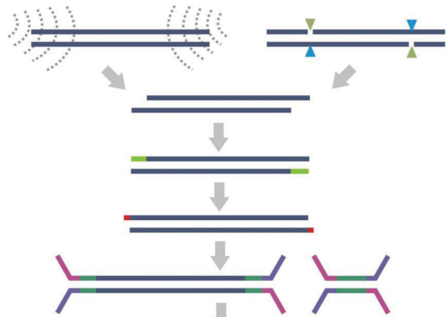
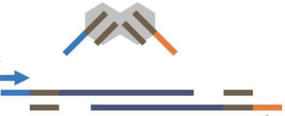
Two types of PCR-free barcoding methods
DNA ligase-based
(more steps, low efficiency)
Transposase-based
(simpler, faster, high efficiency)
Sonication Enzyme
Tn5 transposase complex with adaptors
Fragmentation
End repair
dA addition
A
A
“Cut and Insert”
Adaptor ligation
Single-cell single-molecule long-read sequencing (transposase-based barcoding + PacBio/ONT)
An automatic platform (e.g., 10X): large cell number
Cost: thousands of Tn5 complex with different barcodes
Adey, et al. Genome Biol (2010)

Slide 8
Thanks

Slide 9
Single-cell isolation
Flow-activated cell sorting
Laser capture microdissection
Hwang, et al. Exp Mol Med (2018); Svensson, et al. Nat Protoc (2018)

