Slide 1

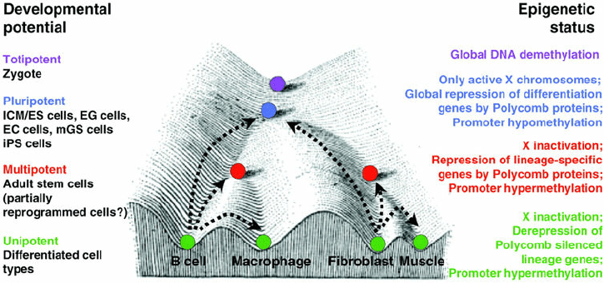

Wei Xie, Ph.D.
Principal Investigator
Tsinghua University
HHMI International Research Scholar
Yunhao Wang Ph.D.
December 18, 2020
Department of Biomedical Informatics, Ohio State University

Slide 2
Research @ Xie Lab since 2013
Goal: epigenetic regulation of mammalian early embryo development
Technology: ultra-sensitive and low-input epigenetic analysis
DNA methylation: STEM-seq
Histone modifications: STAR ChIP-seq
Chromatin accessibility: miniATAC-seq
3D chromatin architecture: sisHi-C
DNA binding: Stacc-seq

Slide 3
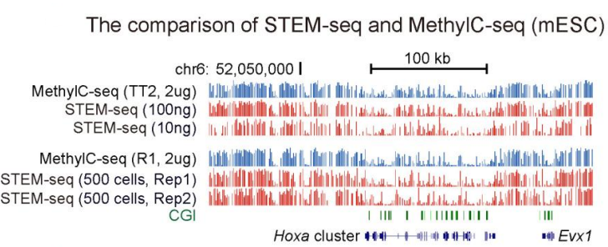
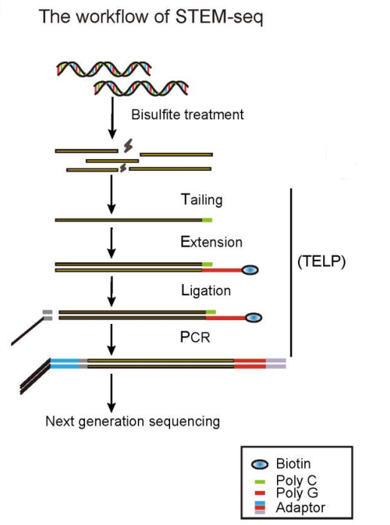
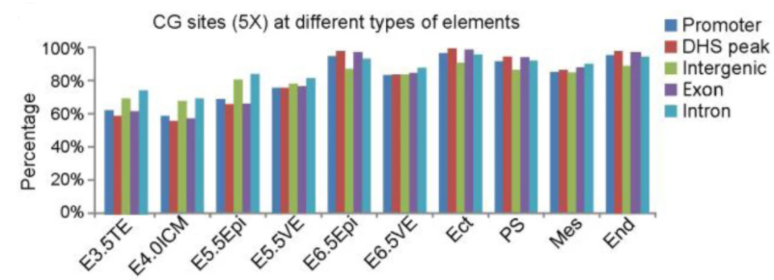
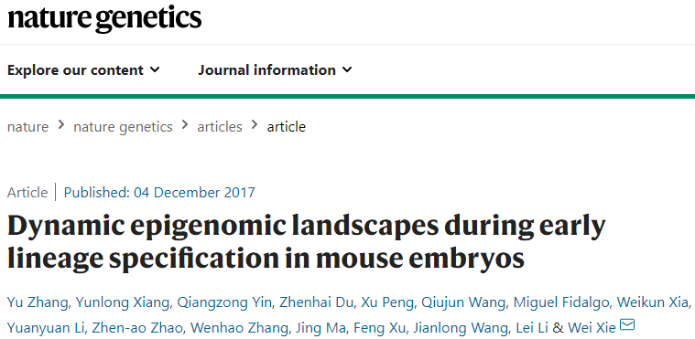
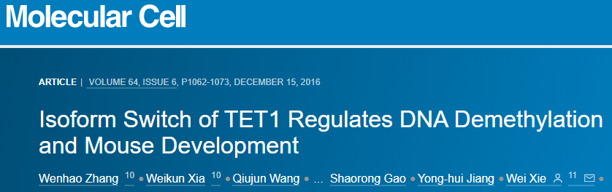
DNA methylation: STEM-seq
STEM-seq: small-scale TELP-enabled methylome sequencing (500 cells)

Slide 4
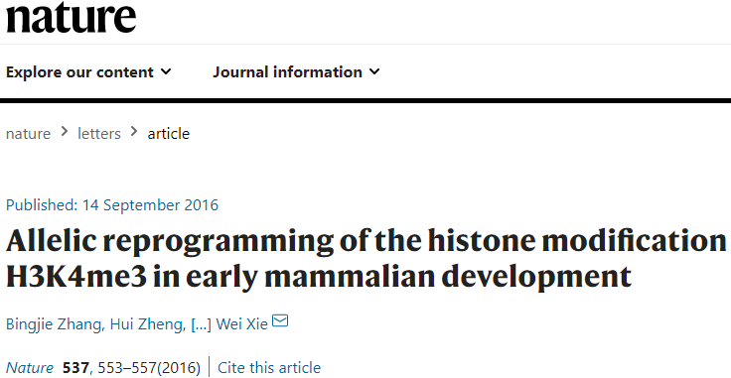
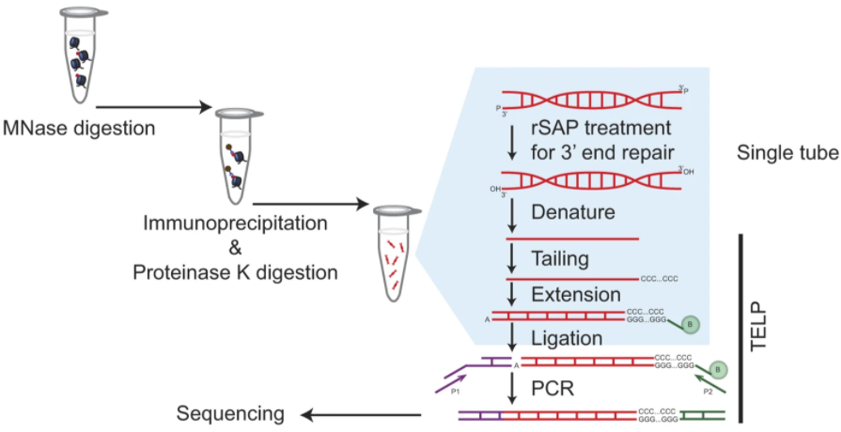
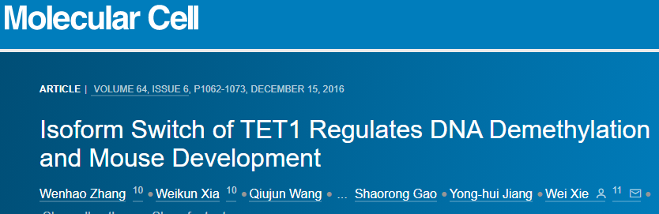
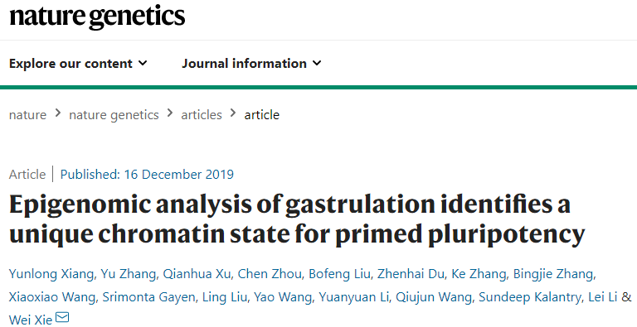
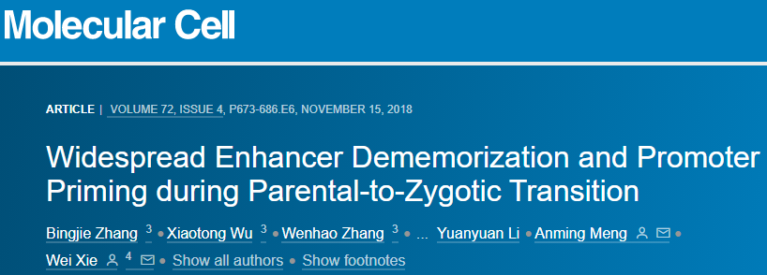
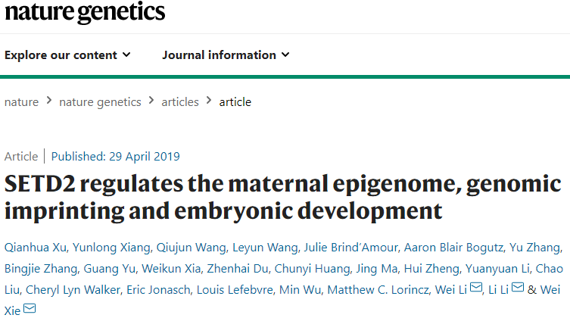
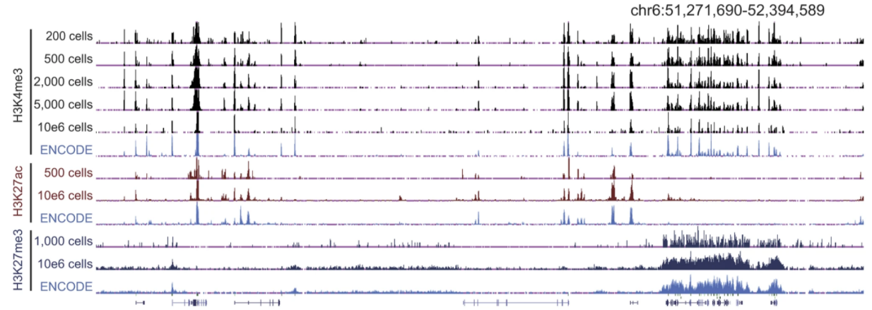
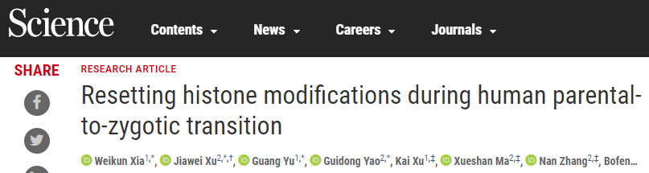
Histone modifications: STAR ChIP-seq
STAR ChIP-seq: small-scale TELP-assisted rapid ChIP–seq (200 cells)

Slide 5
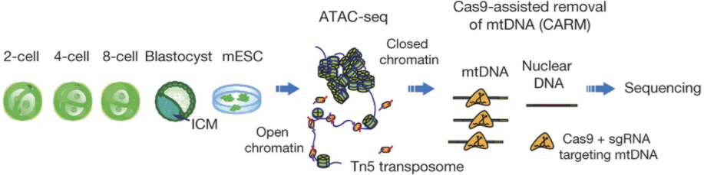
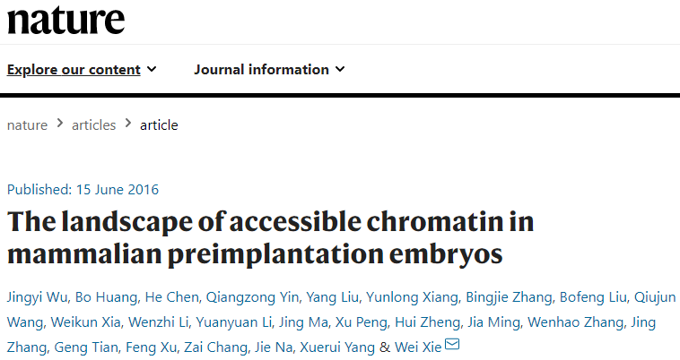
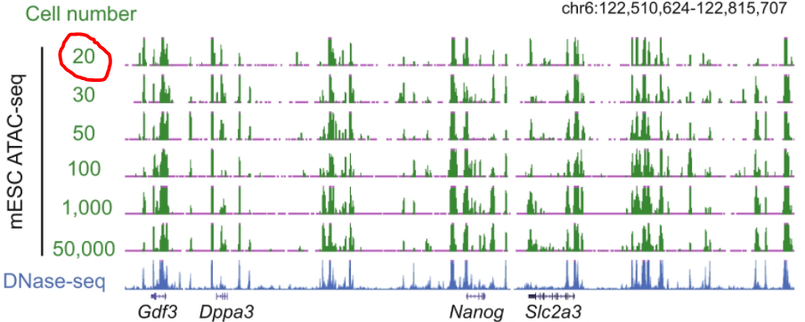
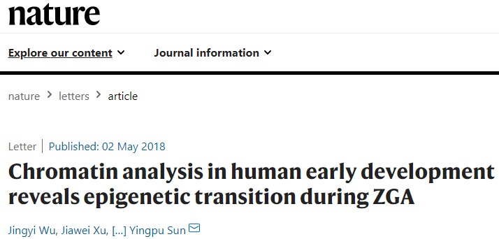
Chromatin accessibility: miniATAC-seq
miniATAC-seq: an improved ATAC-seq (20 cells)

Slide 6
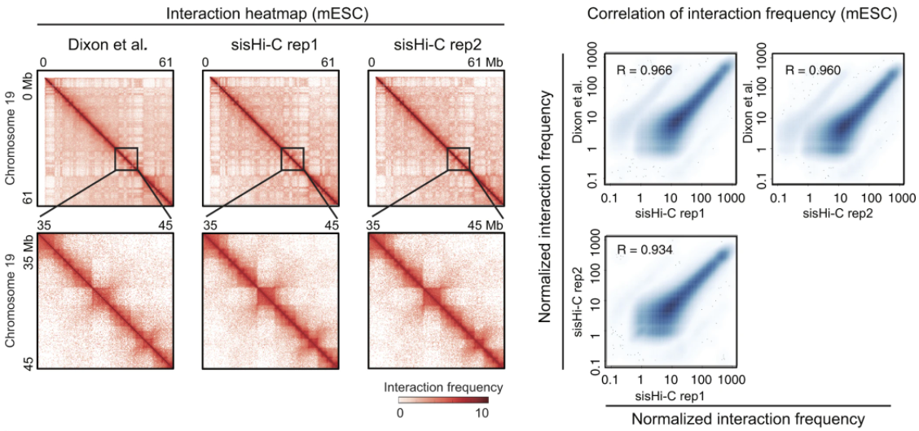
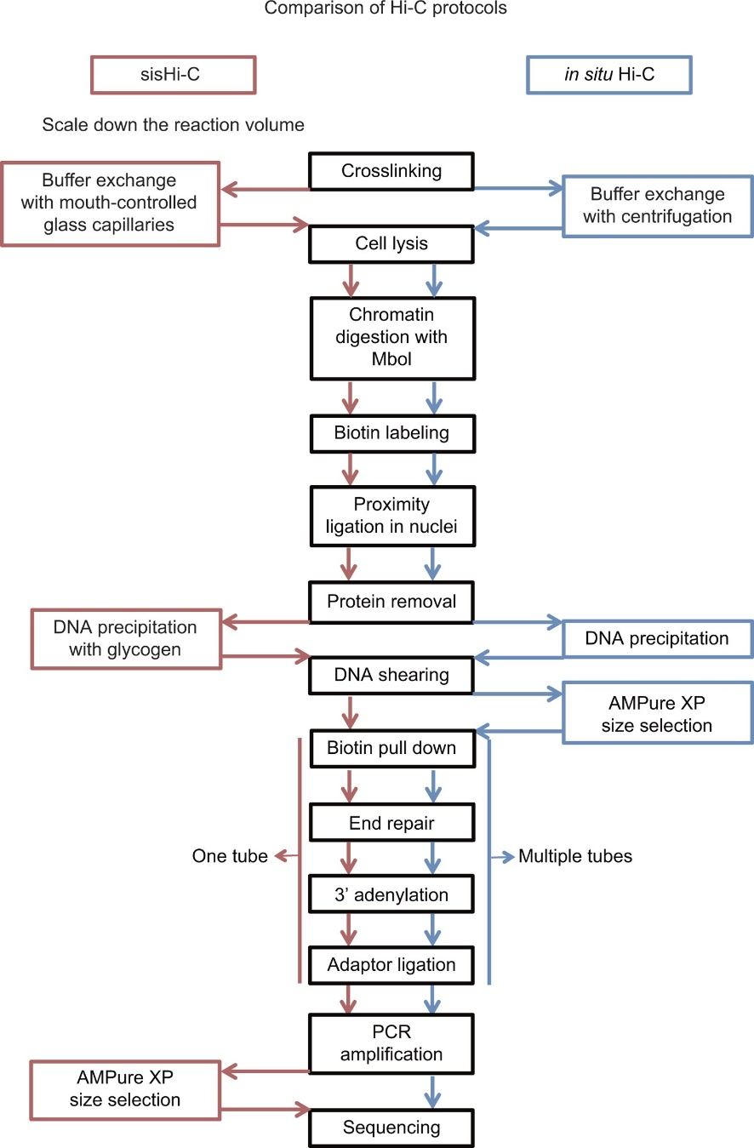
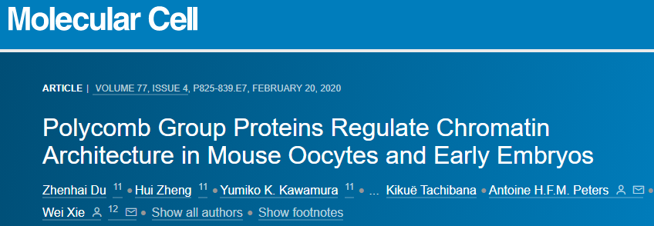
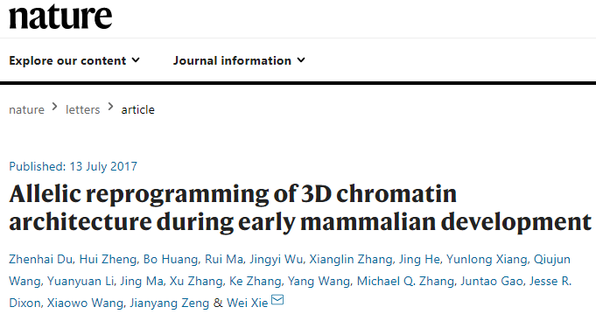
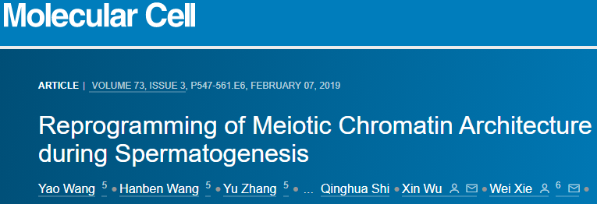
3D chromatin architecture: sisHi-C
sisHi-C: small-scale in situ Hi-C (500 cells)

Slide 7
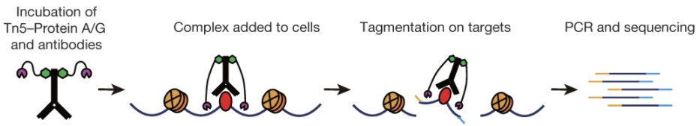
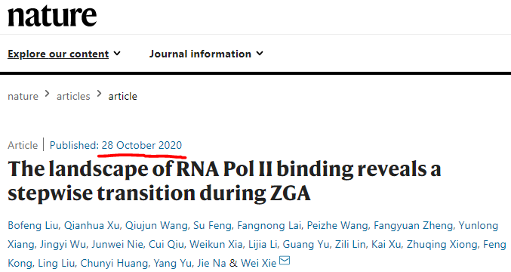
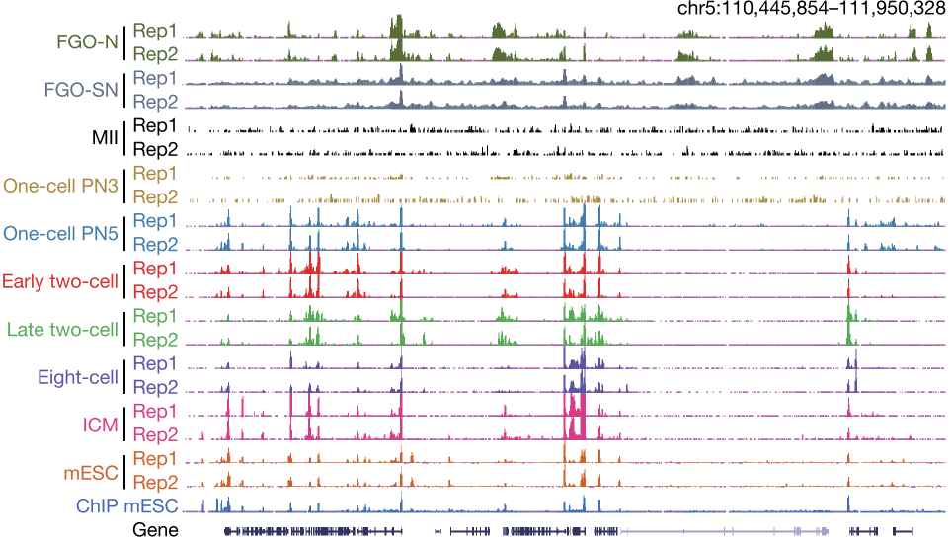
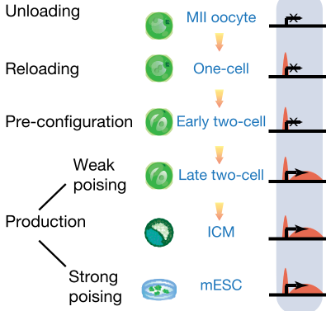
DNA binding: Stacc-seq
Stacc-seq: small-scale Tn5-assisted chromatin cleavage with sequencing (200 cells, within 3.5 hour)

Slide 8
Thanks

