Slide 1



Writing Scientific Papers
刘小乐
2017-10-05

Slide 2
The Order of Writing
Method
Figures and legends
Results
Discussion
Introduction
Abstract & title
Cover letter

Slide 3
Methods
Write as you work on a project
Keep track of experiments done, data downloaded, analysis parameters, and results at each stage (lab notebook)
Can shrink later as needed…
Font (times 12 or Arial 11)
Margin (1 inch)
Line breaks

Slide 4
Figures and Legends
Draw your figures as what you saw in CNS papers
Only include figures contributing to the main theme of the story, but milk the cow
Supp figure naming
Diverse drawings but consistent fonts
Readability in printouts
Summarize the findings and figure our target journal

Slide 5
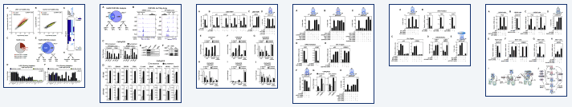
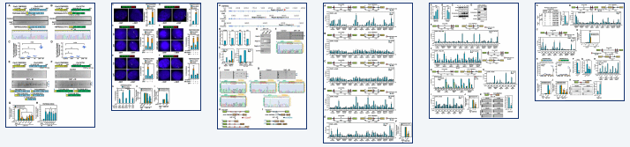
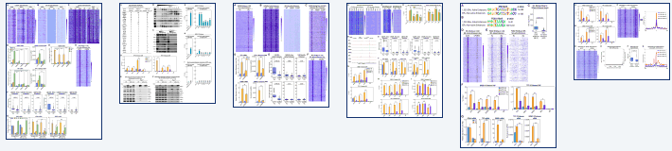
The Bad

Slide 6
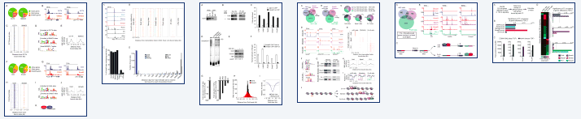
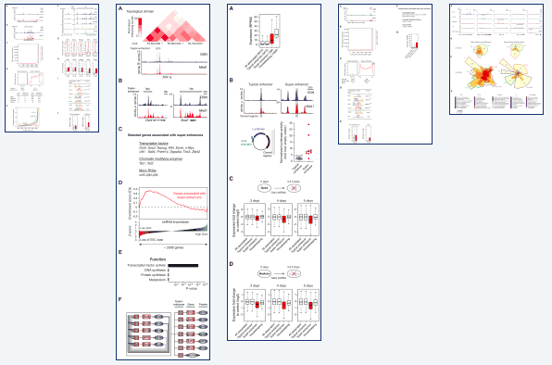
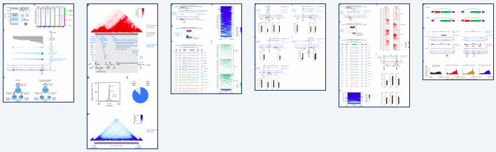
The Good

Slide 7
Results
Long figure legend, Logic, logic, logic…
Write sub-section titles for each figure with consistent grammar
Instead of “Fig 1 shows X”, just say “X (Fig 1)”.
Paragraphs shouldn’t be too long (> 20 lines) or too short (< 3 sentences).
Don’t have > 10 numbers in a paragraph or a table, instead show them in a figure.
Discuss the figures in the order they appear
Reduce “we found”, “we observe”.
Consistent present / past tense

Slide 8
Discussions
Summary: similar to cover letter
Limitations of the current study
Discuss some interesting observations and speculate
Future perspectives: always end with positive

Slide 9
Introduction
This area is super important, cite big papers
However, something is still unknown or there are still unmet needs
X, Y, Z have done work in this area, but there are limitations
Acknowledge your potential reviewers
In this study, we did …
Focus on the Why and a little bit of What
Don’t discuss the main results

Slide 10
Abstract & Title
Something is important but something is missing / unknown / challenging.
We did X, Y, Z. Throw in the numbers, buzz words, and what’s special.
We found A, B, C.
The study has the potential to…
Check http://jane.biosemantics.org
Don’t use numbers in the title
Authorship: discuss and wait…

Slide 11
Common Writing Mistakes from Chinese Writers
Sentences too long (> 3 lines) with too many commas.
Multiple predicates in a sentence.
Unusual word / phrase appear twice close to each other
太长的定语, 指代不明
Long phrases with nouns used as adjectives.
Unconnected sentences in paragraphs, or neighboring sentences saying the same thing
Informal English: lots of, found out, etc
杀鸡焉用宰牛刀
http://www.wallaceediting.cn/blog and other resources
Do you ever see this in a scientific paper?

Slide 12
Examples
There are about 10-20 percent genes are cell surface genes in human, how can we identify the genes which can be used for immune therapy?
The scaffold-linker-U6 segment containing decoding primer targeting site is cloned in between the paired gRNAs.
Considering some factors, this experiment was designed to ….
A is a widely used technique for studying Xs such as Y and Z.
A is the ratio of X over Y. Y is defined as xxx. It is expected to be around 70%.

Slide 13
Cover Letter
Dear Editor, we are pleased to submit our ms titled XXX for consideration as a Publication Type at Journal.
Problem X is really important, our approach / finding Y is really novel and great.
Our track record: our previous papers in this journal (highly downloaded, cited, etc)
We would like to suggest the following reviewers:
~6: 1. friends; 2. experts in the area; 3. journal >= their normal publication levels; 4. <= 50% Chinese.
Test the water, find/make your friends.
Pre-submission? Talk to the professional editor

Slide 14
Revision
Rebut or submit elsewhere?
Thank the editor and reviewers, we have made substantial revision.
Summarize the revision, then point-to-point, reviewer comments & address in diff fonts (color alone insufficient).
Don’t thank or apologize within the p2p.
Answer to the point: “we agree with the reviewer that X”, “we followed the reviewer’s suggestion to add X”, “we clarified this point in the revised ms”.
Show efforts, but make the answers short and clear.
Don’t antagonize the reviewers, unless convincing the editor to switch reviewers.

Slide 15
Most Important Trick
Do solid good work in one field for a long time to establish reputation
Published papers are like married daughters
Read and write more papers
Go to conferences and present your work
Make friends within the field
Thank you!

