Slide 1

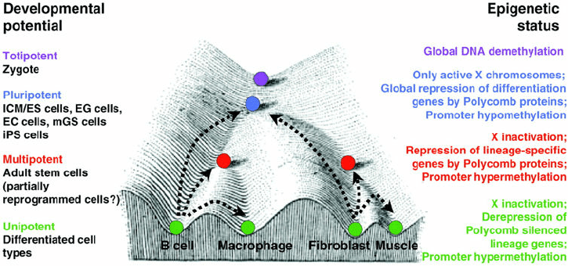

Wei Xie, Ph.D.
Principal Investigator
Tsinghua University
HHMI International Research Scholar
Yunhao Wang Ph.D.
December 18, 2020
Department of Biomedical Informatics, Ohio State University
Notes:
1

Slide 2
Research @ Xie Lab since 2013
Goal: epigenetic regulation of mammalian early embryo development
Technology: ultra-sensitive and low-input epigenetic analysis
    DNA methylation: STEM-seq
    Histone modifications: STAR ChIP-seq
    Chromatin accessibility: miniATAC-seq
    3D chromatin architecture: sisHi-C
    DNA binding: Stacc-seq
Notes:
2

Slide 3
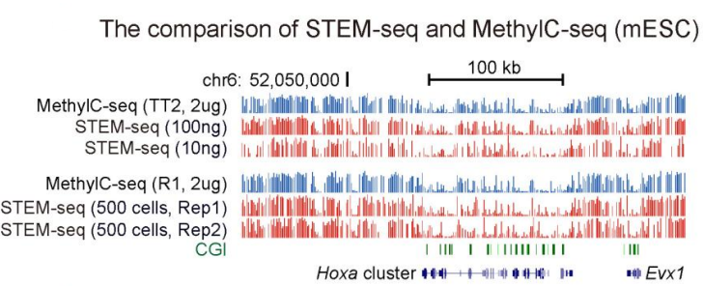
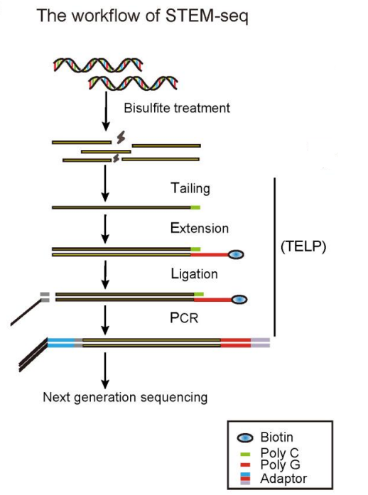
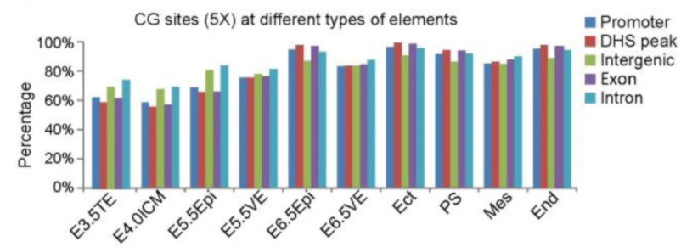
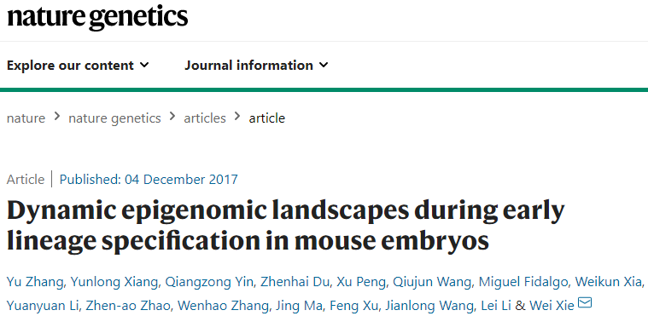
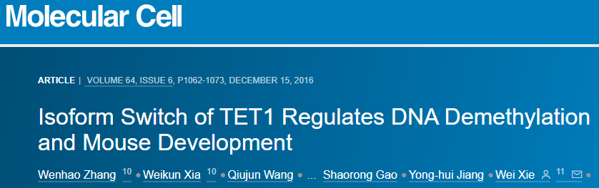
DNA methylation: STEM-seq
STEM-seq: small-scale TELP-enabled methylome sequencing (500 cells)
Notes:
3

Slide 4
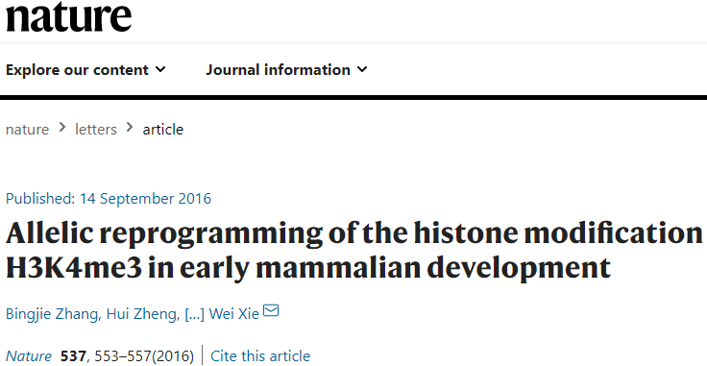
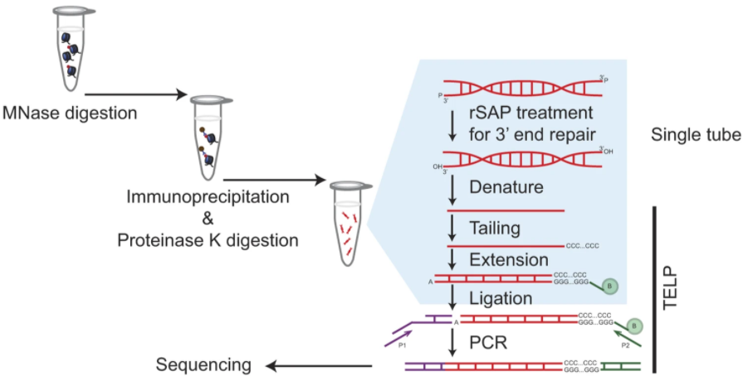
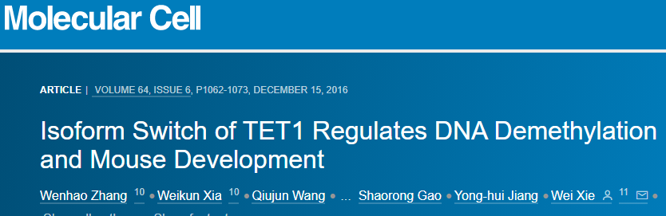
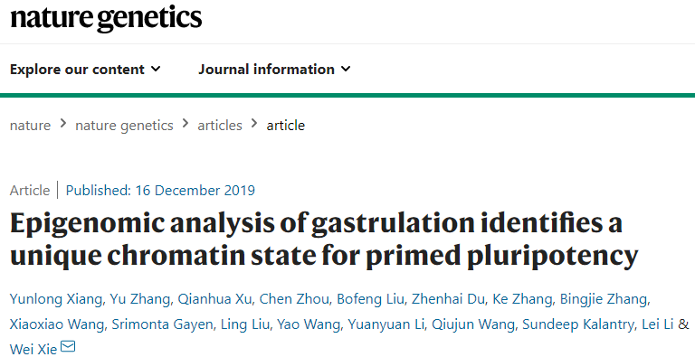
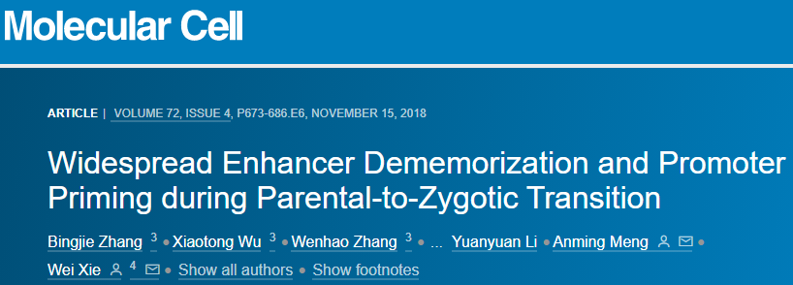
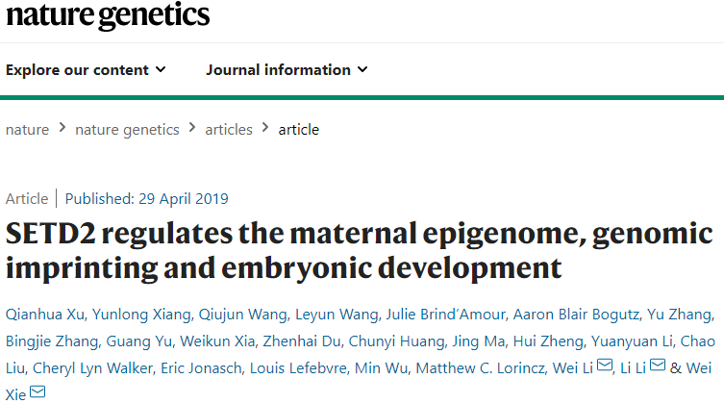
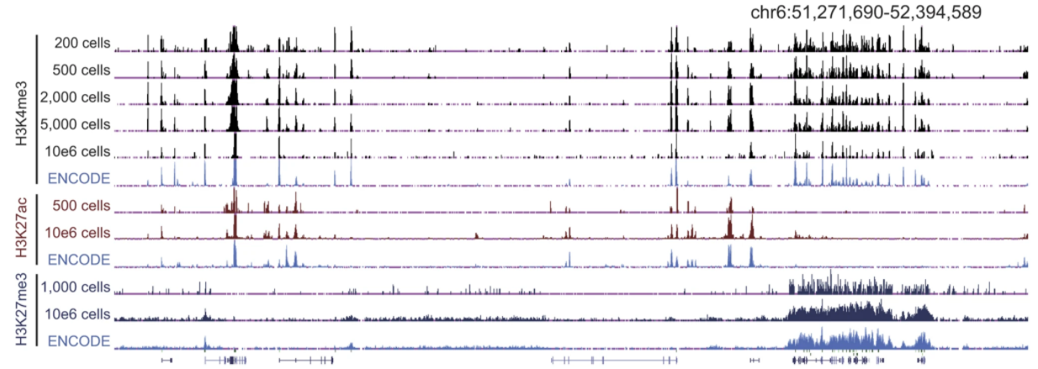
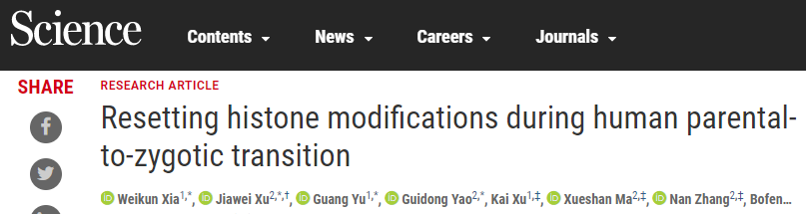
Histone modifications: STAR ChIP-seq
STAR ChIP-seq: small-scale TELP-assisted rapid ChIP–seq (200 cells)
Notes:
4

Slide 5
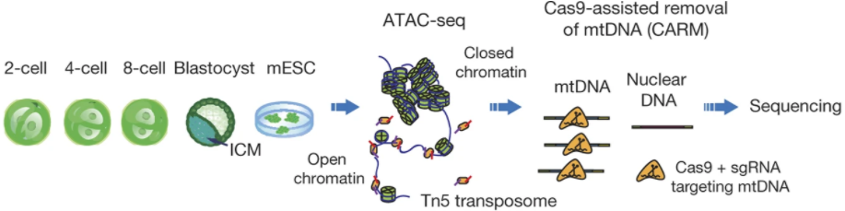
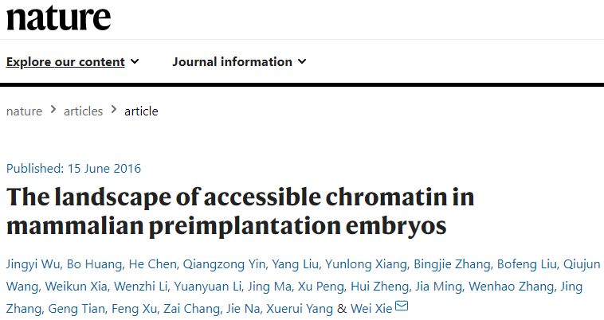
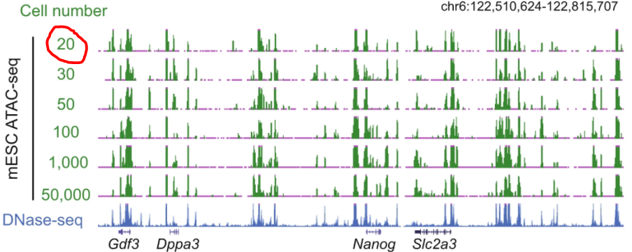
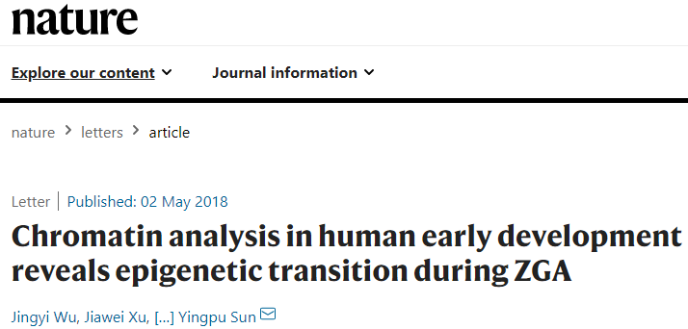
Chromatin accessibility: miniATAC-seq
miniATAC-seq: an improved ATAC-seq (20 cells)
Notes:
5

Slide 6
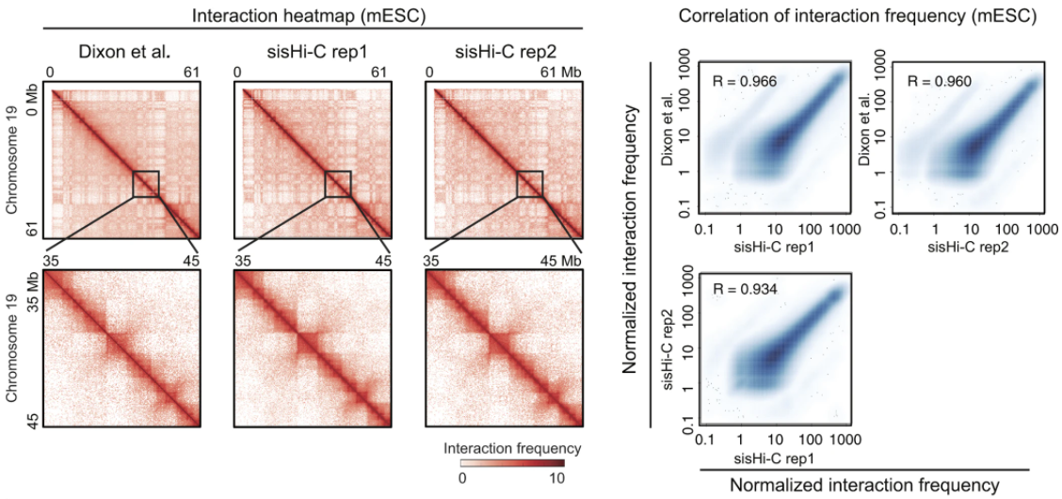
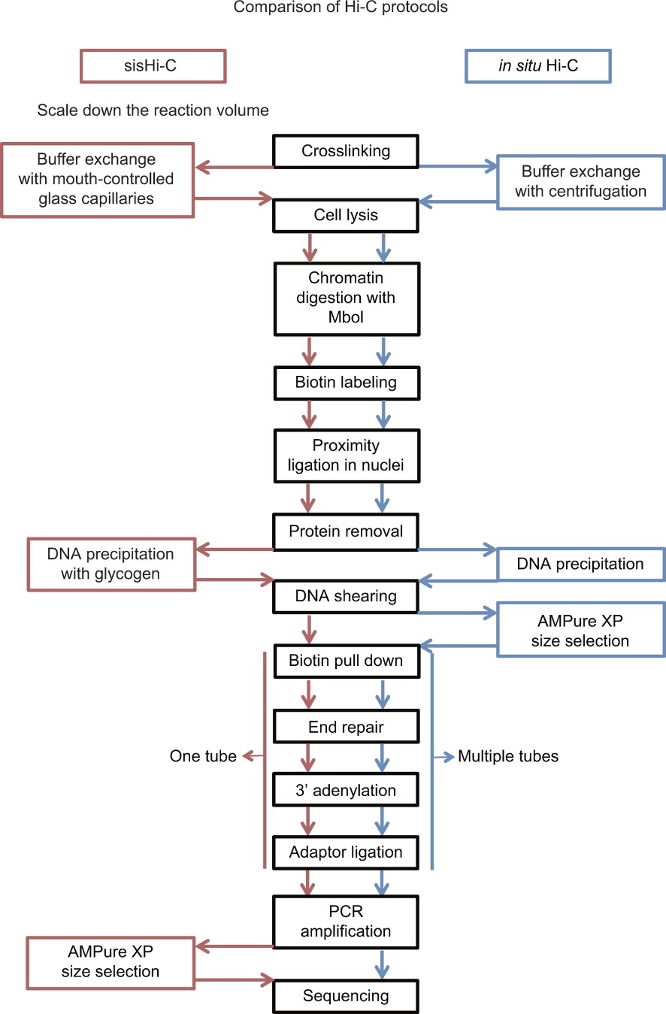
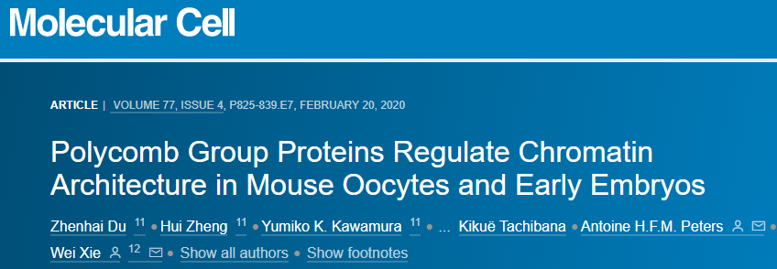
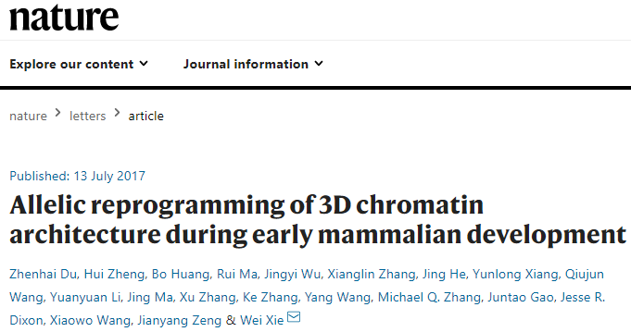
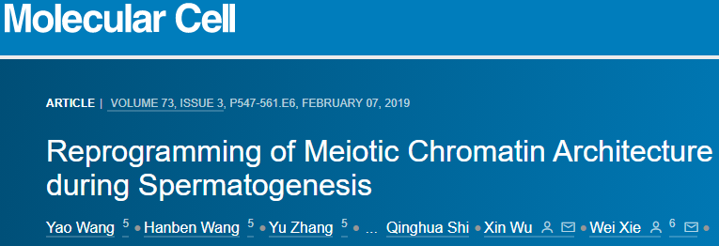
3D chromatin architecture: sisHi-C
sisHi-C: small-scale in situ Hi-C (500 cells)
Notes:
6

Slide 7
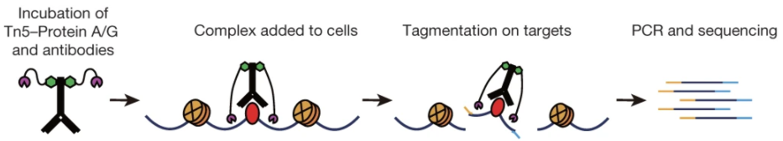
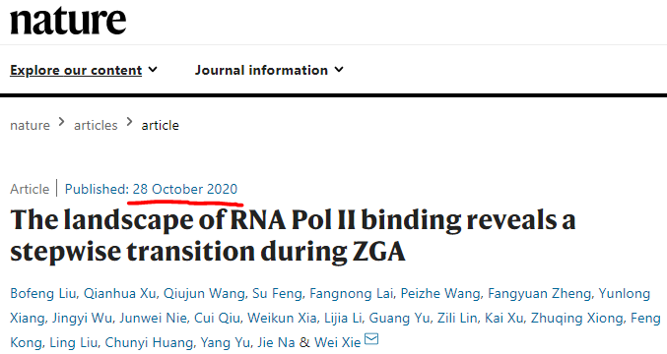
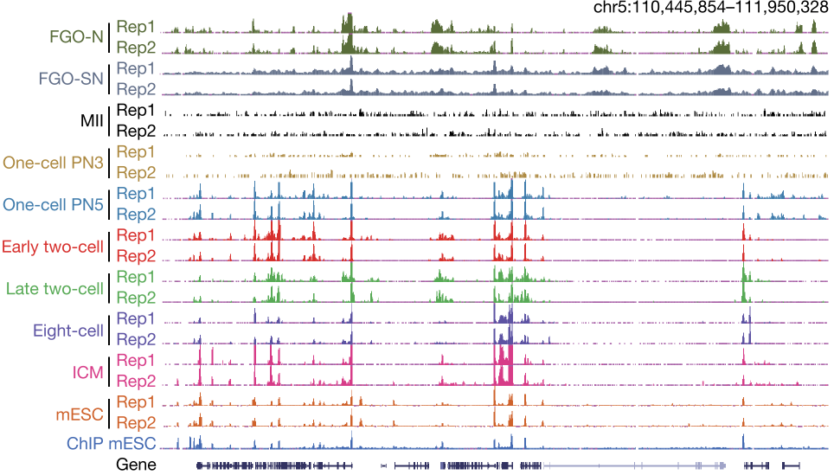
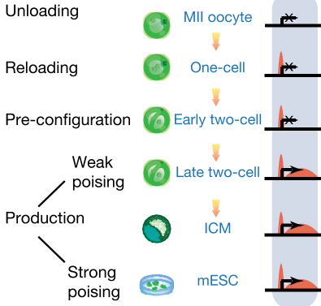
DNA binding: Stacc-seq
Stacc-seq: small-scale Tn5-assisted chromatin cleavage with sequencing (200 cells, within 3.5 hour)
Notes:
7

Slide 8
Thanks
Notes:
8

