Slide 1

Long-read RNA sequencing data
Dingjie Wang, PhD
Department of Computational Medicine and Bioinformatics
University of Michigan
March 15, 2024

Slide 2
Database | Data type | Species | Platform | Library | # of Samples
GTEx | long read RNA-seq | Home sapiens (GTEx tissue and cell line) | ONT | PCR-cDNA | 86
GTEx | long read RNA-seq | Home sapiens (GTEx tissue and cell line) | ONT | direct-cDNA | 2
GTEx | long read RNA-seq | Home sapiens (K562 cell line) | ONT | direct-cDNA | 4
GTEx | long read RNA-seq | Home sapiens (Heart) | ONT | direct-cDNA | 4
ENCODE4 | long read RNA-seq | Home sapiens (human tissues and cell lines) | PacBio: Sequel II | cDNA | 95
ENCODE | long read RNA-seq | Home sapiens | ONT | Direct RNA | 6
ENCODE | long read RNA-seq | Home sapiens | ONT | CapTrap | 6
ENCODE | long read RNA-seq | Home sapiens | ONT | PCR-cDNA | 3
ENCODE | long read RNA-seq | Home sapiens | ONT | R2C2 | 3
ENCODE | long read RNA-seq | Home sapiens | PacBio | SMRTbell | 98
LRGASP | long read RNA-seq | Home sapiens | ONT: MinION | cDNA | 4
LRGASP | long read direct RNA-seq | Home sapiens | ONT: MinION | Direct RNA | 4
LRGASP | long read RNA-seq | Home sapiens | ONT: MinION | R2C2 | 4
LRGASP | long read RNA-seq | Home sapiens | ONT: MinION | CapTrap | 4
LRGASP | long read RNA-seq | Home sapiens | PacBio:Sequel II | cDNA | 4
LRGASP | long read RNA-seq | Home sapiens | PacBio:Sequel II | CapTrap | 4
SG-Nex | long read RNA-seq | Home sapiens | ONT(MinION, GridION, PromethION) | PCR cDNA | 8
SG-Nex | long read RNA-seq | Home sapiens | ONT(MinION, GridION, PromethION) | Direct cDNA | 7
SG-Nex | long read direct RNA-seq | Home sapiens | ONT(MinION, GridION, PromethION) | Direct RNA | 14
DirectRMDB | long read direct RNA-seq | Home sapiens | ONT | Direct RNA | 43

Slide 3
Database | Data type | Species | Platform | Library | # of Samples
ENCODE | long read scRNA-seq | Mus musculus | ONT | Parse Single Cell Whole Transcriptome Kit | 36
ENCODE | long read scRNA-seq | Mus musculus | PacBio | Parse Single Cell Whole Transcriptome Kit | 28
ENCODE4 | long read RNA-seq | Mus musculus (mouse tissues and cell lines) | PacBio: Sequel II | cDNA | 64
ENCODE | long read RNA-seq | Mus musculus | ONT | Direct RNA | 2
ENCODE | long read RNA-seq | Mus musculus | ONT | CapTrap | 1
ENCODE | long read RNA-seq | Mus musculus | ONT | PCR-cDNA | 1
ENCODE | long read RNA-seq | Mus musculus | ONT | R2C2 | 1
ENCODE | long read RNA-seq | Mus musculus | PacBio | SMRTbell | 66
LRGASP | long read RNA-seq | Mus musculus | ONT: MinION | cDNA | 1
LRGASP | long read direct RNA-seq | Mus musculus | ONT: MinION | Direct RNA | 1
LRGASP | long read RNA-seq | Mus musculus | ONT: MinION | R2C2 | 1
LRGASP | long read RNA-seq | Mus musculus | ONT: MinION | CapTrap | 1
LRGASP | long read RNA-seq | Mus musculus | PacBio:Sequel II | cDNA | 1
LRGASP | long read RNA-seq | Mus musculus | PacBio:Sequel II | CapTrap | 1
DirectRMDB | long read direct RNA-seq | Mus musculus | ONT | Direct RNA | 18
LRGASP | long read RNA-seq | manatee | ONT: MinION | cDNA | 1
LRGASP | long read direct RNA-seq | manatee | ONT: MinION | Direct RNA | 1
LRGASP | long read RNA-seq | manatee | ONT: MinION | R2C2 | 1
LRGASP | long read RNA-seq | manatee | ONT: MinION | CapTrap | 1
LRGASP | long read RNA-seq | manatee | PacBio:Sequel II | cDNA | 1
LRGASP | long read RNA-seq | manatee | PacBio:Sequel II | CapTrap | 1
DirectRMDB | long read direct RNA-seq | Drosophila melanogaster | ONT | Direct RNA | 5
DirectRMDB | long read direct RNA-seq | Saccharomyces cerevisiae | ONT | Direct RNA | 8
DirectRMDB | long read direct RNA-seq | Zea mays | ONT | Direct RNA | 5
DirectRMDB | long read direct RNA-seq | Arabidopsis thaliana | ONT | Direct RNA | 3
DirectRMDB | long read direct RNA-seq | Other | ONT | Direct RNA | 42

Slide 4
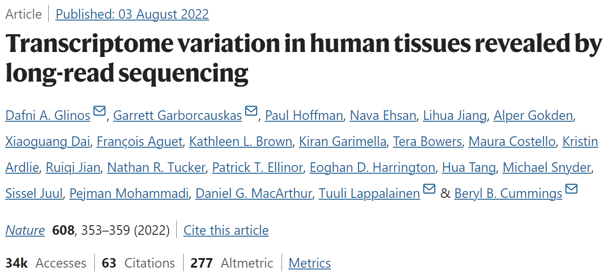
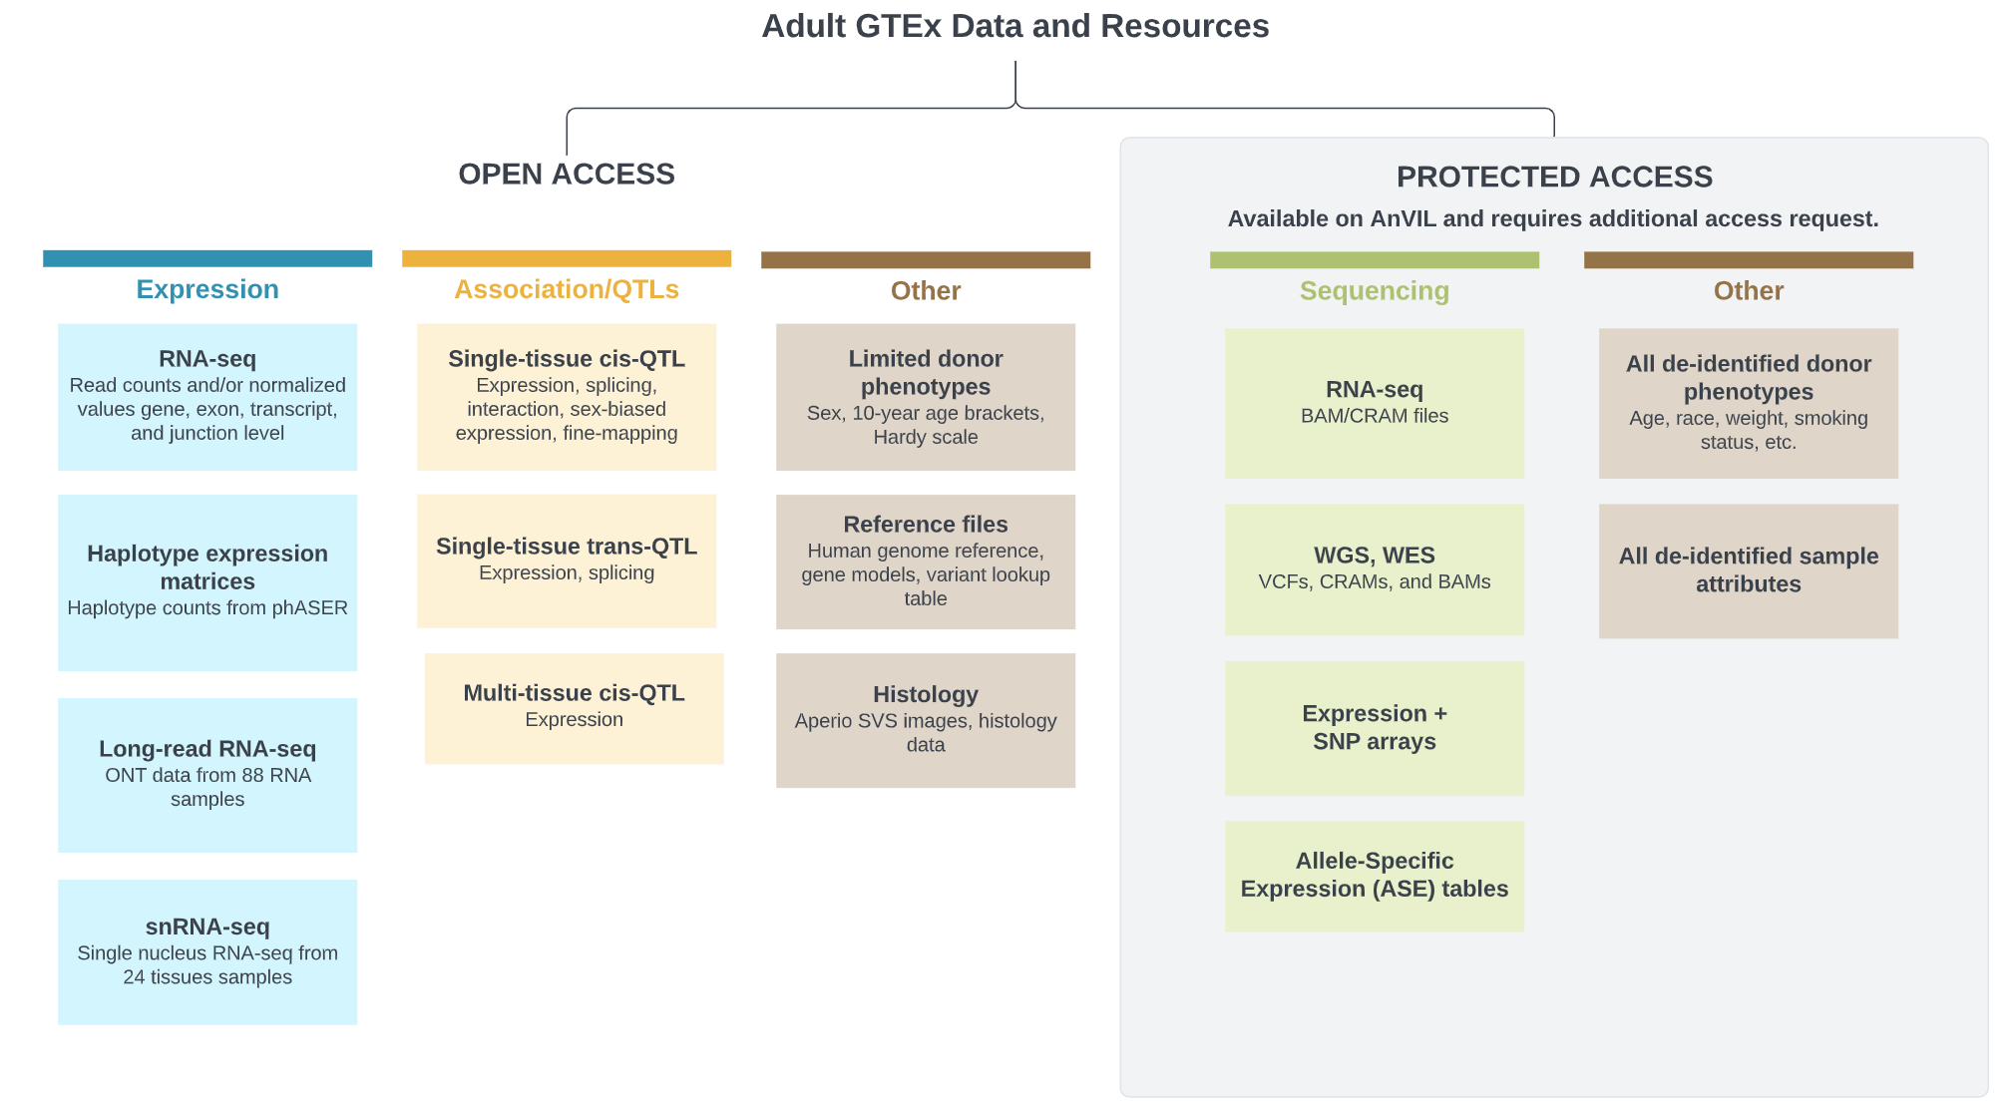
Long-read RNA sequencing in GTEx consortium project
GTEx long-read RNA sequencing data
Platforms
ONT: MinION and GridION
Protocols
PCR-cDNA and direct-cDNA protocols
Reference genome
hg38
Reference annotation
GENCODE v26
# of samples
88 GTEx tissue and cell line samples
-- 86 PCR-cDNA and 2 direct-cDNA
4 K562 cell line samples (PCR-cDNA)
4 Heart - Left Ventricle (PCR-cDNA)
Webpage: https://gtexportal.org/home/downloads/adult-gtex/long_read_data

Slide 5
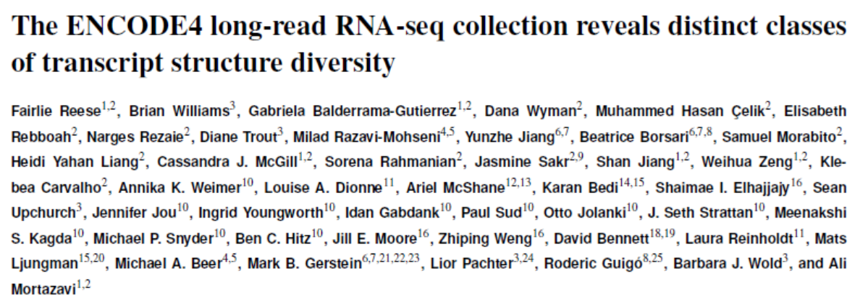
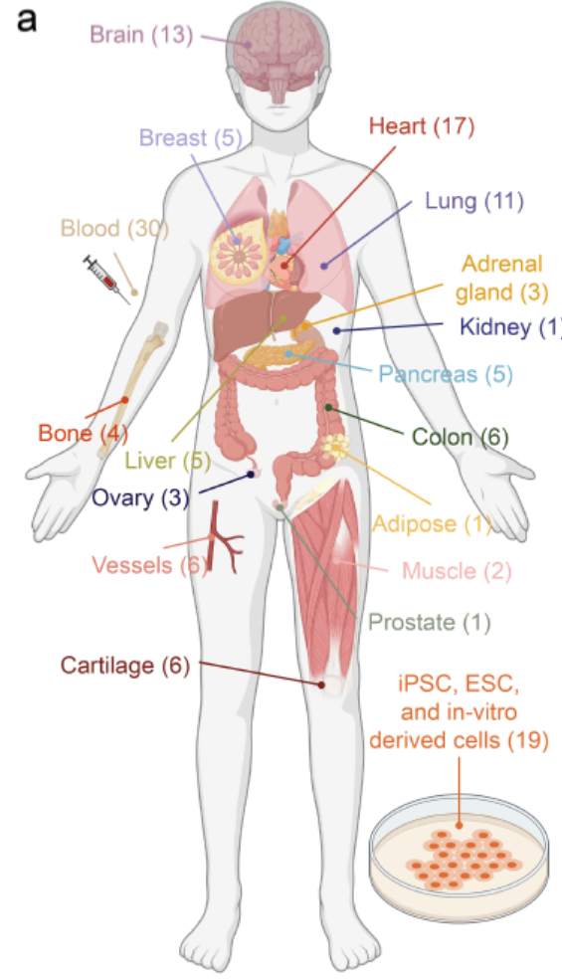
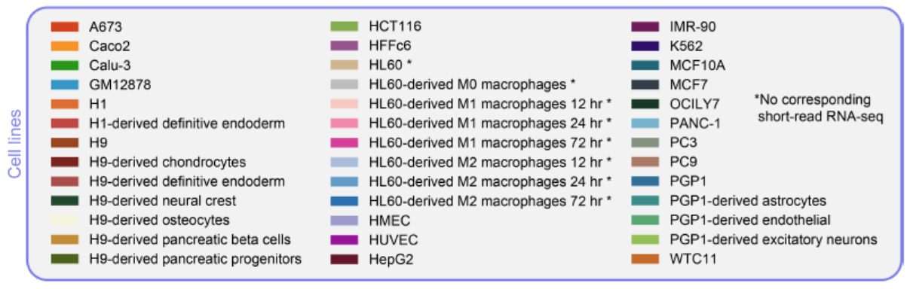
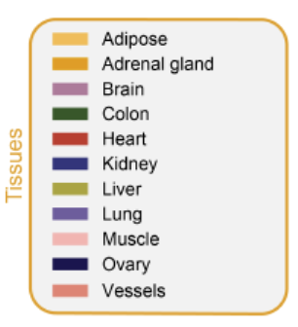
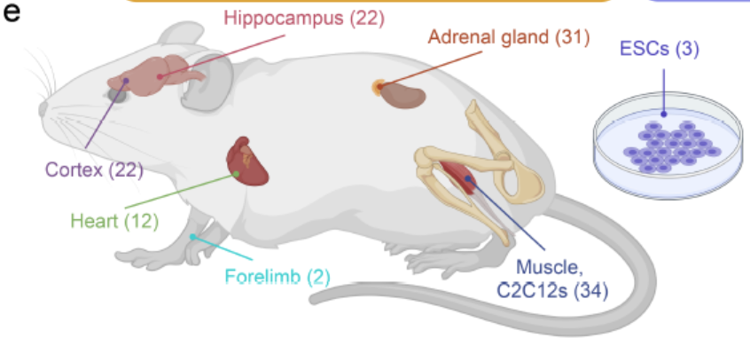
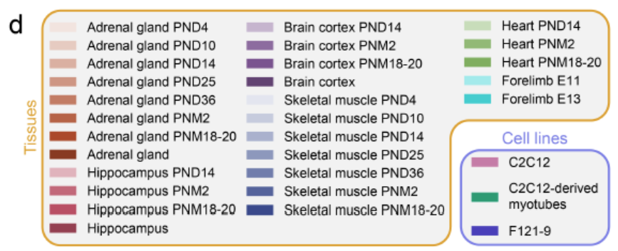
Long-read RNA sequencing in ENCODE4
Human long-read RNA sequencing data
Platforms
PacBio: Sequel II
Protocols
cDNA
Human genome
hg38
Reference annotation
GENCODE v29
# of samples
95 samples from 50 human tissues and cell lines
Human
Mouse long-read RNA sequencing data
Platforms
PacBio: Sequel II
Protocols
cDNA
Reference genome
mm10
Reference annotation
GENCODE vM21
# of samples
64 samples from 31 mouse tissues and cell lines
Mouse
Raw data are available at the following links:
• Human: https://www.encodeproject.org/carts/829d339c-913c-4773-8001-80130796a367/
• Mouse: https://www.encodeproject.org/carts/55367842-f225-45cf-bfbe-5ba5e4182768/

Slide 6
Long-read RNA sequencing in ENCODE (Include ENCODE4, collection from Aifu)
Long-read single-cell RNA-seq summary in ENCODE
Database | Data type | Species | Platform | Library | # of Samples
ENCODE | long read scRNA-seq | Mus musculus | ONT | Parse Single Cell Whole Transcriptome Kit | 36
ENCODE | long read scRNA-seq | Mus musculus | PacBio | Parse Single Cell Whole Transcriptome Kit | 28
Long-read RNA-seq summary in ENCODE
Database | Data type | Species | Platform | Library | # of Samples
ENCODE | long read RNA-seq | Home sapiens | ONT | Direct RNA | 6
ENCODE | long read RNA-seq | Home sapiens | ONT | CapTrap | 6
ENCODE | long read RNA-seq | Home sapiens | ONT | PCR-cDNA | 3
ENCODE | long read RNA-seq | Home sapiens | ONT | R2C2 | 3
ENCODE | long read RNA-seq | Home sapiens | PacBio | SMRTbell | 98
ENCODE | long read RNA-seq | Mus musculus | ONT | Direct RNA | 2
ENCODE | long read RNA-seq | Mus musculus | ONT | CapTrap | 1
ENCODE | long read RNA-seq | Mus musculus | ONT | PCR-cDNA | 1
ENCODE | long read RNA-seq | Mus musculus | ONT | R2C2 | 1
ENCODE | long read RNA-seq | Mus musculus | PacBio | SMRTbell | 66
Webpage: https://www.encodeproject.org/

Slide 7
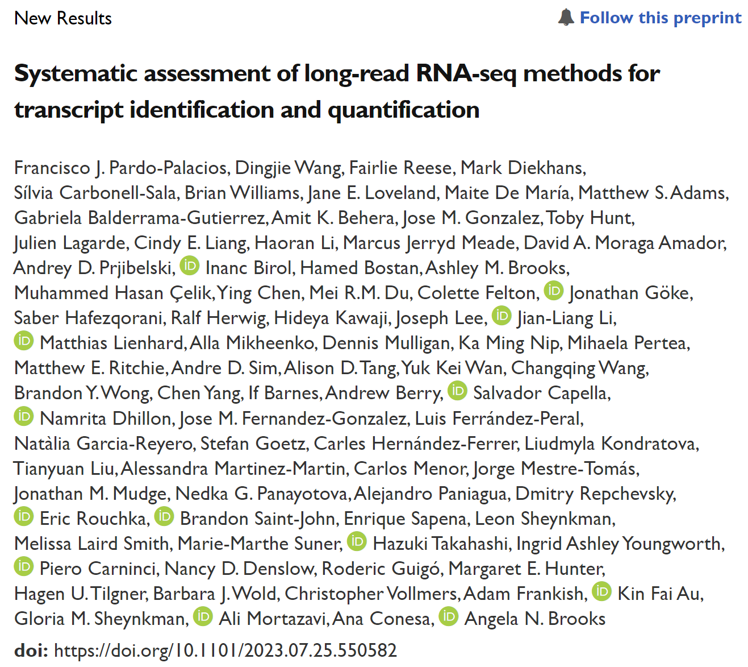
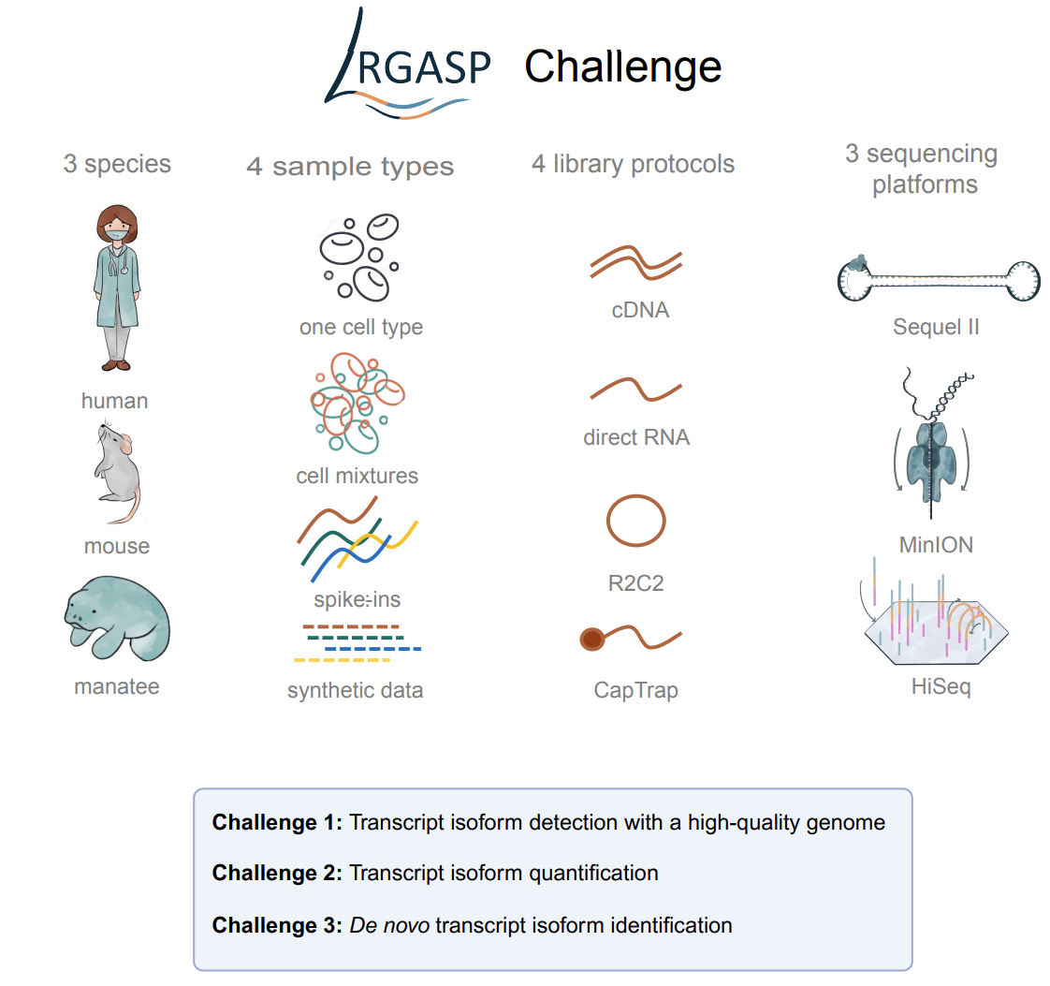
Long-read RNA sequencing in LRGASP consortium project
Data summary in LRGASP consortium project
Database | Data type | Species | Platform | Library | # of Samples
LRGASP | long read RNA-seq | Home sapiens | ONT: MinION | cDNA | 4
LRGASP | long read direct RNA-seq | Home sapiens | ONT: MinION | Direct RNA | 4
LRGASP | long read RNA-seq | Home sapiens | ONT: MinION | R2C2 | 4
LRGASP | long read RNA-seq | Home sapiens | ONT: MinION | CapTrap | 4
LRGASP | long read RNA-seq | Home sapiens | PacBio:Sequel II | cDNA | 4
LRGASP | long read RNA-seq | Home sapiens | PacBio:Sequel II | CapTrap | 4
LRGASP | long read RNA-seq | Mus musculus | ONT: MinION | cDNA | 1
LRGASP | long read direct RNA-seq | Mus musculus | ONT: MinION | Direct RNA | 1
LRGASP | long read RNA-seq | Mus musculus | ONT: MinION | R2C2 | 1
LRGASP | long read RNA-seq | Mus musculus | ONT: MinION | CapTrap | 1
LRGASP | long read RNA-seq | Mus musculus | PacBio:Sequel II | cDNA | 1
LRGASP | long read RNA-seq | Mus musculus | PacBio:Sequel II | CapTrap | 1
LRGASP | long read RNA-seq | manatee | ONT: MinION | cDNA | 1
LRGASP | long read direct RNA-seq | manatee | ONT: MinION | Direct RNA | 1
LRGASP | long read RNA-seq | manatee | ONT: MinION | R2C2 | 1
LRGASP | long read RNA-seq | manatee | ONT: MinION | CapTrap | 1
LRGASP | long read RNA-seq | manatee | PacBio:Sequel II | cDNA | 1
LRGASP | long read RNA-seq | manatee | PacBio:Sequel II | CapTrap | 1

Slide 8
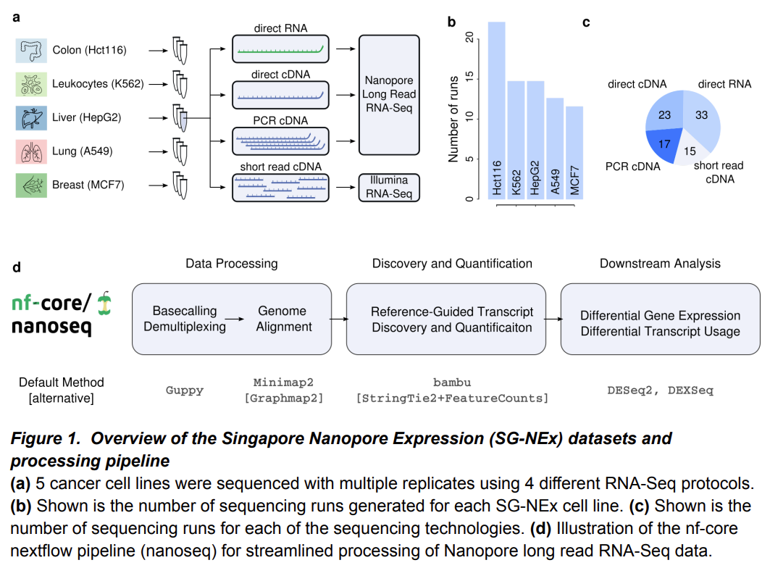
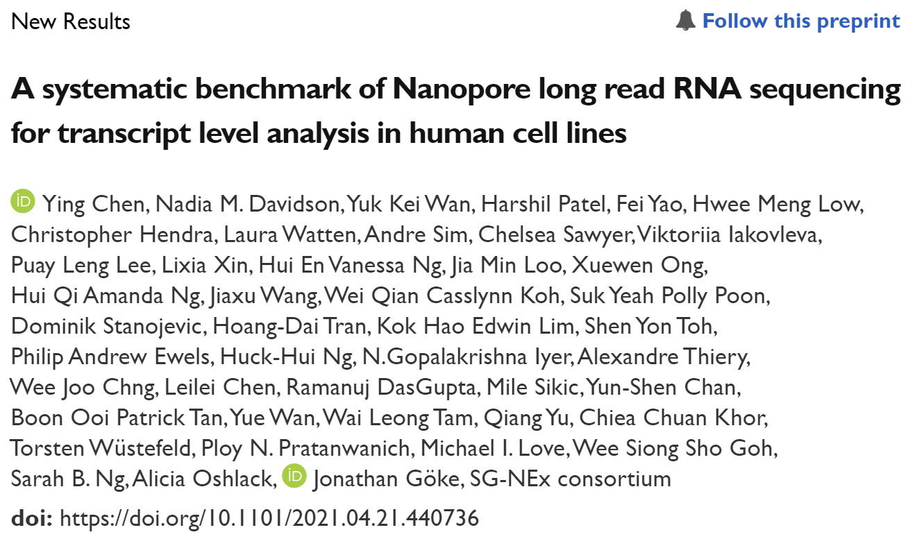
Long-read RNA sequencing in SG-NEx consortium project
Data summary in SG-NEx consortium project
Database | Data type | Species | Platform | Library | # of runs | # of Samples
SG-Nex | long read RNA-seq | Home sapiens | ONT(MinION, GridION, PromethION) | PCR cDNA | 27 | 8
SG-Nex | long read RNA-seq | Home sapiens | ONT(MinION, GridION, PromethION) | Direct cDNA | 30 | 7
SG-Nex | long read direct RNA-seq | Home sapiens | ONT(MinION, GridION, PromethION) | Direct RNA | 55 | 14
Github: https://github.com/GoekeLab/sg-nex-data?tab=readme-ov-file
Data are listed in the sample spreadsheet:
https://github.com/GoekeLab/sg-nex-data/blob/master/docs/samples.tsv

Slide 9
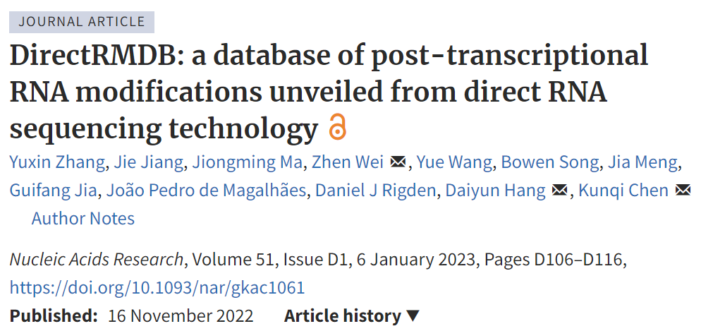
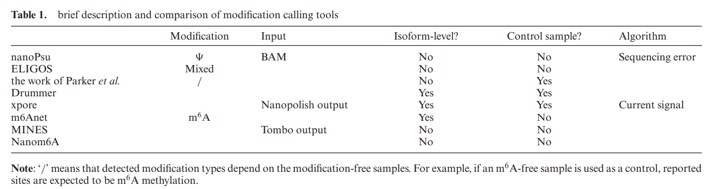
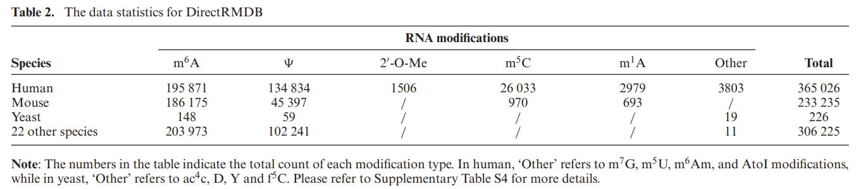
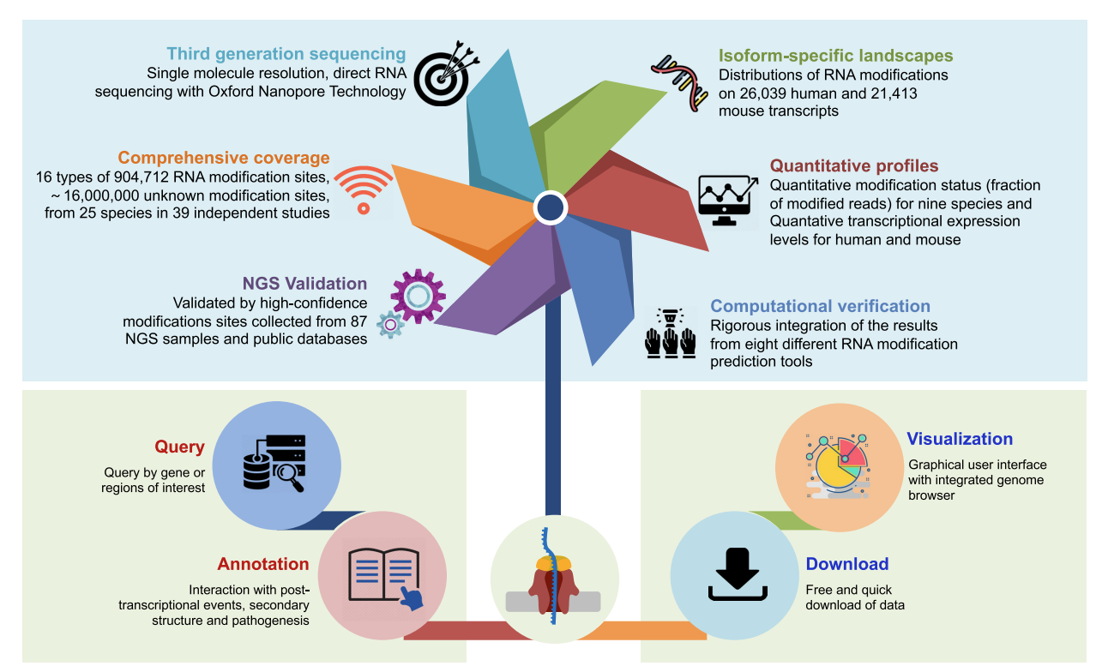
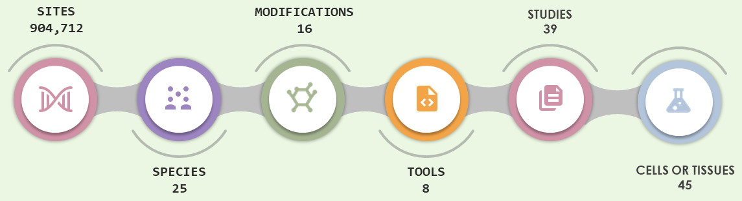
Long-read RNA sequencing in directRMDB database (Collection from Aifu)
The overall design of DirectRMDB.
Data summary in directRMDB database
Database | Data type | Species | Platform | Library | # of Samples
DirectRMDB | long read direct RNA-seq | Home sapiens | ONT | Direct RNA | 43
DirectRMDB | long read direct RNA-seq | Mus musculus | ONT | Direct RNA | 18
DirectRMDB | long read direct RNA-seq | Drosophila melanogaster | ONT | Direct RNA | 5
DirectRMDB | long read direct RNA-seq | Saccharomyces cerevisiae | ONT | Direct RNA | 8
DirectRMDB | long read direct RNA-seq | Zea mays | ONT | Direct RNA | 5
DirectRMDB | long read direct RNA-seq | Arabidopsis thaliana | ONT | Direct RNA | 3
DirectRMDB | long read direct RNA-seq | Other | ONT | Direct RNA | 42
Webpage: http://www.rnamd.org/directRMDB/index.html

Slide 10
Thanks for your attention!

