Slide 1


Team Details
Team name: Model Citizens | Project: Irene
Team leader name: Debadrita Dutta
Problem Statement: Make therapy or therapist-led support more affordable,
with a private first step for people who find it hard to ask for help.
Notes:
Project Irene | Model Citizens | Team leader: Debadrita Dutta. Theme: Sustainability & Social Impact, with a social-good and healthcare-access focus. Founder motivation is the personal experience supplied by the team leader, not a population study.

Slide 2

Note: Please download this template to make your edits and submit the final version.
To download, go to File > Download > Microsoft PowerPoint (.PPTX). Kindly refrain from sending edit requests.

Slide 3
Brief about the idea
It began with a very personal hesitation.
In college, I needed therapy. It was expensive.
I did not want to tell my parents because I knew they would worry.
FOUNDER EXPERIENCE · DEBADRITA DUTTA
What if the cost could be shared, without having to begin in public?
Irene is a working platform for private intake and therapist-led groups. With consent,
Gemini helps organize a person’s story; the person confirms it, a professional reviews it,
and compatible participants can choose a group with an upfront shared session fee.
MODEL CITIZENS / PROJECT IRENE
03
Notes:
Founder story paraphrased from the user’s own account. Pause after “they would worry.” This is the emotional starting point, not evidence of market demand. Current implementation evidence: frontend/src/Workspace.jsx; backend workflow/ExperienceService.java; docs/DEPLOYMENT_STATUS.md, verified 10 October 2026.

Slide 4
Opportunities
How is the idea different?
A private-to-group journey combines participant-confirmed AI summaries,
practical matching, professional decisions and a visible shared fee.
How does it address the problem?
Sharing a session fee can reduce the amount each person pays. Private intake
lets someone explain their needs before deciding what to share in a group.
USP: affordability, agency and human judgment together
AI prepares information. A therapist decides suitability. The participant
chooses whether to join. The starting focus is college-age adults.
MODEL CITIZENS / PROJECT IRENE
04
Notes:
Positioning is a product hypothesis, not a claim of being the first or only group-support platform. The product does not guarantee confidentiality among group members, clinical suitability or lower total operating cost. Societal theme source: https://aibuildercup.com/themes.html (accessed 10 October 2026).

Slide 5
List of features offered by the solution
01 A private first step
02 AI you can correct
Consent, personal preferences, budget
and a story shared with the chosen therapist.
Gemini drafts the intake summary.
The participant edits and confirms it.
03 A practical group fit
04 A human decision
Availability, language, age band, region,
sharing comfort and related goals.
Verified professional access, intake review
and explicit approval before invitations.
05 A clear, shared fee
06 Control after joining
An exact quote before acceptance,
with the freedom to accept or decline.
Private preparation, calendar export,
and intake data export or deletion.
MODEL CITIZENS / PROJECT IRENE
05
Notes:
Implemented features, not future promises. Gemini embeddings contribute to similarity ranking; hard filters and professional review remain separate. Meet URLs are supplied manually; calendar integration is an ICS download, not a Google Calendar API integration. No payments are collected. Evidence: application workflow and deployment verification.

Slide 6
Process flow diagram or Use-case diagram
1 Private intake
Preferences + consent
2 Gemini draft
Participant corrects + confirms
3 Professional review
Individual suitability decision
6 Participant chooses
Accept / decline + preparation
5 Therapist approves
Time, group and exact fee
4 Suggest a circle
Hard filters + goal similarity
High or uncertain review signals → excluded from routine matching for individual review.
AI supports preparation; it does not diagnose, deliver therapy or make the final placement.
MODEL CITIZENS / PROJECT IRENE
06
Notes:
Workflow implemented in ExperienceService.java and matching services. Risk signal is experimental, not a clinically validated detector. Human review is mandatory and there is no live crisis monitoring. Shape boxes and connectors are editable.

Slide 7
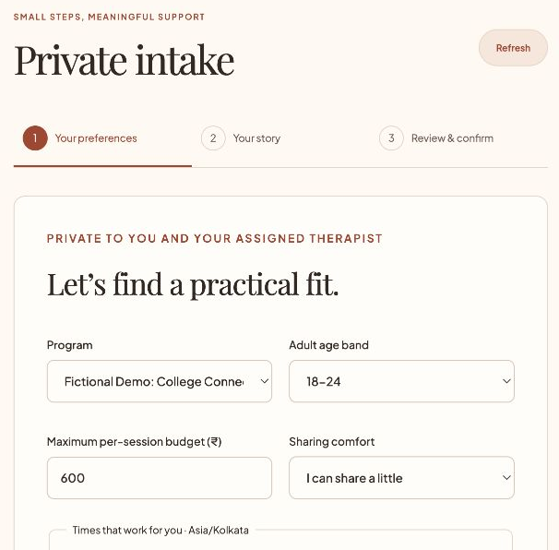
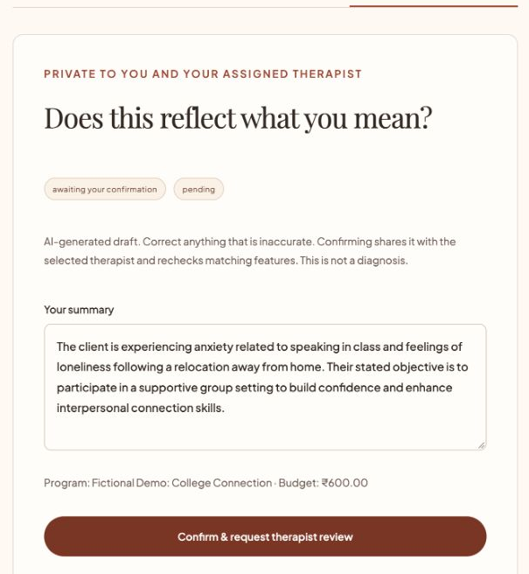
Wireframes/Mock diagrams of the proposed solution (optional)
Built interface: a calm first step, with control over what happens next.
Preferences before disclosure
An editable summary before sharing
MODEL CITIZENS / PROJECT IRENE
07
Notes:
Actual deployed-app screenshots recorded 10 October 2026. All participant information shown is fictional. Images are cropped for readability without changing UI or values. Coral interface refined with Google Stitch; React/Vite implementation.

Slide 8
Architecture diagram of the proposed solution
Gemini API
Intake + preparation drafts
Embeddings for similarity
Firebase Hosting
React / Vite web app
Cloud Run
Java / Spring Boot API
JWT + role / ownership checks
Secret Manager
Runtime secrets
Restricted service identity
Supabase PostgreSQL
Restricted application role
Certificate-verified TLS
Cloud Build + Artifact Registry → tested backend container → Cloud Run
Firestore is not used. PostgreSQL is the system of record for the current implementation.
MODEL CITIZENS / PROJECT IRENE
08
Notes:
Actual deployed architecture as of 10 October 2026. Firebase Hosting Spark; Cloud Run asia-south1 minimum 0, maximum 2; Supabase PostgreSQL Free, session pooler; Secret Manager runtime identity. Gemini Developer API, not Vertex AI. Cloud SQL, Firebase Authentication, Firestore, ADK, Gemma, DLP and automated Workspace APIs are not implemented. Evidence: docs/DEPLOYMENT_STATUS.md, application-hosted.yml, GoogleAiService.java, cloudbuild.yaml.

Slide 9
Technologies to be used in the solution
Technology | How Irene uses it | Status
Firebase Hosting | HTTPS delivery of the React / Vite web app | Live
Cloud Run | Spring Boot workflow, access checks and matching | Live
Gemini API | Draft summaries, facilitator preparation, embeddings | Live
Secret Manager | Database, JWT and Gemini secrets | Live
Cloud Build / Artifact Registry | Build, test and store the backend container | Used
Google Stitch | UI exploration and coral interface refinement | Used
Supabase PostgreSQL | Intakes, programs, circles and invitations | Live
Firestore | Not integrated; PostgreSQL stores application data | Not used
MODEL CITIZENS / PROJECT IRENE
09
Notes:
Implementation status, not a wishlist. Gemini generation model configured as gemini-3.5-flash-lite; embeddings gemini-embedding-001 (768 dimensions). Model identifiers are configurable. Refer to docs/DEPLOYMENT_STATUS.md and backend/src/main/java/com/irene/irene/ai/service/GoogleAiService.java. Google AI Studio can support API experimentation but is not claimed as a deployed component.

Slide 10
Estimated implementation cost (optional)
Light-use deployment
Target: ₹0 while usage fits free allowances and trial credit.
Firebase Spark + Supabase Free; Google backend on trial.
Actual charges depend on usage; zero cost is not guaranteed.
Shared-session illustration
Operating model to validate
₹2,400 total ÷ 4 participants = ₹600 per person.
The same total ÷ 6 = ₹400 per person.
Illustrative arithmetic; not market pricing or a clinical comparison.
A transparent coordination fee could fund operations.
Screening, preparation, unfilled seats and support
must be costed before setting real prices.
Cost controls: Cloud Run min 0 / max 2; ₹500 monthly budget alert. Alerts are not caps.
MODEL CITIZENS / PROJECT IRENE
10
Notes:
No billed expenditure or revenue measurement is claimed. Cost target assumes very light demo traffic within free/trial allowances, excluding professional time and development labor. Cloud Run min0 max2 do not cap total spending. Sources: https://firebase.google.com/pricing ; https://cloud.google.com/run/pricing ; https://ai.google.dev/gemini-api/docs/pricing ; https://supabase.com/pricing . Configuration evidence: docs/DEPLOYMENT_STATUS.md. Fee arithmetic is an illustrative team assumption.

Slide 11
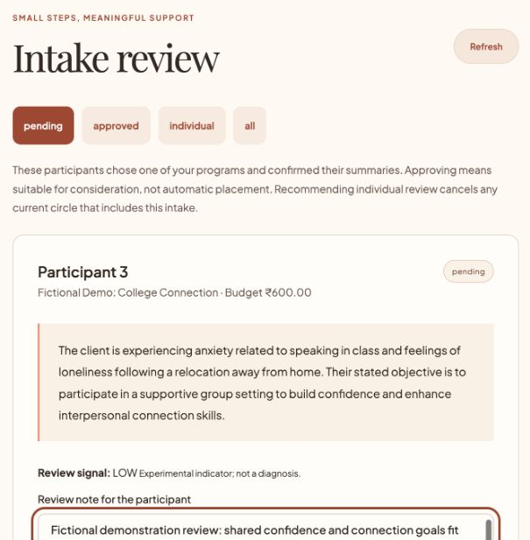
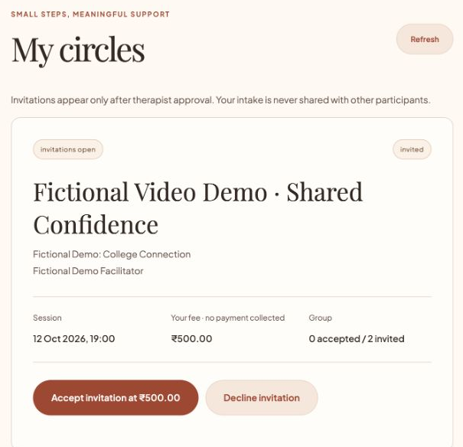
Snapshots of the prototype
A human reviews the fit. The participant makes the final choice.
Therapist review of a confirmed intake
A ₹500 quote with accept / decline
MODEL CITIZENS / PROJECT IRENE
11
Notes:
Actual live-app screenshots, fictional demo only. Demo fee INR1,000 divided by 2 invited participants gives INR500 per participant. No real payment, appointment or Meet room was created. The video-created circle was cancelled after capture.

Slide 12
Prototype Performance report/Benchmarking
30
6
35
Backend tests passed
Frontend routing tests
Live workflow checks
What was verified
Fictional intake → real Gemini generation / embeddings → therapist review →
matching → group approval → fixed quote → acceptance → cancellation / deletion.
What this evidence does not establish
Clinical suitability, crisis-detection accuracy, real-user outcomes or high-load performance.
The next evaluation should measure affordability, access and participant control.
MODEL CITIZENS / PROJECT IRENE
12
Notes:
Recorded verification dated 10 October 2026, not a benchmark against competitors. Evidence: docs/DEPLOYMENT_STATUS.md; backend/target/surefire-reports; frontend/tests/authRouting.test.js; prior live release verification. Counts refer to software checks and fictional workflows, not patients. No latency, model-accuracy or clinical-outcome percentages are claimed.

Slide 13
Additional Details/Future Development (if any)
Next: establish safe, appropriate group criteria
Work with qualified clinicians on suitability, consent, escalation and the limits of AI.
Evaluate labelled fictional cases before considering any service trial.
Then: validate access and economics
Explore campus counselling and nonprofit pilots. Measure out-of-pocket cost,
time to an appropriate group, attendance, comfort and therapist preparation time.
Grow only after the foundations are tested
Validate sustainable pricing, accessibility and language support. Add paid sessions
and stronger operational governance only after professional and user review.
MODEL CITIZENS / PROJECT IRENE
13
Notes:
Roadmap and potential channels only: no confirmed clinician partnership, campus contract, pilot participants or revenue. Before a real-health-data pilot, professional, legal, privacy and operational review would be required. This prototype is restricted to fictional data.

Slide 14
Provide links to your:
GitHub Public Repository
github.com/TheAverageGatsby13/project-irene
Demo Video Link (3 Minutes)
Watch the narrated product demo
Final Product Link
project-irene-fd39e.web.app
MODEL CITIZENS / PROJECT IRENE
14
Notes:
Repository and deployment links must be checked without account access before submission. Google Drive demo is shared with anyone who has the link as a viewer. Prepared video: docs/submission/video/Irene-Demo-English.mp4, under three minutes, 1920x1080 with a youthful Aoede synthetic voice and captions.

Slide 15
Why this belongs in Sustainability & Social Impact
The first step towards support should not
feel out of reach.
For someone worried about the fee.
For someone protecting their parents from worry.
For someone who wants to speak, but needs to begin privately.
Our intended impact: a lower financial barrier, more choice over disclosure,
and a path into professionally guided community.
MODEL CITIZENS / PROJECT IRENE
15
Notes:
Theme alignment: https://aibuildercup.com/themes.html . Founder motivation supplied directly by Debadrita Dutta. Impact is intended, not yet demonstrated through a real-user study. Closing sentiment is original pitch copy based on that experience.

Slide 16


