Slide 1

Poker Hand Classification Using Machine Learning
A Comparative Study of Feature Methods and Models
Camerin Casesa, Lily Lockwood, Azaria Reed, Diana De Santiago
CS 488-01: Intro to Big Data Computing
Dr. Vineetha Menon

Slide 2
Big Data Context
5V Model
Implication
Volume: many combinations
Velocity: real-time potential
Variety: mixed feature types
Veracity: structured data
Value: strong benchmark
Structure > size
Relationships drive accuracy

Slide 3
Defining the Problem Space
Problem
Challenge
Classify 5-card hands into 10 categories
Features: suit + rank
Values are categorical, not numeric
Strong feature interactions
Nonlinear patterns
Class imbalance

Slide 4
Hypothesis
If statistical and machine learning techniques analyze card combinations, then they can accurately classify poker hands, because the frequency and structure of card ranks and suits follow consistent probabilistic patterns.

Slide 5
Feature and Modeling Techniques
Data Pipeline
Feature Methods
Model Selection
Train/test split (80/20)
SMOTE (train only)
Scaling (fit on train)
Prevent data leakage
Domain features:
Unique rank count
Rank range
One-hot encoding → categorical clarity
LDA → dimensional reduction
Linear SVM
RBF SVM
Random Forest
XGBoost
Nonlinear models perform better

Slide 6
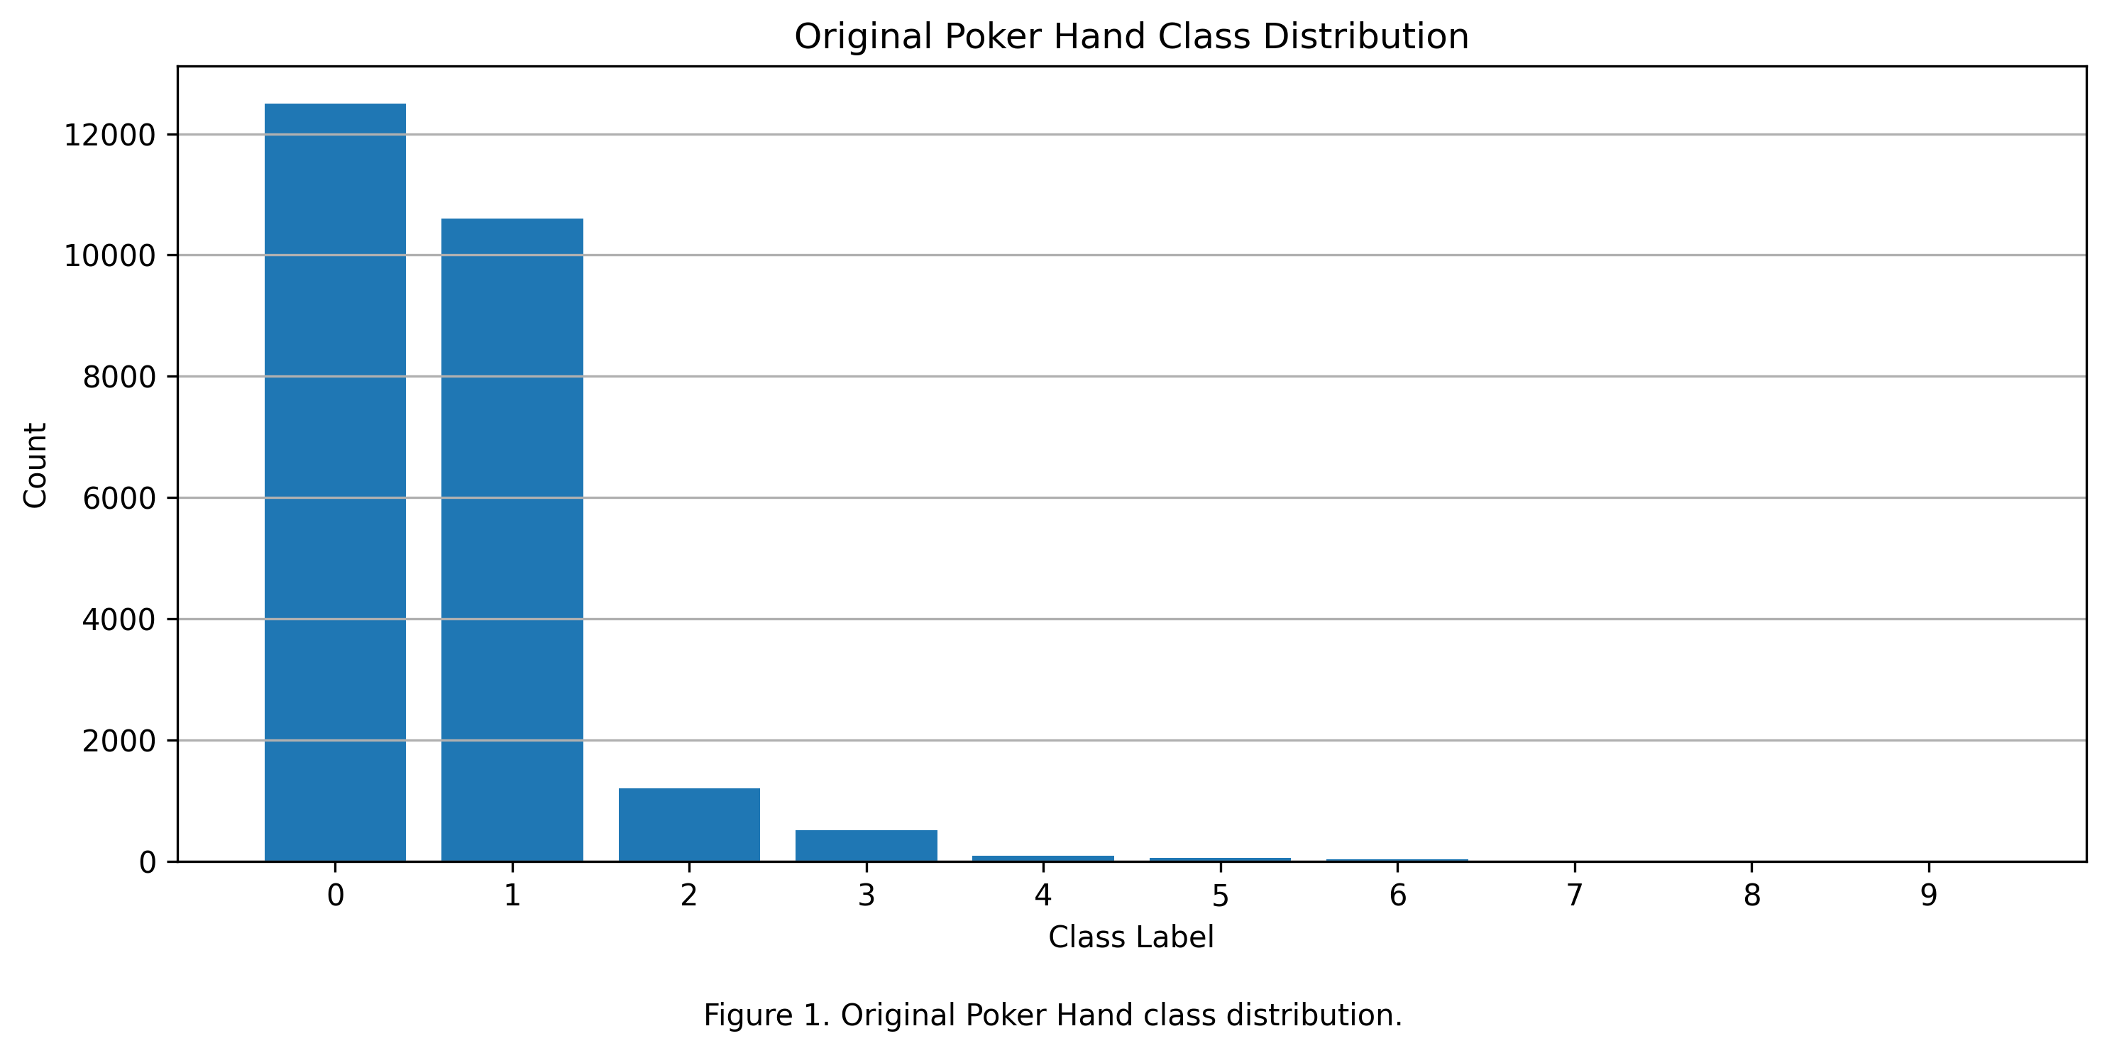
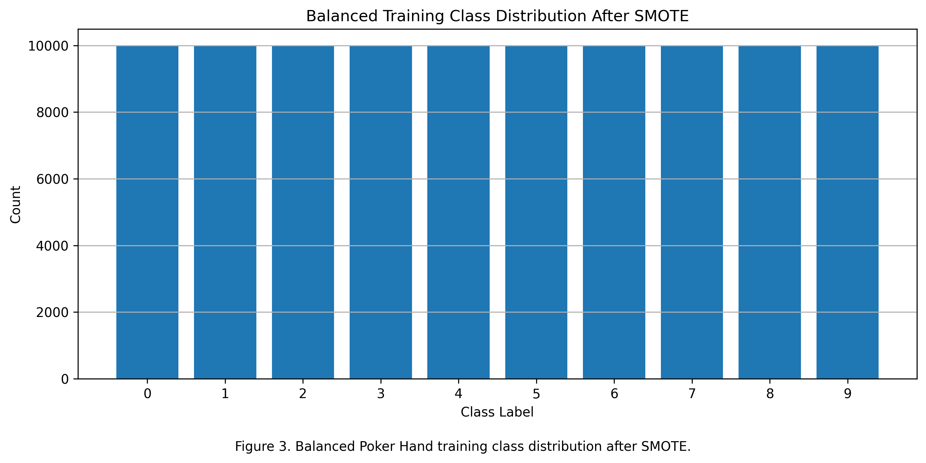
Class Imbalance
Before
After SMOTE

Slide 7
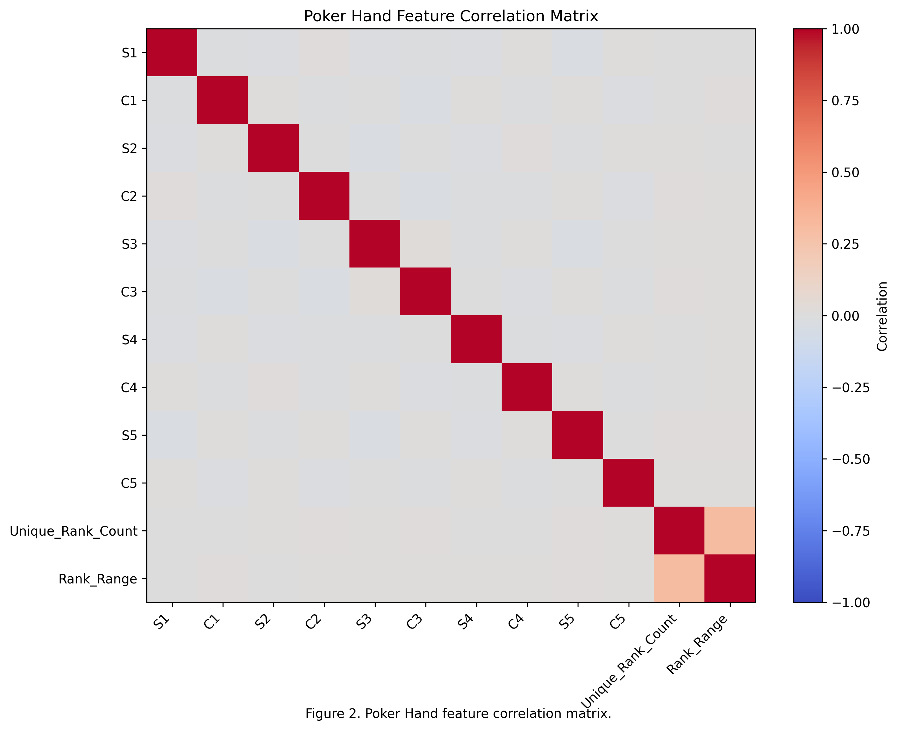
Feature Relationships
Weak correlations
No dominant feature

Slide 8
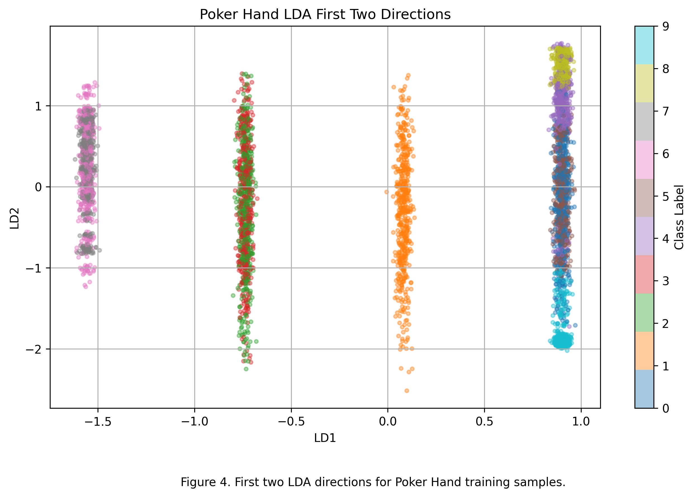
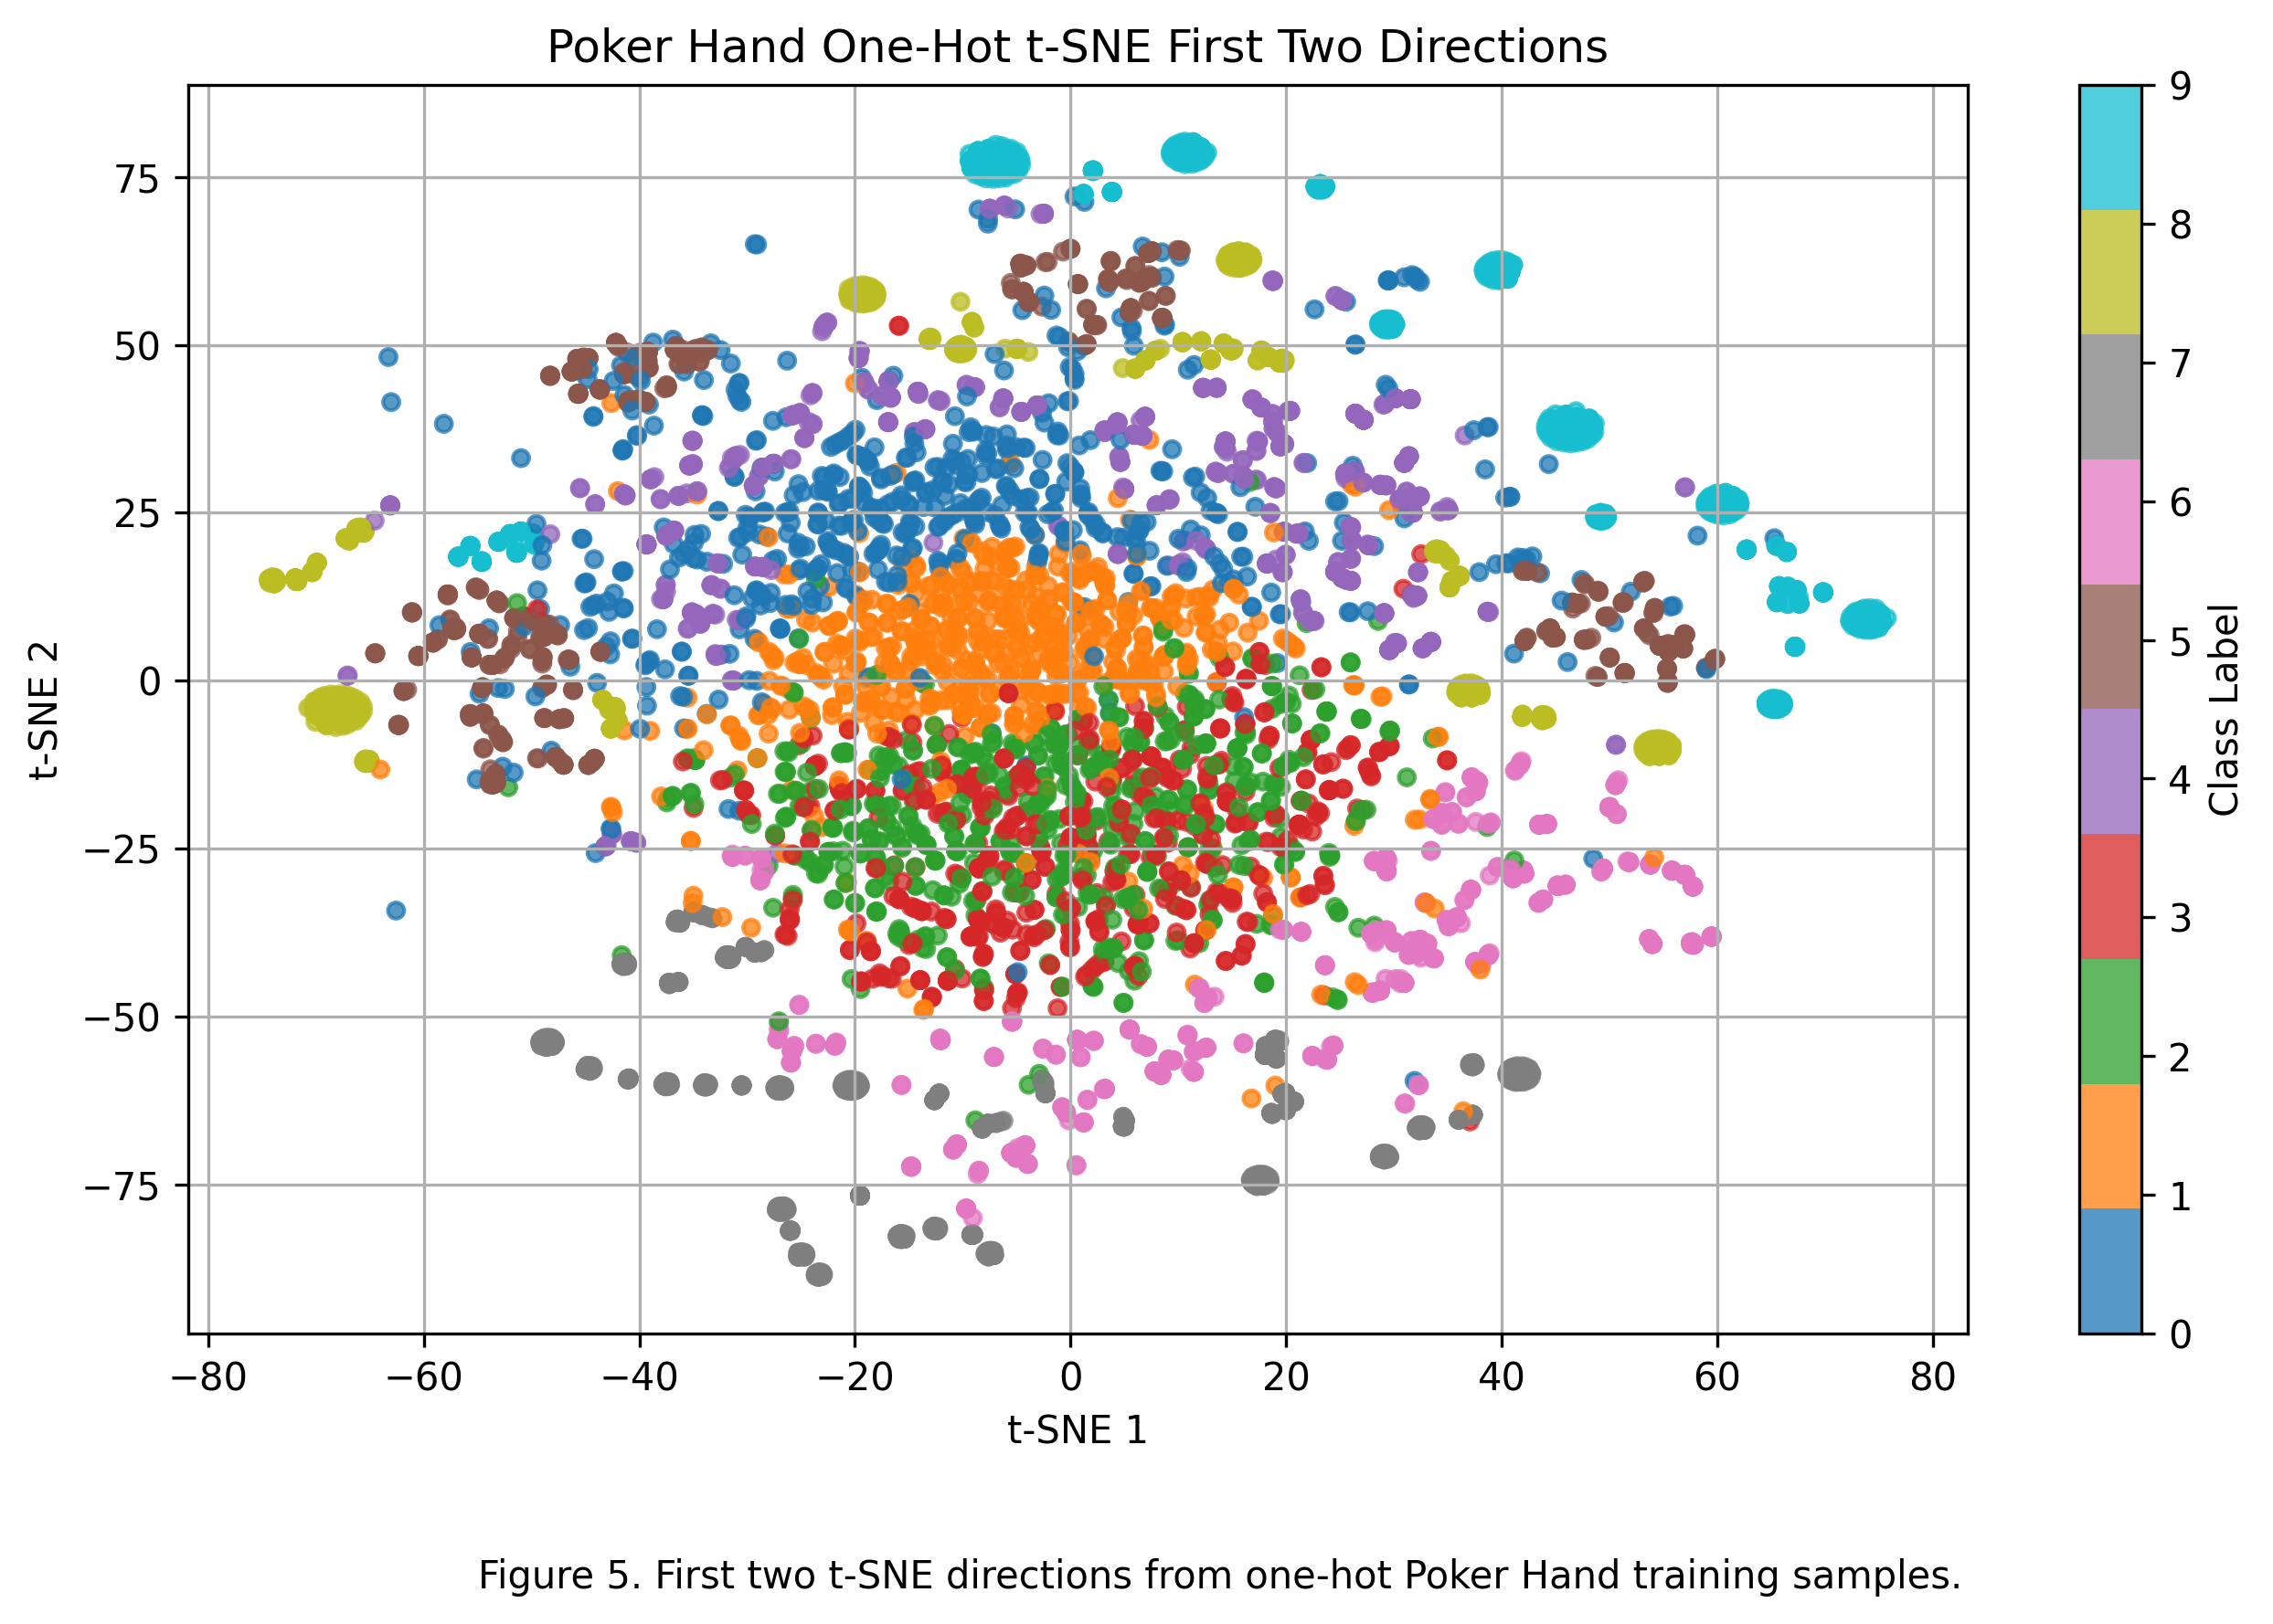
Feature Space Comparison
LDA
t-SNE

Slide 9
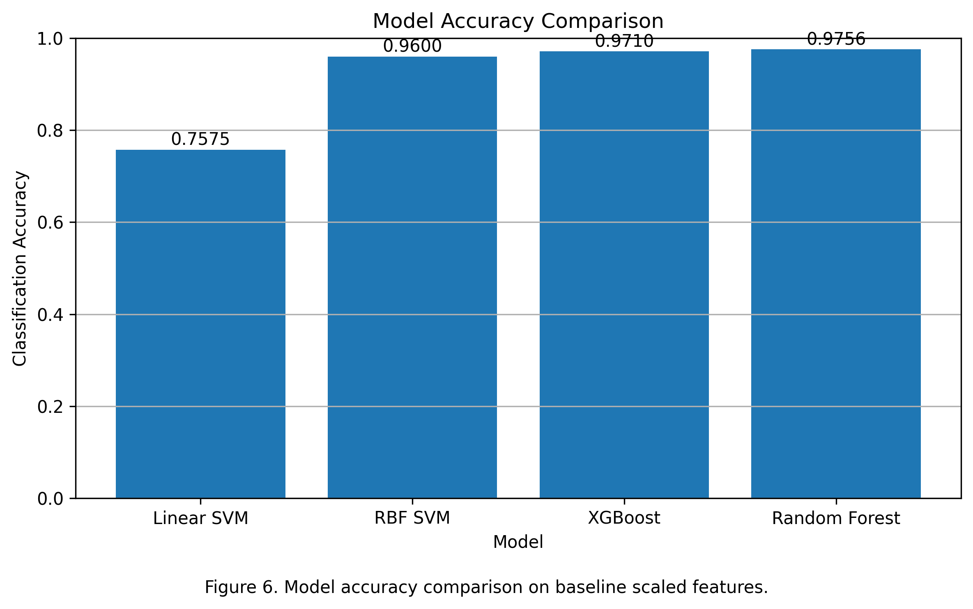
Baseline Performance
RF ≈ 97.6% (best)
XGB, RBF close
Linear SVM low

Slide 10
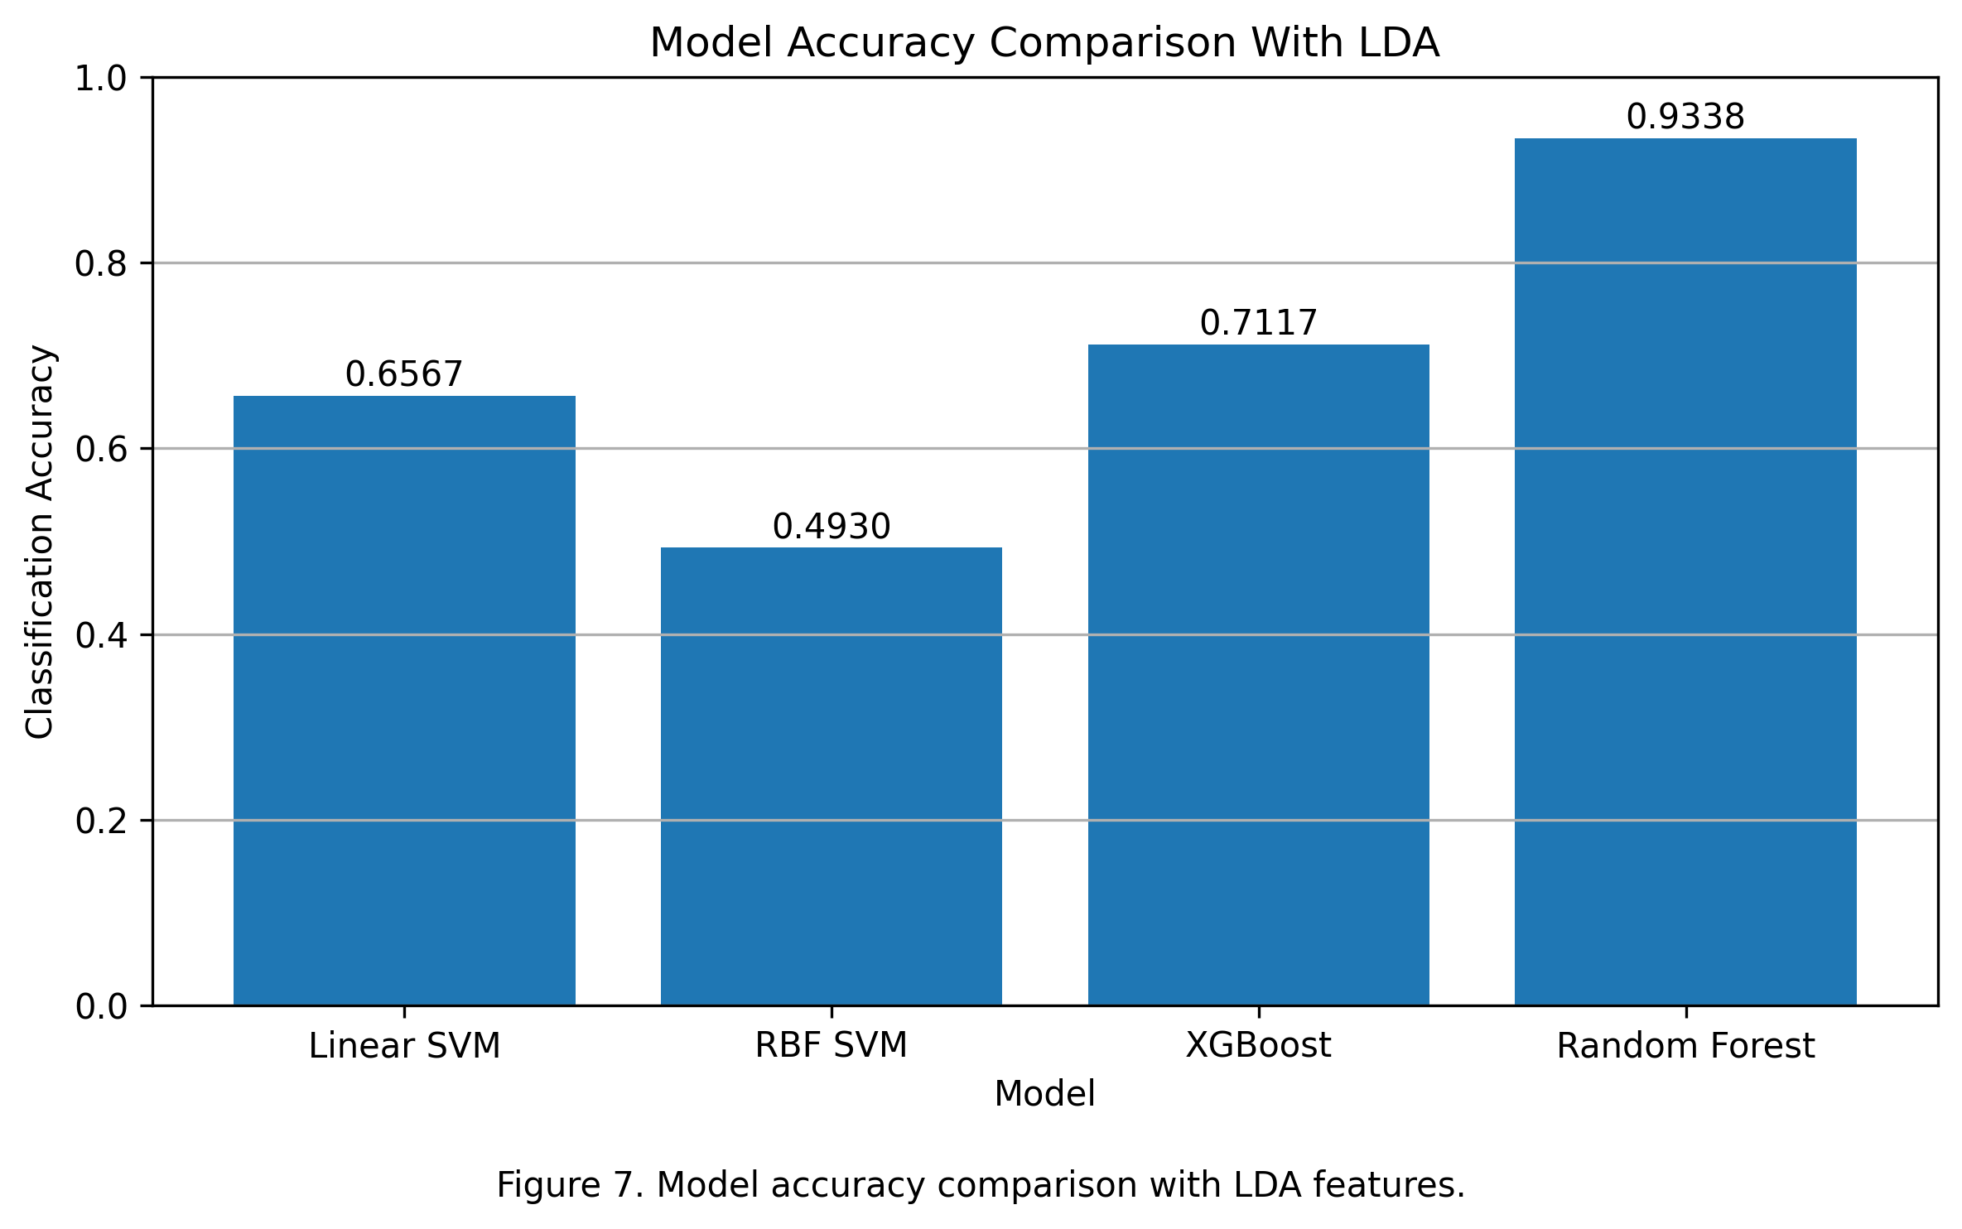
LDA Performance
Accuracy drops
Information loss

Slide 11
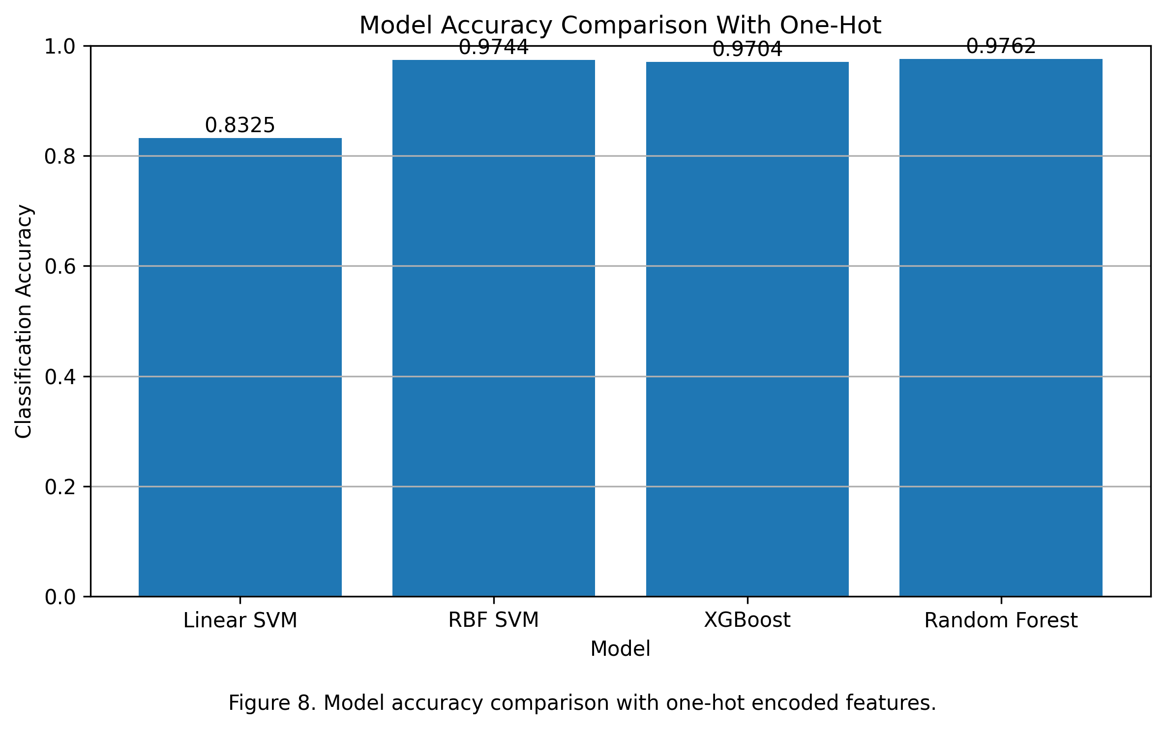
One-Hot Performance
RF best overall
RBF improves
Linear improves slightly

Slide 12
Model Behavior and Key Findings
Performance Patterns
Core Findings
RF best
RBF next
XGB close
Linear worst
Nonlinear > linear
One-hot improves results
LDA reduces accuracy
Nonlinear models dominate
RF most consistent

Slide 13
Human vs. AI
Human
Model
Designed pipeline
Selected features/models
Interpreted results
Learned patterns
Scaled predictions

Slide 14
Hypothesis supported — models learned card patterns effectively
Feature representation + nonlinear models → highest accuracy
Best: Random Forest + One-Hot

