Slide 1

predicting automobile fuel efficiency using svr and ann
Wyatt Laughner and Azaria Reed (Group 9)
CS 430: Survey of Artificial Intelligence
Dr. Chaity Banerjee Mukherjee
December 2025

Slide 2
Project description
Goals of the Project:
Predict miles per gallon (mpg) from the UCI Auto MPG dataset.
Apply two machine learning approaches:
  Support Vector Regressor (SVR)
  Artificial Neural Network (ANN)
Compare their performance using the mean squared error (MSE) metric.
What We Did:
Loaded and cleaned the dataset
Preprocessed the features
Trained both models using existing libraries and pipelines
Evaluated and compared accuracy

Slide 3
Dataset description
Dataset: UCI Auto MPG Dataset
Instances: 398
ID: Car name
Features:
Displacement
Cylinders
Horsepower
Weight
Acceleration
Model year
Origin
Target:
MPG (automobile fuel efficiency)
Issues Identified:
Missing values for horsepower

Slide 4
Data preprocessing
Steps We Took:
Read the dataset using pandas.read_csv() with whitespace delimiter.
Converted “?” to NaN using na_values="?".
Dropped missing rows using dropna().
Selected the 7 numeric features.
Performed 80/20 train-test split using train_test_split().
Why This Matters:
Removes invalid entries
Matches preprocessing from class homework

Slide 5
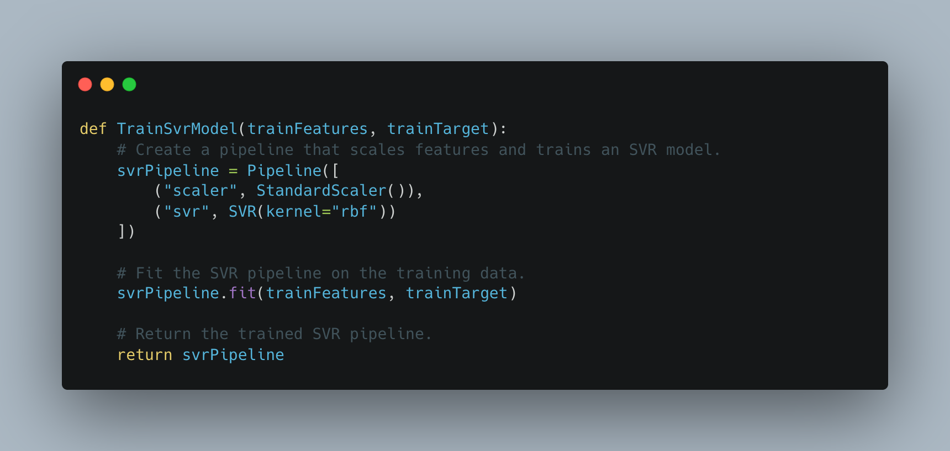
Svr approach
Learns nonlinear patterns
Performs well on small datasets
Widely used baseline regression model
Library Used: scikit-learn (sklearn.svm.SVR)
Pipeline Steps:
Scale features using StandardScaler()
Train SVR with RBF kernel
Code Structure:
    Pipeline([
    ("scaler", StandardScaler()),
    ("svr", SVR(kernel="rbf"))
    ])

Slide 6
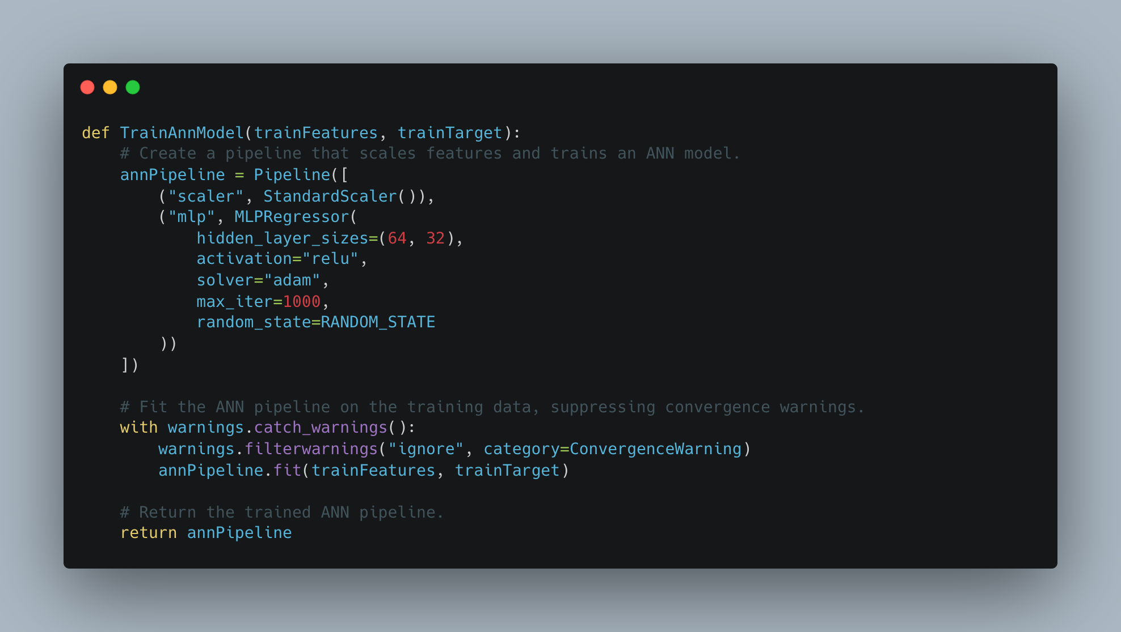
ann approach
Learns deeper nonlinear relationships
Often outperforms SVR with enough training
Works well with continuous prediction tasks
Library Used: scikit-learn (MLPRegressor)
Note: We used a small incremental ANN to generate the training vs. validation convergence curve, and a final ANN pipeline for computing the test MSE.
Architecture in Our Code:
Hidden layers: (64, 32)
Activation: ReLU
Optimizer: Adam
Max iterations: 1000
Pipeline:
    Pipeline([
    ("scaler", StandardScaler()),
    ("mlp", MLPRegressor(...))
    ])

Slide 7
Experimental setup
Train/Test Split:
80% Training
20% Testing
random_state = 42 for reproducibility
Evaluation Metric:
Mean Squared Error (MSE)
  Lower = better
Reason for MSE:
Used in homework
Standard regression loss

Slide 8
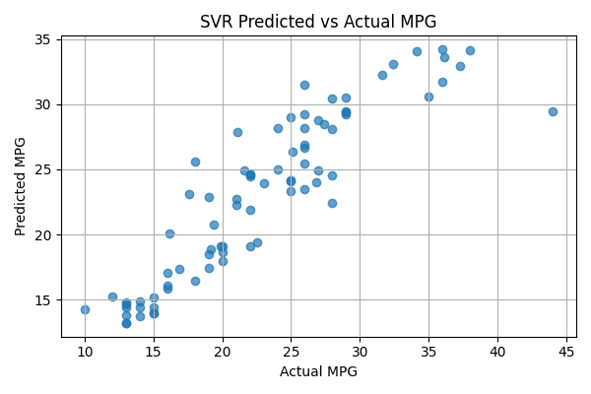
Svr results
Support Vector Regressor
Test MSE: 9.27383
Interpretation:
The model predicts mpg values with modest error
SVR handles nonlinear relationships but sometimes underfits small datasets
Reasonable performance given default hyperparameters

Slide 9
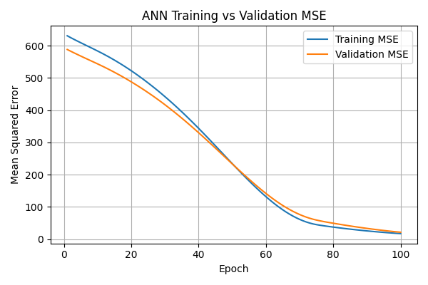
Ann results
Artificial Neural Network
Test MSE: 7.38223
Interpretation:
Lower error than SVR
ANN captured more complex patterns
Increasing hidden layers or epochs could improve accuracy further

Slide 10
Model comparison
Model | Test MSE | Notes
SVR | ~9.27 | Good baseline, simpler
ANN | ~7.38 | Best performance
Conclusion:
The ANN performed better on the Auto MPG prediction task due to its ability to learn more complex relationships among features.

Slide 11
Key takeaways
Cleaning and scaling is crucial
Both SVR and ANN can model mpg prediction
ANN produced the lowest MSE
Pipelines kept code simple, clean, and reproducible

Slide 12
References and acknowledgments
Dataset: UCI Machine Learning Repository (Auto MPG dataset)
Libraries Used:
pandas
scikit-learn
Acknowledgments:
Professor: Dr. Chaity Banerjee Mukherjee
Teaching Assistant: Shania Shakri

