Slide 1
Card Colosseum: War
Justin Birge, Keegan Pendleton, and Azaria Reed

Slide 2
Why We Chose War
No prior game development experience
No prior Unity experience
No prior digital art experience
Simple base
Room to innovate
Card Colosseum: War is our puzzle-action reinterpretation of the classic card game of War. None of us had prior experience with game development, Unity, or digital art, so we chose a project within scope and transformed it into something unique and meaningful.

Slide 3
Why We Chose War
Precisely, we wanted a game that was simple enough to learn quickly but flexible enough to change. War was perfect for that. The rules are simple, and because it’s traditionally a luck-based game, we could add elements that made gameplay more strategic, dramatic, and meaningful.

Slide 4
Basics of War
Traditional War
Scoring instead of stealing cards
In standard War, both players flip cards, and the higher card wins; ties lead to a multi-card “war.” In our version, the player and the AI each have their own deck, and, instead of taking cards, a scoring system tracks performance. These aren’t even our most significant changes: they just set the foundation for puzzle and action elements.

Slide 5
What Makes Our Game Unique
Tactical Option Points
Timing mini-game for ties
Strategy + reflex = puzzle/action
We introduced two significant changes: tactical Option Points and timing mini-games for ties. To elaborate, Option Points let you Peek, Swap, or Burn cards, giving you planning and resource-management decisions that turn the game into a puzzle. Ties trigger a reflex-based timing mini-game: something only possible in a digital format. This blend is what firmly shifts the game into the puzzle-action genre.

Slide 6
Game Story/Scenario
Background-driven narrative
Emotional arc of war
Inspired by the game’s name, we chose to convey a narrative about the nature of war visually.

Slide 7
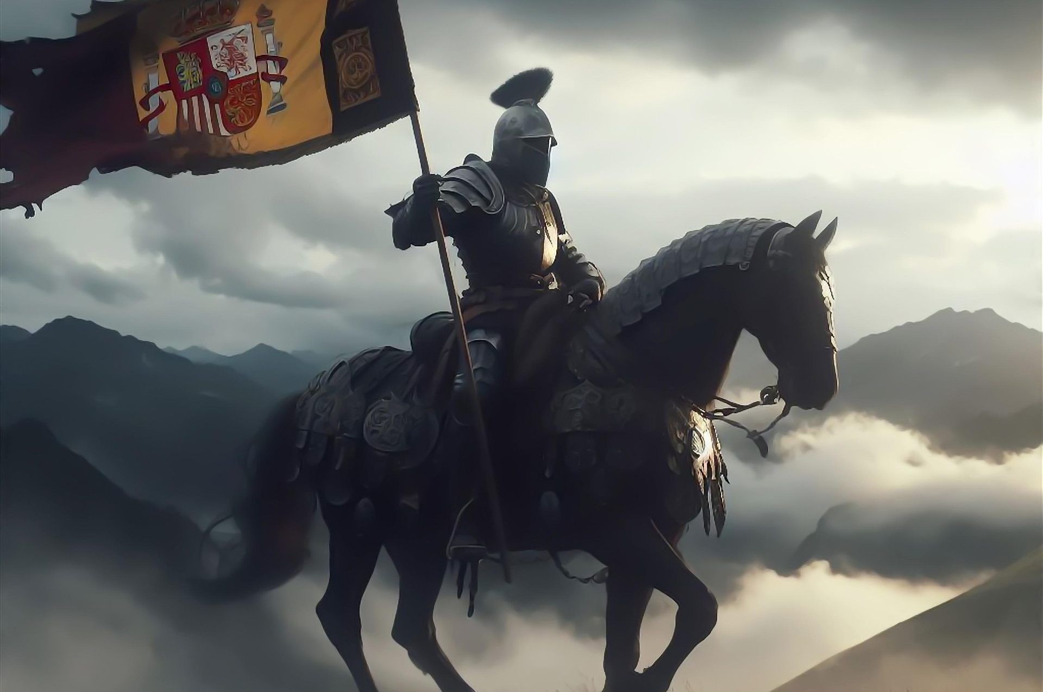
Game Story/Scenario
The opening image shows a lone warrior on horseback, reminding the player of the duty, burden, and resolve real soldiers carry into conflict.

Slide 8

Game Story/Scenario
The gameplay shifts to the face of a child, representing the civilians, especially the families and children of soldiers, who pay the hidden cost of war.

Slide 9

Game Story/Scenario
The results screen shows ancient ruins sinking into water, conveying a loud message: even victory leaves destruction behind.

Slide 10
Game Story/Scenario
Although the narrative is brief, it is indubitably emotionally resonant; its design frames the simple gameplay with a focusably complex set of feelings: those of sacrifice, consequence, and fragility.

Slide 11
Core Gameplay Overview
Use tactical options
Flip cards
Higher card wins
Tie triggers timing game
Score updates
Game ends when decks empty
Each turn begins with optional actions: Peek, Swap, or Burn. After that, both sides flip their top card. If one is higher, the round ends normally. If it’s a tie, the timing mini-game appears, and whoever lands closer to the center wins the war. Scoring updates continuously until the deck runs out.

Slide 12
Tactical Options
Peek (-1 Option Point)
Swap (-2 Option Points)
Burn (-1 Option Point)
Earn Option Points via streaks and wars
These options push the game into puzzle territory. Peek reveals your next card, Swap rearranges your top two cards, and Burn moves your top card to the bottom. You start with three Option Points, and you earn more by winning wars or achieving streaks of three wins.

Slide 13
Timing Mini-Game
Fast-moving slider
Hit Space in the gold zone
AI gets randomized score
Determines “war” winner
Ties bring the action element into the game. The slider moves quickly across the bar, and the player presses Space as close as possible to the gold zone. The AI gets a randomized precision score. This element breaks the monotony of card flipping and introduces moments of skill-based tension.

Slide 14
Scoring System
Win: +10
Lose: -2 (min 0)
Win war: +10 +1 OP
Final Score = Score + (OP * 5)
The scoring system keeps the game goal-oriented. Winning around yields 10 points. Losing deducts 2, but never below zero. Winning a war yields 10 points and an Option Point. At the end, leftover Option Points act as a bonus multiplier.

Slide 15
Things We Would Add
Deck count display
More narrative integration
Animations and polish
Expanded soundscape
With more time and experience, we would have added a deck counter, more narrative cues, visual polish like animations, and a fuller soundscape. These additions would help reinforce the game’s emotional arc and improve usability.

