Slide 1
Subject Review: MEGDP/COLLIBRA Governed Columns 06/11/2019

Slide 2
The Big Data / Datalake Approach
Datalakes tend to separate the shape of data being used from its physical file characteristics. Most Datalake tooling favors this abstraction
This enables a structure to be applied at QUERY-TIME rather than a less flexible but more traditional structure being required at STORAGE-TIME….often called schema on read
This also enables discrete data shapes (per user) to be leveraged by code that controls its expected structure and content long after the data was landed and favors a concept called DataWrangling
RAW data is generally altered from less useful semi-structured PRIMITIVE data formats and collections that represent an operational view of data [ source system’s view ] to more useful analytics views via a process called DataShaping or DataWrangling
Shapes over existing data both logically and physically transform the data, but only while the transformation process is manipulating the data or stored as a result of the process
We leverage SCHEMAS to allow semi-structured stored data to meet expectations of Calculator authors with different perspectives over the same data

Slide 3
The Big Data / Datalake Approach
Raw data reflecting a source system’s perspective lands in the INCOMING ZONE
It is immediately checked against its Registered ControlSet shape for that file, if it passes, it’s placed in the RAW ZONE and given a default schema matching the Registered shape, else the sender is notified
It is then immediately CURATED (checked against its storage model integrity rules) and listed as being available through the CURATED ZONE via one of its many defined schemas (sometimes one per different calculator over this same ControlSet). Calculators waiting for this data are notified.
Lastly it is then immediately GOVERNED (marked as available through the GOVERNED ZONE) but only through the COLLIBRA column mapped format or shape…this too is just another schema.
Although present in the file’s content, columns that are not mapped to COLLIBRA columns, will never be made available through this GOVERNED schema. Again Calculators waiting for this data are notified.

Slide 4
How a Datalake works
There really are no tables. Tables are actually file system directories with lots of files : “mpart files”. Aggregated together but sent day after day, they represent the total number of records for a table [ControlSet] since data was first sent.
Schemas over these ControlSets abstract the user from the physical constructs of the files underlying them.
Different schemas applied to the same ControlSet give it different shapes
Schemas are like views in an RDB, except they are more powerful physically yet weaker logically as is the Datalake as a whole than an RDB
Examples of weakness:
There are no logical indexes [ data must be physically sorted to reorder it or alter its access ] partitioning as an example
There are no linkages by reference such as relationships between tables
Examples of strength:
You can have thousands of columns: ‘width is of no consequence’
You can work on petabyte length files: ‘depth is of no consequence’
Storage is the single cheapest asset, compute the second cheapest asset
A transformational change in the way we process data

Slide 5
Example of MEG Shaping and Transformation

Slide 6



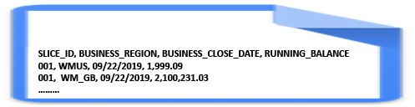
TODAY IS FRIDAY : SEND NEW FILE
my_controlset_file.csv
SEND
INCOMING MEGDP LOCATION
DIRECTORY: MY_CONTROLSET_FILE
m_part_000_AF2345.csv 100 records data from Monday
m_part_001_122345.csv 100 records data from Tuesday
m_part_002_EA2345.csv 100 records data from Wednesday
m_part_003_ADD345.csv 100 records data from Thursday
m_part_004_FF2345.csv 100 records data from Today
SLICE_ID, BUSINESS_REGION, BUSINESS_CLOSE_DATE, RUNNING_BALANCE
001, WMUS, 09/22/2019, 1,999.09
001, WM_GB, 09/22/2019, 2,100,231.03
………
A
Note: Each file has the same “SHAPE” as that submitted, yet the data in the columns is different for each send
They are all stored in the same directory matching the name of the file, minus the ‘.cvs’ extension
The sent file’s name is changed to the platform multi-part format so the name is lost. i.e : m_part_xxxx.csv
Note: The first line of the file is the header describing the column names, all subsequent lines are data
B

Slide 7
TODAY IS FRIDAY : MOVE TO RAW ZONE
INCOMING MEGDP LOCATION
DIRECTORY: MY_CONTROLSET_FILE
m_part_000_AF2345.csv 100 records data from Monday
m_part_001_122345.csv 100 records data from Tuesday
m_part_002_EA2345.csv 100 records data from Wednesday
m_part_003_ADD345.csv 100 records data from Thursday
m_part_004_FF2345.csv 100 records data from Today
C
RAW ZONE
Note: transformation process picks up the file from today, without changing anything drops it into the RAW zone.
RAW ZONE MEGDP LOCATION
DIRECTORY: MY_CONTROLSET_FILE
m_part_000_AF2345.csv 100 records data from Monday
m_part_001_122345.csv 100 records data from Tuesday
m_part_002_EA2345.csv 100 records data from Wednesday
m_part_003_ADD345.csv 100 records data from Thursday
m_part_004_FF2345.csv 100 records data from Today
Note: transformation process picks up the file from today, adds a timestamp to each row, reads the schema [ shape ] defined for the next zone and rewrites the file to that default shape

Slide 8
TODAY IS FRIDAY : MOVE TO CURATED ZONE
RAW ZONE MEGDP LOCATION
DIRECTORY: MY_CONTROLSET_FILE
m_part_000_AF2345.csv 100 records data from Monday
m_part_001_122345.csv 100 records data from Tuesday
m_part_002_EA2345.csv 100 records data from Wednesday
m_part_003_ADD345.csv 100 records data from Thursday
m_part_004_FF2345.csv 100 records data from Today
D
CURATED ZONE
Note: transformation process picks up the file from today in RAW, adds a a new columns called platform timestamp to each row, reads the schema [ shape ] defined for the CURATED ZONE and rewrites the file to that default shape, coverts the file to PARQUET format
SLICE_ID, BUSINESS_REGION, BUSINESS_CLOSE_DATE, RUNNING_BALANCE, PLATFORM_TS
001, WMUS, 09/22/2019, 1,999.09, Tue Jun 11 00:00:00 UTC 2019
001, WM_GB, 09/22/2019, 2,100,231.03, Tue Jun 11 00:00:00 UTC 2019
………
CURATED ZONE MEGDP LOCATION
DIRECTORY: MY_CONTROLSET_FILE
We added this COLUMN to the file
m_part_000_AF2345.pqt 100 records data from Monday
m_part_001_122345.pqt 100 records data from Tuesday
m_part_002_EA2345.pqt 100 records data from Wednesday
m_part_003_ADD345.pqt 100 records data from Thursday
m_part_004_FF2345.pqt 100 records data from Today

Slide 9
Adding Schemas to a ControlSet in a Zone to facilitate access

Slide 10
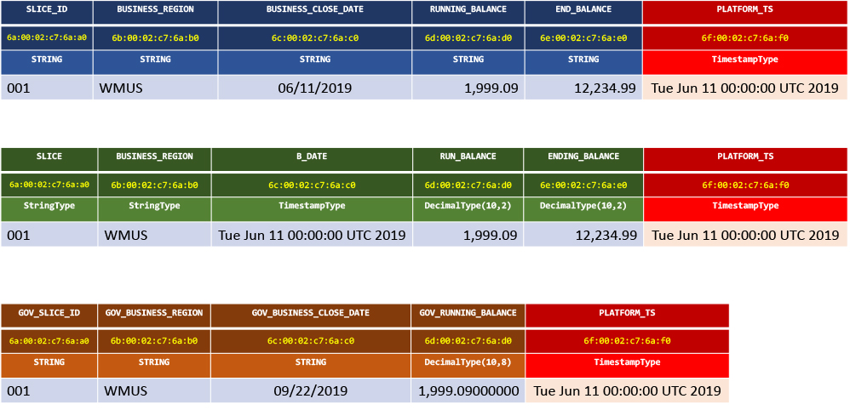
DEPENDING ON THE SCHEMA APPLIED TO A ZONE
THE LOGICAL SHAPE OF THE DATA IS DIFFERENT
SLICE_ID, BUSINESS_REGION, BUSINESS_CLOSE_DATE, RUNNING_BALANCE, PLATFORM_TS
001, WMUS, 09/22/2019, 1,999.09, Tue Jun 11 00:00:00 UTC 2019
001, WM_GB, 09/22/2019, 2,100,231.03, Tue Jun 11 00:00:00 UTC 2019
………
INCOMMING FILE
no schema applied
column_name
column_id
column_type
RAW FILE
default schema applied
CURATED FILE
curated schema(s) applied
column_name
column_id
column_type
GOVERNED FILE
governed schema applied
column_name
column_id
column_type

Slide 11
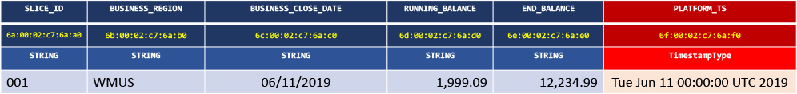
DEPENDING ON THE SCHEMA APPLIED TO A ZONE
THE LOGICAL SHAPE OF THE DATA IS DIFFERENT
FILE X RAW ZONE SCHEMA
COLUMN_ID:
ALIAS:
COLUMN_NAME:
COLUMN_TYPE:
COLUMN_ORDER:
6a:00:02:c7:6a:a0
NULL
SLICE_ID
StringType
0
COLUMN_ID:
ALIAS:
COLUMN_NAME:
COLUMN_TYPE:
COLUMN_ORDER:
6d:00:02:c7:6a:d0
NULL
RUNNING_BALANCE
StringType
3
COLUMN_ID:
ALIAS:
COLUMN_NAME:
COLUMN_TYPE:
COLUMN_ORDER:
6b:00:02:c7:6a:b0
NULL
BUSINESS_REGION
StringType
1
COLUMN_ID:
ALIAS:
COLUMN_NAME:
COLUMN_TYPE:
COLUMN_ORDER:
6e:00:02:c7:6a:e0
NULL
END_BLANACE
StringType
4
COLUMN_ID:
ALIAS:
COLUMN_NAME:
COLUMN_TYPE:
COLUMN_ORDER:
6c:00:02:c7:6a:c0
NULL
BUSINESS_CLOSE_DATE
StringType
2
COLUMN_ID:
ALIAS :
COLUMN_NAME:
COLUMN_TYPE:
COLUMN_ORDER:
6f:00:02:c7:6a:f0
NULL
PLATFORM_TS
TimestampType
5

Slide 12
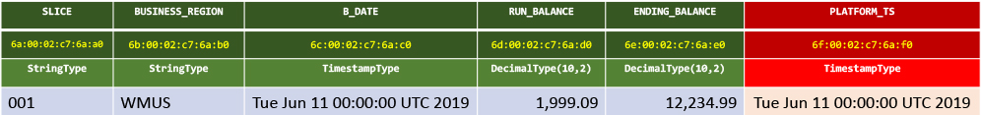
DEPENDING ON THE SCHEMA APPLIED TO A ZONE
THE LOGICAL SHAPE OF THE DATA IS DIFFERENT
FILE X CURATED ZONE SCHEMA
COLUMN_ID:
ALIAS:
COLUMN_NAME:
COLUMN_TYPE:
COLUMN_ORDER:
6a:00:02:c7:6a:a0
NULL
SLICE_ID
StringType
0
COLUMN_ID:
ALIAS:
COLUMN_NAME:
COLUMN_TYPE:
COLUMN_ORDER:
6d:00:02:c7:6a:d0
NULL
RUN_BALANCE
DecimalType(10,2)
3
COLUMN_ID:
ALIAS:
COLUMN_NAME:
COLUMN_TYPE:
COLUMN_ORDER:
6b:00:02:c7:6a:b0
NULL
BUSINESS_REGION
StringType
1
COLUMN_ID:
ALIAS:
COLUMN_NAME:
COLUMN_TYPE:
COLUMN_ORDER:
6e:00:02:c7:6a:e0
NULL
ENDING_BLANACE
DecimalType(10,2)
4
COLUMN_ID:
ALIAS:
COLUMN_NAME:
COLUMN_TYPE:
COLUMN_ORDER:
6c:00:02:c7:6a:c0
NULL
BUSINESS_CLOSE_DATE
TimestampType
2
COLUMN_ID:
ALIAS:
COLUMN_NAME:
COLUMN_TYPE:
COLUMN_ORDER:
6f:00:02:c7:6a:f0
NULL
PLATFORM_TS
TimestampType
5

Slide 13
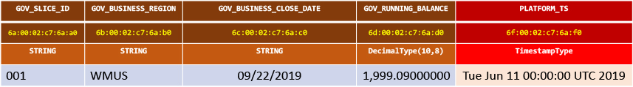
DEPENDING ON THE SCHEMA APPLIED TO A ZONE
THE LOGICAL SHAPE OF THE DATA IS DIFFERENT
FILE X GOVERNED ZONE SCHEMA
COLUMN_ID:
ALIAS:
COLUMN_NAME:
COLUMN_TYPE:
COLUMN_ORDER:
6a:00:02:c7:6a:a0
10342
GOV_SLICE_ID
StringType
0
COLUMN_ID:
ALIAS:
COLUMN_NAME:
COLUMN_TYPE:
COLUMN_ORDER:
6d:00:02:c7:6a:d0
34987
GOV_RUNNING_BALANCE
DecimalType(10,8)
3
COLUMN_ID:
ALIAS :
COLUMN_NAME:
COLUMN_TYPE:
COLUMN_ORDER:
6b:00:02:c7:6a:b0
20441
GOV_BUSINESS_REGION
StringType
1
COLUMN_ID:
ALIAS:
COLUMN_NAME:
COLUMN_TYPE:
COLUMN_ORDER:
6f:00:02:c7:6a:f0
44561
PLATFORM_TS
TimestampType
4
COLUMN_ID:
ALIAS:
COLUMN_NAME:
COLUMN_TYPE:
COLUMN_ORDER:
6c:00:02:c7:6a:c0
4312
GOV_BUSINESS_CLOSE_DATE
TimestampType
2

Slide 14
Mapping Collibra columns to Governed Schema

Slide 15
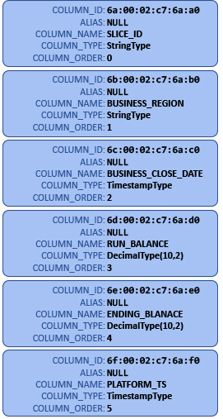
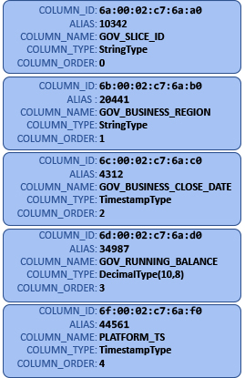
DESIGNING A GOVERNED SCHEMA
BY MAPPING CURATED COLUMNS TO GOVERNED COLUMNS VIA COLLIBRA
ALIAS:
COLUMN_NAME:
COLUMN_TYPE:
10342
GOV_SLICE_ID
StringType
ALIAS :
COLUMN_NAME:
COLUMN_TYPE:
20441
GOV_BUSINESS_REGION
StringType
ALIAS:
COLUMN_NAME:
COLUMN_TYPE:
4312
GOV_BUSINESS_CLOSE_DATE
TimestampType
ALIAS:
COLUMN_NAME:
COLUMN_TYPE:
34987
GOV_RUNNING_BALANCE
DecimalType(10,8)
ALIAS:
COLUMN_NAME:
COLUMN_TYPE:
44561
PLATFORM_TS
TimestampType
CURATED SCHEMA
COLLIBRA COLUMN PICKLIST (by version label)
GOVERNED SCHEMA

Slide 16
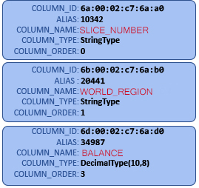
THE NEED FOR VERSION CONTROL OF COLLIBRA
Typically, in a Calculator I will need to do low level operations by Column Name
but if the column names have changed ……
val dataSetOne: Dataset[MyDataSetOne] = Moniker.getData("com.ubs.megdp.MyDatasetOne")
val dataSetTwo: Dataset[MyDataSetTwo] = Moniker.getData("com.ubs.megdp.MyDatasetTwo")
// I’m going to do a group-by operation and then aggregate over a column here
dataSetOne.
groupByKey( dataSetOne=>
(dataSetOne.GOV_SLIDE_ID, dataSetOne.GOV_BUSINESS_REGION))
.agg(typedSum[dataSetOne](_.GOV_RUNNING_BALANCE)
.name("sum(GOV_RUNNING_BALANCE_SUM)").divide(8))
.show()
// OR here when doing a join over a common colummn
val dataSetThree = dataSetOne.join(dataSetTwo, Seq("GOV_JOINER_COLUMN"), "left”)
ORIG GOVERNED SCHEMA
ALTERED GOVERNED SCHEMA COLUMNS
BROKEN CALCULATOR CODE
Calculators need to be isolated from schema changes by having the Registration Process either make a deep copy of its mapped schema or by forcing the registrar to pick a VERSIONED SCHEMA it is locked into.

