Slide 1

PROJECT: Group chat for Linphone (Agile DO-178)

Slide 2
Project background
Linphone is the leading open source implementation of Voice Over IP (VOIP) IM functionality.
Compatible with iOS, Android, Blackberry, Windows Phones, Windows, OS X and Linux desktop and web browser clients.
Linphone’s IM implementation lacks some functionality.

Slide 3
Project vision
Extend Linphone’s IM implementation on an Android platform
Some functionalities that needs to be implemented is to include group chat and improve minor functionalities to Linphone’s IM and user interface.

Slide 4
Functionality
Group chat <- High Priority
Secure group chat (encryption)
Creation and deletion of groups
Voice record and send over IM

Slide 5
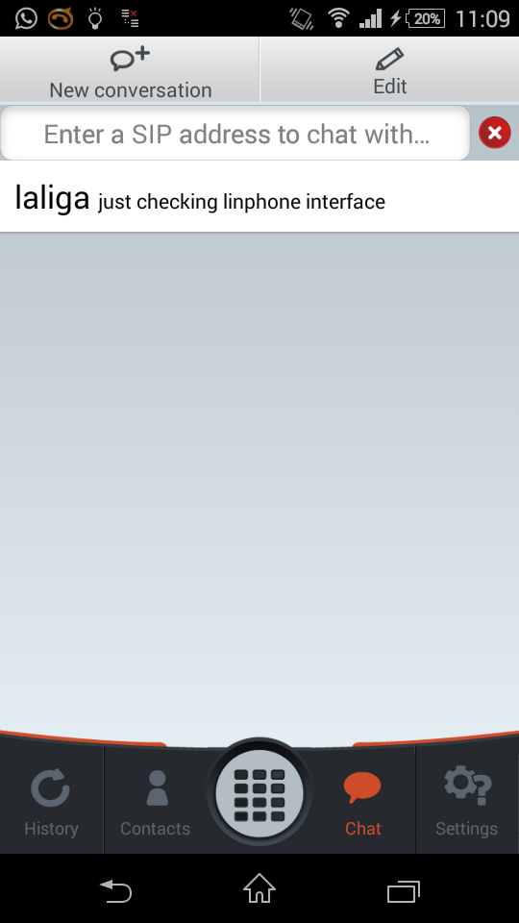
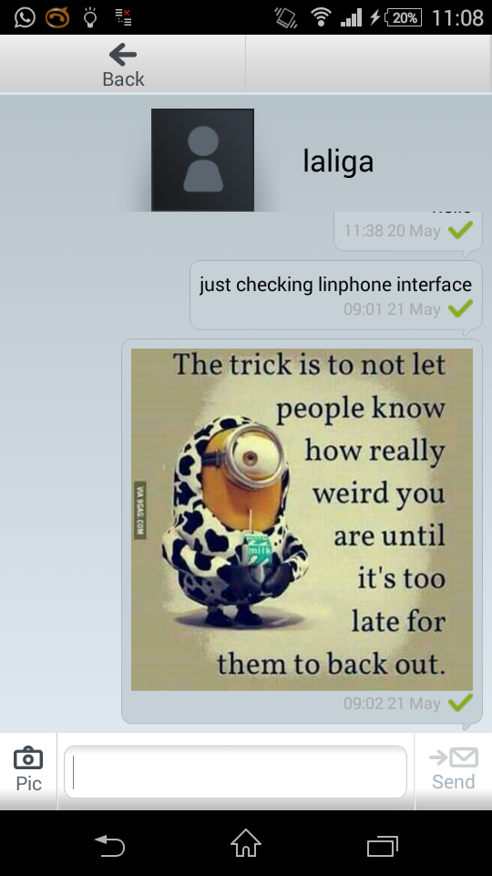
Functionality
Change user interface:
Make text bigger
Add profile picture
Improve spacing between words
User Presence

Slide 6
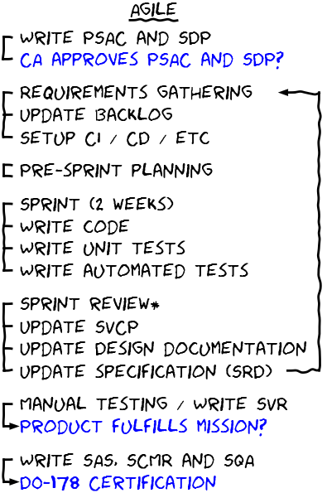
Project Plan
Agile software development methodology will be followed with this project:

Slide 7
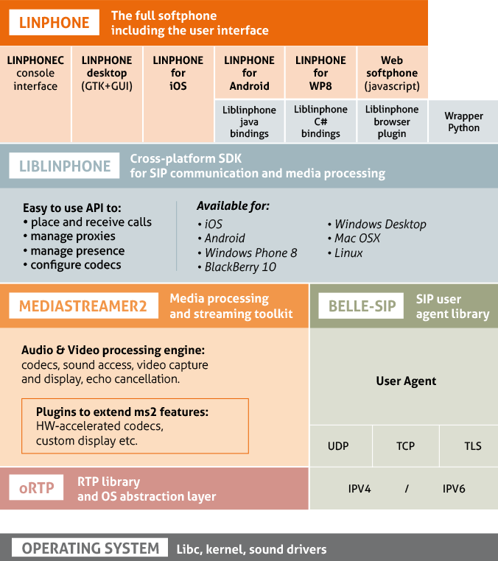
Architecture & Infrastructure

Slide 8
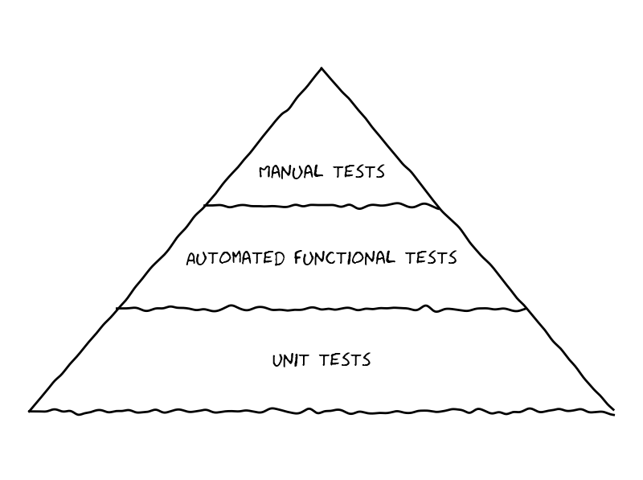
Test driven development

Slide 9
BUIlD TOOLs
Maven
Maven’s primary goal is to allow a developer to comprehend the complete state of a development effort in the shortest period of time.
Apache Maven is a software project management and comprehension tool.
The result is a tool that can now be used for building and managing any Java-based project.
Based on the concept of a project object model (POM)
Maven can also run reports, generate a web site, and facilitate communication among members of a working team.

Slide 10
Build tools
Maven
Provides a uniform build system
Provides quality project information
Providing guidelines for best practices development
Allows transparent migration to new features
Makes build process easy

Slide 11
TESTING Tools -
Continuous Integration(CI) and Continuous deployment (CD)
The following need to be tested:
Quality testing
GUI testing
Performance testing
Load testing
Configuration testing
Isolation testing

Slide 12
Continue…
Functional testing
Battery drain test
Idle run test
Screen lock test
Memory Leakage testing
Interrupt testing
Installation testing
Certification testing
Unit testing
Acceptance testing
Multimedia testing
Smoke testing
Compatibility testing
Usability testing
The agile setup might look as follows:

Slide 13
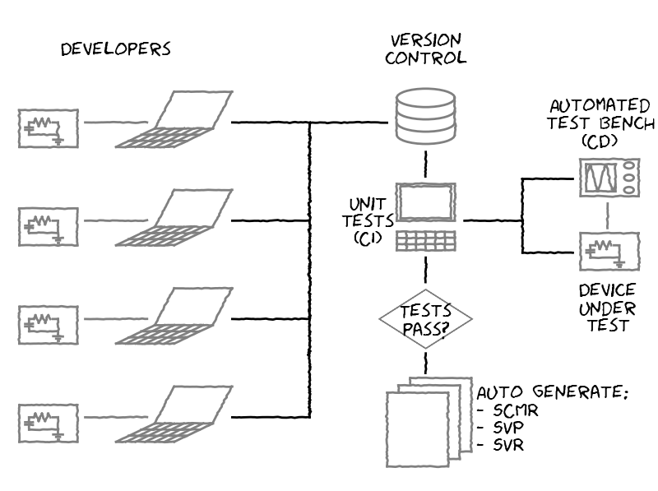

Slide 14
TOOLS SUMMARIES
Android Studio or Eclipse IDE
Linux environment
Java for user interface
C for group chat functionalities
Junit for unit testing user interface

Slide 15
SCRUM Methodology
Srum Master – Potego
Client Representative – Nomzamo
DEVELOPMENT TEAM
Ephiphania, Lerato, Lutfiyya, Nomzamo, Potego, Tsepo

Slide 16
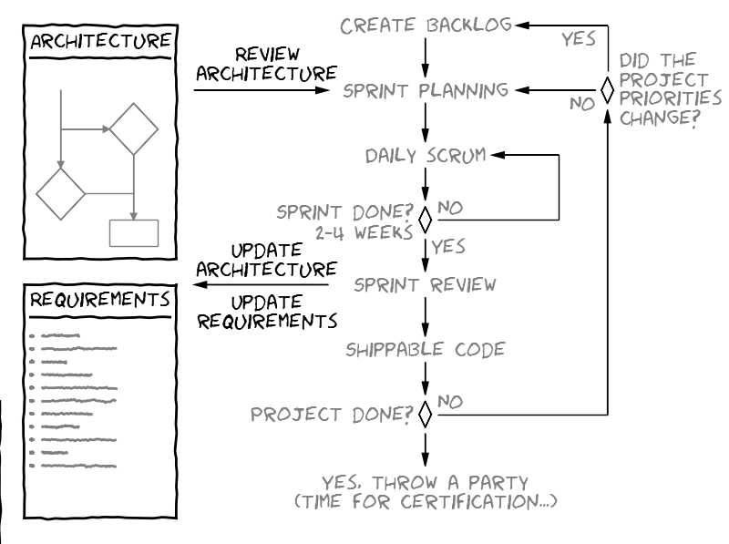
Scrum

Slide 17
Task Breakdown
STORY NAME | TASK NUMBER | TASK DESCRIPTION | STATUS | ESTIMATED EFFORT(weeks) | Effort Remaining
GROUP CHAT | 1 | Create Chat | Open | 2 | 2
 | 2 | Delete Chat | Open | 1 | 1
 | 3 | Add Users | Open | 1 | 1
 | 4 | Members Receive Mgs | Open | 2 | 1
 | 5 | Secure Group Chat | Open | 2 | 2
INTERFACES | 6 | Group Chat Interface | Open | 3 | 3
 | 7 | Change Message Interface | Open | 1 | 1
RECORDING | 8 | Voice Recoding | Open | 2 | 2
 | 9 | Send Recording | Open | 1 | 1

Slide 18
Burn-Down Chart

Slide 19
Any Questions?

Slide 20
END

