Slide 1

Objection
Null Chennai meet

Slide 2

WHOAMI
Dinesh / Dinz
Security Engineer @ Briskinfosec

Slide 3



What is Frida & Objection
&
=
Frida is a dynamic instrumentation toolkit.
It is mainly created for testers, developers and reverse engineering enthusiasts.
we can inject our own JavaScript into apps of Windows, macOS, GNU/Linux, iOS, Android, and QNX.
Frida is a swiss Army knife
Notes:
What is Frida

Slide 4
Where it will be useful
Will be useful during the static & dynamic analysis (Most of the features will be used here).
Patching the Application’s package with Frida.
Bypassing the Jailbreak/root and SSL pinning.

Slide 5
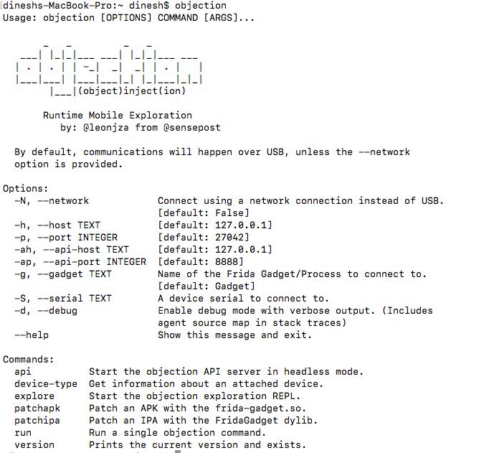
Objection
objection is a runtime mobile exploration toolkit, powered by Frida.
built to help you assess the security posture of your mobile applications.
Supports both iOS and Android
Has So many cool features.
Installation :
pip3 install objection
Reference : https://github.com/sensepost/objection/

Slide 6
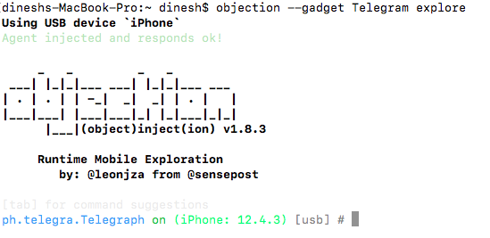
Injecting Applications
objection --gadget AppName explore

Slide 7

Exploring With Objection
Basic Commands :
Commands, frida, reconnect, exit, ui
env, ls, !, pwd, cd, rm, sqlite
android, ios
file, plugin, jobs
import, memory, Evaluate
Notes:
Frida, Reconnect, ui, exit
Env, ls, pwd, cd, rm,
file

Slide 8
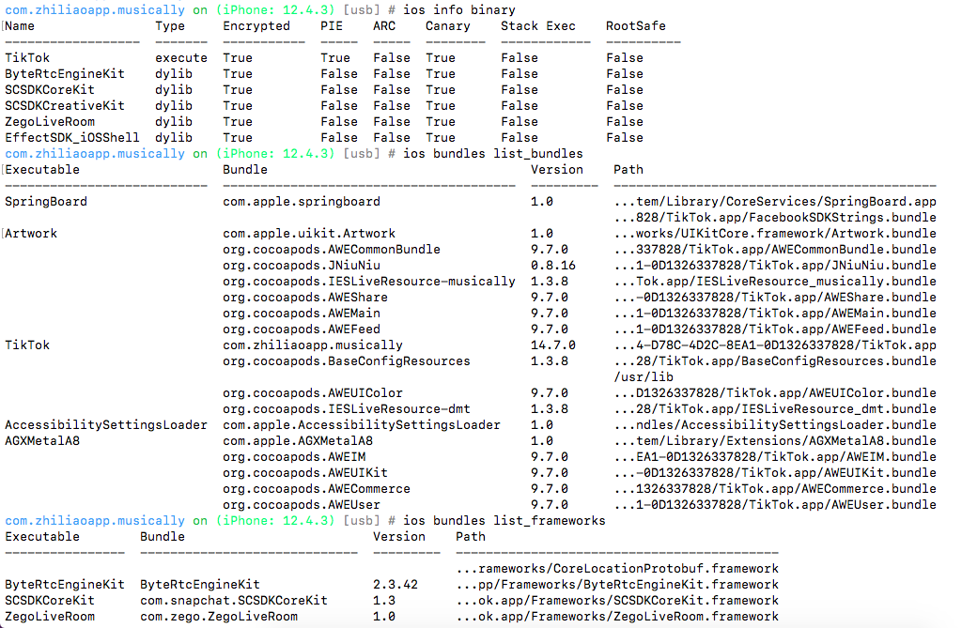
Static Analysis
ios info binary
ios bundles list_bundles
ios bundles list_frameworks
Notes:
Dylib – dynamic lib and similar to dll will run in runtime not at compilation

Slide 9
Finding class and methods
ios hooking list classes
ios hooking list class_methods Classname
ios hooking search classes keywords
ios hooking search methods classname
ios hooking watch class classname --include-parents
ios hooking set return_value "+[classname methodname]" false

Slide 10
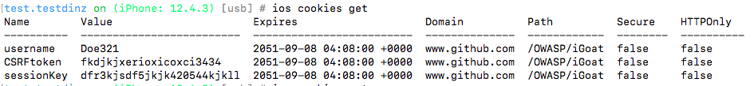
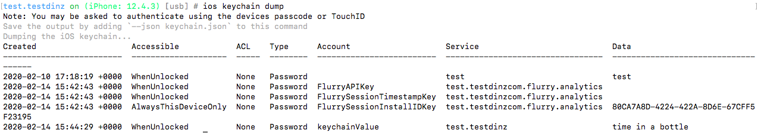
Dynamic Analysis
ios cookies get – for getting the cookie values from the domains used in the application.
ios keychain dump – dump the entries in the iOS keychain
Lets see some more options

Slide 11

Ending notes

Slide 12

Any Questions

