Slide 1




PRODUCT Security Best Practices
Pawan Bhandari

Slide 2
Disclaimer
The opinions and thoughts expressed in this presentation and subsequent slides are solely of my own and do not necessary reflect the views or position of my employer.
The information provided in the slides are not comprehensive and created solely on the basis of experience I gather while working in projects.

Slide 3
About Me
Who I am
Currently working with McAfee
Security & ML Enthusiast
Blue Team Member
Love to cook and play with my daughters

Slide 4
Agenda
To learn about best practices while implementing
Web system
CLI
Application
DBs

Slide 5
Security is Important
Anyone disagree??

Slide 6
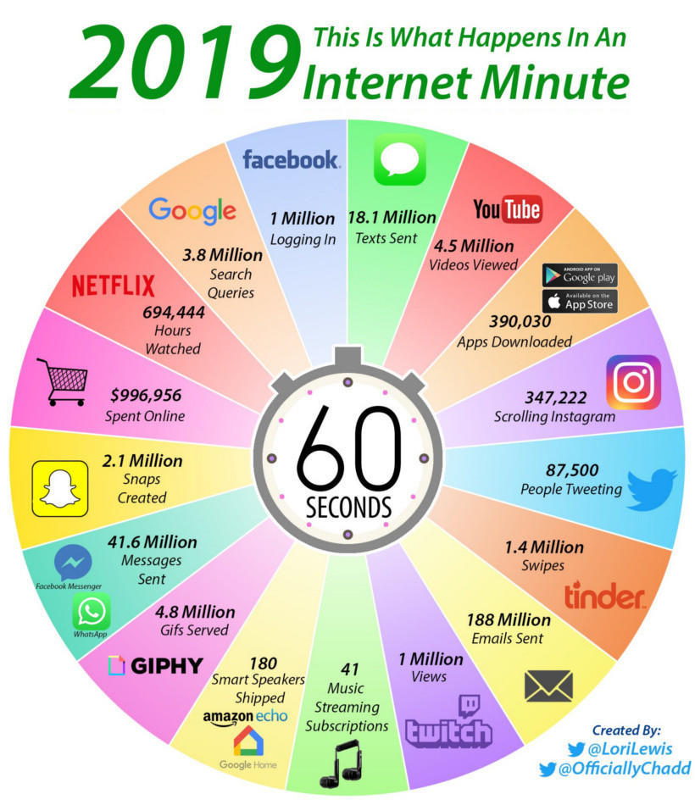

Slide 7
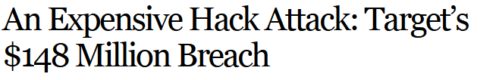

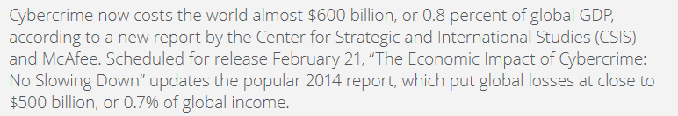
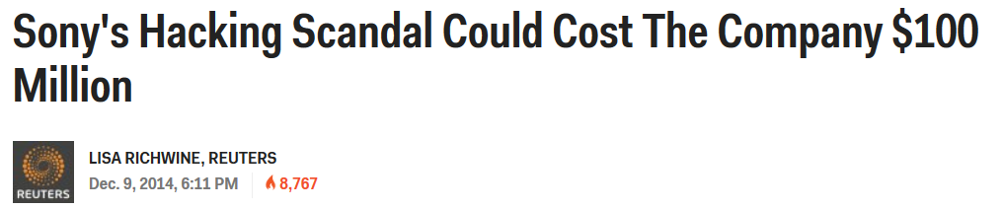

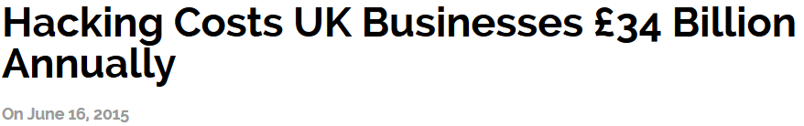


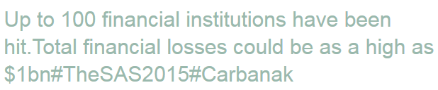
What is at Stake
Notes:
The numbers for Sony even went upto $171 million
Target hack could be upto $450 million
https://www.mcafee.com/enterprise/en-us/assets/executive-summaries/es-economic-impact-cybercrime.pdf

Slide 8
Stakeholders
People
Passwords, Bank/Credit Card details, Personal Information etc.
Researchers
Chrysler, GM
Banks, Stock Markets, Financial Organization
JP Morgan Chase
Small/Large Business
OlaCabs, Ebay, Sony, LinkedIn, NASA, ISRO and many more…..
Countries
India, USA, UK, Japan, Pakistan, Iran, S. Korea, and every single country
Notes:
http://www.wired.com/2015/07/hackers-remotely-kill-jeep-highway/
http://www.informationisbeautiful.net/visualizations/worlds-biggest-data-breaches-hacks/

Slide 9
Attackers
Trusted Insiders
Hackers/Hactivist
Terrorist and Extremist Groups
Industrial Spies and Organized Crime Groups
Nation States
Less Structured
Less Skilled
Highly Structured
Highly Skilled

Slide 10
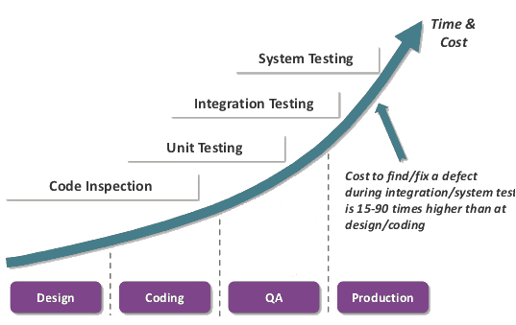
Prevention is Better Than Cure
Source: https://www.checkmarx.com

Slide 11
Our Goal
Make software secure and robust
Web Security
Application Security
DB Security
CLI Security
Notes:
http://www.wired.com/2015/07/hackers-remotely-kill-jeep-highway/
http://www.informationisbeautiful.net/visualizations/worlds-biggest-data-breaches-hacks/

Slide 12
Best Practices For Web Security
Change password at the first time use
Two-Factor authentication and proper authorization
Store password in hash
Implement strong password with lock and expiry
Implement input validation
Server-side validation
Use non-admin/root user (Least Privilege)
Use safer protocols
Use well known strong algorithms
Implement file upload checks
Collect limited information
NOTE: Applicable in other components also

Slide 13
Best Practices For CLI Security
Implement input validation
Input length validation
Input type validation
Input range validation
Implement output validation
Logs sanitization

Slide 14
Best Practices For Application Security
Implement defense-in-depth
Handle exceptions and errors
Implement secure OS configurations
Implement encryption of data
Check/Maintain default values in libraries
Use secure and latest trusted (3rd party) libraries
Implement fail-secure
Do not use hard-code credentials
Remove/Disable unnecessary libraries

Slide 15
Best Practices For DB Security
Implement access control
limited privileges
Check source of connection request
Keep check on concurrent connection
Single source
Multiple source
Limit concurrent connections

Slide 16
Top 25 Weaknesses (CWE)
CWE-89 Improper Neutralization of Special Elements used in an SQL Command ('SQL Injection')
CWE-78 Improper Neutralization of Special Elements used in an OS Command ('OS Command Injection')
CWE-120 Buffer Copy without Checking Size of Input ('Classic Buffer Overflow')
CWE-79 Improper Neutralization of Input During Web Page Generation ('Cross-site Scripting')
CWE-306 Missing Authentication for Critical Function
CWE-862 Missing Authorization
CWE-798 Use of Hard-coded Credentials
CWE-311 Missing Encryption of Sensitive Data
CWE-434 Unrestricted Upload of File with Dangerous Type
CWE-807 Reliance on Untrusted Inputs in a Security Decision
CWE-250 Execution with Unnecessary Privileges
CWE-352 Cross-Site Request Forgery (CSRF)
CWE-22 Improper Limitation of a Pathname to a Restricted Directory ('Path Traversal')
CWE-494 Download of Code Without Integrity Check
CWE-863 Incorrect Authorization
CWE-829 Inclusion of Functionality from Untrusted Control Sphere
CWE-732 Incorrect Permission Assignment for Critical Resource
CWE-676 Use of Potentially Dangerous Function
CWE-327 Use of a Broken or Risky Cryptographic Algorithm
CWE-131 Incorrect Calculation of Buffer Size
CWE-307 Improper Restriction of Excessive Authentication Attempts
CWE-601 URL Redirection to Untrusted Site ('Open Redirect')
CWE-134 Uncontrolled Format String
CWE-190 Integer Overflow or Wraparound
CWE-759 Use of a One-Way Hash without a Salt
http://cwe.mitre.org/top25/index.html

Slide 17
HOW DO WE ACHIEVE THIS?
More on Backup Slides

Slide 18
Secure Development Life Cycle
Different than regular Software Development Life Cycle
Security is required at every step of development:
Requirements (Architectural Risk Analysis, Security Requirement)
Design (Security Oriented Design)
Implementation (Secure Coding, Code Reviews)
Testing/ Quality Assurance (Security Tests, Penetration Testing)

Slide 19
Reality = ytilaeR
Most of the people are not even aware of it
Those who are aware, don’t accept till it happens
Lack of resources
Need time/ resources to create secure software
High competition
Short time to market
Everyone is looking for fast solution aka Agile DevOps

Slide 20
Thank You

