Slide 1
Welcome to The Guild of Assassins
An application utilising microservices, version control, and continuous deployment

Slide 2
Contents
Introduction
Planning
Trello board
Coding and deployment
Tools used
Demonstration
Future goals

Slide 3
Introduction
Aims
Design and create an application with individually containerised microservices
Utilise version control system and continuous deployment
Ability to set up VMs instantly

Slide 4
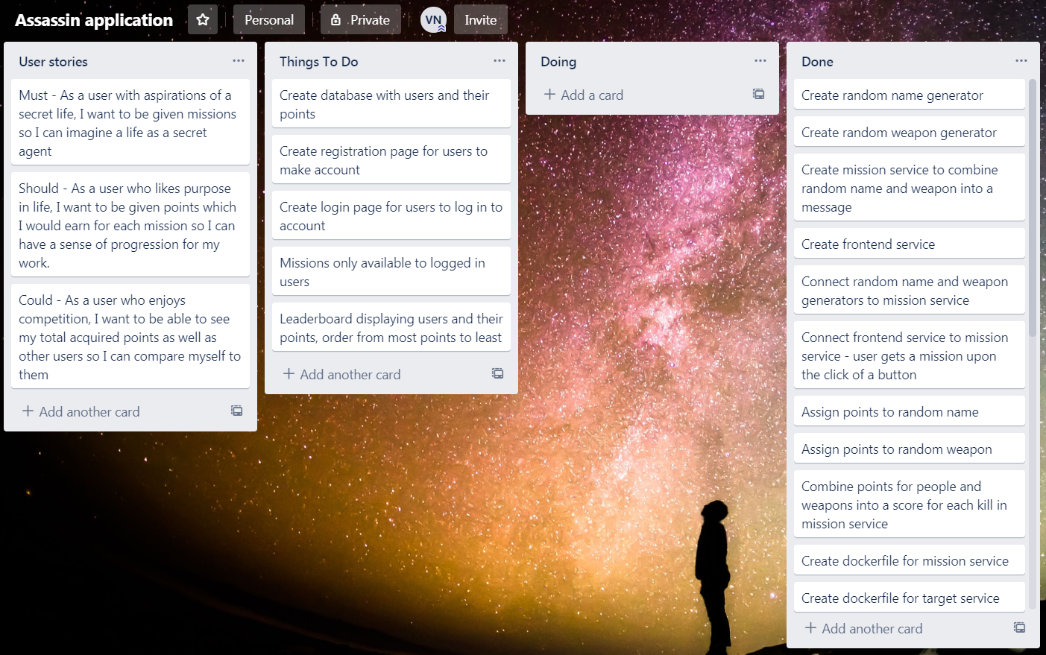
Planning

Slide 5
Technologies Used
Google Cloud Platform
Python – Flask, Jinja2
HTML
Git/GitHub
Ansible
Jenkins
NGINX
Docker
Docker Compose
Docker Swarm

Slide 6
Microservices
Random character, associated points
Random weapon, associated points
Combine these into mission and points
Deliver this to user

Slide 7
Initiation
Ansible used
Set up VMs with correct installations
Initialise swarm

Slide 8
Deployment
GitHub webhook
Jenkins job updates images, updates containers on other vm
Rolling update – multiple replicas

Slide 9
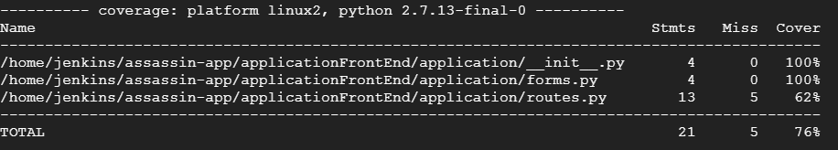
Testing

Slide 10
Live demonstration
http://34.76.193.128/
https://github.com/TheBartThe/assassinsGuild

Slide 11







CI Pipeline

Slide 12
Improvements
Testing – connections between containers
Testing in Jenkins before deployment
Start application in Ansible playbook

Slide 13
Thank you for listening
Any Questions?

