Slide 1
Programming Methodology I COEN-243 Section N NA
Tenth Tutorial
November 23, 2022

Slide 2

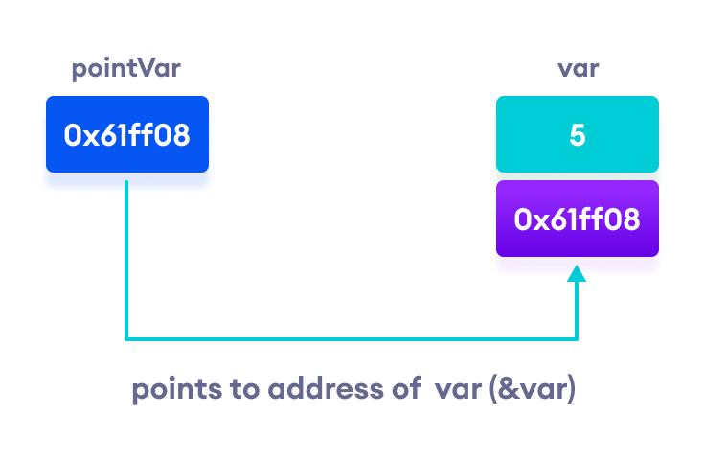
POINTERS
Pointers are variables that store the memory address of other variables
Pointers are declared with an asterisk ‘ * ’: int *ptr;
(*) is called dereference operator, it is used in declaration of a pointer and also extraction of the value pointed by the pointer.
Printing out addresses in C++ - two ways, two concepts
https://www.programiz.com/cpp-programming/pointers

Slide 3
POINTERS & REFERENCES
Pointers allow for manipulation of dynamic memory (memory on demand)
If you don’t know the address for a pointer to point to, a ‘nullptr’ can be used
‘nullptr’ means that it points to nothing (no arrows) – similar to NULL value
Arithmetic’s applicability to pointers is limited and can be meaningless:
Applicable opertors: ++, --, + or +=, - or -=
Invalid Pointers: Uninitialized pointers, pointers pointing to illegal addresses…

Slide 4
POINTERS Fun Facts
Why do we usually give a data type to a pointer?
Pass-by-reference also works with pointers
Array names actually point to the beginning of the array, so does this mean they are pointers?
‘new’ & ‘delete’ allows us to allocate memory on demand and store them in pointers
Pointers can also point to pointers (2D arrays)
If the datatype is unknown; void pointers can be used!

Slide 5


Pointers: Singly linked list (SLL)
Data Structures: Concepts or methods depicting how data is stored and managed
Arrays are data-structures
Linked-list is another popular data structure where elements point to each other
In SLL, elements are not arranged based on an index, instead each element points to the next element (There is no concept of index/position in SLL)
Linked list don’t have fixed size (they are based on the memory-on-demand concept)
ADV.: Sometimes with LL it is easier to implement more abstract data structures

Slide 6
Activity: Doubly linked list (DLL)
In SLL, there is only one pointer that points to the next element.
In DLL, there is another additional pointer that points to previous element
= Two pointers in total
With DLL, it is easier to traverse (search) and there is less time required for certain operations
Exercise: Implement a Doubly Linked List
DLL is also a Linked List.

Slide 7
References
https://www.programiz.com/cpp-programming/pointers
https://github.com/TheBarzani/COEN243_Fall2022

Slide 8
Thank you ☺

