Slide 1
Programming Methodology I COEN-243 Section N NA
Nineth Tutorial
November 16, 2022

Slide 2
LAST Tutorial ACTIVITY: Car class
Objective: make a class of cars that can be used to drive the car around a track
Attributes: make, model year, top speed, speed, license plate number, current owner, track, history.
Methods: Getters & setters, accelerate() & brake(), move(char l), drive(), position(), display()
More stuff was discussed during the tutorial.

Slide 3
Organizing your files
In programming, different pieces of code should be separated for easier maintainability
In OOP, different files are there for different components of the class
HEADER File: gives the blueprint/declaration of the class
CPP File: gives the definition of the class components
This method provides flexibility and modularity for your declared classes
I.E., it can be used to create multiple implementations of single classes
Defining a method in .cpp: return_type class_name :: method name(args) {}
Only static variables can be initialized in .cpp
https://stackoverflow.com/questions/9579930/separating-class-code-into-a-header-and-cpp-file

Slide 4

STRUCT – C++ Structures
Similar to classes, it is a collection of variables only, under one name
It can hold different datatypes & is often used for code reduction
E.G., to store information in a variable Person, struct definition can outline the type of information it can hold.
Struct Person can contain age, name, phone number, salary, city…
DECLARATION: struct Person{ …; data_type info1; data_type info2; …}
When a structure is created, no memory is allocated;
Allocation happens during declaration of a struct variable (how much memory?)
Think of a struct as a new datatype you define
https://www.programiz.com/cpp-programming/structure

Slide 5


Use of Functions with OOP
Functions can return and take arguments in the form of default datatypes
Moreover, this behaviour can be extended to user-defined datatypes (objects & structs)
An object can be provided as an argument and or the returned depending on the function
E.G., for the car class: car newer(car a, car b);
https://www.programiz.com/cpp-programming/pass-return-object-function

Slide 6
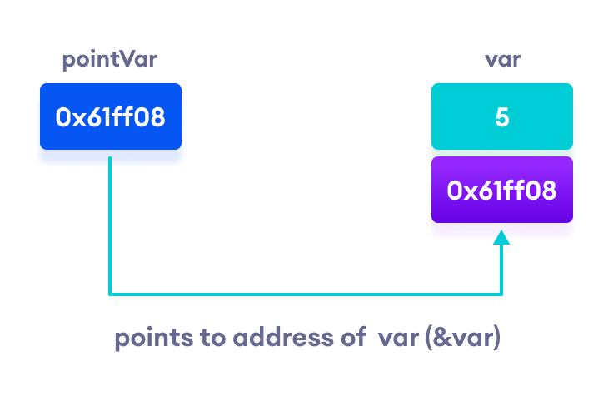
POINTERS
Pointers are variables that store the memory address of other variables
Pointers are declared with an asterisk ‘ * ’: int *ptr;
(*) is called dereference operator, it is used in declaration of a pointer and also extraction of the value pointed by the pointer.
Printing out addresses in C++ - two ways, two concepts
https://www.programiz.com/cpp-programming/pointers

Slide 7
References
https://sourcecodeera.com/blogs/Samath/Car-Class-using-C.aspx
https://stackoverflow.com/questions/9579930/separating-class-code-into-a-header-and-cpp-file
https://www.programiz.com/cpp-programming/structure
https://www.programiz.com/cpp-programming/pass-return-object-function
https://www.programiz.com/cpp-programming/pointers
https://github.com/TheBarzani/COEN243_Fall2022

Slide 8
Thank you ☺

