Slide 1
PROGRAMMING FOR MECHANICAL AND INDUSTRIAL ENGINEERS MIAE-215 Section T TB
TENTH Tutorial
November 24, 2022

Slide 2
Functions: Default Values & Static Storage
In programming, user behaviour is unexpected
So, it can be a good practice to provide default cases
In functions, parameters can have default values
E.G., int divide(int a, int b=2); void printS(string str, int count=1);
The ‘static’ keyword can provide tracker variables in functions
If a variable is set static in a function, its value is stored after each function call
Activity: void printCalls();

Slide 3
Object-Oriented Programming (OOP)
OOP is about objects that contain both data and functions (W3Schools)
Procedural Programming vs OOP
OOP Advantages:
It provides a better and clearly structured code
It is faster and easier to execute
It keeps C++ code DRY (Don’t Repeat Yourself) – easier to maintain, modify, and debug
It forms the basis for multiple data structures (ways to store data)
It provides desired flexibility

Slide 4
Classes & Objects
In OOP, objects belong to classes
‘Class’ in programming comes from the word ‘Classification’
Classes provide the attributes and methods for certain type of objects
Objects (similar to variables) can be classified to one class but they can have different homogenous attributes, a.k.a. characteristics
E.G., class of cars, class of students, …
https://www.w3schools.com/cpp/cpp_oop.asp

Slide 5

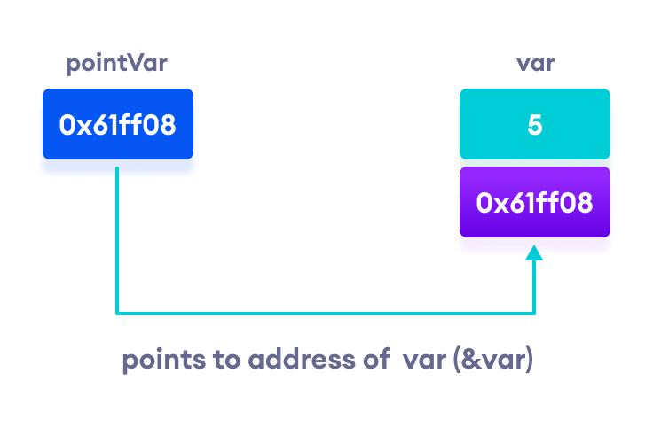
POINTERS
Pointers are variables that store the memory address of other variables
Pointers are declared with an asterisk ‘ * ’: int *ptr;
(*) is called dereference operator, it is used in declaration of a pointer and also extraction of the value pointed by the pointer.
Printing out addresses in C++ - two ways, two concepts
https://www.programiz.com/cpp-programming/pointers

Slide 6
POINTERS & REFERENCES
Pointers allow for manipulation of dynamic memory (memory on demand)
If you don’t know the address for a pointer to point to, a ‘nullptr’ can be used
‘nullptr’ means that it points to nothing (no arrows) – similar to NULL value
Arithmetic’s applicability to pointers is limited and can be meaningless:
Applicable opertors: ++, --, + or +=, - or -=
Invalid Pointers: Uninitialized pointers, pointers pointing to illegal addresses…

Slide 7
Fstream (File stream)
Reading from or writing to a file.
ifstream is for reading from the file
ofstream is for writing to the file
Multiple features available for manipulating with file data
Small Exercise: Try to read from a file line by line
https://www.w3schools.com/cpp/cpp_files.asp

Slide 8
References
https://www.programiz.com/cpp-programming/pointers
https://www.w3schools.com/cpp/cpp_files.asp
https://www.w3schools.com/cpp/cpp_oop.asp
https://github.com/TheBarzani/COEN243_Fall2022

Slide 9
Thank you ☺

