Slide 1
PROGRAMMING FOR MECHANICAL AND INDUSTRIAL ENGINEERS MIAE-215 Section T TB
ELEVENTH Tutorial
December 01, 2022

Slide 2
Classes & Objects
In OOP, objects belong to classes
‘Class’ in programming comes from the word ‘Classification’
Classes provide the attributes and methods for certain type of objects
Objects (similar to variables) can be classified to one class but they can have different homogenous attributes, a.k.a. characteristics
E.G., class of cars, class of students, …
https://www.w3schools.com/cpp/cpp_oop.asp

Slide 3
Class Syntax Components
Attributes: Data wise characteristic fields for each object
Methods: Behaviours each object can have
Constructors: Specifies the actions & initializations to be done when object created
Destructor: Specifies the actions & initializations to be done when object deleted
Encapsulation: Hiding sensitive data from the users
Access Specifiers
Getters/ Setters
https://www.w3schools.com/cpp/cpp_oop.asp

Slide 4
Attributes & Methods
In real life, objects have properties/characteristics; similarly, objects have attributes in OOP
Attributes define the properties of the object and are used for distinction
Example: for a car object, ‘Model Year’, ‘Color’, ‘Make’…etc. are all attributes
Similar to attributes, real-life objects can have actions/behaviours and OOP objects have methods
Methods specify what an object is capable of doing and how it an behave
Example: for a car object, ‘accelerate(int r)’, ‘TurnLeft()’, ‘SwitchON()’…etc. are all attributes

Slide 5

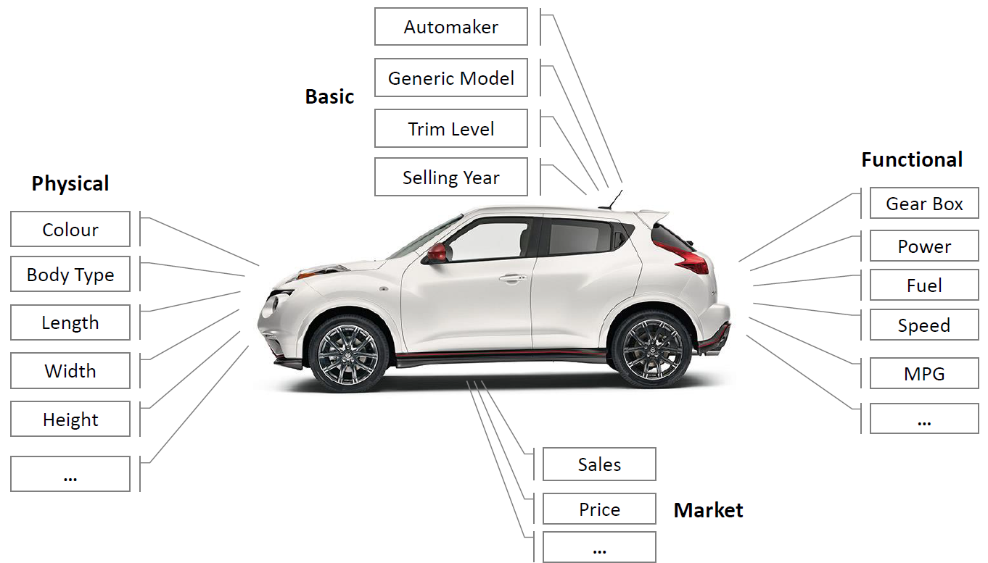
Attributes & Methods
AN object can have unlimited number of attributes but we only care about the ones that are relevant in our design and the ones we need.
Reference: https://deepvisualmarketing.github.io/

Slide 6
Constructor & Destructors
Constructor: Special method automatically called when an object created
Used for automating initialization of object baseline attributes and behaviour
Example: for an object car, the constructor can automatically specify model year and make.
Car(int year, string m){ Model_year = year; Make = m; } // definition
Calling the constructor: Car my_car(2019, “BMW”);
Types of Constructors: Default, Copy, and Parametrized
Destructors: they behave similar to constructors but are called when deleting an object
Syntax: virtual ~class_name(){}

Slide 7
Encapsulation
In Computer programs, it is important to specify what a can be accessed and what cannot
PRIVACY REASONS!
Encapsulation in OOP specifies which attributes/method can be manipulated by the user
Specifiers:
‘public’: Accessible in all environments
‘private’: Only objects of the same class can access it, not accessible outside of class
‘protected’: similar to ‘private’ but used in polymorphism and inheritance
Getters & Setter methods are used for accessing ‘private’ attributes with minimal privacy risks

Slide 8
ACTIVITY: Let’s make cars!
Objective: make a class of cars that can be used to drive the car around a track
Attributes: make, model year, top speed, speed, license plate number, current owner, track, history.
Methods: Getters & setters, accelerate() & brake(), move(char l), drive(), position(), display()
More stuff to be discussed during the tutorial.

Slide 9
References
https://sourcecodeera.com/blogs/Samath/Car-Class-using-C.aspx
https://cplusplus.com/forum/beginner/216417/
https://www.w3schools.com/cpp/cpp_oop.asp
https://github.com/TheBarzani/COEN243_Fall2022

Slide 10
Thank you ☺

