Slide 1
PROGRAMMING FOR MECHANICAL AND INDUSTRIAL ENGINEERS MIAE-215 Section T TB
NINETH Tutorial
November 17, 2022

Slide 2
Functions Overloading
Functions are most useful when they are made modular
Functions overloading: One function name that can have different return types, arguments and implementations
Overloading is only feasible when the re-defined function is distinct
Alternatively related (not in scope of the course): Templates
https://cplusplus.com/doc/tutorial/functions2/

Slide 3
PBV vs PBR
Arguments/Parameters can either be pass-by-value or pass-by-reference
Pass-by-value: the argument makes a copy of the passed variable value and uses it
The value of the passed variable is unaffected outside the function
Pass-by-reference: the argument becomes a reference to the passed variable
The value of the passed variable can change accordingly
In PBV only the value is provided while in PBR the memory location is provided
https://www.educative.io/answers/pass-by-value-vs-pass-by-reference

Slide 4
Function calls
A function defined globally can be called anywhere
In competitive programming, one can make new functions from multiple other functions
Activity: Double triangle
Function 1:
A) type upperTriangle(string str);
B) type upperTriangle(char arr[]);
Function 2:
A) type lowerTriangle(string str);
B) type lowerTriangle(char arr[])
Function 3: type doubleTriangle(string strU, string strL, char c)

Slide 5
Default Values & Static Storage
In programming, user behaviour is unexpected
So, it can be a good practice to provide default cases
In functions, parameters can have default values
E.G., int divide(int a, int b=2); void printS(string str, int count=1);
The ‘static’ keyword can provide tracker variables in functions
If a variable is set static in a function, its value is stored after each function call
Activity: void printCalls();

Slide 6
Object-Oriented Programming (OOP)
OOP is about objects that contain both data and functions (W3Schools)
Procedural Programming vs OOP
OOP Advantages:
It provides a better and clearly structured code
It is faster and easier to execute
It keeps C++ code DRY (Don’t Repeat Yourself) – easier to maintain, modify, and debug
It forms the basis for multiple data structures (ways to store data)
It provides desired flexibility

Slide 7
Classes & Objects
In OOP, objects belong to classes
‘Class’ in programming comes from the word ‘Classification’
Classes provide the attributes and methods for certain type of objects
Objects (similar to variables) can be classified to one class but they can have different homogenous attributes, a.k.a. characteristics
E.G., class of cars, class of students, …
https://www.w3schools.com/cpp/cpp_oop.asp

Slide 8
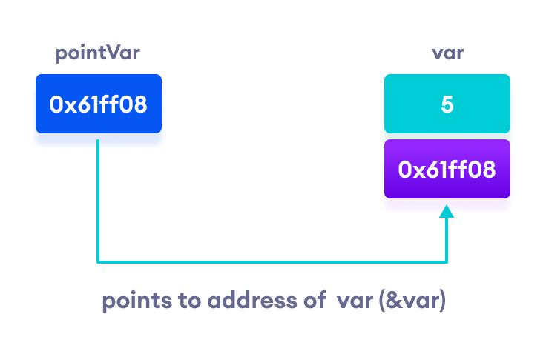
POINTERS
Pointers are variables that store the memory address of other variables
Pointers are declared with an asterisk ‘ * ’: int *ptr;
(*) is called dereference operator, it is used in declaration of a pointer and also extraction of the value pointed by the pointer.
Printing out addresses in C++ - two ways, two concepts
https://www.programiz.com/cpp-programming/pointers

Slide 9
References
https://cplusplus.com/doc/tutorial/functions2/
https://www.educative.io/answers/pass-by-value-vs-pass-by-reference
https://www.w3schools.com/cpp/cpp_oop.asp
https://github.com/TheBarzani/COEN243_Fall2022

Slide 10
Thank you ☺

