Slide 1

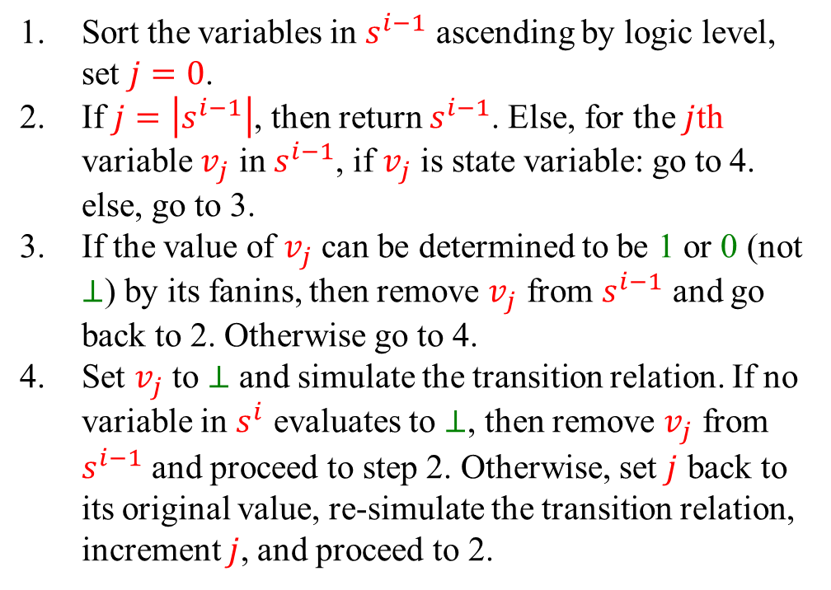
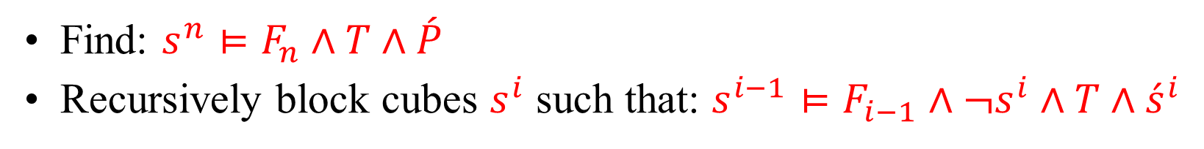
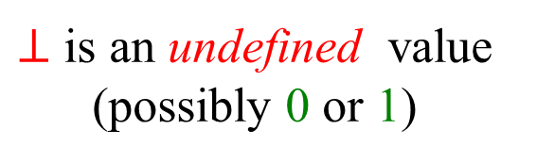
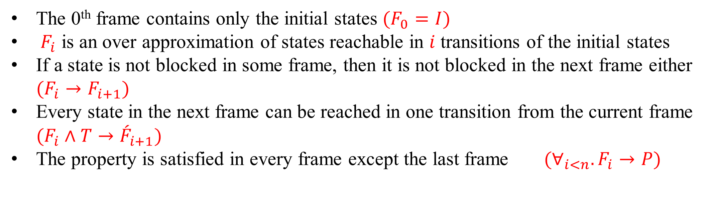
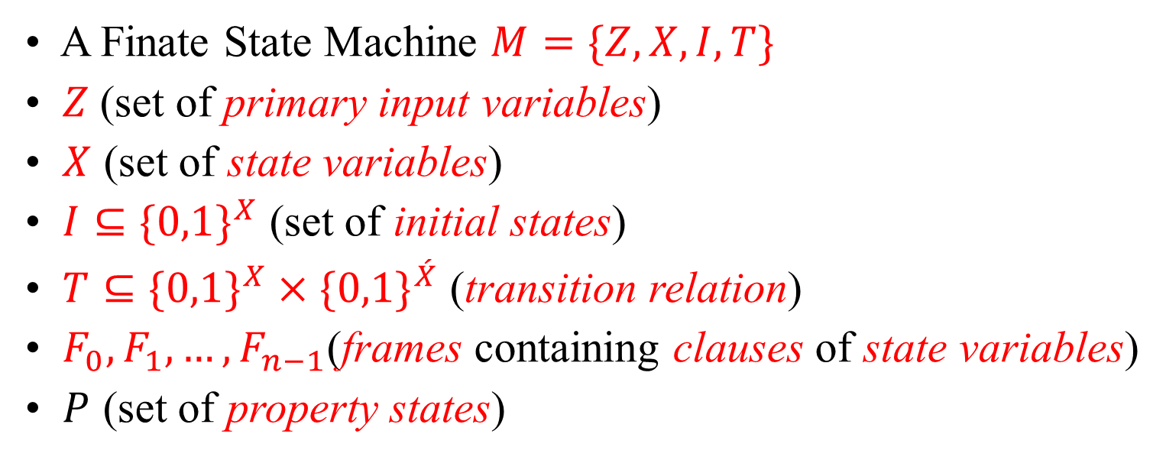
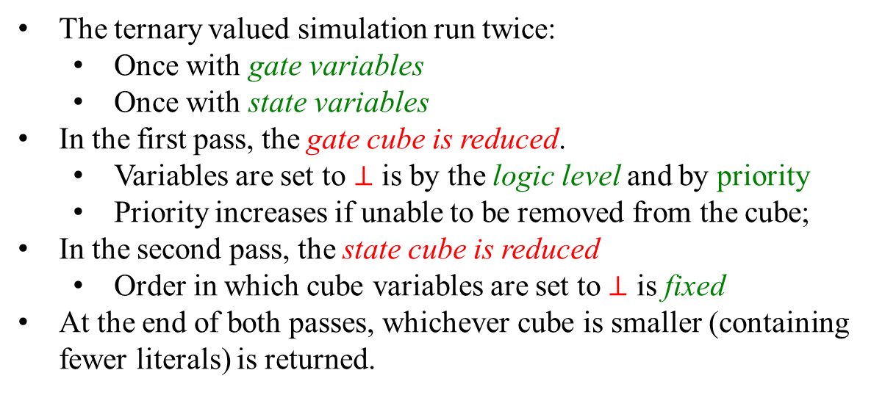
Using Cubes of Non-state Variables With
Property Directed Reachability
Marc Riedel
John Backes
Associate Professor, University of Minnesota
Ph.D. Candidate, University of Minnesota
Property Directed Reachability (PDR)
Abstract
PDR is a symbolic model checking algorithm for verifying safety properties.
The algorithm solves SAT instances representing discrete time frames in isolation.
A new SAT-Based algorithm for symbolic model checking has been gaining popularity. This algorithm, referred to as “Incremental Construction of Inductive Clauses for Indubitable Correctness” (IC3) or “Property Directed Reachability” (PDR), uses information learned from SAT instances of isolated time frames to either prove that an invariant exists, or provide a counter example. The information learned between each time frame is recorded in the form of cubes of the state variables. In this work, we study the effect of extending PDR to use cubes of intermediate variables representing the logic gates in the transition relation. We demonstrate that we can improve the runtime for satisfiable benchmarks by up to 3.2X, with an average speedup of 1.23X. Our approach also provides a speedup of up to 3.84X for unsatisfiable benchmarks.
Variables, Notation and Terms:
Trace Properties
A Finate State Machine $M=\{Z, X, I,T\}$
$Z$(set of primary input variables)
$X$ (set of state variables)
$I⊆\{0,1\}^{X}$ (set of initial states)
$T⊆\{0,1\}^{X}×\{0,1\}^{\acute{X}}$ (transition relation)
$F_{0},F_{1}, …,F_{n−1}$(frames containing clauses of state variables)
$P$ (set of property states)
The 0th frame contains only the initial states $(F_{0}=I)$
$F_{i}$ is an over approximation of states reachable in $i$ transitions of the initial states
If a state is not blocked in some frame, then it is not blocked in the next frame either $(F_{i}→F_{i+1})$
Every state in the next frame can be reached in one transition from the current frame $(F_{i}∧T→{\acute{F}}_{i+1})$
The property is satisfied in every frame except the last frame $(∀_{i<n}.F_{i}→P)$
Blocking Phase:
Propagation Phase:
Find: $s^{n}⊨F_{n}∧T∧\acute{P}$
Recursively block cubes $s^{i}$ such that: $s^{i−1}⊨F_{i−1}∧¬s^{i}∧T∧{\acute{s}}^{i}$
If: $F_{i}∧T∧{\acute{s}}^{i+1}$ is unsatisfiable, then cube $s$ is blocked in frame $i+1$
Why Use Cubes of Gate Variables?
Ternary Valued Simulation
With Gate Variables
UNSAT Results
Three cubes in terms of x₀,x₁,x₂,x₃ can by blocked by one cube in terms of g₀,g₁!
Experiment
Benchmark | Time States (s) | Frames States | Inv. States | Time Gates (s) | Frames Gates | Inv. Gates | Time Ratio
6s2 | 46.67 | 13 | 601 | 46.35 | 13 | 601 | 0.99
6s34 | 3984.89 | 77 | 2284 | 1053.82 | 89 | 1057 | 0.26
6s6 | 19.19 | 18 | 1709 | 21.59 | 21 | 1796 | 1.13
bj08amba2g3f3 | 1.12 | 10 | 44 | 14.37 | 10 | 48 | 12.83
bjrb07amba10andenv | 2081.17 | 11 | 204 | 2024.49 | 9 | 246 | 0.97
bjrb07amba3andenv | 10.56 | 9 | 103 | 10.07 | 8 | 73 | 0.95
bjrb07amba4andenv | 54.87 | 7 | 78 | 31.6 | 7 | 66 | 0.58
bjrb07amba5andenv | 93.45 | 8 | 130 | 79.5 | 8 | 109 | 0.85
bjrb07amba6andenv | 277.88 | 8 | 160 | 438.81 | 8 | 192 | 1.58
bjrb07amba7andenv | 176.79 | 11 | 148 | 160.12 | 9 | 159 | 0.91
bjrb07amba9andenv | 974.83 | 9 | 253 | 1013.88 | 14 | 185 | 1.04
bob05 | 69.06 | 18 | 407 | 101.86 | 21 | 505 | 1.47
bobcohdoptdcd4 | 84.73 | 17 | 1417 | 51.61 | 13 | 1144 | 0.61
bobsmi2c | 48.03 | 50 | 1121 | 193.33 | 187 | 1183 | 4.03
cmudme1 | --- | --- | --- | 7342.07 | 90 | 7148 | ---
cmudme2 | 4255.06 | 97 | 6197 | 2917.46 | 99 | 4746 | 0.69
eijkbs1512 | 48.11 | 176 | 303 | 31.36 | 161 | 312 | 0.65
eijks382 | 28.02 | 57 | 368 | 34.35 | 69 | 380 | 1.23
eijks420 | 64.07 | 464 | 161 | 67.97 | 501 | 161 | 1.06
eijks444 | 407.75 | 62 | 429 | 237.49 | 61 | 394 | 0.58
eijks526 | 142.32 | 64 | 509 | 80.75 | 62 | 500 | 0.57
intel006 | 23.96 | 11 | 543 | 25.11 | 13 | 615 | 1.05
intel007 | 243.7 | 10 | 1580 | 193.47 | 8 | 1554 | 0.79
intel026 | 2262.39 | 52 | 6504 | 2183.98 | 49 | 6239 | 0.97
intel054 | 239.29 | 19 | 1048 | 305 | 21 | 1129 | 1.27
intel055 | 69.98 | 17 | 309 | 70.03 | 19 | 211 | 1
intel056 | 146.26 | 23 | 835 | 91.82 | 22 | 720 | 0.63
intel057 | 144.43 | 22 | 536 | 134.2 | 20 | 494 | 0.93
intel059 | 62.88 | 18 | 543 | 66.52 | 20 | 536 | 1.06
intel062 | 2095.27 | 28 | 4101 | 2077.67 | 26 | 4909 | 0.99
nusmvguidancep5 | 23.98 | 18 | 292 | 26.35 | 18 | 292 | 1.1
nusmvguidancep7 | 77.49 | 21 | 628 | 78.24 | 21 | 628 | 1.01
nusmvguidancep8 | 19.9 | 22 | 155 | 20.17 | 22 | 155 | 1.01
nusmvguidancep9 | 21.25 | 20 | 154 | 21.25 | 20 | 154 | 1
nusmvreactorp2 | 1093.58 | 172 | 4437 | 2394.32 | 7389 | 7389 | 2.19
nusmvreactorp6 | 1416.97 | 163 | 4390 | 1444.97 | 163 | 4390 | 1.02
pdtpmscoherence | 68.82 | 16 | 1491 | 44.5 | 12 | 1217 | 0.65
pdtpmsheap | 18.72 | 25 | 653 | 11.47 | 23 | 503 | 0.61
pdtpmsretherrtf | 278.97 | 51 | 2510 | 48.65 | 43 | 925 | 0.17
pdtpmsvsar | 25.64 | 11 | 263 | 12.9 | 11 | 260 | 0.5
pdtswvibs8x8p1 | 18.2 | 20 | 867 | 13.45 | 21 | 813 | 0.74
pdtswvqis10x6p1 | 50.05 | 73 | 192 | 35.91 | 66 | 208 | 0.72
pdtswvqis8x8p1 | 108.93 | 56 | 285 | 187.01 | 62 | 339 | 1.72
pdtswvroz10x6p1 | 12.84 | 58 | 73 | 12.99 | 56 | 73 | 1.01
pdtswvroz10x6p2 | 117.03 | 88 | 136 | 105.51 | 76 | 166 | 0.9
pdtswvroz8x8p1 | 13.54 | 50 | 60 | 12.43 | 50 | 64 | 0.92
pdtswvroz8x8p2 | 62.52 | 71 | 183 | 90.46 | 60 | 135 | 1.45
pdtswvsam6x8p3 | 24.84 | 40 | 284 | 24.78 | 39 | 311 | 1
pdtswvtma6x4p2 | 186.35 | 52 | 1537 | 221.31 | 60 | 1758 | 1.19
pdtswvtma6x4p3 | 1006.19 | 58 | 6150 | 1754.36 | 64 | 7837 | 1.74
pdtswvtma6x6p1 | 297.39 | 50 | 1191 | 184.71 | 48 | 1187 | 0.62
pdtswvtma6x6p2 | 1573.62 | 69 | 5944 | 1851.38 | 69 | 7054 | 1.18
pdtswvtms10x8p1 | 107.81 | 16 | 1735 | 97.07 | 15 | 1521 | 0.9
pdtswvtms12x8p1 | 70.52 | 16 | 1531 | 201.81 | 37 | 1625 | 2.86
pdtswvtms14x8p1 | 73.4 | 16 | 1362 | 81.38 | 23 | 1353 | 1.11
pdtvisbakery0 | 30.29 | 32 | 42 | 32.83 | 32 | 42 | 1.08
pdtvisbakery1 | 17.68 | 21 | 47 | 32.17 | 31 | 46 | 1.82
pdtvisbakery2 | 27.42 | 32 | 43 | 25.01 | 27 | 47 | 0.91
pdtvisgoodbakery0 | 24.07 | 27 | 44 | 26.79 | 28 | 40 | 1.11
pdtvisgoodbakery1 | 19.64 | 25 | 46 | 38 | 26 | 55 | 1.93
pdtvisgoodbakery2 | 15.28 | 25 | 43 | 26.12 | 27 | 47 | 1.71
pdtvisns3p00 | 15.51 | 11 | 99 | 23.34 | 11 | 111 | 1.5
pdtvisns3p01 | 12.55 | 12 | 68 | 12.35 | 11 | 82 | 0.98
pdtvisns3p02 | 36.21 | 14 | 125 | 18.3 | 14 | 99 | 0.51
pdtvisns3p03 | 7.14 | 9 | 62 | 15.22 | 12 | 87 | 2.13
pdtvisns3p04 | 20.97 | 13 | 100 | 16.64 | 11 | 97 | 0.79
pdtvisns3p05 | 31.82 | 14 | 126 | 13.44 | 12 | 82 | 0.42
pdtvisns3p06 | 29.23 | 11 | 124 | 20.99 | 11 | 90 | 0.72
pdtvisns3p07 | 19.04 | 16 | 91 | 10.28 | 12 | 84 | 0.54
pdtvistimeout0 | 4649.41 | 35 | 16496 | --- | --- | --- | ---
pdtvisrethersqo4 | 49.12 | 38 | 454 | 31.97 | 38 | 450 | 0.65
pdtvisvending01 | 54.2 | 16 | 1176 | 58.74 | 19 | 1102 | 1.08
Geometric Average | --- | --- | --- | --- | --- | --- | 0.98
The ternary valued simulation run twice:
Once with gate variables
Once with state variables
In the first pass, the gate cube is reduced.
Variables are set to $⊥$ is by the logic level and by priority
Priority increases if unable to be removed from the cube;
In the second pass, the state cube is reduced
Order in which cube variables are set to $⊥$ is fixed
At the end of both passes, whichever cube is smaller (containing fewer literals) is returned.
x₀,x₁,x₂,x₃ | g₀,g₁ | x₄
0000 | 01 | 1
0011 | 01 | 1
0110 | 10 | 1
1100 | 01 | 1
Shifting Time Frames
SAT Results
Original Transition Relation
New Transition Relation
Generally better results for satisfiable benchmarks
Some unsatisfiable benchmarks proved faster
Sort the variables in $s^{i−1}$ ascending by logic level, set $j=0$.
If $j=\left|s^{i−1}\right|$, then return $s^{i−1}$. Else, for the $j$th variable $v_{j}$ in $s^{i−1}$, if $v_{j}$ is state variable: go to 4. else, go to 3.
If the value of $v_{j}$ can be determined to be 1 or 0 (not $⊥$) by its fanins, then remove $v_{j}$ from $s^{i−1}$ and go back to 2. Otherwise go to 4.
Set $v_{j}$ to $⊥$ and simulate the transition relation. If no variable in $s^{i}$ evaluates to $⊥$, then remove $v_{j}$ from $s^{i−1}$ and proceed to step 2. Otherwise, set $j$ back to its original value, re-simulate the transition relation, increment $j$, and proceed to 2.
Benchmark | Time States(s) | Frames States | Time Gates (s) | Frames Gates | Time Ratio
abp4p2ff | 12.34 | 17 | 6.57 | 15 | 0.53
abp4ptimoneg | 22.46 | 18 | 19.99 | 17 | 0.89
bc57sensorsp0 | 353.59 | 59 | 248.85 | 41 | 0.7
bc57sensorsp0neg | 339.25 | 62 | 353.39 | 55 | 1.04
bc57sensorsp1 | 217.01 | 59 | 550.17 | 73 | 2.53
bc57sensorsp1neg | 595.57 | 63 | 428.22 | 47 | 0.72
bc57sensorsp2 | 468.53 | 69 | 274.03 | 63 | 0.59
bc57sensorsp2neg | 460.64 | 79 | 586.85 | 71 | 1.27
bc57sensorsp3 | 731.42 | 67 | 227.82 | 58 | 0.31
intel017 | --- | --- | 4878.43 | 232 | ---
intel046 | 2274.65 | 68 | 2191.27 | 70 | 0.96
intel045 | 2101.11 | 70 | 1810.71 | 70 | 0.86
intel047 | 1371.72 | 62 | 2643.31 | 69 | 1.93
irstdme4 | 68.67 | 31 | 21.67 | 26 | 0.32
irstdme5 | 19.46 | 26 | 6.46 | 26 | 0.33
irstdme6 | 31.84 | 29 | 17.94 | 28 | 0.56
nusmvtcasp5n | 99.66 | 24 | 78.58 | 24 | 0.79
nusmvtcastp5 | 77.46 | 22 | 67.15 | 23 | 0.87
prodcellp0neg | 77.71 | 60 | 105.54 | 78 | 1.36
prodcellp1 | 155.62 | 72 | 141.58 | 72 | 0.9
prodcellp1neg | 96.87 | 64 | 145.41 | 63 | 1.5
prodcellp2 | 181.08 | 60 | 141.76 | 81 | 0.78
prodcellp2neg | 143.65 | 82 | 114.42 | 62 | 0.8
prodcellp3 | 117.7 | 58 | 102.05 | 56 | 0.87
prodcellp4 | 146.54 | 66 | 143.28 | 75 | 0.98
prodcellp4neg | 162.73 | 80 | 526.8 | 62 | 3.23
Geometric Average | --- | --- | --- | --- | 0.82
Gates g₀,g₁,g₂,g₃ have only state variables in their cone of influence (COI)
Gates g₀,g₁,g₂,g₃ have only state variables in their cone of influence (COI)
$⊥$ is an undefined value (possibly 0 or 1)

