Slide 1
Resolute: An Assurance Case Language for Architecture Models
Andrew Gacek, John Backes, Darren Cofer, Konrad Slind – Rockwell Collins
Mike Whalen – University of Minnesota
High Integrity Language Technology
20 October 2014

Slide 2
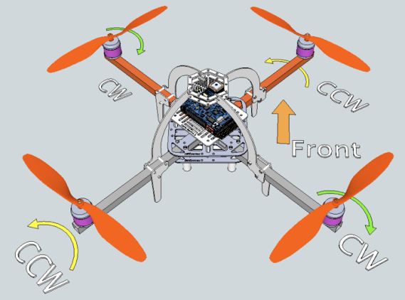
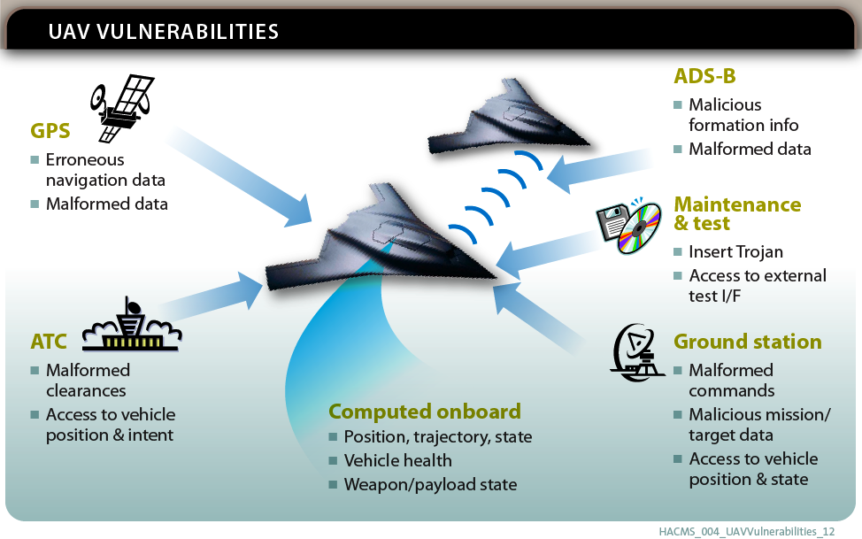
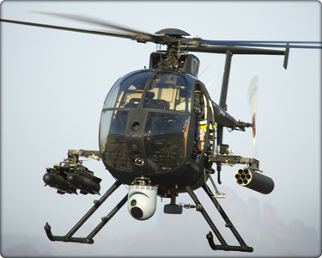
HACMS– Security of Cyber Physical Systems
Security vulnerabilities that can lead to safety hazards

Slide 3
Evidence in the model
How can we make high-level claims about correctness?
Combine heterogeneous evidence from multiple sources
Galois: IVORY DSL
NICTA: Sel4 Microkernel
Boeing: Internal Processes and Best Practices

Slide 4
Assurance Cases
A reasoned and compelling argument, supported by a body of evidence, that a system, service or organization will operate as intended for a defined application in a defined environment
GSN community standard V1
A graphical representation of an argument supported by evidence
May address different system aspects
Safety
Security
Correctness

Slide 5
Assurance Cases
Goal Structuring Notation (GSN) is used in several tools
Goals: claims about the system
Strategy: argues why a goal is true
Assumptions
Solution: leaf level evidence

Slide 6
Assurance Cases
Positives
Informal
Can include many different sources of evidence
Understandable by domain experts
Captures structure of argument
Negatives
Informal
Not strongly tied to the system design
Semantics are loose (English is ambiguous)

Slide 7
Assurance Cases
Negatives
Informal
Not strongly tied to the system design
Semantics are loose (English is ambiguous)
Resolute: An Assurance Case Language for Architecture Models
Use a logic to generate an assurance case
Make the structure of the system architecture dictate the structure of the assurance case
Use an architectural design language with defined semantics (AADL)

Slide 8
Resolute Language
Claims and rules for satisfying those claims
Rules and claims parameterized by AADL types
Assurance cases instantiated with elements from AADL model
memory_protected(p : process) <=
** "The memory of process " p " is protected from alterations by other processes" **
property(p, SMACCM::OS) = "SeL4" or
(property(p, SMACCM::OS) = "eChronos" and
forall (mem : memory). bound(p, mem) =>
forall (q : process). bound(q, mem) => memory_safe_process(q))

Slide 9
Resolute Logic
Rules are sufficient but not complete
No closed world assumption (similar to other logic programing languages)
This means a claim can never be used in a negative context
“The absence of evidence is not evidence of absence”
Resolute supports computations which can be used in a negative context
memory_protected(p : process) <=
** "The memory of process " p " is protected from alterations by other processes" **
property(p, SMACCM::OS) = "SeL4" or
(property(p, SMACCM::OS) = "eChronos" and
forall (mem : memory). bound(p, mem) =>
forall (q : process). bound(q, mem) => memory_safe_process(q))

Slide 10
Tool Environment
Implemented as an annex in AADL
Uses Xtext to work fluidly in OSATE
process implementation Main_Loop.Impl
subcomponents
SS: thread Sensors;
CCT: thread Command_Control_Telemetry;
RC: thread Radio_Control;
SN: thread Stability_Navigation;
MC: thread Motor_Control;
DC: thread Decrypt;
annex resolute {**
prove only_receive_gs(this.MC)
prove schedulable(this)
**};
end Main_Loop.Impl;

Slide 11
memory_protected(p : process) <=
** "The memory of process " p " is protected
from alterations by other processes" **
property(p, SMACCM::OS) = "SeL4" or
(property(p, SMACCM::OS) = "eChronos" and
forall (mem : memory). bound(p, mem) =>
forall (q : process). bound(q, mem) => memory_safe_process(q))
memory_safe_process(p : process) <=
** "The process " p " only writes to its own memory space" **
forall (t : thread). contained(t, p) => memory_safe_thread(t)
memory_safe_thread(t : thread) <=
** "The thread " t " only writes to its own memory space" **
ivory_thread(t)
ivory_thread(t : thread) <=
** "The thread " t " is generated from Ivory" **
property(t, SMACCM::Language) = "Ivory"

Slide 12
Process “System.Proc1” protected from other processes
memory_protected(p : process) <=
** "The memory of process " p " is protected
from alterations by other processes" **
property(p, SMACCM::OS) = "SeL4" or
(property(p, SMACCM::OS) = "eChronos" and
forall (mem : memory). bound(p, mem) =>
forall (q : process). bound(q, mem) => memory_safe_process(q))
memory_safe_process(p : process) <=
** "The process " p " only writes to its own memory space" **
forall (t : thread). contained(t, p) => memory_safe_thread(t)
memory_safe_thread(t : thread) <=
** "The thread " t " only writes to its own memory space" **
ivory_thread(t)
ivory_thread(t : thread) <=
** "The thread " t " is generated from Ivory" **
property(t, SMACCM::Language) = "Ivory"

Slide 13
Process “System.Proc1” protected from other processes
Process “System.Proc1” Writes to own memory
memory_protected(p : process) <=
** "The memory of process " p " is protected
from alterations by other processes" **
property(p, SMACCM::OS) = "SeL4" or
(property(p, SMACCM::OS) = "eChronos" and
forall (mem : memory). bound(p, mem) =>
forall (q : process). bound(q, mem) => memory_safe_process(q))
memory_safe_process(p : process) <=
** "The process " p " only writes to its own memory space" **
forall (t : thread). contained(t, p) => memory_safe_thread(t)
memory_safe_thread(t : thread) <=
** "The thread " t " only writes to its own memory space" **
ivory_thread(t)
ivory_thread(t : thread) <=
** "The thread " t " is generated from Ivory" **
property(t, SMACCM::Language) = "Ivory"

Slide 14
Process “System.Proc1” protected from other processes
Process “System.Proc1” Writes to own memory
“System.Proc1.Thread1” Writes to own memory
memory_protected(p : process) <=
** "The memory of process " p " is protected
from alterations by other processes" **
property(p, SMACCM::OS) = "SeL4" or
(property(p, SMACCM::OS) = "eChronos" and
forall (mem : memory). bound(p, mem) =>
forall (q : process). bound(q, mem) => memory_safe_process(q))
memory_safe_process(p : process) <=
** "The process " p " only writes to its own memory space" **
forall (t : thread). contained(t, p) => memory_safe_thread(t)
memory_safe_thread(t : thread) <=
** "The thread " t " only writes to its own memory space" **
ivory_thread(t)
ivory_thread(t : thread) <=
** "The thread " t " is generated from Ivory" **
property(t, SMACCM::Language) = "Ivory"

Slide 15
Process “System.Proc1” protected from other processes
Process “System.Proc1” Writes to own memory
“System.Proc1.Thread1” Writes to own memory
“System.Proc1.Thread1” Written in Ivory
memory_protected(p : process) <=
** "The memory of process " p " is protected
from alterations by other processes" **
property(p, SMACCM::OS) = "SeL4" or
(property(p, SMACCM::OS) = "eChronos" and
forall (mem : memory). bound(p, mem) =>
forall (q : process). bound(q, mem) => memory_safe_process(q))
memory_safe_process(p : process) <=
** "The process " p " only writes to its own memory space" **
forall (t : thread). contained(t, p) => memory_safe_thread(t)
memory_safe_thread(t : thread) <=
** "The thread " t " only writes to its own memory space" **
ivory_thread(t)
ivory_thread(t : thread) <=
** "The thread " t " is generated from Ivory" **
property(t, SMACCM::Language) = "Ivory"

Slide 16
Process “System.Proc1” protected from other processes
Process “System.Proc1” Writes to own memory
“System.Proc1.Thread1” Writes to own memory
“System.Proc1.Thread2” Writes to own memory
“System.Proc1.Thread1” Written in Ivory
memory_protected(p : process) <=
** "The memory of process " p " is protected
from alterations by other processes" **
property(p, SMACCM::OS) = "SeL4" or
(property(p, SMACCM::OS) = "eChronos" and
forall (mem : memory). bound(p, mem) =>
forall (q : process). bound(q, mem) => memory_safe_process(q))
memory_safe_process(p : process) <=
** "The process " p " only writes to its own memory space" **
forall (t : thread). contained(t, p) => memory_safe_thread(t)
memory_safe_thread(t : thread) <=
** "The thread " t " only writes to its own memory space" **
ivory_thread(t)
ivory_thread(t : thread) <=
** "The thread " t " is generated from Ivory" **
property(t, SMACCM::Language) = "Ivory"

Slide 17
Process “System.Proc1” protected from other processes
Process “System.Proc1” Writes to own memory
“System.Proc1.Thread1” Writes to own memory
“System.Proc1.Thread2” Writes to own memory
“System.Proc1.Thread1” Written in Ivory
“System.Proc1.Thread2” Written in Ivory
memory_protected(p : process) <=
** "The memory of process " p " is protected
from alterations by other processes" **
property(p, SMACCM::OS) = "SeL4" or
(property(p, SMACCM::OS) = "eChronos" and
forall (mem : memory). bound(p, mem) =>
forall (q : process). bound(q, mem) => memory_safe_process(q))
memory_safe_process(p : process) <=
** "The process " p " only writes to its own memory space" **
forall (t : thread). contained(t, p) => memory_safe_thread(t)
memory_safe_thread(t : thread) <=
** "The thread " t " only writes to its own memory space" **
ivory_thread(t)
ivory_thread(t : thread) <=
** "The thread " t " is generated from Ivory" **
property(t, SMACCM::Language) = "Ivory"

Slide 18
Process “System.Proc1” protected from other processes
Process “System.Proc1” Writes to own memory
Process “System.Proc2” Writes to own memory
“System.Proc1.Thread1” Writes to own memory
“System.Proc1.Thread2” Writes to own memory
“System.Proc1.Thread1” Written in Ivory
“System.Proc1.Thread2” Written in Ivory
memory_protected(p : process) <=
** "The memory of process " p " is protected
from alterations by other processes" **
property(p, SMACCM::OS) = "SeL4" or
(property(p, SMACCM::OS) = "eChronos" and
forall (mem : memory). bound(p, mem) =>
forall (q : process). bound(q, mem) => memory_safe_process(q))
memory_safe_process(p : process) <=
** "The process " p " only writes to its own memory space" **
forall (t : thread). contained(t, p) => memory_safe_thread(t)
memory_safe_thread(t : thread) <=
** "The thread " t " only writes to its own memory space" **
ivory_thread(t)
ivory_thread(t : thread) <=
** "The thread " t " is generated from Ivory" **
property(t, SMACCM::Language) = "Ivory"

Slide 19
Process “System.Proc1” protected from other processes
Process “System.Proc1” Writes to own memory
Process “System.Proc2” Writes to own memory
“System.Proc1.Thread1” Writes to own memory
“System.Proc1.Thread2” Writes to own memory
“System.Proc1.Thread1” Written in Ivory
“System.Proc1.Thread2” Written in Ivory
memory_protected(p : process) <=
** "The memory of process " p " is protected
from alterations by other processes" **
property(p, SMACCM::OS) = "SeL4" or
(property(p, SMACCM::OS) = "eChronos" and
forall (mem : memory). bound(p, mem) =>
forall (q : process). bound(q, mem) => memory_safe_process(q))
memory_safe_process(p : process) <=
** "The process " p " only writes to its own memory space" **
forall (t : thread). contained(t, p) => memory_safe_thread(t)
memory_safe_thread(t : thread) <=
** "The thread " t " only writes to its own memory space" **
ivory_thread(t)
ivory_thread(t : thread) <=
** "The thread " t " is generated from Ivory" **
property(t, SMACCM::Language) = "Ivory"
“System.Proc2.Thread3” Writes to own memory

Slide 20
Process “System.Proc1” protected from other processes
Process “System.Proc1” Writes to own memory
Process “System.Proc2” Writes to own memory
“System.Proc1.Thread1” Writes to own memory
“System.Proc1.Thread2” Writes to own memory
“System.Proc1.Thread1” Written in Ivory
“System.Proc1.Thread2” Written in Ivory
memory_protected(p : process) <=
** "The memory of process " p " is protected
from alterations by other processes" **
property(p, SMACCM::OS) = "SeL4" or
(property(p, SMACCM::OS) = "eChronos" and
forall (mem : memory). bound(p, mem) =>
forall (q : process). bound(q, mem) => memory_safe_process(q))
memory_safe_process(p : process) <=
** "The process " p " only writes to its own memory space" **
forall (t : thread). contained(t, p) => memory_safe_thread(t)
memory_safe_thread(t : thread) <=
** "The thread " t " only writes to its own memory space" **
ivory_thread(t)
ivory_thread(t : thread) <=
** "The thread " t " is generated from Ivory" **
property(t, SMACCM::Language) = "Ivory"
“System.Proc2.Thread3” Writes to own memory
“System.Proc2.Thread3” Written in Ivory

Slide 21
Failed Assurance Cases
Unlike traditional assurance cases, Resolute can produce a failed assurance case
Claims that are false are shown in red so the assurance case can be debugged
Failures may occur if the architecture changes, or if external analysis fails

Slide 22
Process “System.Proc1” protected from other processes
Process “System.Proc1” Writes to own memory
Process “System.Proc2” Writes to own memory
“System.Proc1.Thread1” Writes to own memory
“System.Proc1.Thread2” Writes to own memory
“System.Proc1.Thread1” Written in Ivory
“System.Proc1.Thread2” Written in Ivory
memory_protected(p : process) <=
** "The memory of process " p " is protected
from alterations by other processes" **
property(p, SMACCM::OS) = "SeL4" or
(property(p, SMACCM::OS) = "eChronos" and
forall (mem : memory). bound(p, mem) =>
forall (q : process). bound(q, mem) => memory_safe_process(q))
memory_safe_process(p : process) <=
** "The process " p " only writes to its own memory space" **
forall (t : thread). contained(t, p) => memory_safe_thread(t)
memory_safe_thread(t : thread) <=
** "The thread " t " only writes to its own memory space" **
ivory_thread(t)
ivory_thread(t : thread) <=
** "The thread " t " is generated from Ivory" **
property(t, SMACCM::Language) = "Ivory"
“System.Proc2.Thread3” Writes to own memory
“System.Proc2.Thread3” Written in Ivory

Slide 23
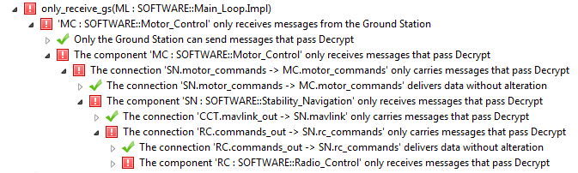
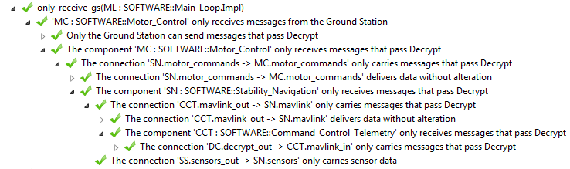
Analysis Results
Failed assurance case
Successful assurance case

Slide 24
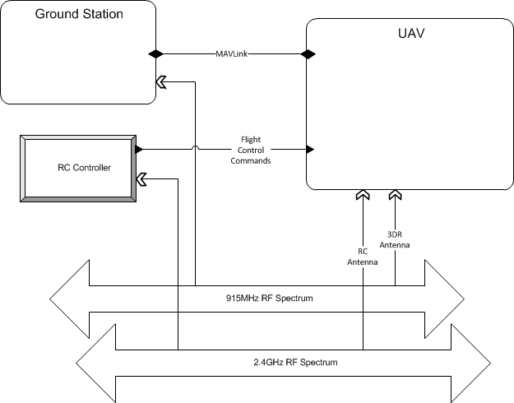
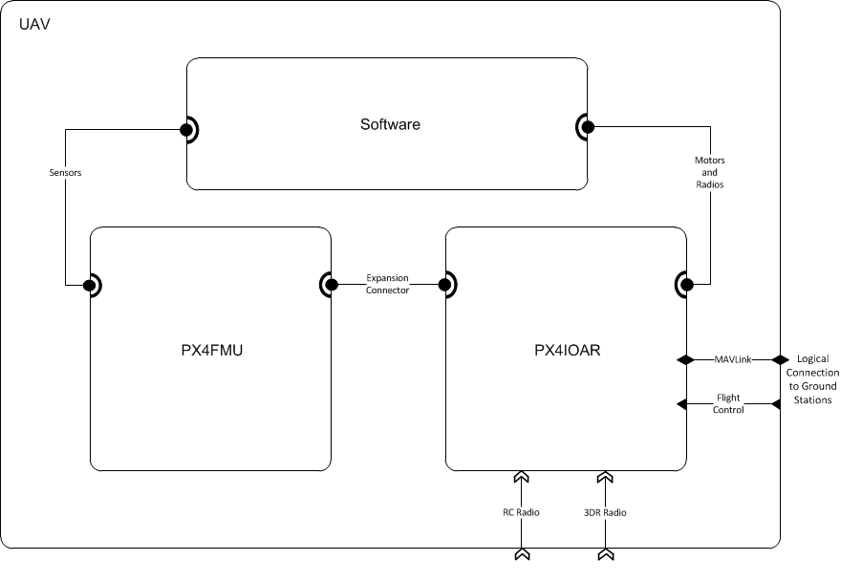

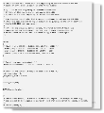
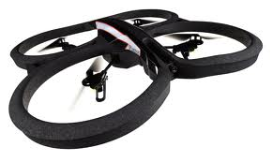
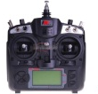
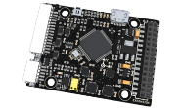
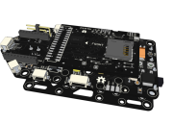
Research Vehicle Architecture

Slide 25
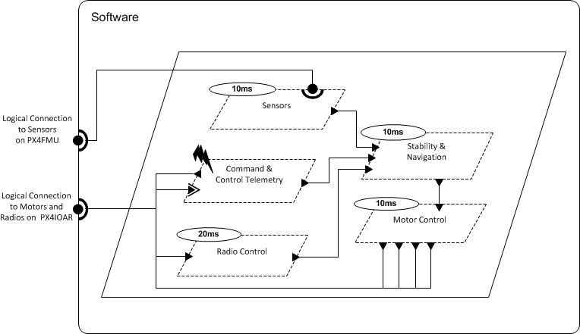
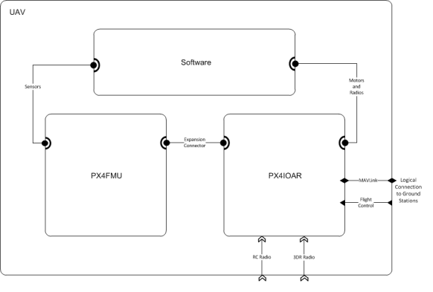
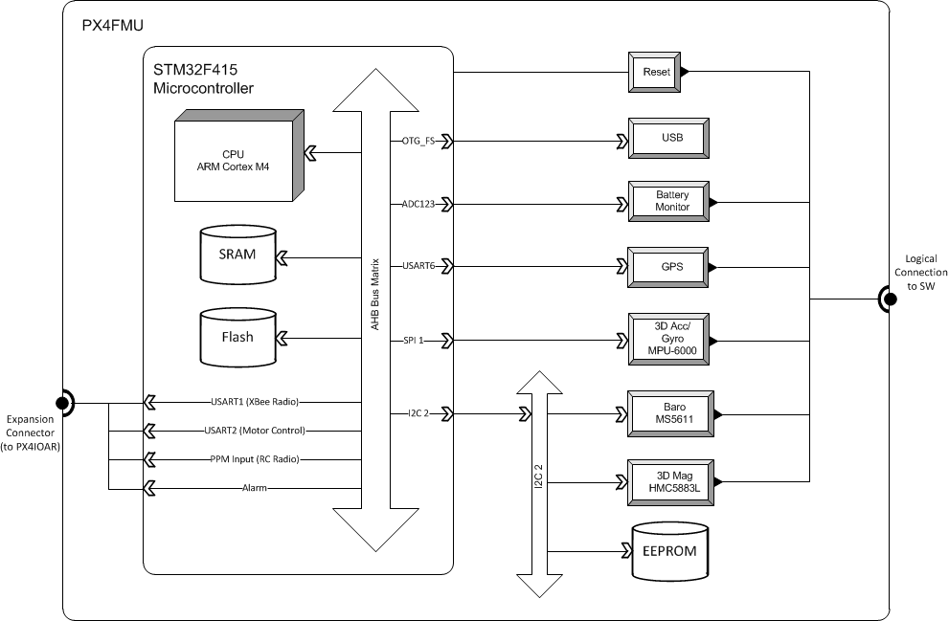
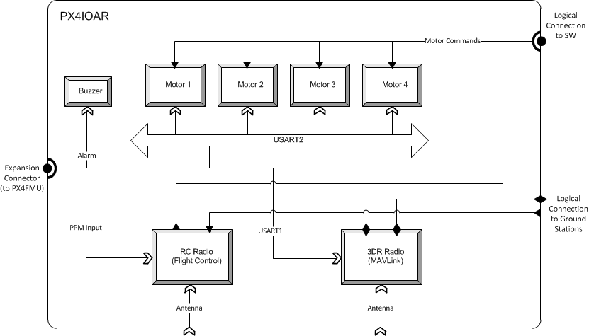
AADL model

Slide 26
Properties from SMACCM Project
Attacker A
Vehicle
Attacker
Comm
Internal bus
command
Unknown credentials
Wireless network
Mission computer
Flight computer
Comm
Decrypt
Validate
Control Laws
Ground Station
Key
User
command
Encrypt
Actuator
Key
The motor controller only receives messages from the trusted ground station.
All messages received by the radio reach the motor controller.
All connections are accurate/non-bypassable.
Requires memory-safety

Slide 27
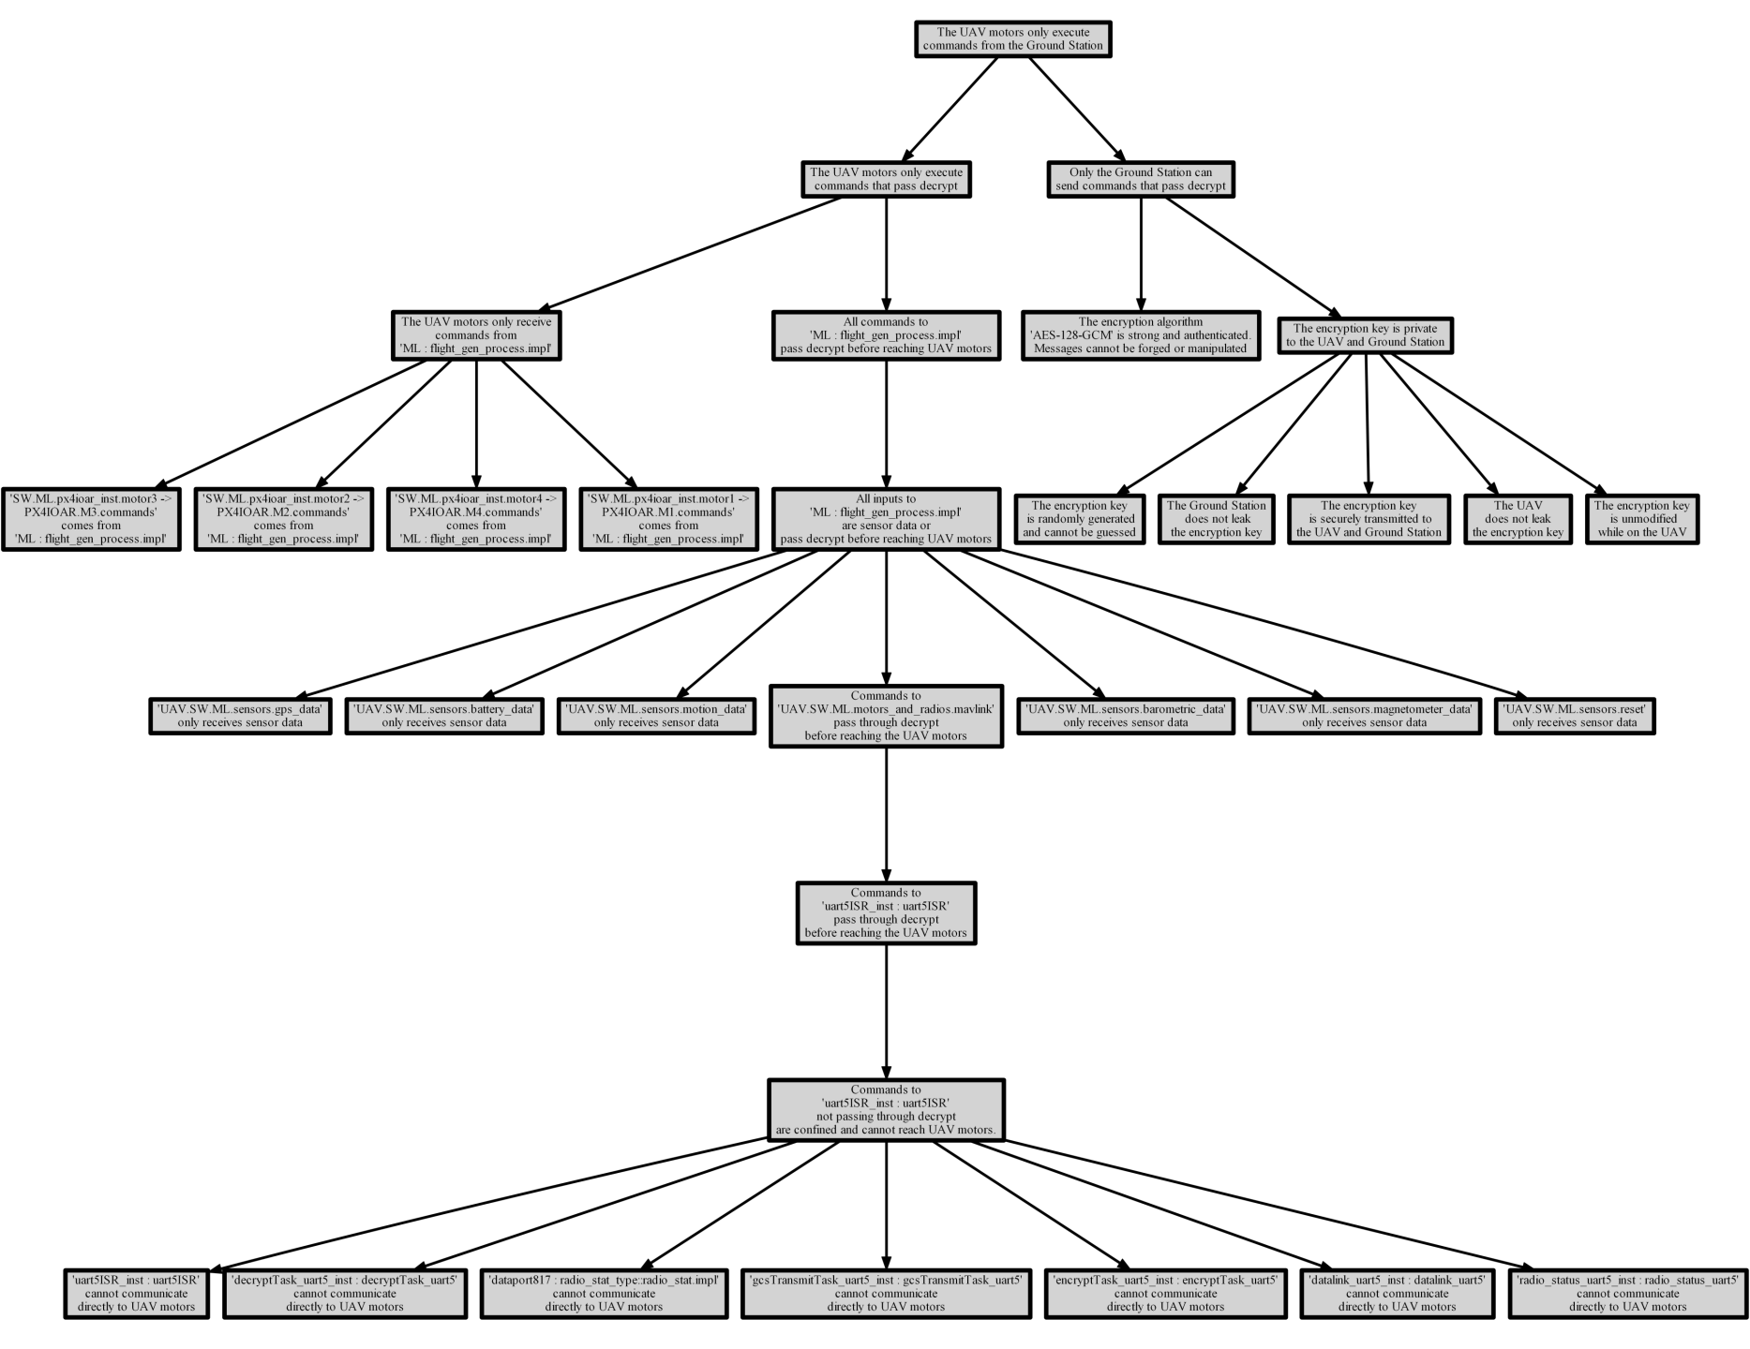
Secure Delivery
UAV motors only execute
commands from the ground station
Proper use of
encryption
Classification of inputs
Threads before
authentication

Slide 28
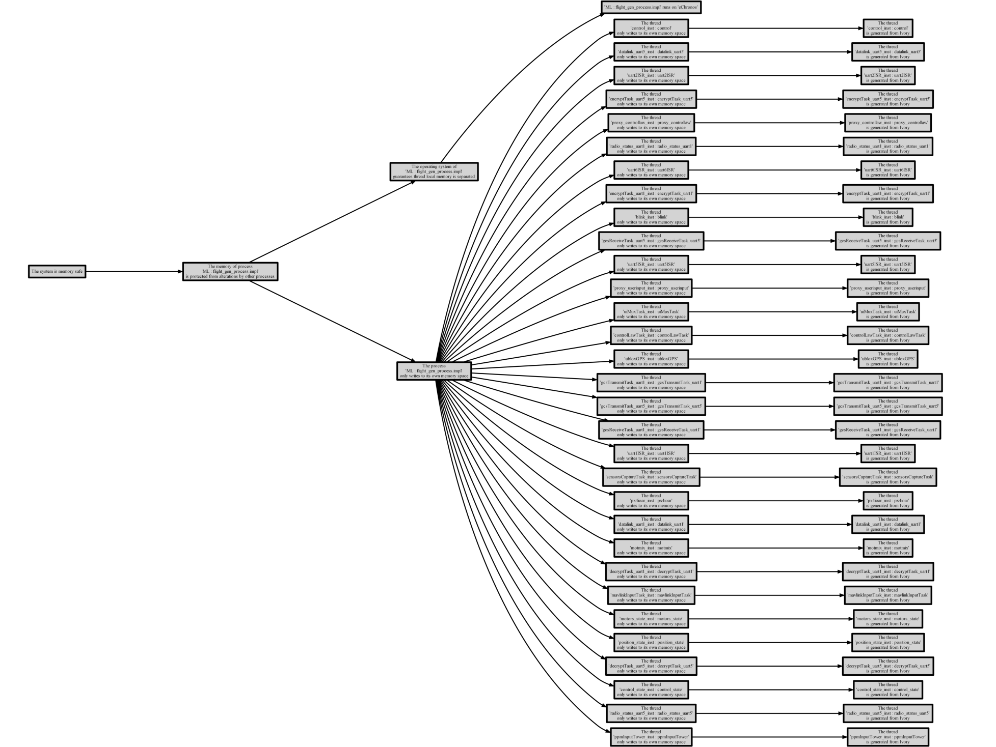
Memory Safety
Thread only writes to to its own memory space
Thread local state protected by
RTOS
Requires guarantees from eChronos RTOS and Ivory-Tower component generation

Slide 29
Future Work
Integration with other assurance case tools
We currently support CertWare
Support for other GSN types
Integration with other AADL analyses
Internal: Schedulability, Fault Analysis
External: HOL, SMT Solvers
Support for other AADL semantics

Slide 30
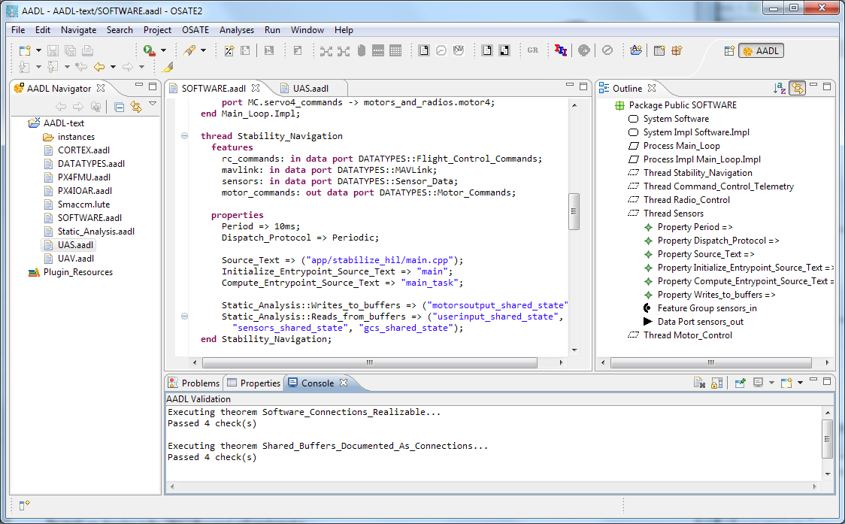


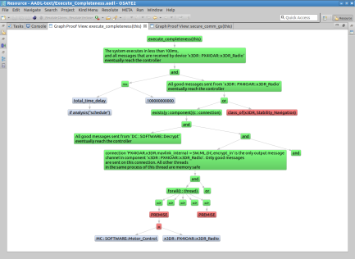
Common tools: Formal Methods Workbench
Resolute
OSATE
Assurance Case
AGREE
Trusted
Build
Behavioral Analysis
Lute
Structural
Analysis
Architecture Models
Architecture Translation
Architecture Analysis
A
C
Assumption: Input < 20
Guarantee: Output < 2*Input
Assumption: none
Guarantee: Output = Input1 + Input2
B
seL4
Assumption: Input < 20
Guarantee: Output < Input + 15
Assumption: Input < 10
Guarantee: Output < 50
eChronos
Kind/JKind

Slide 31
Comments/Questions?

