Slide 1

UxAS on seL4
John Backes, Rockwell Collins
Dan DaCosta, Rockwell Collins

Slide 2
What is UxAS?
UxAS: Unmanned Systems Autonomy Services
Collection of software modules that interconnect to automate mission-level decision making
Task assignment
Cooperative control
Sensor steering
Used to conduct experiments and demonstrations of cooperative control and human-machine teaming
Services are deployed across multiple entities

Slide 3
What would we like to prove about UxAS?
Safety properties
“Services do not throw exceptions”
“Services implement their formal specification”
“The vehicle stays within a safe flight envelope”
“Multiple vehicles maintain safe separation”
Quality of service properties
“Messages are processed and delivered in a timely manner”
Security properties
“Services cannot alter each other’s state except through defined channels”
“Only trusted commands are executed”
“Services do not consume resources not allocated to them”

Slide 4
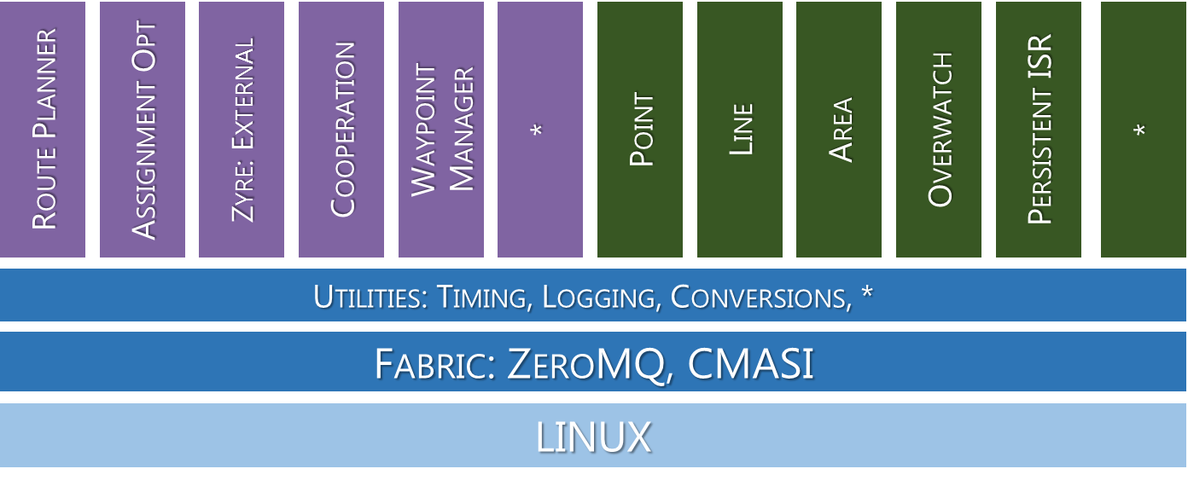
Problems with initial UxAS
Services/Tasks written in C++
Not type safe and difficult to reason about formally
Services/Tasks are dispatched sporadically with no bounds on IAT
Framework all runs on Linux (there are bugs)
All Services/Tasks run as threads within the same memory space

Slide 5

Baseline UxAS Architecture
All Services/Tasks run in untrusted Linux OS
All Services/Tasks have equal priority and criticality
Waypoint Manager
Route Planner
Cooperation
Zyre: External
Point
Assignment Opt
*
Line
*
Area
Persistent ISR
Overwatch
Utilities: Timing, Logging, Conversions, *
Fabric: ZeroMQ, CMASI
LINUX

Slide 6

Baseline UxAS Architecture
All Services/Tasks run in untrusted Linux OS
All Services/Tasks have equal priority and criticality
Waypoint Manager
Route Planner
Cooperation
Zyre: External
Point
Assignment Opt
*
Line
*
Area
Persistent ISR
Overwatch
Utilities: Timing, Logging, Conversions, *
Fabric: ZeroMQ, CMASI
LINUX

Slide 7
Possible Solutions to fix UxAS
Change how Services/Tasks are dispatch so system is schedulable
Middleware group did this
Prove correctness of all UxAS Services/Tasks
Plausible with significant effort
Prove isolation and correctness of critical tasks so UxAS can meet minimal QoS
This is what we worked on ☺

Slide 8


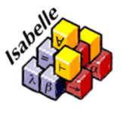

Key Technologies
The seL4 Microkernel
Formally verified microkernel maintained by Data61
Proof is from HOL specification down to the assembly
Provides formally proven isolation between components
Can be used as a hypervisor to host guest OS
Requires specific x86 or ARM instruction sets
Isabelle/HOL and AutoCorres
Isabelle/HOL is an interactive theorem prover
AutoCorres is an Isabelle/HOL extension that provides a framework for reasoning about C programs

Slide 9
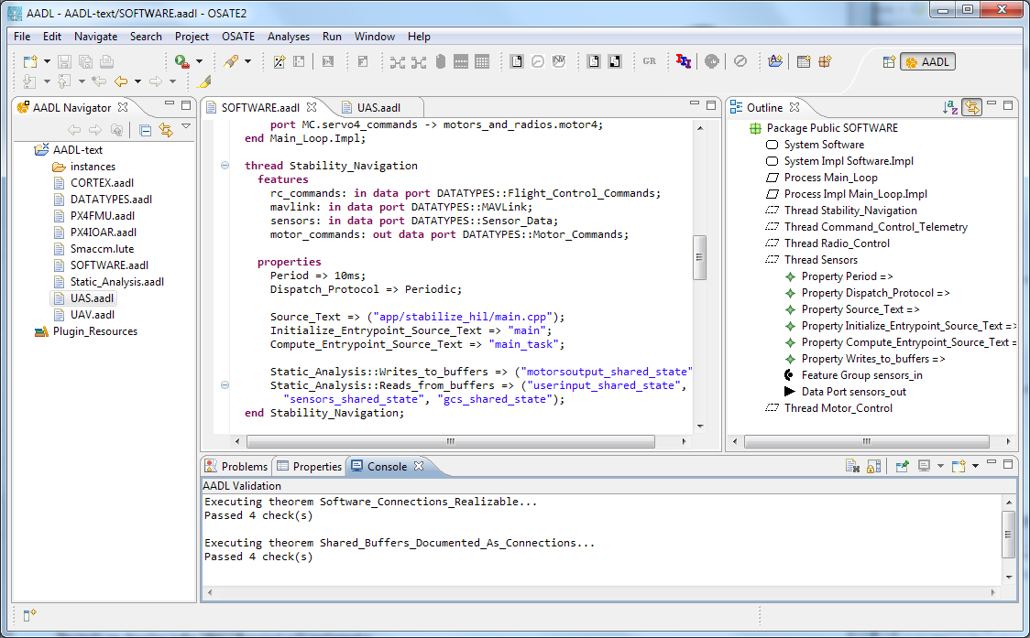

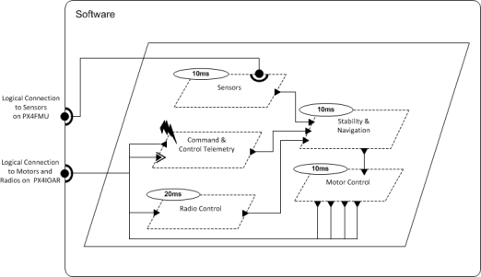
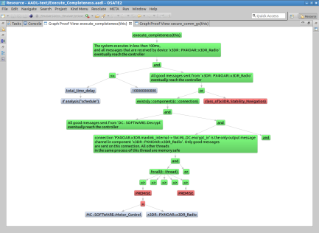
Key Technologies
Resolute
OSATE
Assurance Case
AGREE
Trusted
Build
Behavioral Analysis
SIM
Simulator
Architecture Models
Architecture Translation
Architecture Analysis
A
C
Assumption: Input < 20
Guarantee: Output < 2*Input
Assumption: none
Guarantee: Output = Input1 + Input2
B
seL4
Assumption: Input < 20
Guarantee: Output < Input + 15
Assumption: Input < 10
Guarantee: Output < 50
eChronos
Kind/JKind

Slide 10

UxAS + seL4 Architecture
All Services/Tasks run in untrusted Linux Virtual Machine on top of seL4
Critical services run as isolated native seL4 Services/Tasks
Route Planner
Zyre: External
Waypoint Manager
Cooperation
Point
Assignment Opt
*
Line
*
Area
Persistent ISR
Overwatch
Utilities: Timing, Logging, Conversions, *
Fabric: ZeroMQ, CMASI
Waypoint
Manager
LINUX
seL4

Slide 11


UxAS + seL4 Architecture
All Services/Tasks run in untrusted Linux Virtual Machine on top of seL4
Critical services run as isolated native seL4 Services/Tasks
Route Planner
Zyre: External
Cooperation
Point
Assignment Opt
*
Line
*
Area
Persistent ISR
Overwatch
Utilities: Timing, Logging, Conversions, *
Fabric: ZeroMQ, CMASI
Waypoint
Manager
LINUX
seL4

Slide 12
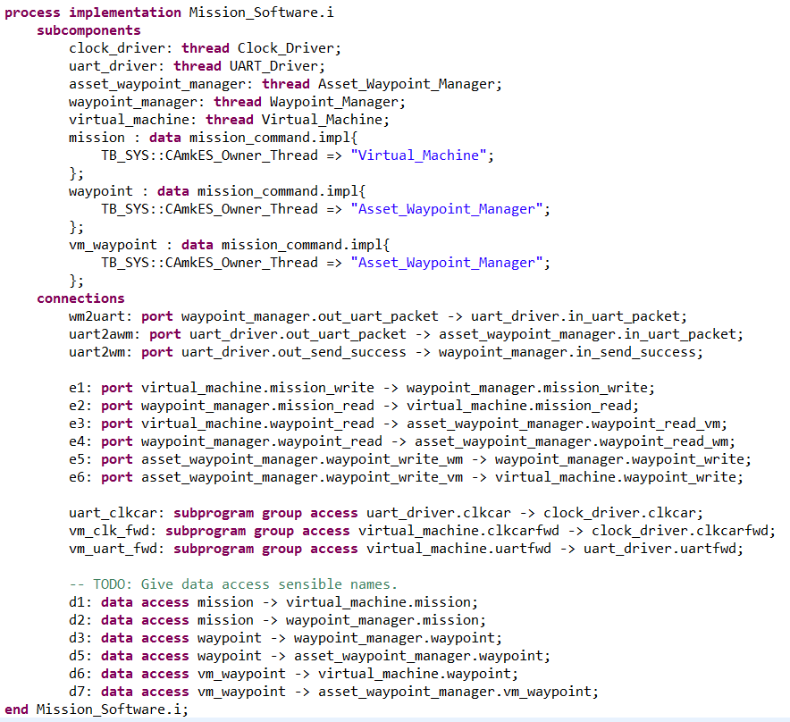
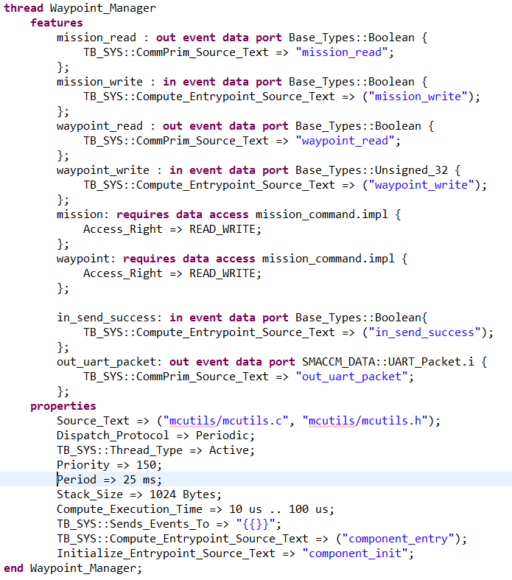
AADL Specification
Component Features
Component
Instances
Component
Connections
Component
Configuration

Slide 13
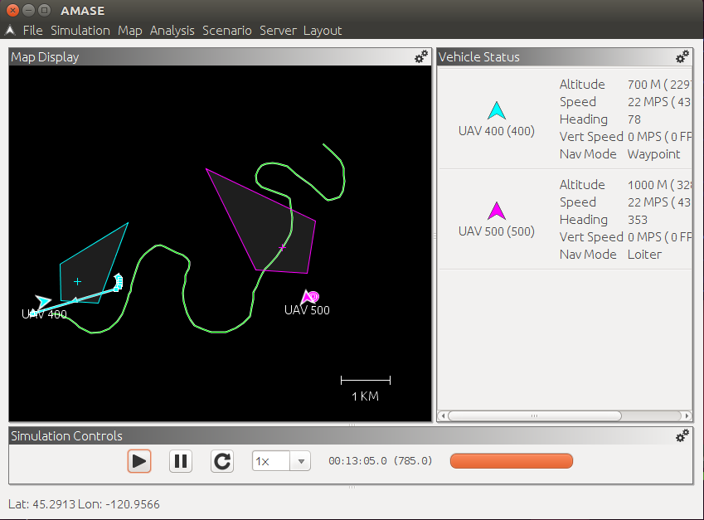
Demonstration
Launch attack against UxAS
Kill UxAS process
Exhaust all resource in Linux
Simulates malicious adversary
Simulates latent bug in UxAS Service
Demonstrate that system still maintains minimal QoS
The waypoint manager continues to deliver waypoints to the autopilot

Slide 14


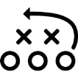

Demonstration
Mission Computer (seL4)
Serial
Bus
Linux Virtual Machine
Waypoint
Manager
Comm
Plan
Assign
FCC
Route
Planner
Payload
Asset
Manager

Slide 15
Verification of Waypoint Manager
The purpose of the Waypoint Manager is to send subsets of the mission’s waypoints to the flight control computer
“Correctness” means:
The component never sends more waypoints than the autopilot can handle
The component sends the next N waypoints whenever the autopilot reaches waypoint N/2

Slide 16
Arguments for Task/Services and seL4
Argument Purpose:
Examine ability of UxAS to return home
Under normal behavior and failure
Provide rationale/organization for benefits of seL4
Decomposed target UxAS service goal into sub-claims based on architectural components
Virtual machine (VM) running tasks
Waypoint manager (WM) running on seL4 kernel with VM
Connection to Autopilot
Autopilot running independently
Notes:
SeL4: proven mico kernel
Tasks and services running on VM on the micro kernel
Even if VM crashes, WP will get you home

Slide 17
Future changes to architecture
Assignment Opt
Route Planner
Zyre: External
Cooperation
Point
Assignment Opt
*
Line
*
Area
Persistent ISR
Overwatch
Route Planner
Utilities: Timing, Logging, Conversions, *
Fabric: ZeroMQ, CMASI
Waypoint
Manager
LINUX
seL4
Task/Service Modeling

Slide 18

What would we like to prove about UxAS?
Safety properties
“Services do not throw exceptions”
“Services implement their formal specification”
“The vehicle stays within a safe flight envelope”
“Multiple vehicles maintain safe separation”
Quality of service properties
“Messages are processed and delivered in a timely manner”
Security properties
“Services cannot alter each other’s state except through defined channels”
“Only trusted commands are executed”
“Services do not consume resources not allocated to them”

Slide 19
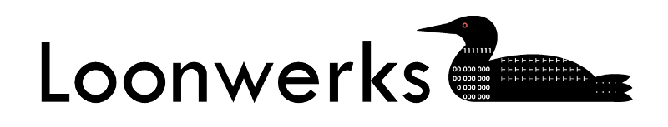
Questions?
Find links to project description, code, and other research at:
loonwerks.com

