Slide 2
THE BEE TEAM
MVG RAD: For Stadt München

Slide 3
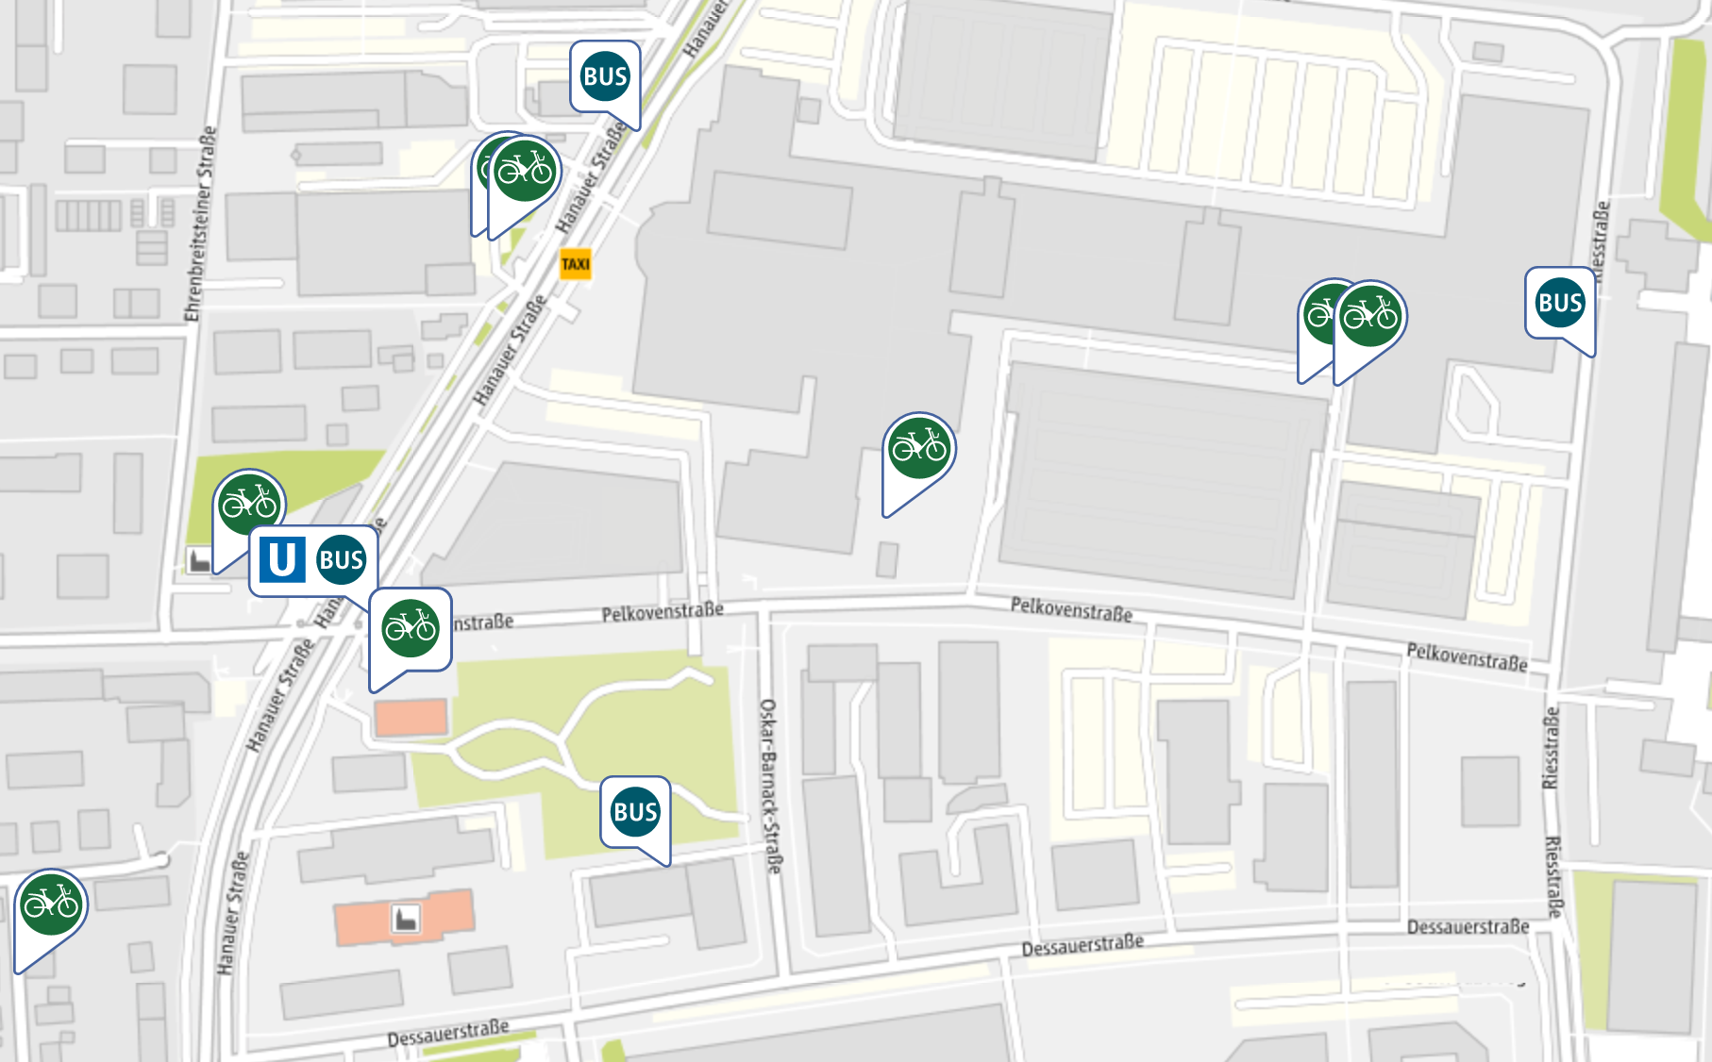

MVG Rad data
Current (Live) Data
Archive

Slide 4
Goals
Find out and visualize:
When bikes were used and where?
Which district in Munich is the “greenest”?

Slide 6
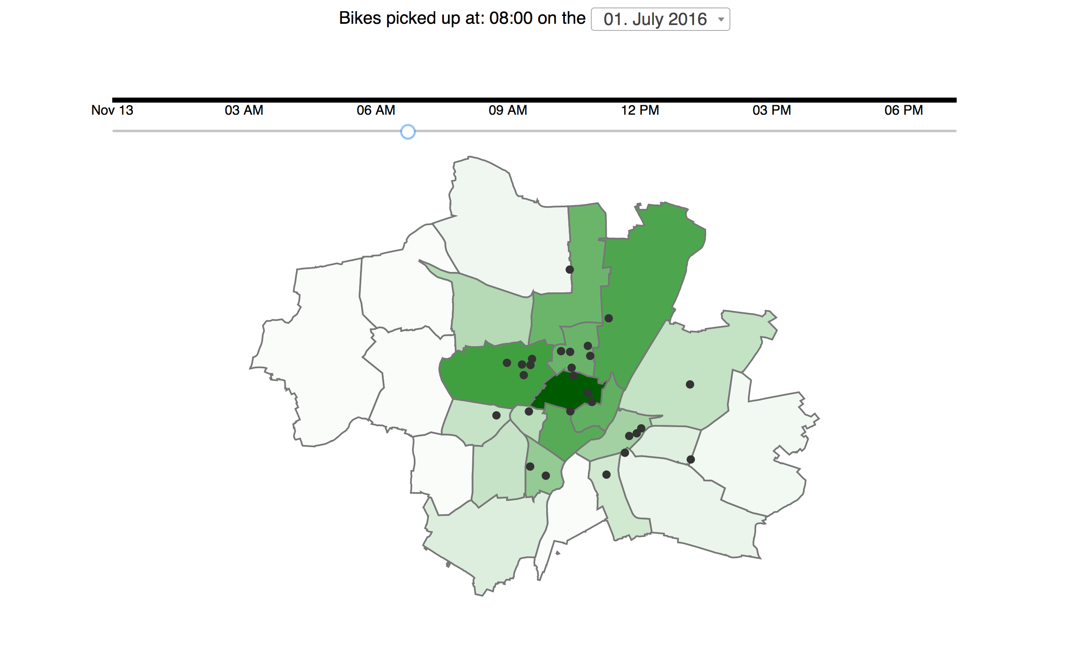

Slide 7
THANK YOU

