Slide 2
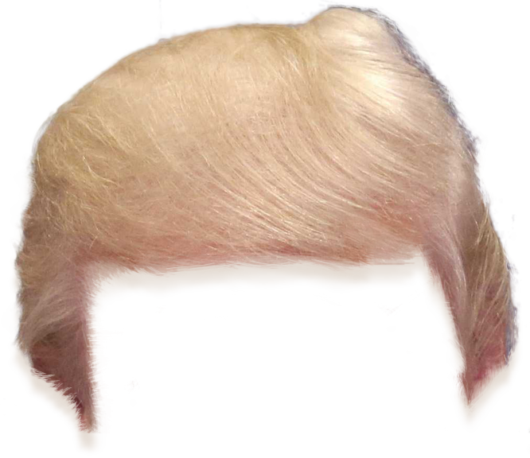
Please Vote
x
💩
💩

Slide 3
Please Vote
x
Yes, I want to pay more every year for overcrowded subways and busses.
No, I have principles, I’m going to pay even more without the Semesterticket!

Slide 4
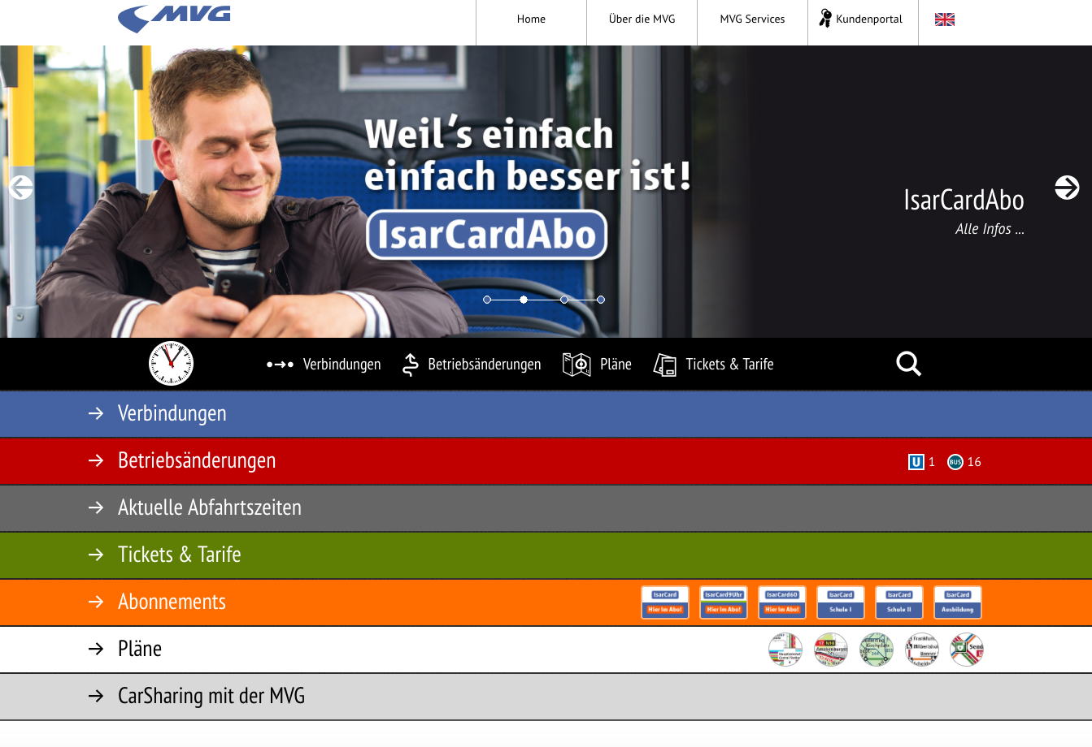

Slide 5
 | 0 – 6 AM | 6 AM – 6 PM | 6 – 12 PM
Monday | 🍺 | 🎓 | 🍺
Tuesday | 🍺 | 🎓 | 🍺
Wednesday | 🍺 | 🎓 | 🍺
Thursday | 🍺 | 🎓 | 🍺
Friday | 🍺 | 🎓 | 🍺
Saturday | 🍺 | 🍺 | 🍺
Sunday | 🍺 | 🍺 | 🍺

Slide 6
 | 0 – 6 AM | 6 AM – 6 PM | 6 – 12 PM
Monday | 🍺 | 🎓 | 🍺
Tuesday | 🍺 | 🎓 | 🍺
Wednesday | 🍺 | 🎓 | 🍺
Thursday | 🍺 | 🎓 | 🍺
Friday | 🍺 | 🎓 | 🍺
Saturday | 🍺 | 🍺 | 🍺
Sunday | 🍺 | 🍺 | 🍺

Slide 7



